Slide 1
Multi-Host
Multi-Network
Persistent Containers
Powering New Opportunities at Scale

Slide 2
Conclusion
Containers + Databases = Happy Developers
  Fire up your dev environment! Don’t disturb ops! Faster Dev / Deploy cycles!
Ephemerical Containers + Databases = DevOps headaches
  Data Redundancy (i.e. More than one copy)
  Database Self Discovery & Cluster formation
  DatabaseSelf Healing (as containers enter and leave)
  Application Tier discovery of Database Cluster
Containers ARE faster, no “virtualization tax”
Where to put the data is HARD
  Help us, container guys !

Slide 3


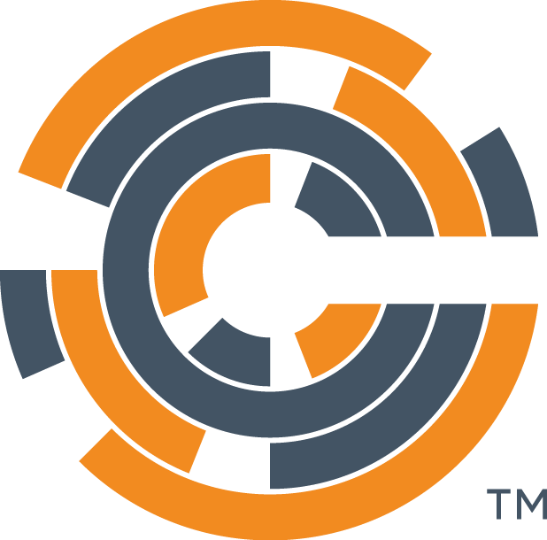



Existing Deployment Models Are Broken
1. Development
2. Test
3. Stage / Production
Version
control
Developer
QA / QE
Sysadmin
Notes:
Benefits
Frictionless portability from dev to test
Faster cycle times
Higher quality releases

Slide 4
Lets talk about…
Containers for
  Encapsulation
  Deployment
  Isolation
Databases for
  Persistent
  Scalable
  Self-organizing / Self-healing

Slide 5




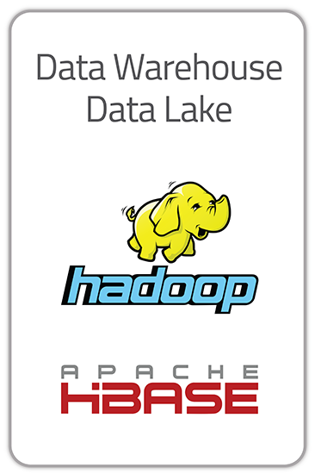

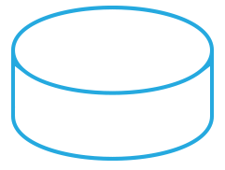
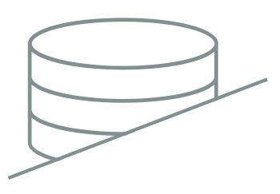
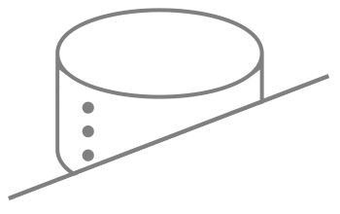
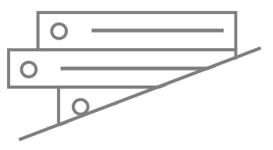
“Stateless” architecture means no state in the container
Fast speed – Consumer Scale
Challenges:
Complex
Maintainability
Durability
Consistency
Scalability
Cost ($)
Data Lag
Real-time
Consumer Facing
Pricing /
Inventory/Billing
Real-time
Decisioning
Streaming
Data
Legacy RDBMS
HDFS BASED
Caching Layer
Operational Database
Enterprise Environment
Legacy Database
(Mainframe)
RDBMS Database
Transactional Systems
Notes:
Key Points:
All of the above challenges
If you use Relational, must use cache and you compromise the value of RDBMS = Consistency & durability issues as well

Slide 6

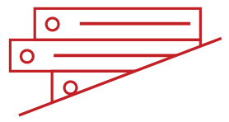
Fast Data Layer - “One Hop” for Containers
Fast speed – Consumer Scale
Benefits:
Simplicity
Maintainability
Durability
Consistency
Scalability
Cost ($)
Data Lag Reduced
Real-time
Consumer Facing
Pricing /
Inventory/Billing
Real-time
Decisioning
Streaming
Data
Legacy RDBMS
HDFS BASED
Hybrid Memory Database
Powered by High Performance NoSQL
Enterprise Environment
XDR
Legacy Database
(Mainframe)
RDBMS Database
Transactional Systems
Aerospike
Aerospike Delivers Predictable Performance, Highest Availability, and Lowest TCO

Slide 7

Where does the data reside?

Slide 8
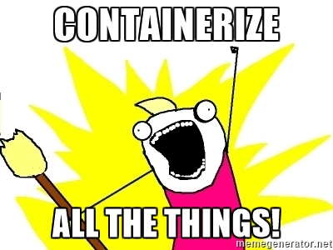
How should we think about containers and data ?
“Stateless architecture” says no state inside the app tier
  “All app servers in a cluster can take any request”
  No sticky load balancers
But, duh, of course you have state
  “use a fast datastore” is the core requirement
  But usually the datastore is not fast
  Which means caches, which means consistency
But… “containerize all the things!!!”

Slide 9

Pattern: don’t containerize the data
Cloud services
  DynamoDB, BigTable, DocumentDB
  Problem: containers are abstract, DBs have characteristics
Split-deploy – Container for Dev/Test only
  In development, use containers and small systems
  In small production, use containers
  In big production, build database cluster outside of containers

Slide 10

POP QUIZ
What is this meme from?
Answer: THIS IS WHY I WILL NEVER BE AN ADULT
( Hyperbole and a Half )
Conclusion!
Do Not Containerize All
The Things

Slide 11
Containerize data anyway : Two options
Ephemerial Containers + PersistentVolumes
  Docker, Kubernetes support “PersistentVolumes”
  These are GENERALLY slow, bulk, network attach devices ( eg, Ceph, EBS )
  Does NOT provide the required high performance database
  Thus, Database needs to support “shadow drives”
    No / few reads from the PersistentVolume
Persistent storage within a container
  Google Compute has “Persistent Disks” which can be mounted directly
  Bare Metal will have local storage, which then limits mount patterns
  Use –volumes-from in Docker to manage where containers launch
  Use Mezos which includes local storage management

Slide 12
Ephemeral and PersistentVolume pattern
Each DB container has ephemeral SSD
PersistentVolume ( slow, networked ) configured as “shadow drive”
When launching new container, read from a particular PersistentVolume
Docker, EC2 ( EBS ) supports high performance ephemeral + slow Volumes
Database
Database
container
Standard container
Ephemeral SSD
Network attach
Device persists
Write during operations
Read at startup only

Slide 13
Persistent local attach ( and Docker )
Two types of containers: DB and Data
Create data containers in specific locations with known names
Then use ‘--volumes-from’ when you launch your db
Bare metal, GCE ( persistent SSD ), Mezos (?)
Database
container
--volumes-from
Works only if you have local persistent fast storage
“manually” created
data containers

Slide 14
Aerospike
( sorry, it’s the product part )

Slide 15
What is Aerospike ?
Large-scale DHT Database ( 100B++ objects, 100T++ storage, O(1) get / put )
… with queries, data structures, UDF, fast clients …
… geographic replication with XDR …
… local synchronous replication, persistance with Flash …
... on Linux …
High availability clustering & rebalancing
… proven multi-year uptime …
Very high performance C code, multi-core and multi-threaded
… 2M++ TPS from Flash, 4M++ TPS from DRAM PER SERVER …
Direct attach storage; persistence through replication and Flash
Cloud-savvy – runs with EC2, GCE, others; Docker, more …
Dual License: Open Source for devs, Enterprise for deployment

Slide 16
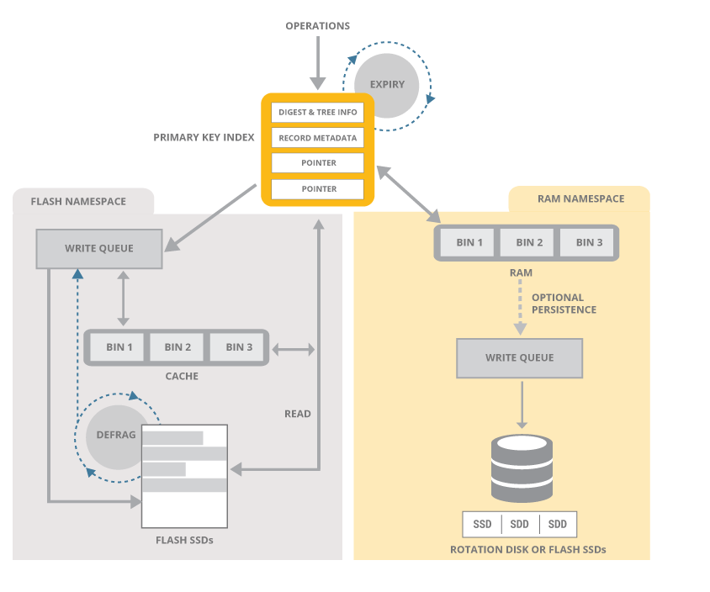
Performance
Hybrid Memory
Flash / SSD Optimized
Primary Index in DRAM
Notes:
Data Storage Layer
Aerospike is a key-value store with schema-less data model. Data is organized into policy containers called namespaces, semantically similar to databases in an RDBMS system. Within a namespace, data is subdivided into sets (similar to tables) and records (similar to rows). Each record has an indexed key that is unique in the set, and one or more named bins (similar to columns) that hold values associated with the record.
Sets and bins do not need to be defined up front, but can be added during run-time for maximum flexibility.
Values in bins are strongly typed, and can include any of supported data-types. Bins themselves are not typed, so different records could have the same bin with values of different types.
Indexes ( primary keys and secondary keys ) are stored in RAM for ultra-fast access and values can be stored either in RAM or more cost-effectively on SSDs. Each namespace can be configured separately, so small namespaces can take advantage of DRAM and larger ones gain the cost benefits of SSDs.
The Data Layer was particularly designed for speed and a dramatic reduction in hardware costs. It can operate all in-memory, eliminating the need for a caching layer or it can take advantage of unique optimizations for flash storage. In either case, data is never lost.
100 Million keys take up only 6.4GB. Although keys have no size limitations, each key is efficiently stored in just 64 bytes.
Native, multi-threaded, multi-core Flash I/O and an Aerospike log structured file system take advantage of low level SSD read and write patterns. In addition, writes to disk are performed in large blocks to minimize latency. This mechanism bypasses the standard file system, historically tuned to rotational disks.
Also built-in are a Smart Defragmenter and Intelligent Evictor . These processes work together to ensure that there is space in RAM and that data is never lost and safely written to disk.
The Defragmenter tracks the number of active records in each block and reclaims blocks that fall below a minimum level of use.
The Evictor removes expired records and reclaims memory if the system gets beyond a set high water mark. Expiration times are configured per namespace, the age of a record is calculated from the last time it was modified, the application can override the default lifetime at any time and specify that a record should never be evicted.

Slide 17
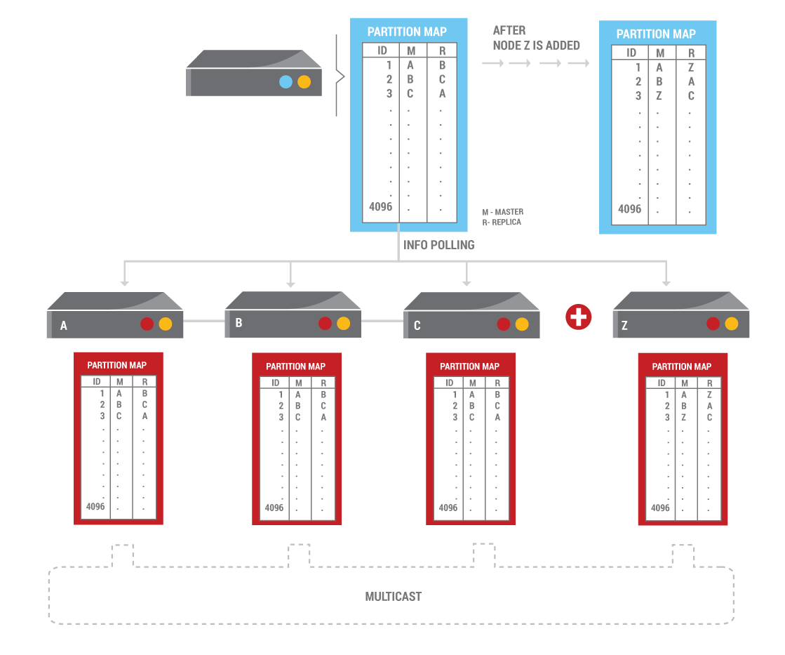
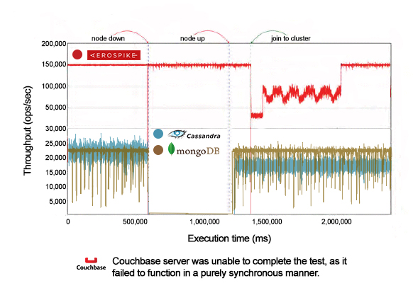
Scale
Clustered ( in production since 2010 )
RIPE MD160 Hashing & Partitioning
Dynamically Add/Remove Nodes
Auto Rebalance, Heal

Slide 18



























































Vertical Focus / Horizontal Expansion
ADTECH
ECOMMERCE
GAMING / BETTING
FINANCIAL
TELECOM
TECHNOLOGY

Slide 19
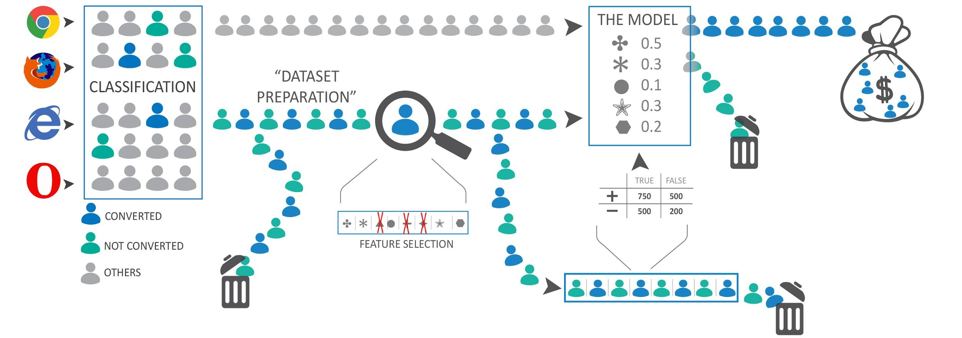

Nielsen Online Machine Learning

Slide 20
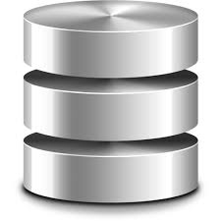

Aerospike and Machine Learning
Online Learning
Unique User DataStore
53 Servers across
4 data centers
Specs
Memory: 512GB
CPU: e5-2620v2 (Dual-Socket)
Disk: Intel S3710(13-15 1.2TB SSDs)
Network: Aggregated 10GB NICs
2-Namespaces
Online Learning (Models Store)
9 Servers across
3 data centers
Specs
Memory: 32GB
CPU: e5-2620 (Dual-Socket)
Disk:1-240GB SSDs
Network: Aggregated 1GB NICs
1-Namespace

Slide 21
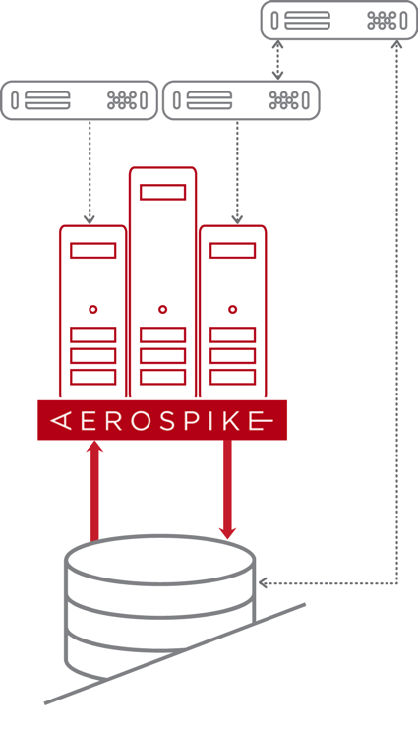
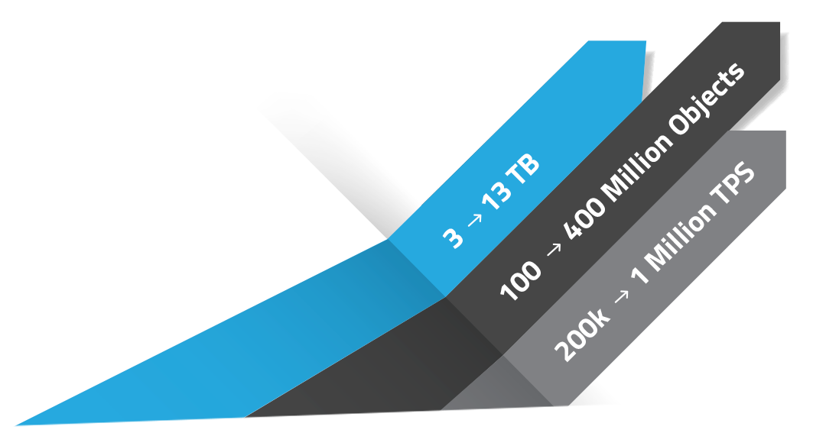
Financial Services – Intraday Risk System for Real Time Trading
Finance App
New Application Load Requirements
  Intra-day Risk ( 24 hours to minutes )
  Post-trade Analytics
  Display trade status while settling
Built for Enterprise Flash with NVMe
Predictable Low latency at High Throughput
Immediate consistency, no data loss
Cross data center (XDR) support
10 Server Cluster replaces
existing legacy 150 servers
Real-Time App
Record App
Account
Positions
Real-Time
Data Feed
Start of the Day
Data Loading
End of Day
Reconciliation
IBM DB2
(Mainframe)

Slide 22
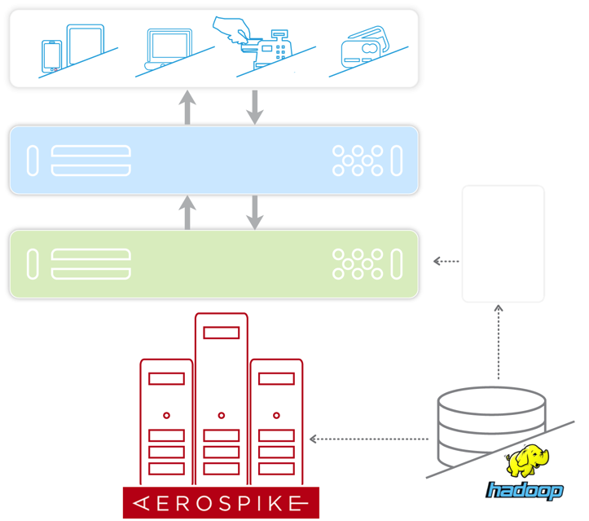
Fraud Prevention – Beyond the Rules Engine
Challenge
  Overall SLA 750 ms
  Oracle system very expensive
  New data types / algorithms
  Mangaement directive: plan for 10x scale increase
Need to Scale
  10 → 500 TB
  10B → 100 B objects
  200k → I Million+ TPS
Built for Flash
Predictable low latency at high throughput
Immediate consistency, no data loss
Cross data center (XDR) support
Credit Card Processing System
Rules
Rule 1
Rule 2
Rule 3
Fraud Detection & Protection App
Account Behavior
Static Data
Account Statistics
Historical Data

Slide 23
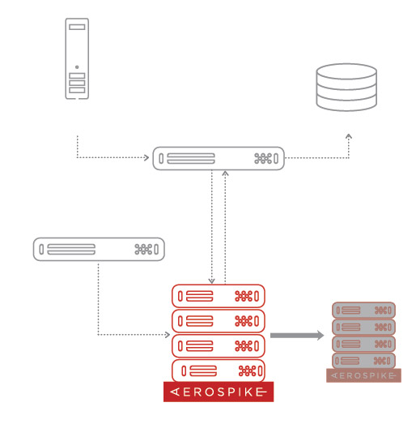
Telco – Real-Time Billing and Charging Systems
Challenge
  Edge access to regulate traffic
  Accessible using provisioning applications
  (self-serve and through support personnel)
Need for Extremely High Availability,
Reliably, Low latency
  > TBs of data
  10-100M objects
  10-200K TPS
  Many, many locations ( 50+ ) synchronized
Clustered system
Predictable low latency at high throughput
Highly-available and reliable on failure
Cross data center (XDR) support
SOURCE
DEVICE/USER
Real-Time
Auth. QoS Billing
DESTINATION
Request
Execute
Request
Config Module App
Real-Time Checks
Update Device
User Setting
Hot-Standby
XDR

Slide 24

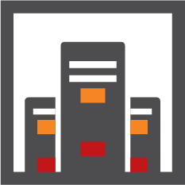

Inmobi – 40T at the edge
Real-time Ad Serving
40TB data per cluster
Deep Analysis
Historical data
XDR
Fast Analytics
40 TB Data
SLA: A few minutes
BATCH BI
XDR
XDR
XDR
DATA WAREHOUSE/
DATA LAKE

Slide 25
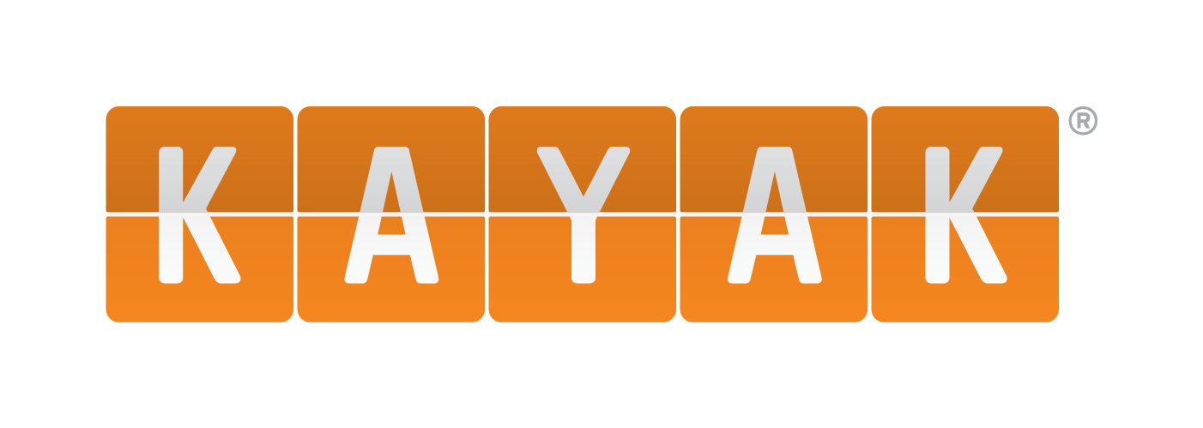
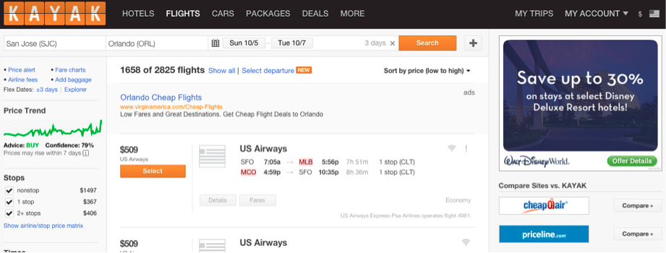
Persistent Cache for High-scale Web Services
“Aerospike filled a gap for KAYAK that other caching and database technologies couldn’t deliver on …. multi-key gets in less than 3 milliseconds, deploy with ease and scale with very low jitter.”
– Ko Baryiames, SVP Technology, KAYAK
Aerospike “presents a modern open source alternative to ancient and fairly expensive tech that has powered a number of caches in legacy travel infrastructure… but also sucked the lifeblood out of many a company”
– Max Rayner, Hudson Crossing and Skift30 (top 30 in travel)
Notes:
http://www.aerospike.com/blog/how-to-travel-smart-with-cache/

Slide 26
Containers and Aerospike

Slide 27
Container Mission – Reduce Complexity
Build
Ship
Run
Platform
Clustering
Distribution
Plumbing
RunC
Notary
Open Standards
Container run-time spec
Image spec
Notes:
Our company product strategy is focused on delivering value both as an open source offering and innovate as a provider of commercial solutions.

Slide 28
What do Containers provide?
Encapsulation of Dependencies
  O/S packages & Patches
  Execution environment (e.g. Python 2.7)
  Application Code & Dependencies
Process Isolation
  Isolate the process from anything else running
Faster, Lightweight virtualization

Slide 29

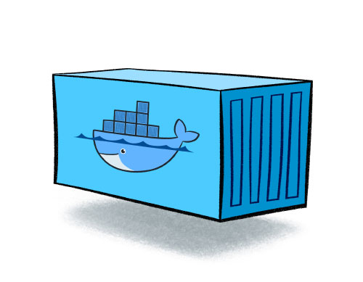
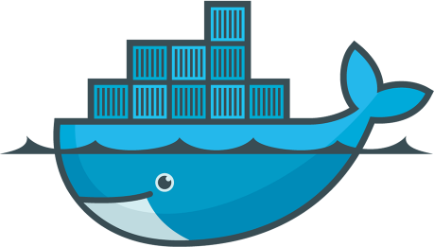
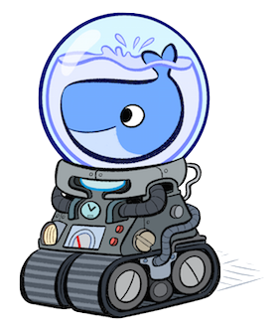

Docker Landscape in Pictures
Docker Compose
Containers encapsulates your code, dependencies…
Containers are run by Docker Engine
Container
Compose orchestrates Container deployment
Docker Engine
Engines are clustered by Docker Swarm
Machine provisions Docker Engines
Docker Machine
Docker Swarm

Slide 30
Databases and Containers

Slide 31
Database Requirements
Data Redundancy
  Containers are Ephemeral – Need more than one copy of the data
Dynamic Self Discovery & Cluster formation
  Need to start and stop Conatiners when needed
  Clusters needs to grow and shrink dynamcially
Self Healing
  Loss of nodes must not be fatal to the cluster integrity
  Addition of nodes must scale capacity
Application Tier should deal with a "black box"
  Automatic discovery of nodes
  Automatic routing of requests to the correct nodes

Slide 32
Example: Aerospike and Containers
Data Redundancy - YES
  Automatic Replication of Data to "n" nodes
Dynamic Self Discovery & Cluster Formation – Works with Swarm
  Shared nothing architecture – all nodes equal
Automatic healing & rebalancing of the cluster - YES
  Automatic hashing of keys across the cluster
  RIPEMD-160 collision free algorithm with Smart Partitions™
Application tier should deal with a "black box” - YES
  Automated cluster discovery with Smart Client™
  Built-in random load balancing
  Java, C/C++, C#, Python, Node.js, Go, PHP5/7, Rust ….
Notes:
Shared nothing architecture, there is no reliance on a single node for configuration, state, management etc.
Automatic hashing of keys across the cluster (using the RIPEMD-160 collision free algorithm) with Smart Partitions™
Automatic healing of the cluster as nodes enter and leave the cluster, including automatic rebalancing
Automatic discovery of the cluster topology with Aerospike Smart Client™ for all the populate languages and frameworks
Automatic replication of data across nodes with a customizable replication factor

Slide 33

Storage: Inside or outside the container?
Host
Host
daemon
daemon
container
container
e.g. SSD
/dev/xvdb
/data/db
/mnt/xx:/data/db
e.g. EBS
Inside
Encapsulation of Concerns
Outside
Separation of Concerns
Bad: location specific

Slide 34
Storage: Data Container?
Host
Host
daemon
daemon
container
container
Data Container
Managed like other containers, but with –volume-from
Special rules for Destruction

Slide 35
Clustering
Multiple DNS entries ( requires AS 3.10+ )
  One per container
  Start the container with its DNS name
  Clients know a few well known DNS names
Single DNS entry
  New servers update the DNS entry
  Swarm, Consul, Route53 ( etc )
  Use “cluster name” to avoid IP reuse issues
Raw IP use
  Avoids DNS as a point of failure
  Requires scripts to manage the IP addresses of container

Slide 36
How it looks

Slide 37
Development through to Production
Build & Run an App in Development
  Python + Aerospike
Deploy to a Swarm cluster in Production
  Add more Web containers behind HAProxy
Scale Aerospike Cluster in production
  Add more Database nodes

Slide 38
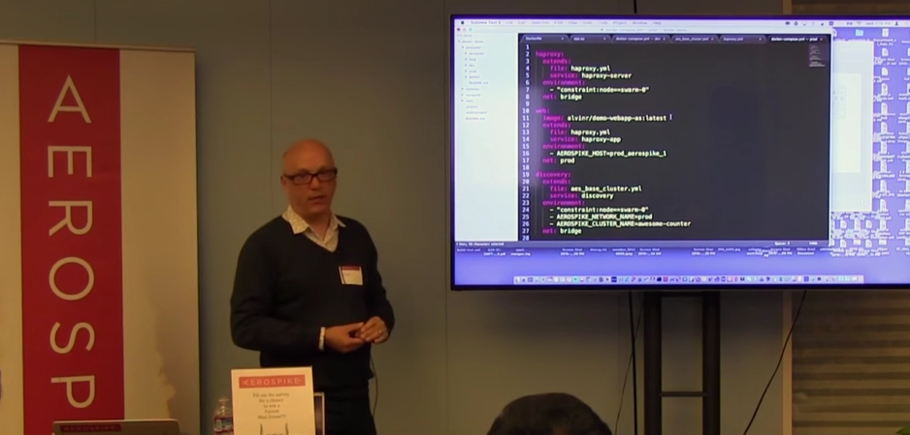
Demo & Code Repo
Watch the demo on YouTube!
  https://github.com/aerospike/docker-demo

Slide 39
Step 1: Lets build an App!
web
python / flask
Aerospike
Development

Slide 40
Scale in Production
HA Proxy
web
web1
web2
web3
web4
…
webN
Aerospike
asd1
asd2
…
asdN
Development
Production

Slide 41
Dockerfile
FROM python:2.7
ADD . /code
WORKDIR /code
RUN apt-get update
RUN apt-get -y install python-dev
RUN apt-get -y install libssl-dev
RUN pip install --no-cache-dir -r requirements.txt
EXPOSE 5000
CMD python app.py

Slide 42
docker-compose.yml
web:
build: .
ports:
- "5000:5000"
links:
- aerospike
hostname: dev.awesome-counter.com
environment:
- AEROSPIKE_HOST=dev_aerospike_1
aerospike:
image: aerospike/aerospike-server:latest
volumes:
- $PWD:/etc/aerospike

Slide 43
Roll the App to Production behind HA Proxy
HA Proxy
web
web1
Aerospike
Aerospike
Development
Production

Slide 44
Step 2: Scale the Web Tier
HA Proxy
web
web1
web2
web3
web4
…
webN
Aerospike
Aerospike
Development
Production

Slide 45
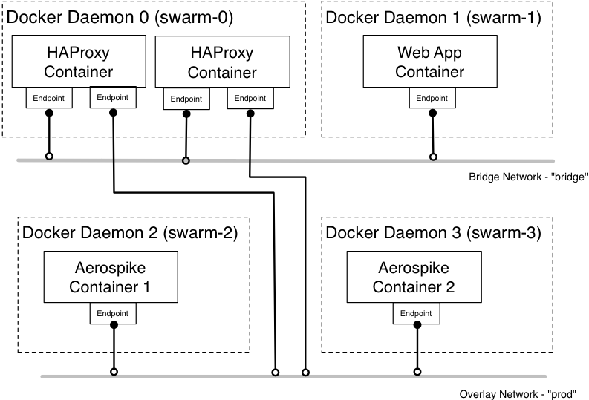
Docker Networking

Slide 46
aes_base_cluster.yml
discovery:
image: aerospike/interlock:latest
environment:
- "DOCKER_HOST"
volumes:
# boot2docker images use the following
- "/var/lib/boot2docker:/etc/docker"
command: "--swarm-url=$DOCKER_HOST --swarm-tls-ca-cert=/etc/docker/ca.pem --swarm-tls-cert=/etc/docker/server.pem --swarm-tls-key=/etc/docker/server-key.pem --debug --plugin aerospike start"
aerospike:
image: aerospike/aerospike-server:latest
volumes:
- "$PWD:/etc/aerospike"

Slide 47
docker-compose.yml
haproxy:
extends:
file: haproxy.yml
service: haproxy-server
environment:
- "constraint:node==swarm-0"
net: bridge
web:
image: alvinr/demo-webapp-as:latest
extends:
file: haproxy.yml
service: haproxy-app
environment:
- AEROSPIKE_HOST=prod_aerospike_1
net: prod
aerospike:
extends:
file: aes_base_cluster.yml
service: aerospike
image: aerospike/aerospike-server:3.14.0
labels:
- "com.aerospike.cluster=awesome-counter"
environment:
- "affinity:com.aerospike.cluster!=awesome-counter"
net: prod

Slide 48
Step 3: Scale the Aerospike Cluster
HA Proxy
web
web1
web2
web3
web4
…
webN
Aerospike
asd1
asd2
…
asdN
Development
Production

Slide 49
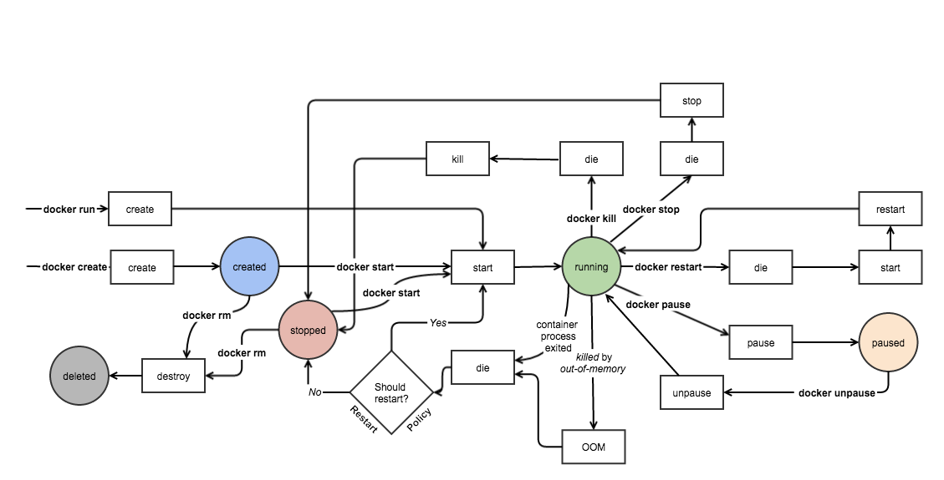
Docker Event API & Interlock
API for Docker Events
  Start / Stop / Die etc
  https://docs.docker.com/engine/reference/api/docker_remote_api/
Interlock – Evan Hazlett
  Framework to listen and publish events
  Plugin Framework (e.g. HAPROXY)
  https://github.com/ehazlett/interlock
Aerospike Interlock plugin
  Add / Remove node from Cluster
  https://github.com/aerospike/interlock

Slide 50
Interlock Plugin - Aerospike
https://github.com/aerospike/interlock
func (p AerospikePlugin) runAsinfoTip(args ...string) bool{
asinfo, err := exec.LookPath("asinfo")
if err != nil{
log.Errorf("error finding asinfo binary: %s", err)
return false
}
time.Sleep(time.Second*5) //sleep 5s for ASD to be ready
cmd := exec.Command(asinfo,args...)

Slide 51
Considerations

Slide 52
Summary
One solution from Dev -> Production
Define Container, their contents and how they work together once
Deploy the same images in Dev, Pre-Prod and Production across Platforms
Running Docker & Database in Production
Ops define the whitelisted images, security policies etc.
Dev use approved images to build upon
Eliminate the complexity (and cost) of deployment
Scale up & down in a Flexible and Simple way

Slide 53
Thanks and Q&A
Code
  http://github.com/aerospike/docker-demo
Docker Images
  http://hub.docker.com/r/aerospike/
Aerospike & Docker deployment guide
  http://www.aerospike.com/docs/deploy_guides/docker/
Contact me!
  brian@aerospike.com
  @bbulkow

