Slide 1
Deep Learning For Application Performance Tuning
Zoran Sevarac, Deep Netts
@zsevarac, @deepnetts
Notes:
How many of you has been doing application performance tuning? To many things to take into account, too much noise, some things not predictable It takes a while to see if assumptions are right
Itcan be very frustrating High pressure if performanceproblems have impact on business, and it almost always does
This is work in progress – na kraju ih pozovi da nam daju intereannti use case
This session is about how do you do it, so I’m not saying that it works , but if you try it and it works please let me know ☺
The idea: how do you apply deep learning to app performanceoptimization Why deep learning is a good choice?

Slide 2
Vision
We want to have applications that are able to learn optimal configuration, and self-tune for best performance in different scenarios
Notes:
The reason why I’m doing this session is that I hope that one day …

Slide 3
Motivation
Performance is always critical
Performance tuning must be tailored for
Application
Load
Infrastructure
Performance tuning is time consuming, error prone, guesswork
When something changes it has to be repeated
Ideally, that should be turned into systematic, repeatable, even continuous process
Notes:
End user experience, business
guesswork – too many parameters

Slide 4
What
Deep
Learning
Model
Configuration
Load
Resources
(CPU, Memory)
Performance metrics
Model dependency between configuration, load, and app performance
Notes:
Modeling application behaviour
Why using dl for perf tuning makes sense? How do you use this model

Slide 5
Why
Modeling a complex, unknown function – typical use case for machine learning (regression)
Model can give prediction of app performnce metrics for specific load and available resources
It can be used to optimize resource usage or ensure quality of service
Notes:
Also explain how to use this model

Slide 6
Inputs: Load and Configuration
Number of concurrent users
Request Rate per second
Number of CPUs
Available Memory
Additional configuration settings and runtime parameters (numeric and nominal)
Notes:
Average in 1, 5, 15 minutes

Slide 7
Outputs – Performance metrics
Average response time
Apdex score: (satisfied req+ tolerating requests/2) / totalRequests
Total execution time (batch processing)
Garbage Collection (frequency, time, total time)

Slide 8
Procedure
Data Collection through load testing
Data Preprocessing
Build model
Evaluate model using test data
Test model in production
Monitor model performance in production and repeat entire procedure as needed with new data (as load or app changes)

Slide 9
Data Collection
Prepare a set of configurations and loads
Run load using configurations
Monitor and record performance metrics (Apache JMeter, logs)
Notes:
How much data?
Generate enough variability in order to provide data for model evaluation

Slide 10
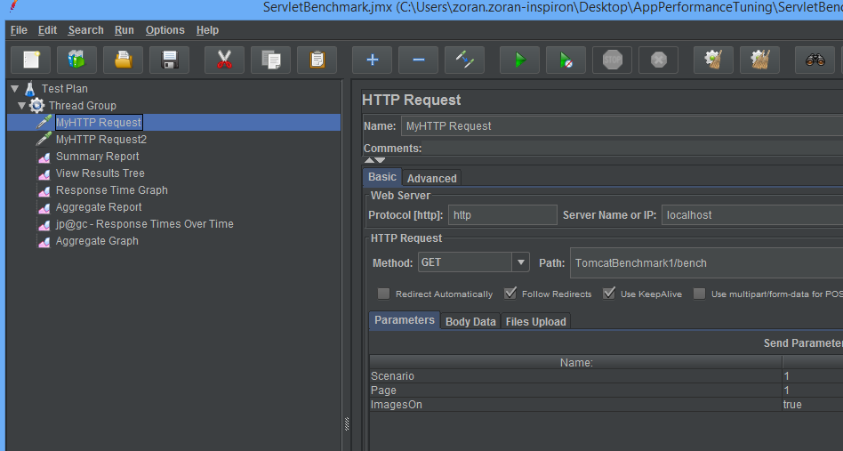
Apache JMeter
Thread Group (users), Samplers (http request)
Listeners (summary, graphs), Pre/Post processors

Slide 11
Data Preprocessing
Clean data
Missing values, errors?
Visualize
Filter outliers?
Decorelate data?
Normalize (scale to range [0,1] or event better [0.1, 0.9])
Transform nominal inputs (settings) to one-hot binary vectors
Prepare data for model building
(calculate avg responses (time window size?),
Apdex score etc.)

Slide 12
Model Building
Feed Forward Neural Network
Network inputs correspond to input parameters (numeric & nominal values)
Outputs correspond to performance metrics that we want to guess
Our goals is to build a neural network that can map inputs to outputs – model the app behaviour

Slide 13
Feed Forward Neural Network for Regression
I N P U T S
O U T P U T S
A sequence of Layers
Each layer performs operations on its inputs and sends outputs to next layer
Hidden Activation: Tanh or ReLu
Output Activation: Linear
Loss Function:
Mean Squared Error

Slide 14
Network Training – Backpropagation
Each layer has a number of learnable parameters called ‘weights’
Training consists of tuning these parameters
In every training iteration, learning algorithm changes all weights for a small amount thats proportional to the network error – a value of loss function

Slide 15
Network Training – Backpropagation
Iterative error minimization procedure
Seeks for set of layer weights that produce min value of Loss Function
Optimization Algorithm:
Stochastic Gradient Descent with Momentum
Learning Rate: 0.01 - how fast weight changes
Momentum 0.9 - accelerate learning
Mini batch

Slide 16
Model tuning
How many hidden neurons/layers and layer sizes
More layers bigger capacity, but possible over-fitting
Optimization algorithm: start with
Stochastic gradient descent with momentum
Other options: Adam, Ada Delta, RMS Prop
Automated procedures: Grid and Random search

Slide 17
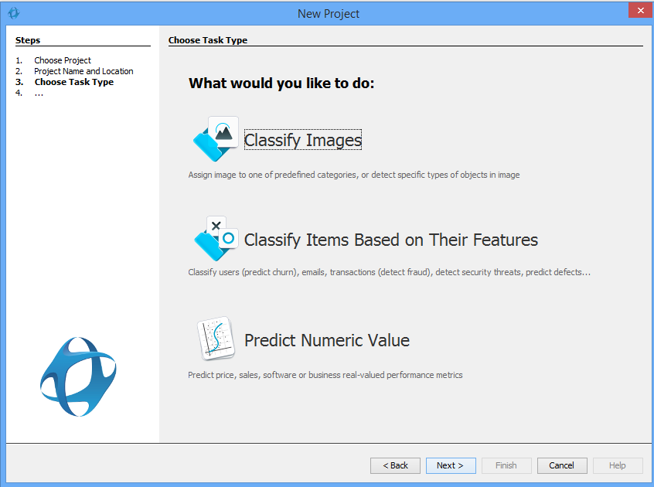
Deep Netts Wizard – Regression

Slide 18
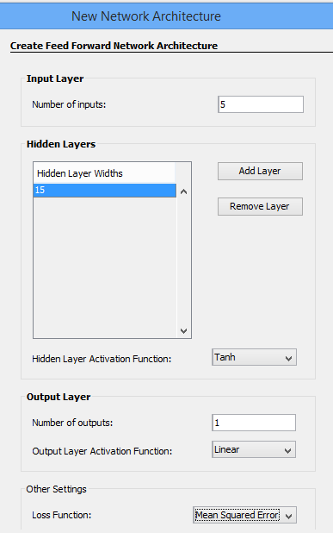
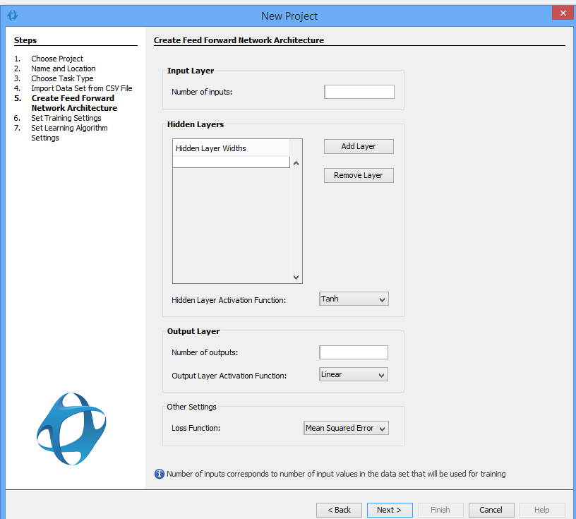
Deep Netts Wizard: Architecture

Slide 19
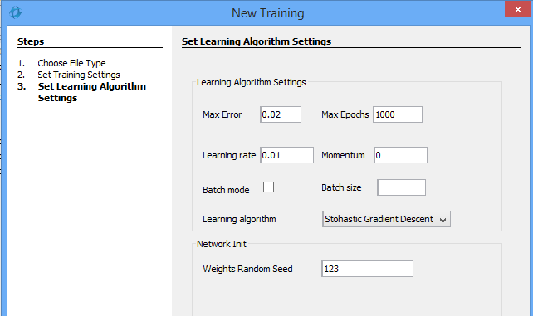
Deep Netts Wizard – Training

Slide 20
Pipeline
App Monitoring
Data Preprocessing
Evaluation with Test Data
Model Building
Deployment to Production
Model Monitoring
Notes:
The architecture of the automated app performance tuning based on deep learning diagram – nacrtaj entire pipeline

Slide 21
Performance Monitoring Tools
Apache JMeter https://jmeter.apache.org/
Java Mission Control http://hg.openjdk.java.net/jmc
GC Viewer tools (log + parser) https://github.com/chewiebug/GCViewer
Notes:
Reduce amount of experitse
Do you need Scientist to replace light bulb?
We are lookung for applications, and tools, for light bulbs The future of software development and machine learning are connected ML will help us solve problems that sd industry is facing in order to meet expectations Help with maintainance, improve productivity, scale SD

Slide 22
Deep Learning Tools
Tensor Flow, Keras
https://www.tensorflow.org/
Deep Learning 4J https://deeplearning4j.org
Neuroph http://neuroph.sourceforge.net
Deep Netts http://www.deepnetts.com

Slide 23
Case Studies
Billing application, batch processing, Web Logic
Before tuning it took 10 hour to generate 6 million bills
The architecture was bad, adding more servers didn’t help
After tuning 8.5h, 15 % faster (GC and Web Logic)
Currently working on with Tomcat and Elastic search tuning
Notes:
If you have an interesting use case please get in touch with us we are interested to collaborate

Slide 24
Why Deep Learning
Less feature engineering – features are learned
Good with high dimensional data
Good with large amounts of data
Flexible model (easyily supports custom settings)

Slide 25
Conclusion
Many tools exist to support the process
Achieved promising results in our test cases
ML/DL approach is already used by several app performance solution providers
ML/DL have potential to revolutionize application performance management
We are open for collaboration and we’re looking for interesting use cases – contact us: contact@deepnetts.com

Slide 26
Usefull Links
Dzone’s Performance and Monitoring Guide
https://dzone.com/guides/performance-and-monitoring
8 Key Application Performance Metrics & How to Measure Them
https://stackify.com/application-performance-metrics/
A Step By Step Guide to Tomcat Performance Monitoring
https://stackify.com/tomcat-performance-monitoring/
Misc Related Tutorials and HowTo
http://www.deepnetts.com/blog

