Slide 1
Natural Language Processing Is So Difficult

Slide 3
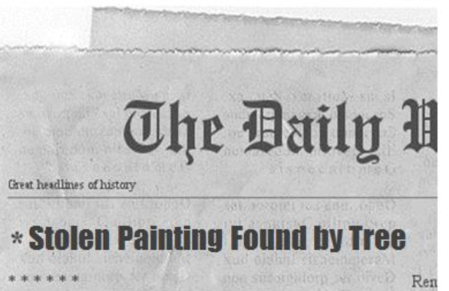

Slide 4
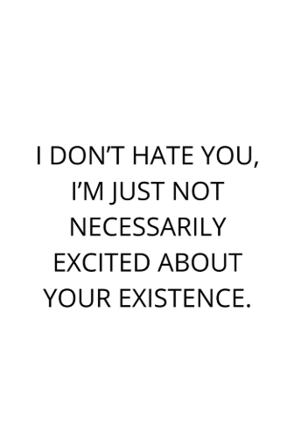

Slide 5
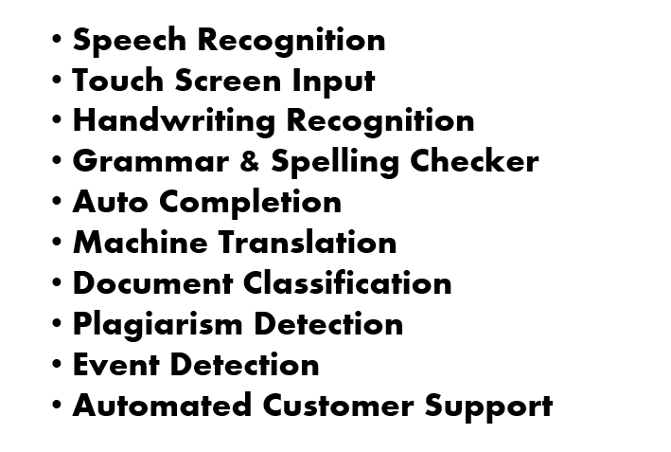

Slide 6
Feature Engineering for Natural Language Processing
2019
Susan Li
https://medium.com/@actsusanli
Sr. Data Scientist

Slide 7
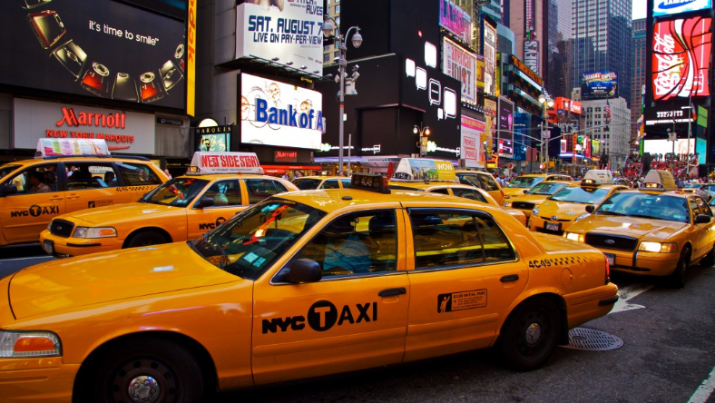
What are features When we predict New York City taxi fare
Distance between pickup and drop off location
Time of the day
Day of the week
Is a holiday or not

Slide 8
What are the features for NLP?

Slide 9
How does computer perceive text?

Slide 10
Meta features Text based features
Number of words in the text
Number of unique words in the text
Number of characters in the text
Number of stopwords
Number of punctuations
Number of upper case words
Number of title case words
Average length of the words
Text distance
Language of text
Page rank
Vectorization (CountVectorizer, TfidfVectorizer, HashingVectorizer)
Tokenization
Lemmatization
Stemming
N-grams
Part of speech tagging
Parsing
Named entity and key phrase extraction
Capitalization pattern

Slide 11
Meta features

Slide 12
Text based features

Slide 16
Feature Engineering for NLP
Feature engineering is the most important part of developing NLP applications.
Feature engineering is the most creative aspect of Data Science (art and skill).
Domain knowledge / brainstorming sessions.
Check / revisit what worked before.

Slide 17
What Is Not Feature Engineering
Data collection
Removing stopwords, removing non-alphanumeric, removing HTML tag, lowercasing. They are data preprocessing.
Creating the target variable (labeling the data)
Scaling or normalization
PCA
Hyperparameter optimization or tuning.

Slide 18
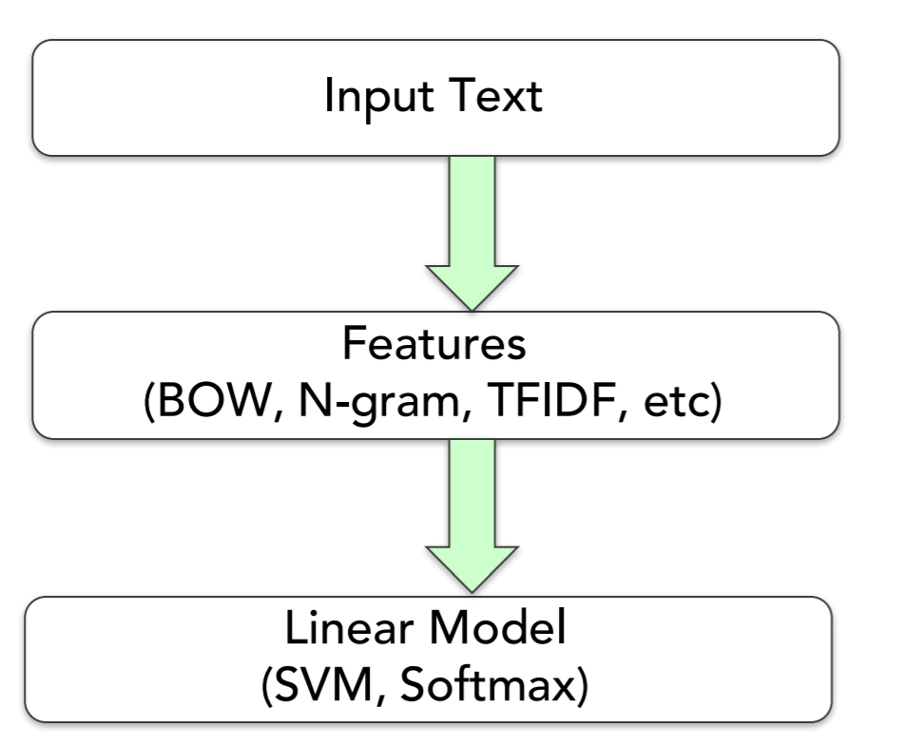
Our machine learning algorithm looks at the textual content before applying SVM on the word vector.

Slide 19
Feature Engineering for NLP
TF-IDF
Word2vec
FastText
Topic Modeling
Simple & complicated features
The future

Slide 20
Problem 1: Predict label of a Stack Overflow question
https://storage.googleapis.com/tensorflow-workshop-examples/stack-overflow-data.csv

Slide 21
Problem formulation
Our problem is best formulated as multi-class, single label text classification which predicts a given Stack Overflow question to one of a set of target labels.

Slide 22
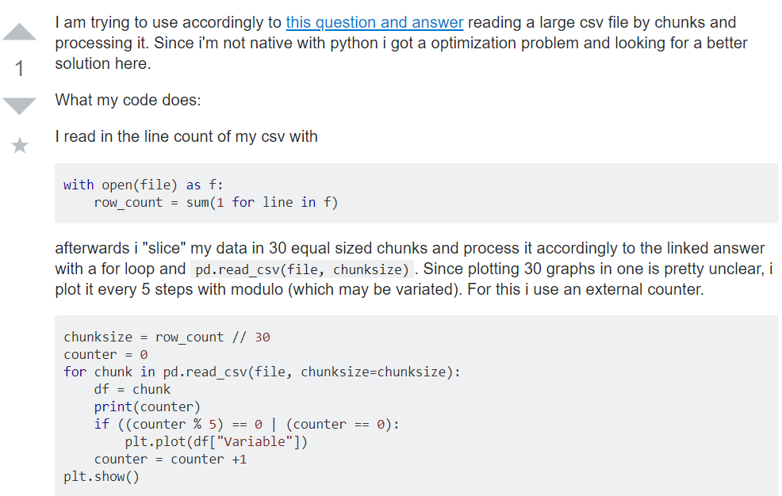
python

Slide 23
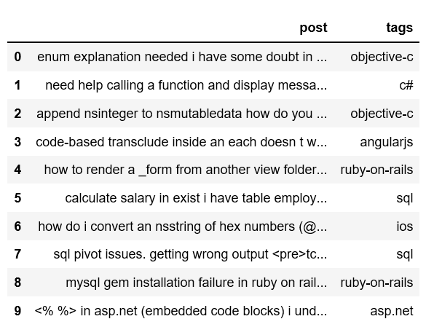

Slide 24
Our machine learning algorithm looks at the textual content before applying SVM on the word vector.

Slide 25
N-gram
Unigrams: “nlp multilabel classification problem” -> [“nlp”, “multilabel”, “classification”, “problem”]
Bigrams: “nlp multilabel classification problem” -> [“nlp multilabel”, “multilabel classification”, “classification problem”]
Trigrams: [“nlp multilabel classification”, “multilabel classification problem”]
Character-grams: “multilabel” -> [“mul”, “ult”, “lti”, “til”, “ila”, “lab”, “abe”, “bel”]

Slide 26
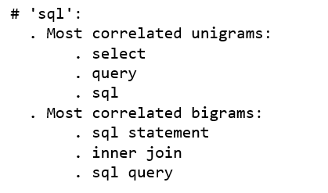
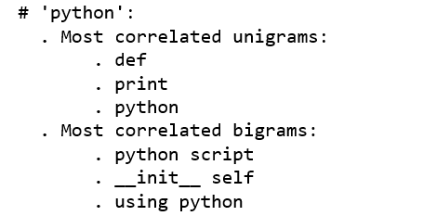

Slide 27
TF-IDF computation of the word “python”

Slide 28
TF-IDF sparse matrix example
Without going into the math, TF-IDF are word frequency scores that try to highlight words that are more interesting, e.g. frequent in a document but not across documents.

Slide 29
Coding TF-IDF
from sklearn.feature_extraction.text import TfidfVectorizer
vectorizer = TfidfVectorizer(min_df=3, max_features = None, token_patterns = r’\w{1, }’, strip_accents = ‘unicode’, analyzer=‘word’, ngram_range(1, 3), strop_words=‘english’)
tfidf_matrix = vectorizer.fit_transform(questions_train)

Slide 30
extract from the sentence a rich set of hand-designed features which are then fed to a classical shallow classification algorithm, e.g. a Support Vector Machine (SVM), often with a linear kernel

Slide 31
Word2vec
You shall know a word by the company it keeps (Firth, J. R. 1957:11)
Word2vec is not deep learning
Word2vec turns input text into a numerical form that deep neural networks can process as inputs.
We can either download one of the pre-trained models from GloVe, or train a Word2Vec model from scratch with gensim

Slide 32
Word2vec
CBOW: if we have the phrase “how to plot dataframe bar graph”, the parameters/features of {how, to, plot, bar, graph} are used to predict {dataframe}. Predicts the current word given the neighboring words.
Skip-gram: if we have the phrase “how to plot dataframe bar graph”, the parameters/features of {dataframe} are used to predict {how, to, plot, bar, graph}. Predicts the neighboring words given the current word.

Slide 33
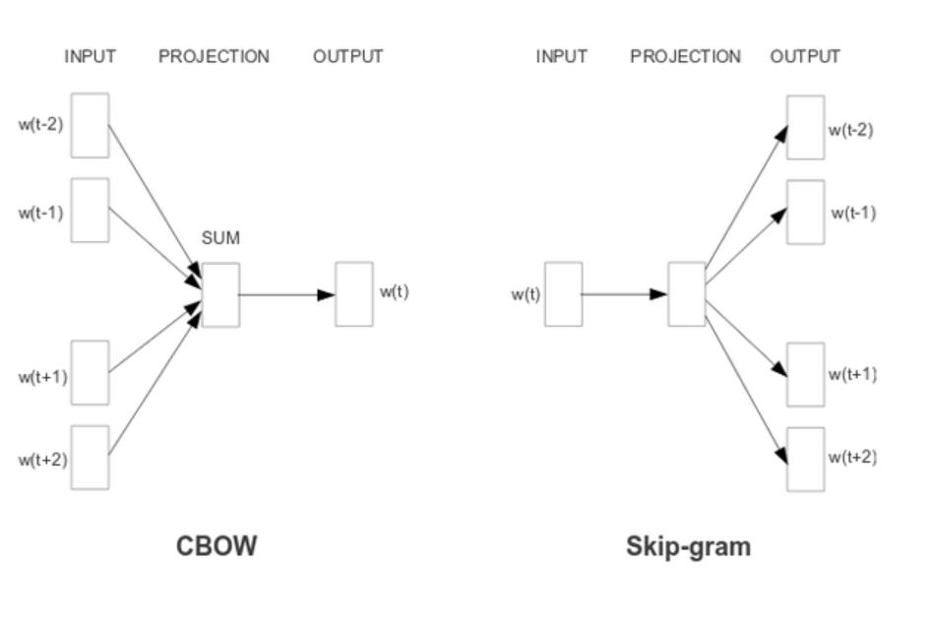
https://papers.nips.cc/paper/5021-distributed-representations-of-words-and-phrases-and-their-compositionality.pdf

Slide 34
Word2vec
https://www.slideshare.net/TraianRebedea/what-is-word2vec

Slide 35
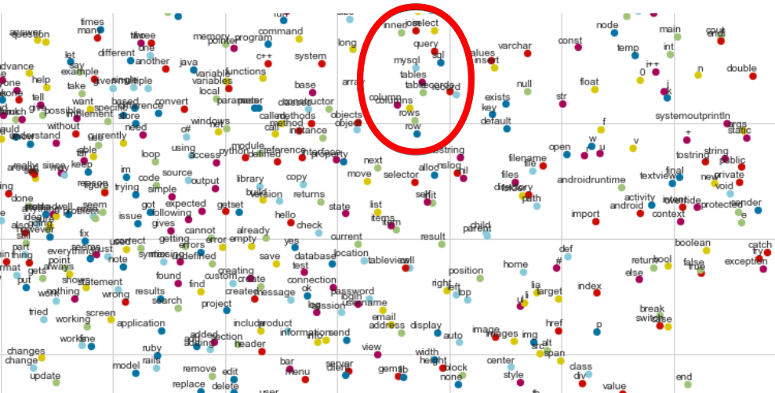

Slide 36
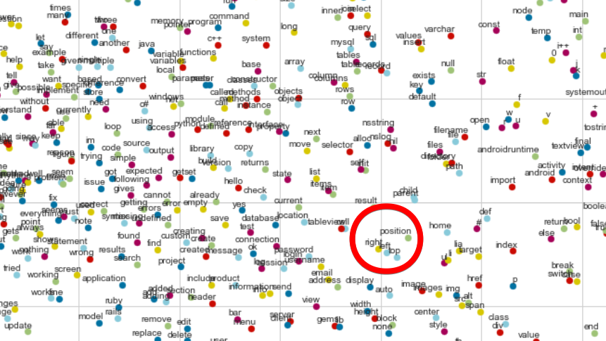

Slide 37
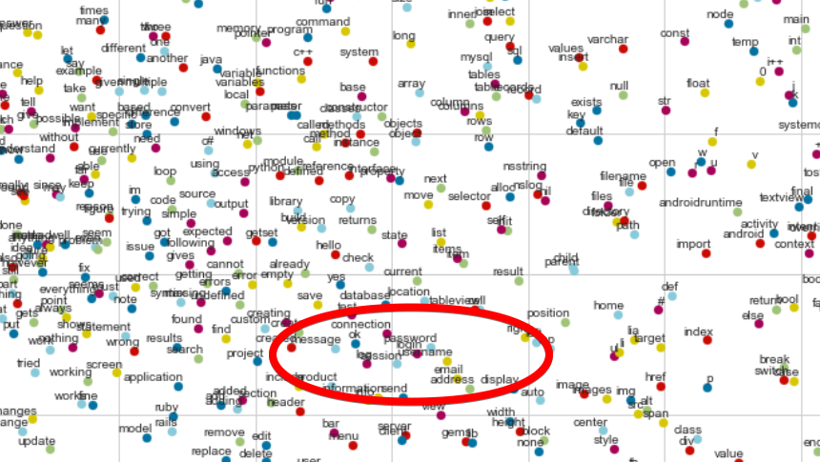

Slide 38
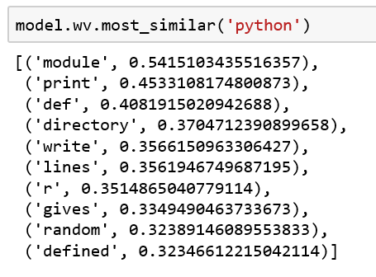
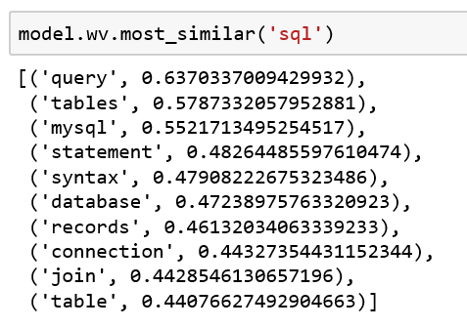

Slide 39
Airbnb
https://medium.com/airbnb-engineering/listing-embeddings-for-similar-listing-recommendations-and-real-time-personalization-in-search-601172f7603e

Slide 40
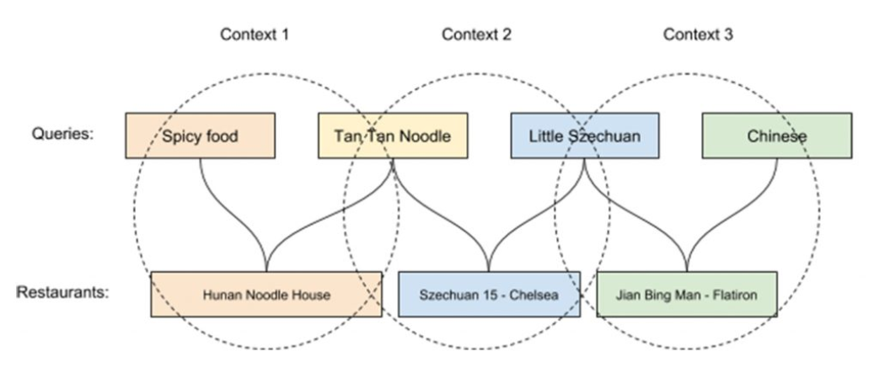
Uber
https://eng.uber.com/uber-eats-query-understanding/

Slide 41
Word2Vec FastText
Treat each word as the smallest unit to train on.
Does not perform well for rare words.
Can’t generate word embedding if a word does not appear in training corpus.
Training faster.
An extension of Word2vec
Treats each word as composed of character n-grams.
Generate better word embeddings for rare words.
Can construct the vector for a word even it does not appear in training corpus.
Training slower

Slide 42
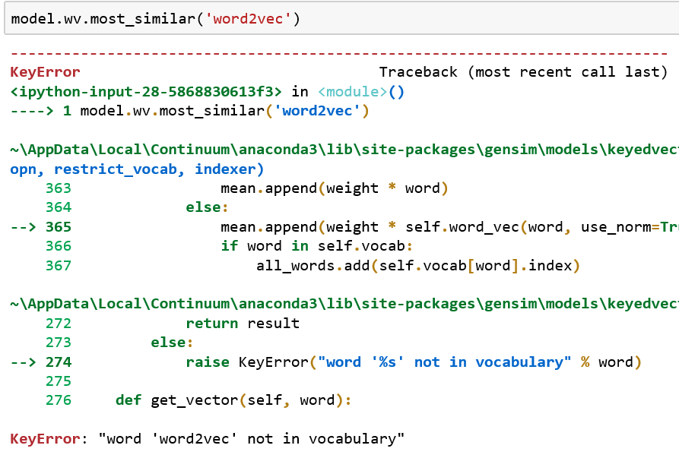
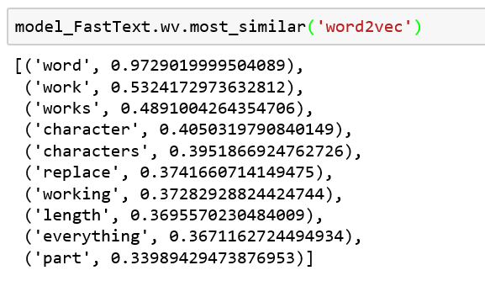

Slide 43
Word2vec FastText
from gensim.models import word2vec
model = word2vec.Word2Vec(corpus, size=100, window=20, min_count=500, workers=4)
from gensim.models import FastText
model_FastText = FastText(corpus, size=100, window=20, min_count=500, workers=4)

Slide 44
Problem 2: Topic Modeling (Unsupervised)

Slide 45
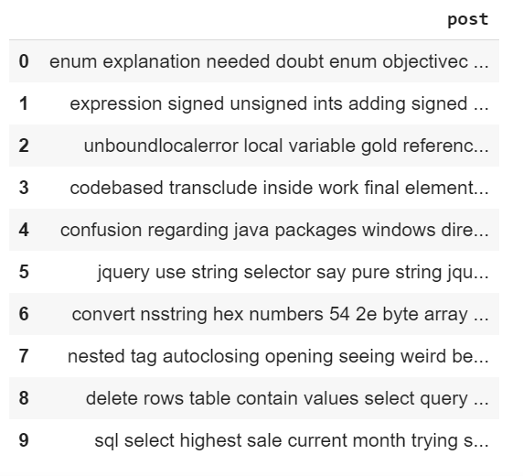

Slide 46
Topic Modeling
from sklearn.decomposition import LatentDirichletAllocation
lda_model = LatentDirichletAllocation(n_components=20, learning_method='online’,
random_state=0, n_jobs = -1)
lda_output = lda_model.fit_transform(df_vectorized)

Slide 47
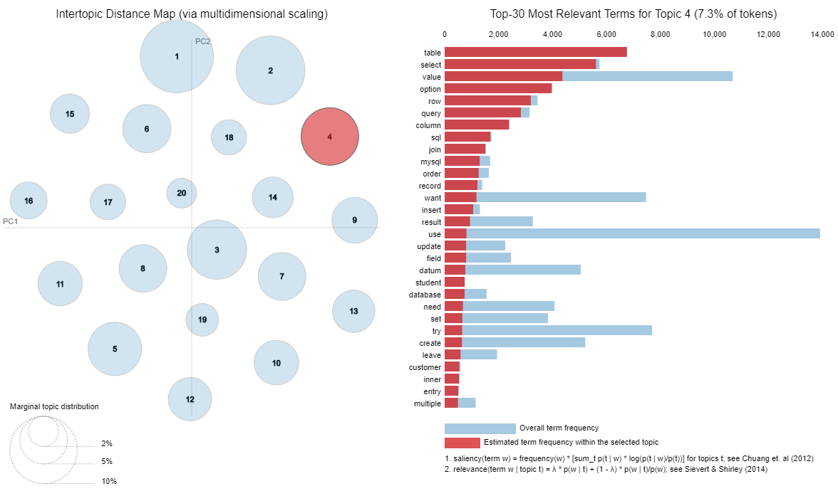

Slide 48
sql
python

Slide 49
Problem 3: Auto detect duplicate Stack Overflow questions

Slide 50
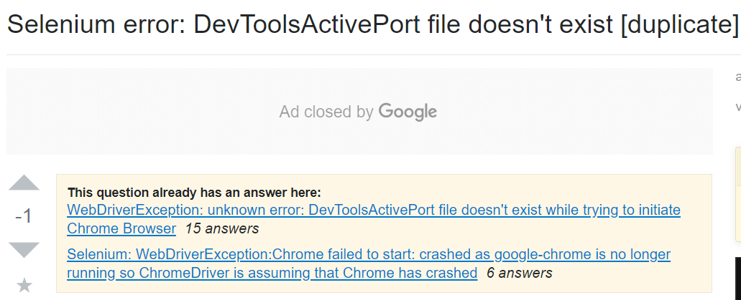

Slide 51
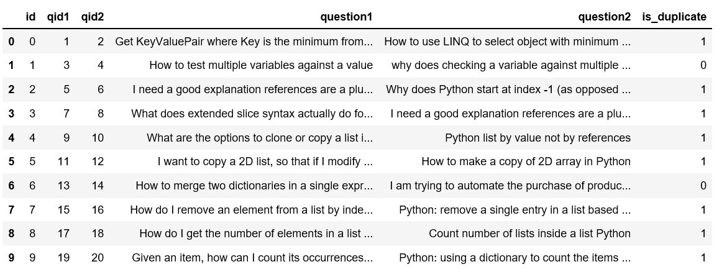

Slide 52
Problem formulation
Our problem is a binary classification problem in which we Identify and classify whether question pairs are duplicates or not

Slide 53
Meta features Word2vec features
The word counts of each question.
The character length of each question.
The number of common words of these two questions
. . .
Fuzzy Features
Fuzzy string matching related features. (https://github.com/seatgeek/fuzzywuzzy)
Word2vec vectors for each question.
Word mover’s distance. (https://markroxor.github.io/gensim/static/notebooks/WMD_tutorial.html)
Cosine distance between vectors of question1 and question2.
Manhattan distance between vectors of question1 and question2.
Euclidean distance between vectors of question1 and question2.
Jaccard similarity between vectors of question1 and question2.
. . .

Slide 55
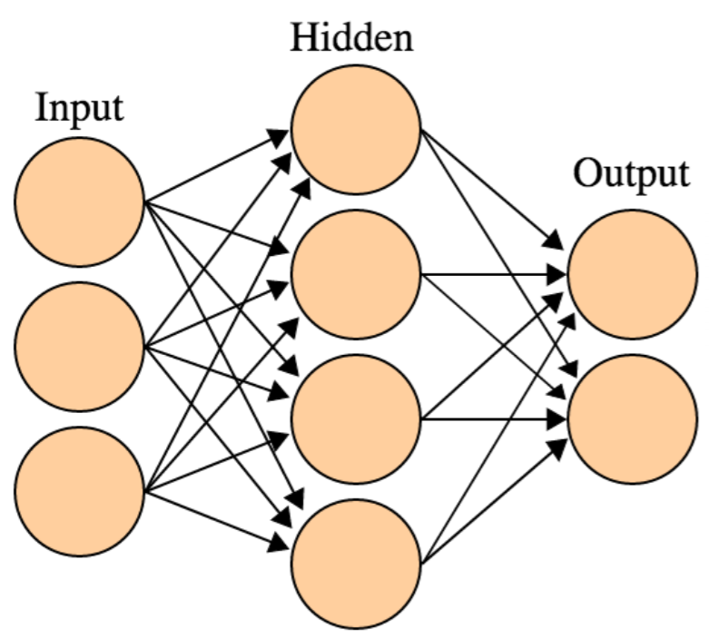

Slide 56
Debug end-to-end Auto ML models
LIME
SHAP

Slide 57
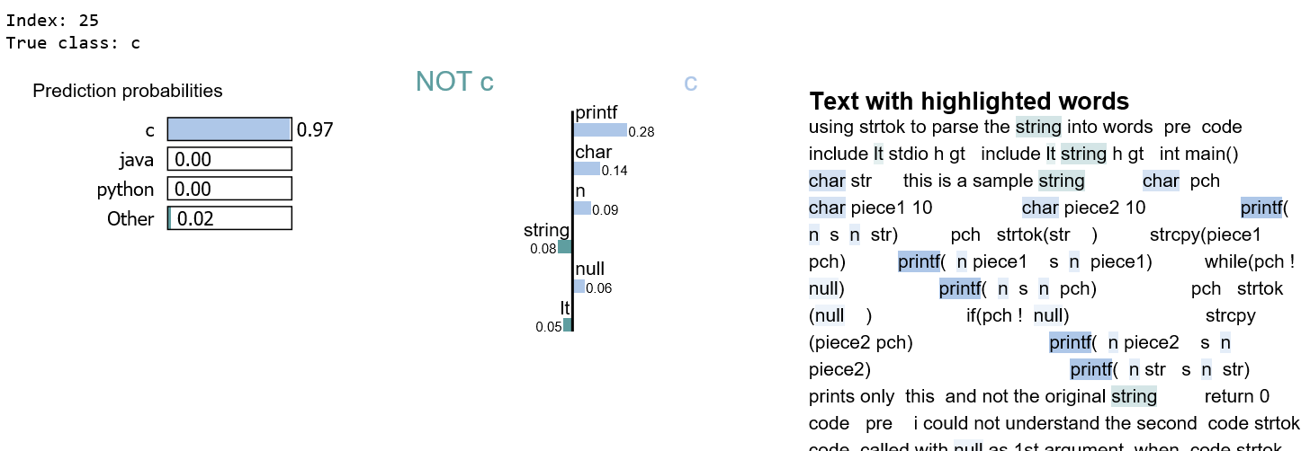
LIME
“printf” is positive for c, but negative for Other.
If we remove the words printf from the document, we expect the model to predict c with probability 0.97 - 0.28 = 0.69

Slide 58
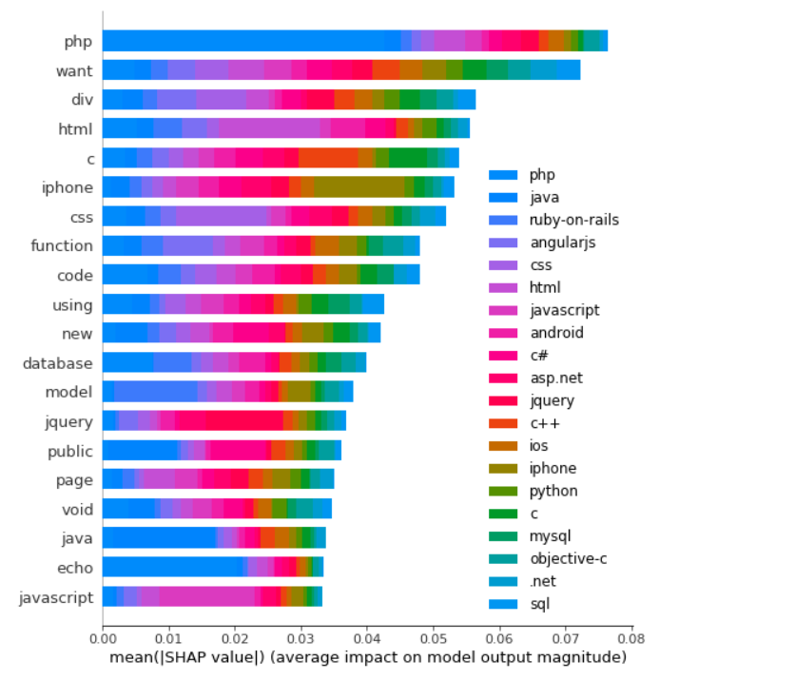
SHAP
“php” is the biggest signal word used by our model, contributing most to “php” predictions.
It’s unlikely you’d see the word “php” used in a python question.

Slide 59
Good Features are the backbone of any machine learning model. And good feature creation often needs domain knowledge, creativity, and lots of time.

Slide 60
Resources:
Glove: https://blog.acolyer.org/2016/04/22/glove-global-vectors-for-word-representation/
Word2vec: https://blog.acolyer.org/2016/04/21/the-amazing-power-of-word-vectors/
https://arxiv.org/pdf/1301.3781.pdf - Mikolov et al. 2013
https://papers.nips.cc/paper/5021-distributed-representations-of-words-and-phrases-and-their-compositionality.pdf - Mikolov et al. 2013
https://arxiv.org/pdf/1411.2738v3.pdf - Rong 2014
https://arxiv.org/pdf/1402.3722v1.pdf - Goldberg and Levy 2014

