Slide 1
How to Leverage Libp2p for blockchain applications
@chrispacia - Lead backend dev OpenBazaar

Slide 2
What

Slide 3
Identity
Peer discovery
Routing
Wire encryption/authentication
Multi-transport
Nat traversal
Stream/protocol multiplexing
Relaying
Common Needs

Slide 4
Languages

Slide 5
Transport agnostic
transports: TCP, UDP, SCTP, UDT, uTP, QUIC, SSH, etc.
authenticated transports: TLS, DTLS, CurveCP, SSH
Architecture

Slide 6
Support addresses for any network protocol.
Are self-describing.
Conform to a simple syntax, making them trivial to parse and construct.
Have human-readable and efficient machine-readable representations.
Encapsulate well, allowing trivial wrapping and unwrapping of encapsulation layers.
/ip6/fe80::8823:6dff:fee7:f172/tcp/4001
/ip4/162.246.145.218/udp/4001/utp
/onion/erhkddypoy6qml6h:4003
/ip6/2601:9:4f81:9700:803e:ca65:66e8:c21/udp/1234/quic
Multiaddr

Slide 7
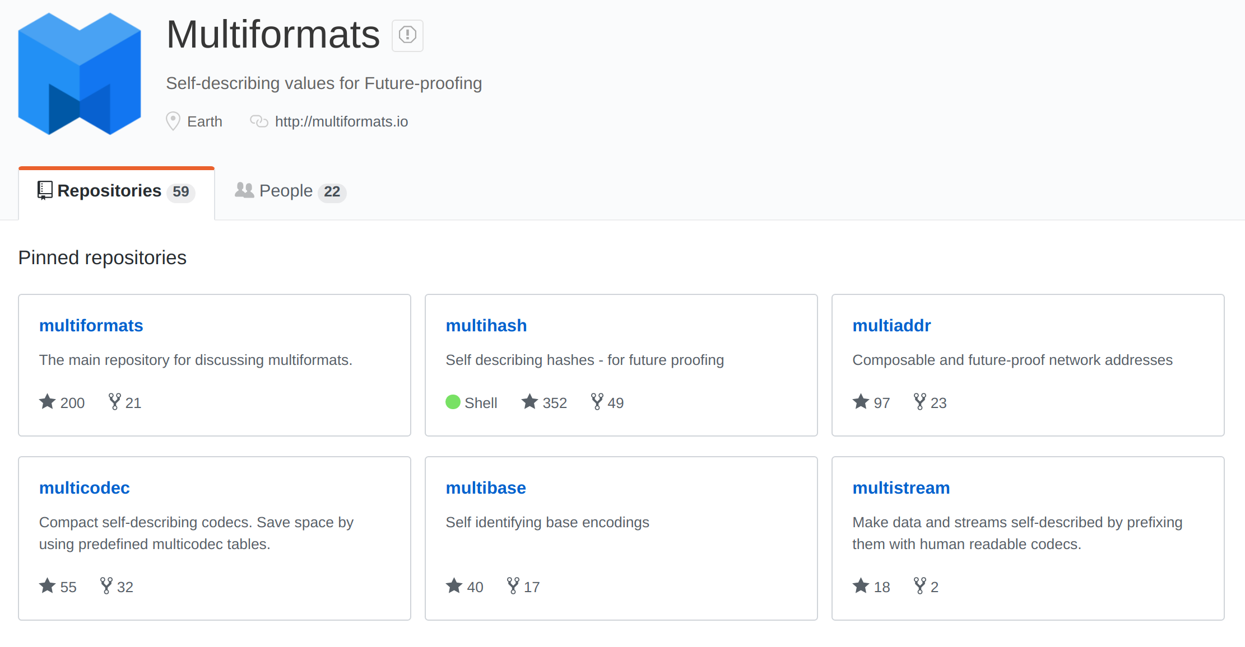

Slide 8
Format
<varint hash function code><varint digest size in bytes><hash function output>
Examples
# sha1 - 0x11 - sha1("multihash") 111488c2f11fb2ce392acb5b2986e640211c4690073e # sha1 in hex CEKIRQXRD6ZM4OJKZNNSTBXGIAQRYRUQA47A==== # sha1 in base32 5dsgvJGnvAfiR3K6HCBc4hcokSfmjj # sha1 in base58 ERSIwvEfss45KstbKYbmQCEcRpAHPg== # sha1 in base64 # sha2-256 0x12 - sha2-256("multihash") 12209cbc07c3f991725836a3aa2a581ca2029198aa420b9d99bc0e131d9f3e2cbe47 # sha2-256 in hex CIQJZPAHYP4ZC4SYG2R2UKSYDSRAFEMYVJBAXHMZXQHBGHM7HYWL4RY= # sha256 in base32 QmYtUc4iTCbbfVSDNKvtQqrfyezPPnFvE33wFmutw9PBBk # sha256 in base58 EiCcvAfD+ZFyWDajqipYHKICkZiqQgudmbwOEx2fPiy+Rw== # sha256 in base64
Multihash

Slide 9
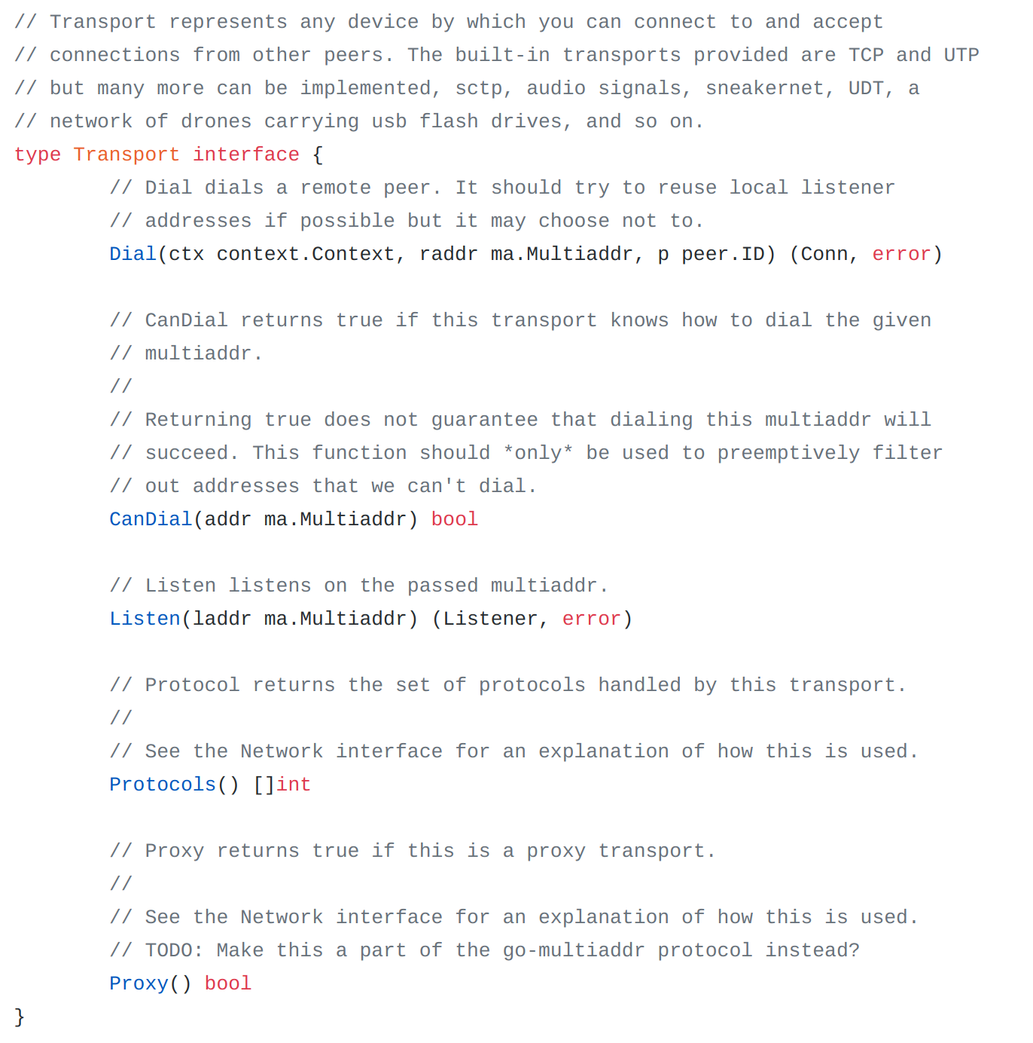

Slide 10
Multiplexing
can multiplex multiple listen network interfaces
can multiplex multiple transport protocols
can multiplex multiple connections per peer
can multiplex multiple client protocols
can multiplex multiple streams per protocol, per connection (SPDY, HTTP2, QUIC, SSH)
has flow control (backpressure, fairness)
encrypts each connection with a different ephemeral key
Architecture

Slide 11
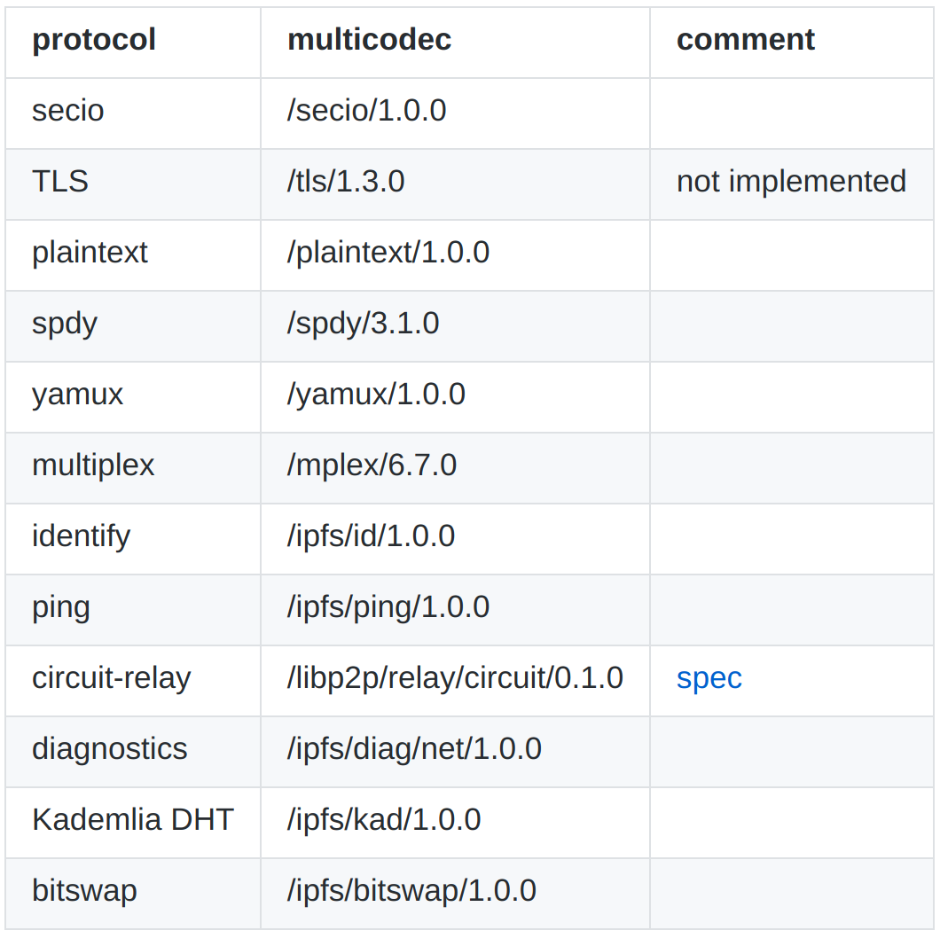
Protocol Muxing

Slide 12
Encryption
Communications on libp2p may be:
encrypted
signed (not encrypted)
clear (not encrypted, not signed)
Architecture

Slide 13
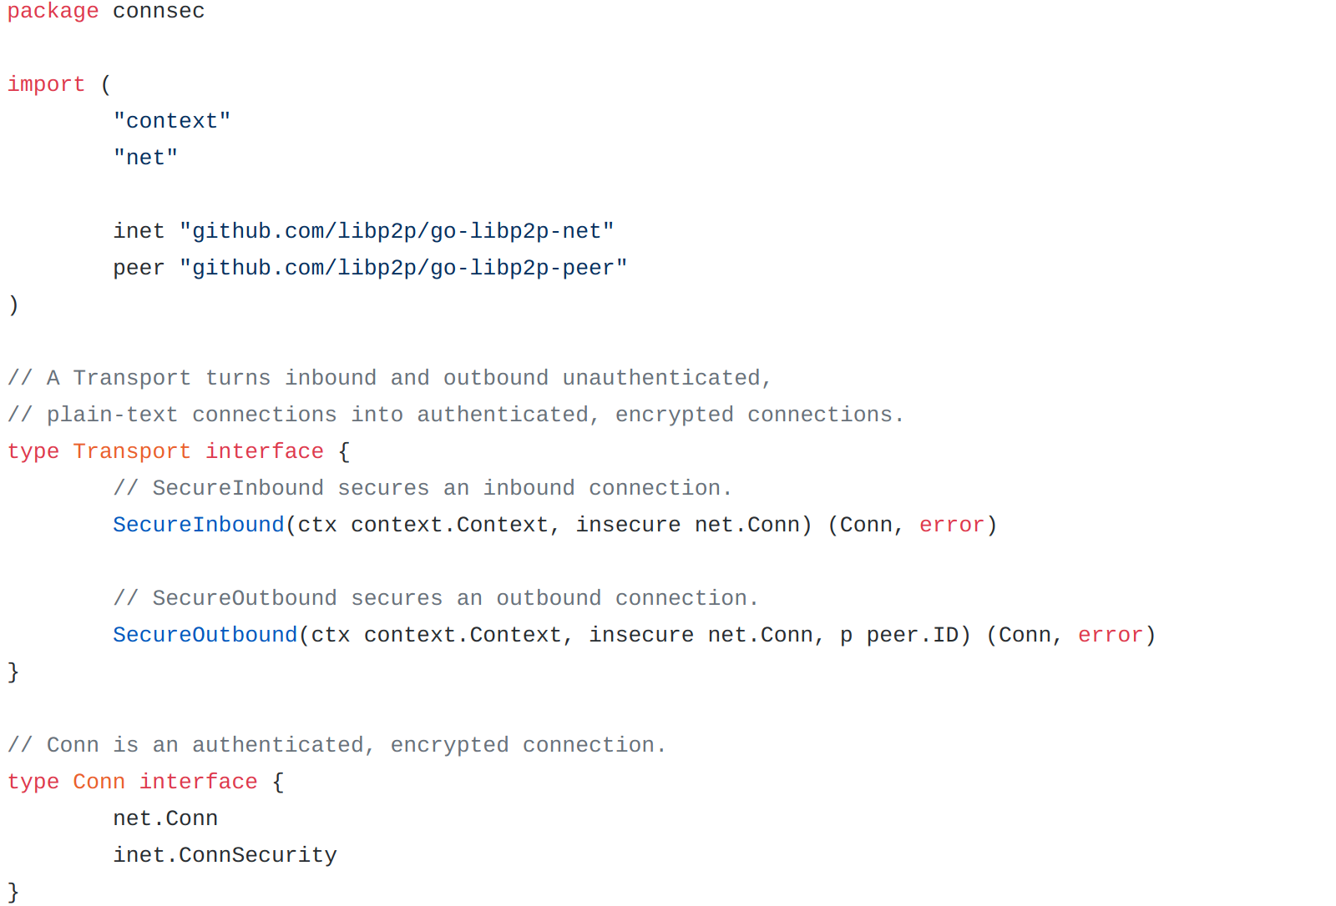

Slide 14
Nat Traversal / Relay
Multiaddr Format
[<relay peer multiaddr>]/p2p-circuit/<destination peer multiaddr>
Examples
/p2p-circuit/p2p/QmVT6GYwjeeAF5TR485Yc58S3xRF5EFsZ5YAF4VcP3URHt - Arbitrary relay node
/ip4/127.0.0.1/tcp/5002/p2p/QmdPU7PfRyKehdrP5A3WqmjyD6bhVpU1mLGKppa2FjGDjZ/p2p-circuit/p2p/QmVT6GYwjeeAF5TR485Yc58S3xRF5EFsZ5YAF4VcP3URHt - Specific relay node
Architecture

Slide 15
Routing
Kademlia DHT
Supernode
MDNS
Other
Architecture

Slide 16
Lightning Network
02212d3ec887188b284dbb7b2e6eb40629a6e14fb049673f22d2a0aa05f902090e@162.246.145.218
Libp2p
QmYMR9kDCSF3yBVVyhsRepJC4Byx6TrYGbjZsBgzVP9rG2 [ “/ip4/127.0.0.1/tcp/4001”,
“/ip4/127.0.0.1/tcp/9005/ws”
“/ip4/10.0.0.8/tcp/4001”,
“/ip4/10.0.0.8/tcp/4001/ws”,
“/ip6/::1/tcp/4001”,
“/ip6/::1/tcp/9005/ws”,
“/ip6/Fe80::8823:6dff:fee7:f172/tcp/9005/ws”,
“/onion/erhkddypoy6qml6h:4003” ]
Routing

Slide 17
Pubsub
Propagate information throughout the network in a structured manner, with or without guarantees
like: order, delivery, efficiency, fault tolerance and so on.
floodsub
multicast
Architecture

Slide 18
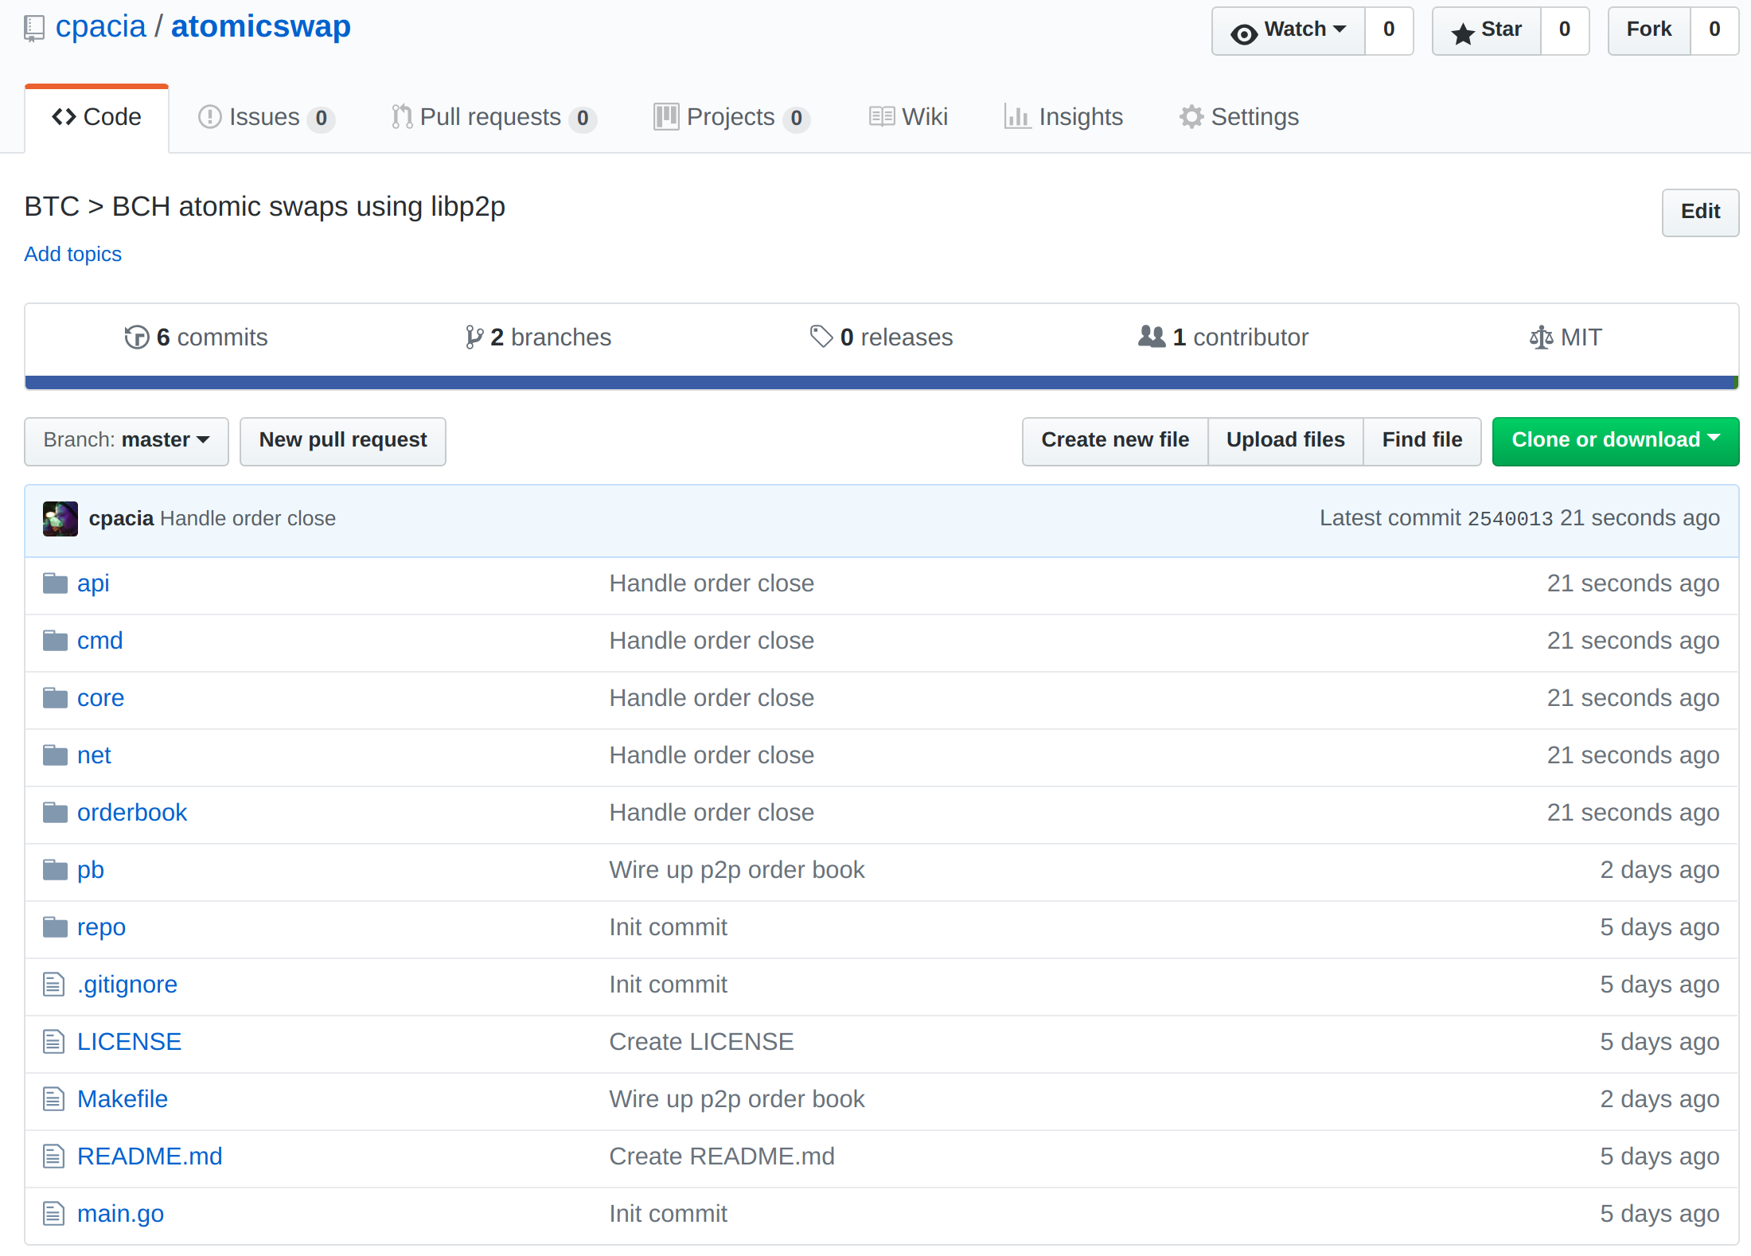
Identity
DHT
Protocol multiplexing
Wire encryption
Pubsub
Example

Slide 19
https://libp2p.io/
https://github.com/libp2p
@chrispacia
ctpacia@gmail.com
Further Reading

