Slide 1
Modern Distributed Optimization
Matt Adereth
QCon NY 2017

Slide 2
Important Legal Information
The views expressed herein are not necessarily the views of Two Sigma Investments, LP or any of its affiliates (collectively, “Two Sigma”). The information presented herein is only for informational and educational purposes and is not an offer to sell or the solicitation of an offer to buy any securities or other instruments. Additionally, the information is not intended to provide, and should not be relied upon for investment, accounting, legal or tax advice. Two Sigma makes no representations, express or implied, regarding the accuracy or completeness of this information, and you accept all risks in relying on the above information for any purpose whatsoever

Slide 3
🎛
Unknown Function
Multiple Parameters
Expensive

Slide 4
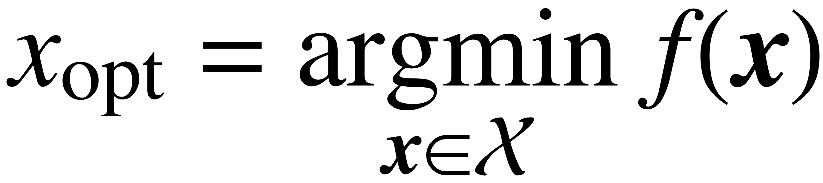

Slide 5
Agenda
Real World Problems
Distributed Algorithm Deep Dive
How to Apply Now

Slide 6
Real World Problems

Slide 7
Cluster Configuration
Number of VMs
CPU count
CPU speed per core
RAM per core
Disk count
Disk speed
Network capacity of the VM

Slide 8
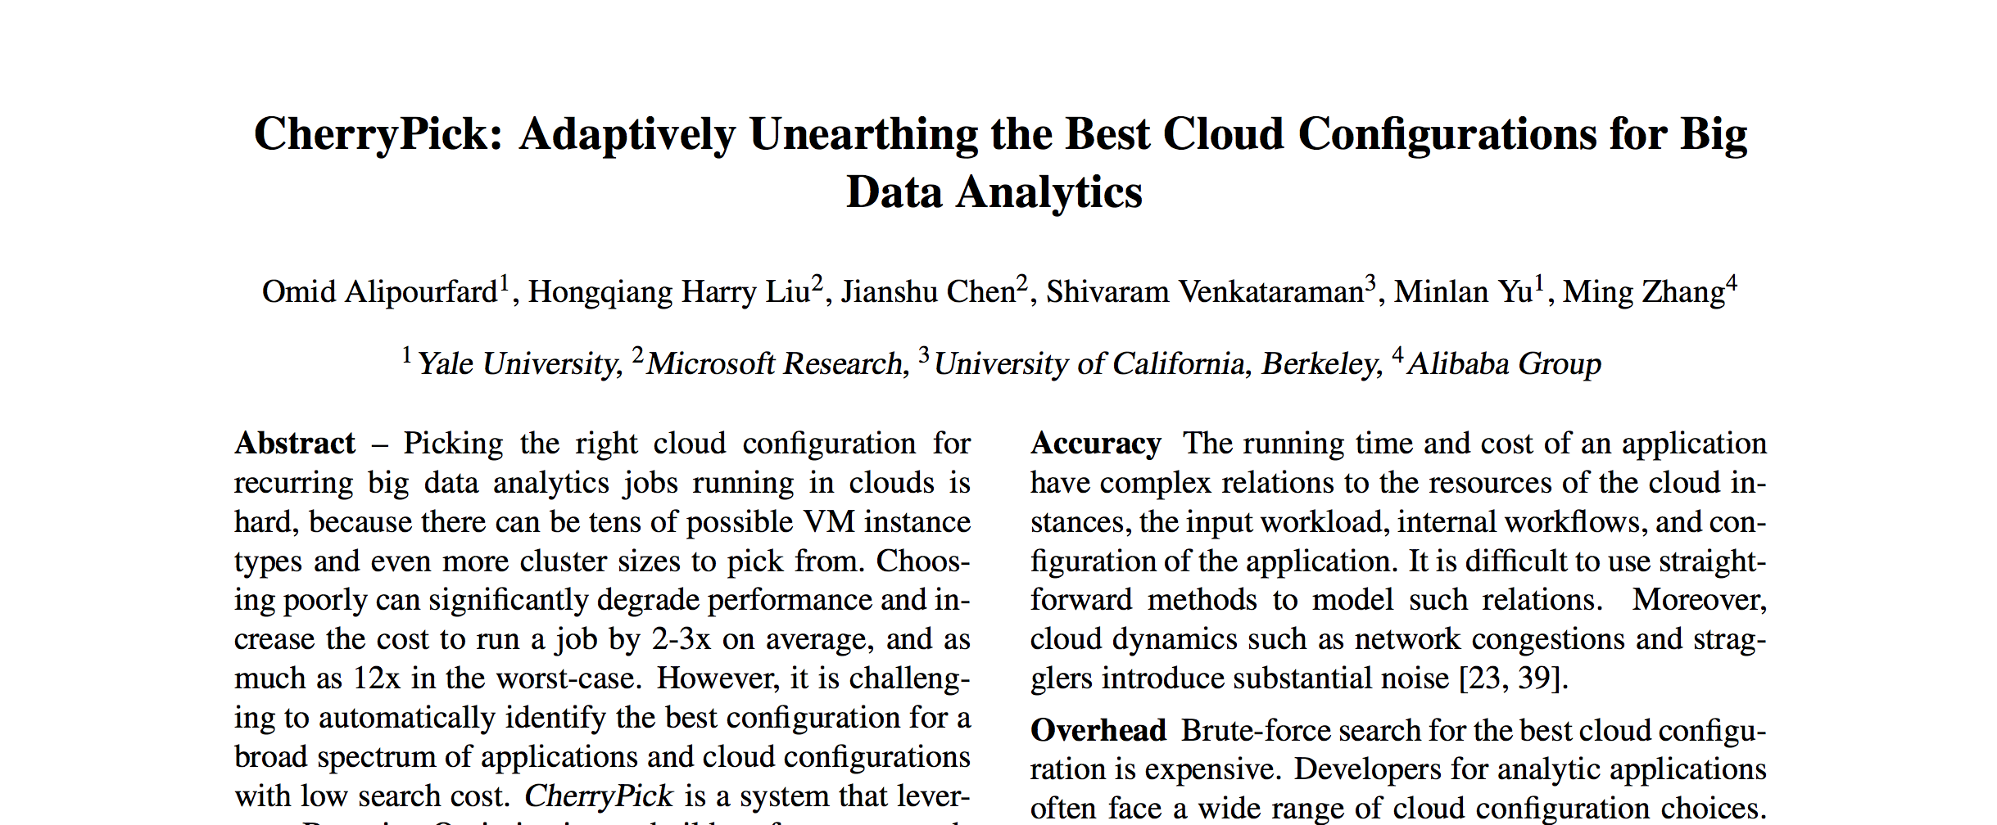
Cluster Configuration with CherryPick

Slide 9
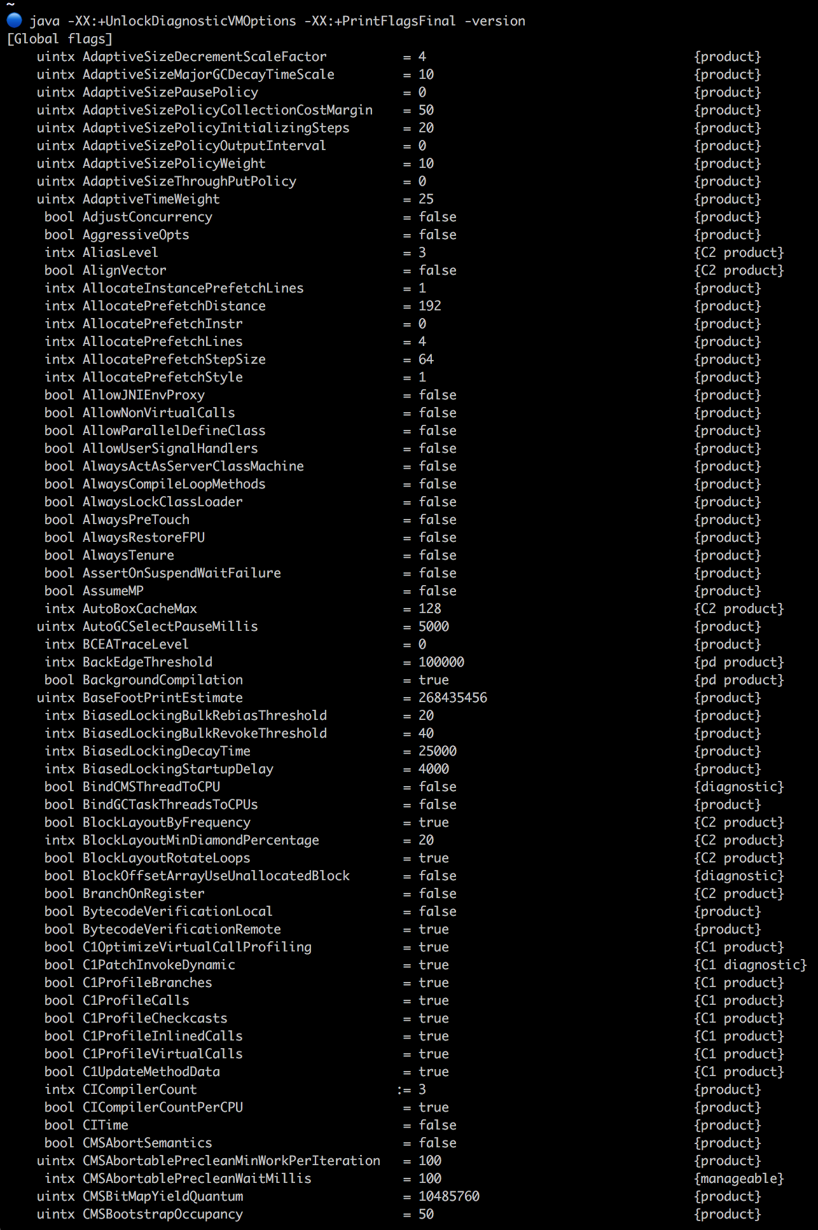
JVM Tuning

Slide 10
JVM Tuning
$ java -XX:+UnlockDiagnosticVMOptions -XX:+PrintFlagsFinal -version | wc -l
java version "1.8.0_92"
Java(TM) SE Runtime Environment (build 1.8.0_92-b14)
Java HotSpot(TM) 64-Bit Server VM (build 25.92-b14, mixed mode)
823

Slide 11
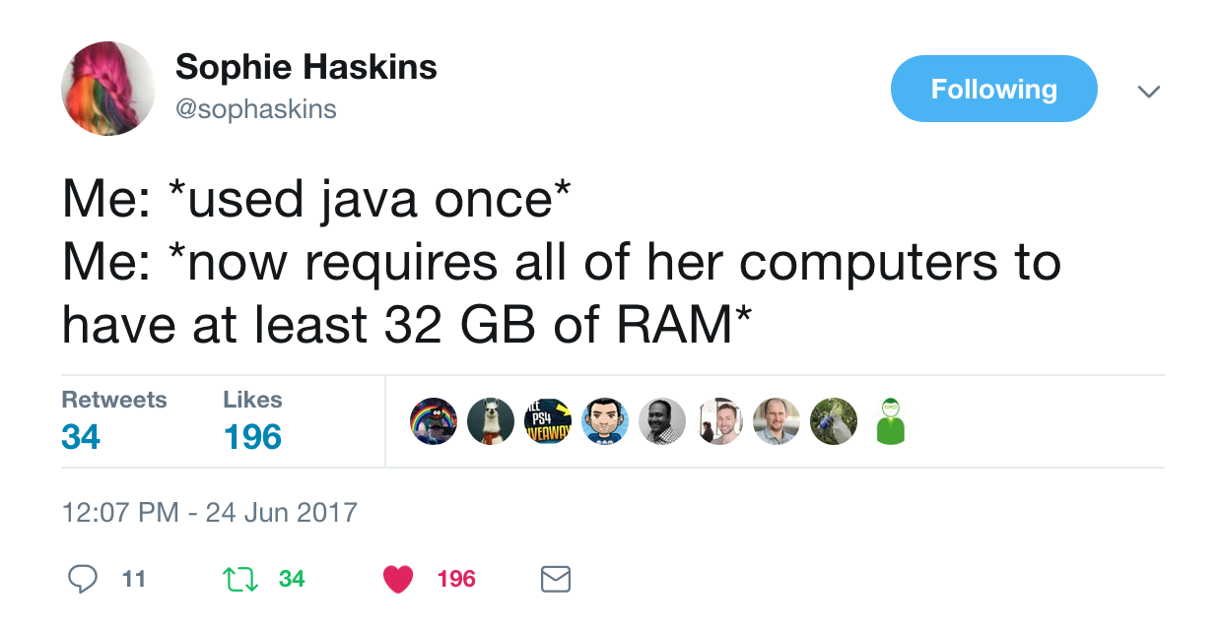

Slide 12
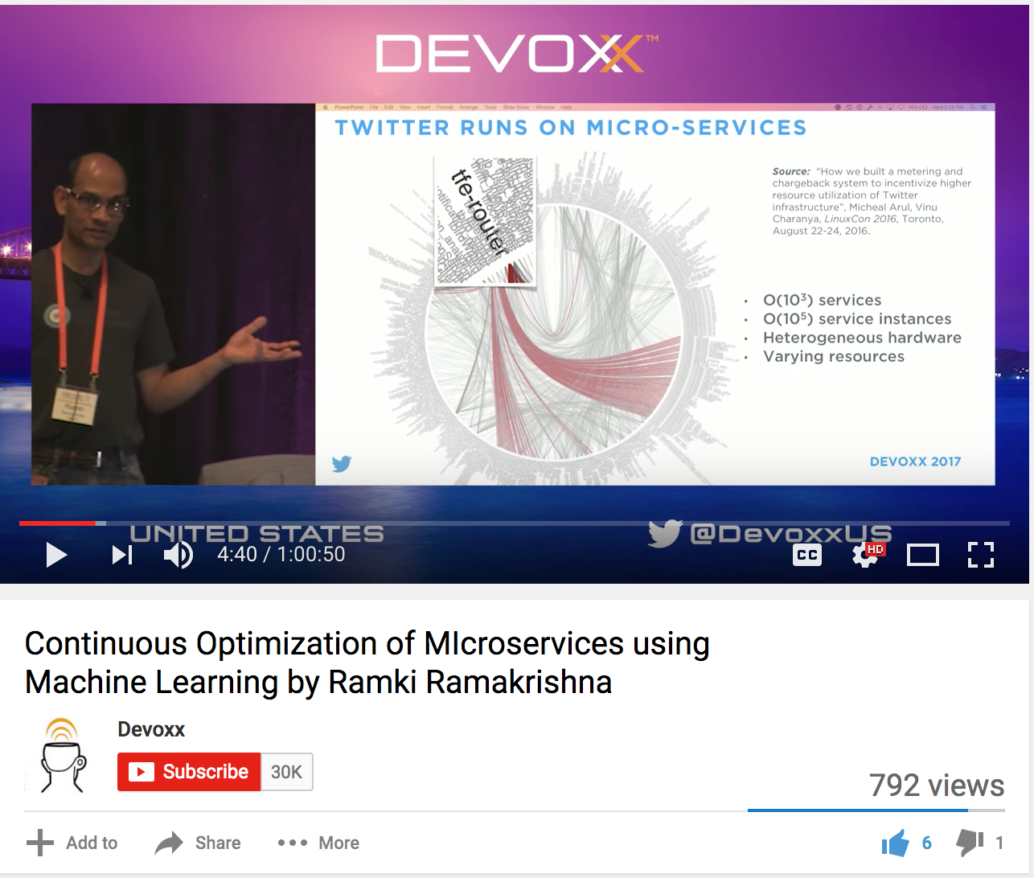
JVM Tuning at Twitter

Slide 13
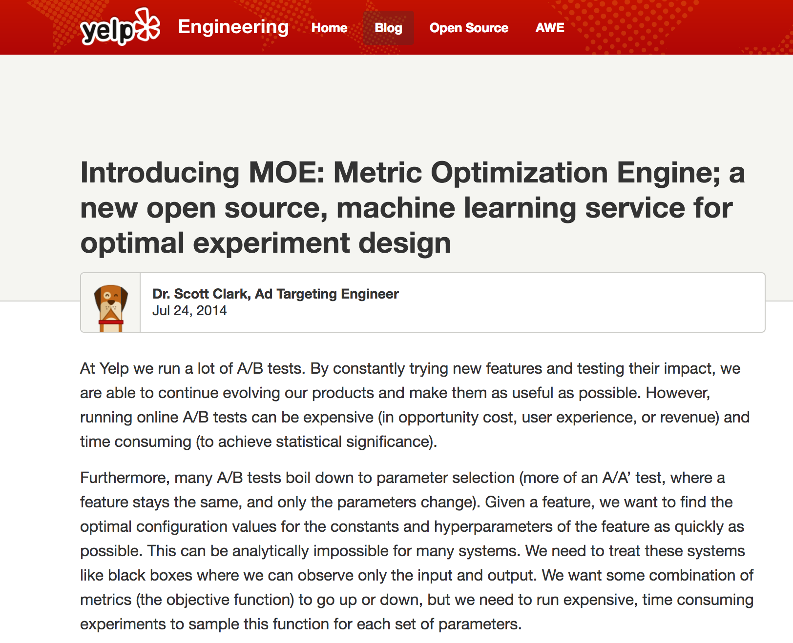
A/B Testing at Yelp

Slide 14
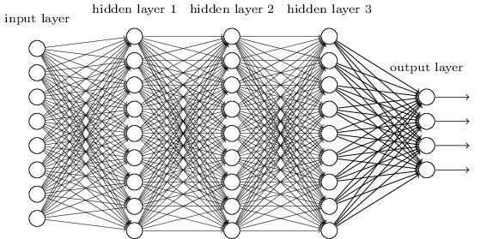
Deep Learning

Slide 15
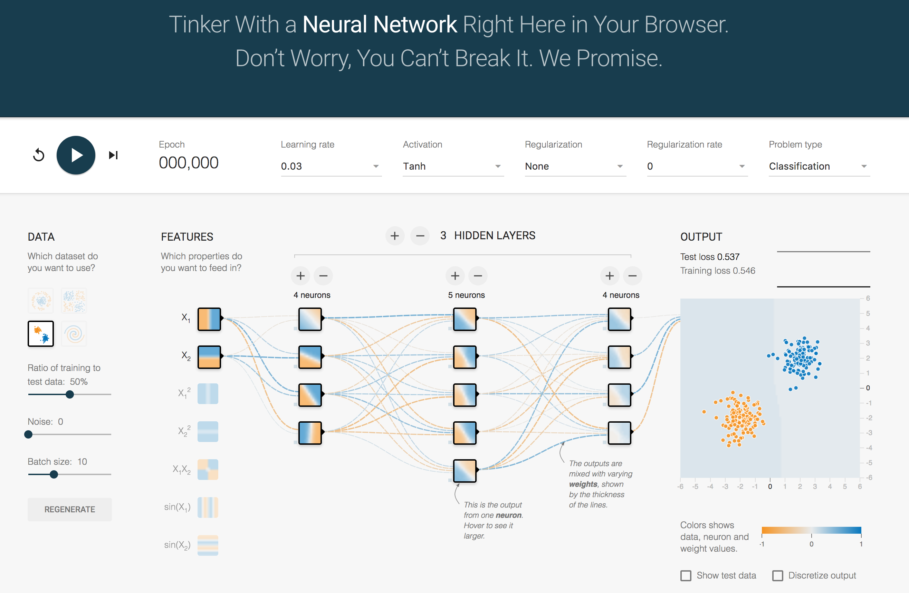
Deep Learning
http://playground.tensorflow.org/

Slide 16
Algorithms

Slide 17
👩(🎛)
Guess and Check
Mental Model
💻(🎛)
Grid Search
Coordinate Descent
🔮(🎛)

Slide 18
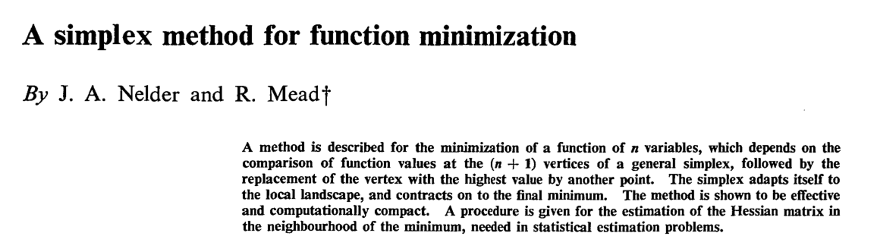
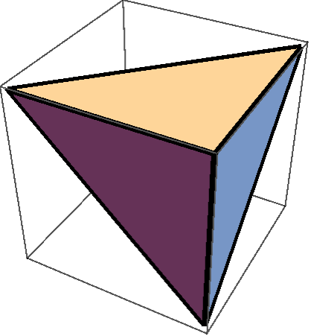
d = 1
n = 2
d = 2
n = 3
d = 3
n = 4

Slide 19
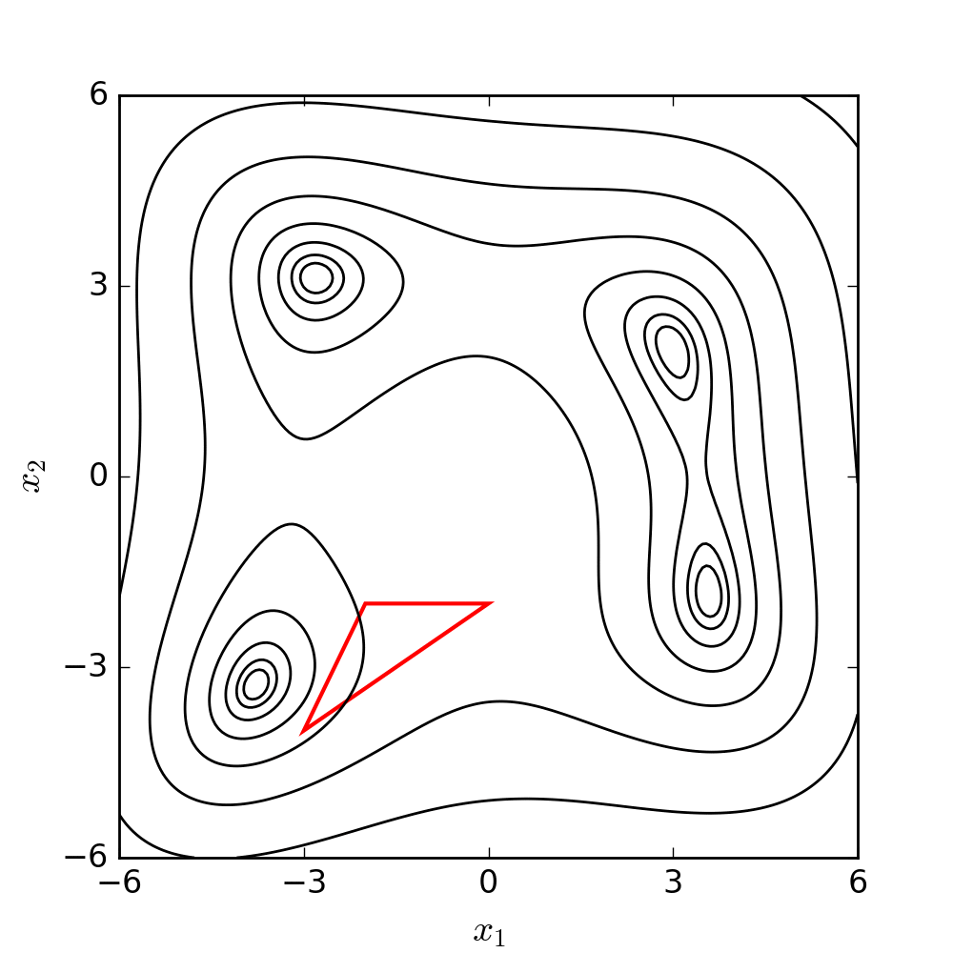
© User:Nicoguaro/ Wikimedia Commons / CC-BY-4.0

Slide 21
© User:Nicoguaro/ Wikimedia Commons / CC-BY-4.0

Slide 22
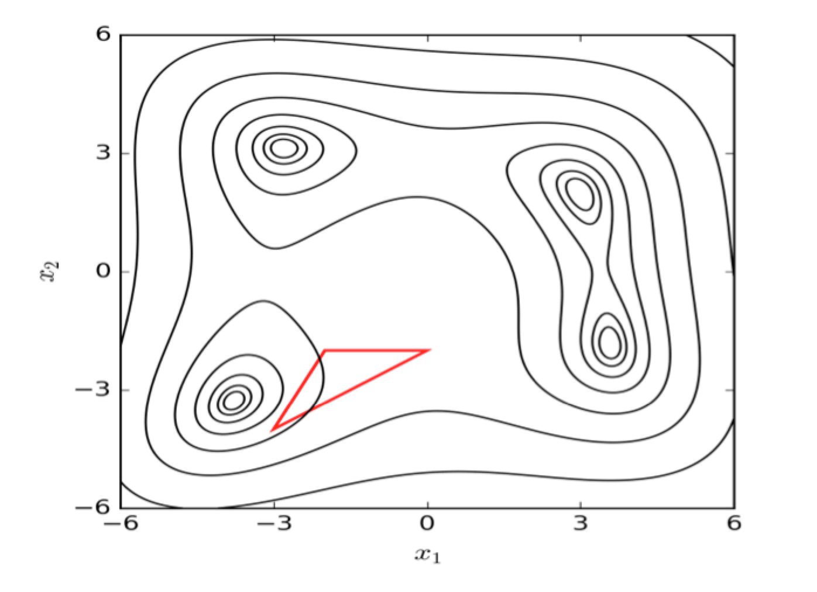
Multi-Start Nelder-Mead

Slide 23
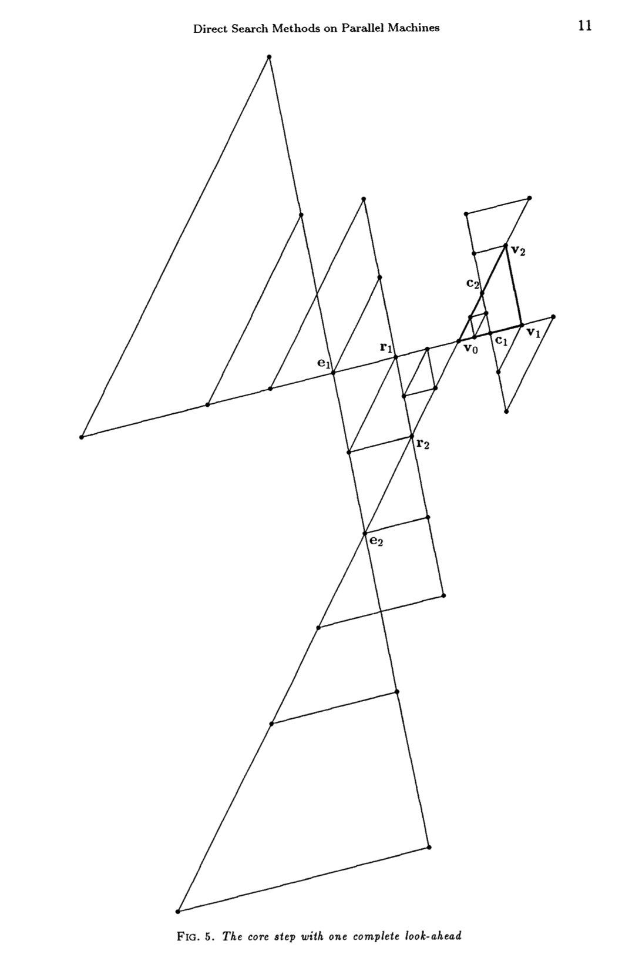
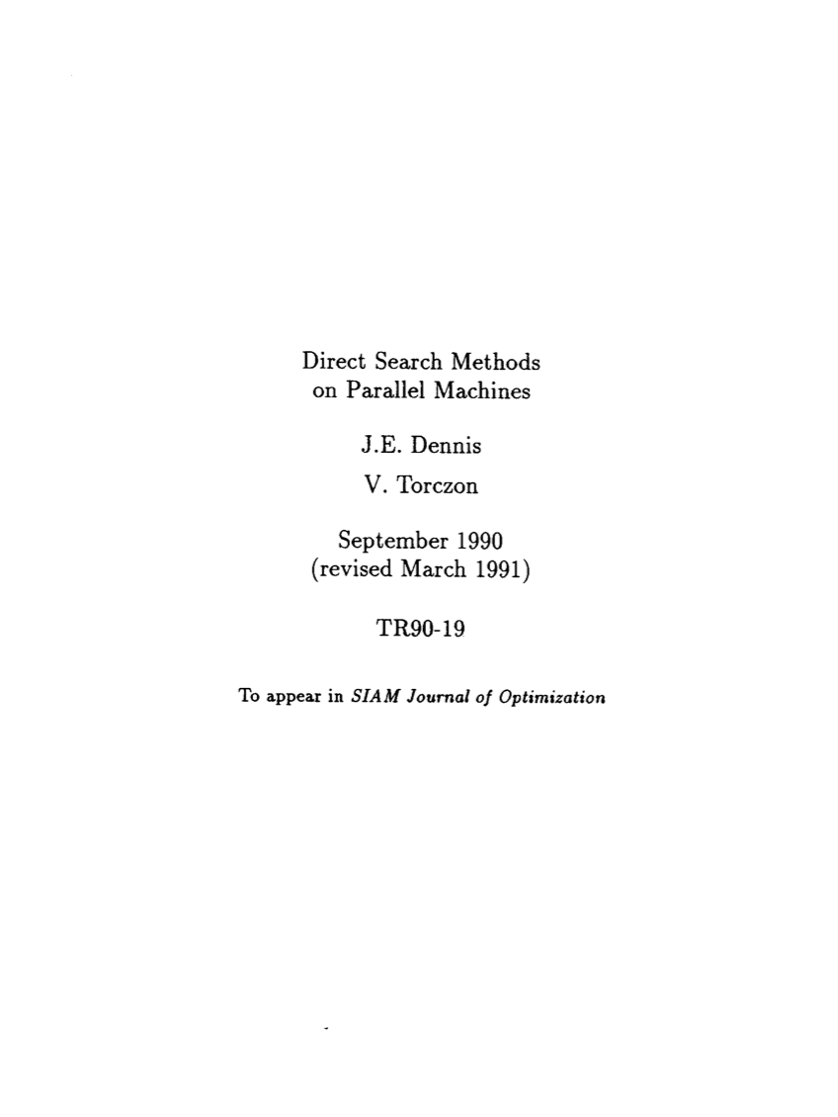

Slide 24
Parallelized Nelder-Mead Options
Speculative
Single large batch
All results influence next batch
Multi-start
Multiple asynchronous tasks
Local results only influence local next steps

Slide 25
Bayesian Optimization
1. Estimate the underlying function
2. Evaluate the point that is most likely to be the optimum of underlying function
3. Update the estimate

Slide 26
Bayesian Optimization Demo

Slide 27
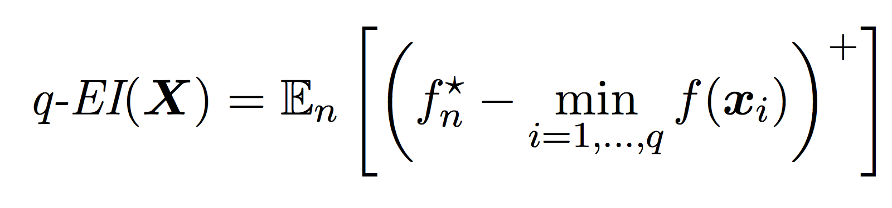
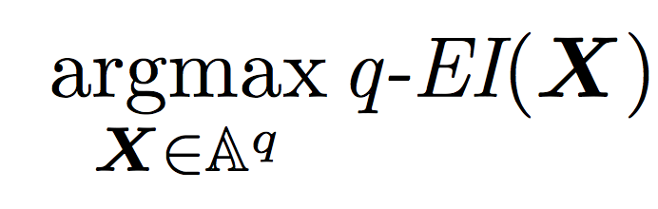
Parallel Bayesian Optimization
Select the set of points that maximize the likelihood of any of them being the new optimum
Unique benefit: Asynchronous with information sharing!
Parallel Bayesian Global Optimization of Expensive Functions
Jialei Wang, Scott C. Clark, Eric Liu, Peter I. Frazier
arXiv:1602.05149 [stat.ML]

Slide 28
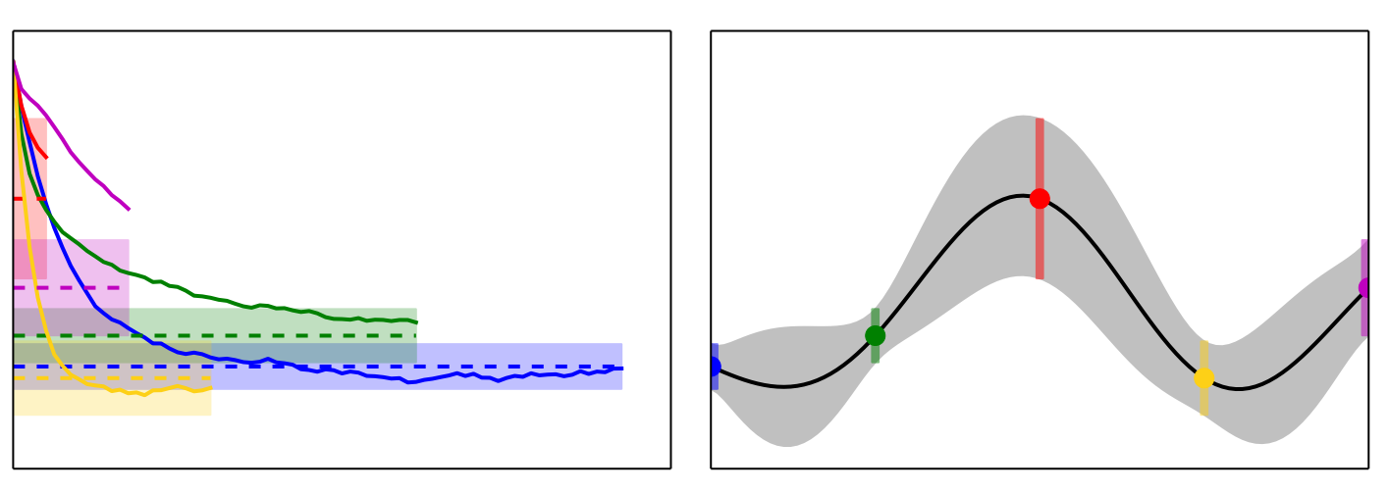
Advanced Parallel BO: Freeze-Thaw
What if you can approximate the objective function early?
Freeze-Thaw Bayesian Optimization
Kevin Swersky, Jasper Snoek, Ryan Prescott Adams
arXiv:1406.3896 [stat.ML]

Slide 29
How to Apply Now

Slide 30
How to apply now?
Packages
  Spearmint
  GPyOpt
  BOAT
Generalized Services
  MOE
  SigOpt
Specialized Services
  Skipjaq

Slide 31
Thanks!
@adereth

