Slide 1
Managing Millions of Data Services @
Gabe Enslein

Slide 2
February 28th, 2017 17:44 UTC

Slide 3
February 28th, 2017 17:44 UTC
Primary Region failure
AWS S3 Outage in Virginia
https://status.heroku.com/incidents/1059
Notes:
https://aws.amazon.com/message/41926/
If screenshot allowed

Slide 4
Dedicated Data Services running on February 28, 2017
Postgresql: ~ 1.5 Million
Redis: ~ 50K
Kafka: ~ 1K

Slide 5
February 28 from 17:37 UTC to March 1 00:18 UTC
AWS S3 service impact officially ended at 21:54 UTC
Other residual effects lasted an undisclosed amount of time
EBS service fulfilling a backlogged requests slowed resolution
AMIs were unavailable due to being stored in S3
It took 5 additional hours to recover
It Could have been so much worse

Slide 6
How can we avoid disasters?
Orchestration for recovering existing services
Immutable infrastructure when failure is not automatically recoverable
CAVEAT: Failover strategies must be in place
Removing manual or script surgery as an option at scale

Slide 7
Who is Gabe Enslein?
Joined Heroku Data late 2016, Careerbuilder before that
Ruby backend services, microservices architecture and DevOps
I was on call during the S3 Incident
Big xkcd fan

Slide 8
Ephemeral services, real hardware
Things to take note of
Layers of abstraction help simplify development
Simplification integration pipeline
Enabling robust deployment strategies
Separating concerns from features and operations

Slide 9
Ephemeral services, real hardware
Be wary of the truth
Ultimately all software runs on hardware
Abstractions can hide the true problems
Mapping symptoms to root causes can take longer
Reproducing failures can be difficult

Slide 10
I’ll just™do this operation...
How often does someone “just”™do this operation?
How likely are they to make a mistake?
Is this going to wake someone up at night?
Is there a way to stop “just”™doing the operation?
Will we operation need the operation in the future?

Slide 11
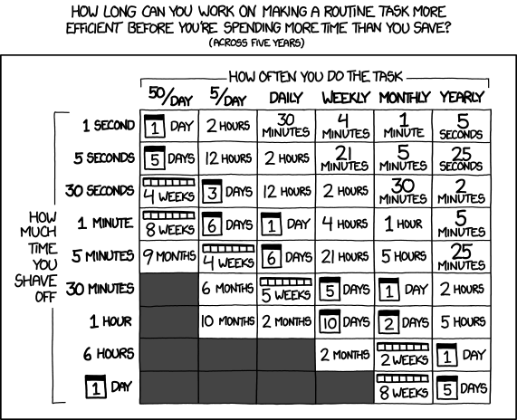
Photo: Is it Worth the Time? By Randall Munroe
https://xkcd.com/1205/
is licensed under CC-BY-NC 2.5

Slide 12
Orchestration

Slide 13
Automate yourself out of a job...but how?
We can generate one-off queries
We make scripts, reusable templates
Configuration Management tools, schedulers, etc.
What about real-time remediation?

Slide 14
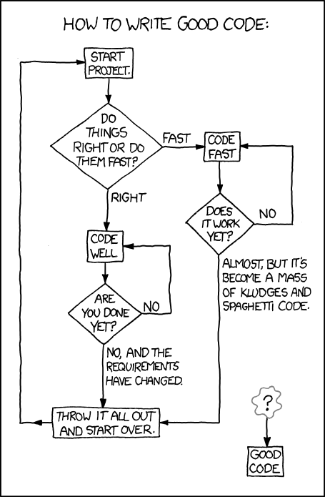
Photo: Good Code By Randall Munroe
https://xkcd.com/844/
is licensed under CC-BY-NC 2.5

Slide 15
Stateful Services, State Machines
Model the management after the objects
Finite State Machines
Deterministic Finite State Machines (DFSM)
Non-deterministic Finite State Machines (NDFSM)

Slide 16
Why use Finite State Machines?
Programmatic control of machines
Easier to model operations for real Services
Reiterable methods of modeling stateful components
Integrated view of relationships
Notes:
Code documented routines to execute
FSMs are abstract versions of machines, like soda machines or elevators
Reuse is high for modeling other components that are stateful
The entire ecosystem relationship in data

Slide 17
Deterministic Finite State Machines
Some Pros
Single direction of state change
A given input can only return one target state
Can only change states after receiving input
State is locked otherwise at the current state

Slide 18
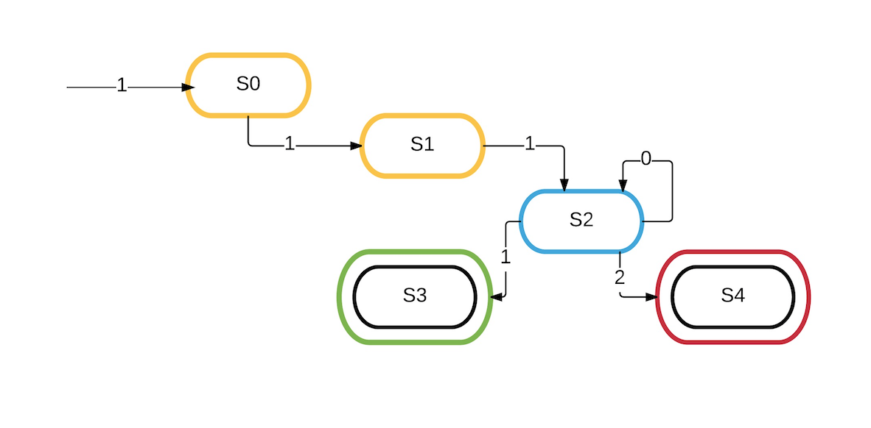
Basic Deterministic Finite State Machine

Slide 19
Deterministic Finite State Machines
Some Cons
State locks can cause stale view of state the object is in
Single direction transitions can make long chains
Repeat State definitions
Multiple reasons the real service can be in a given state

Slide 20
Nondeterministic Finite State Machines
Upsides
Can have multiple transitions from a single input
Can transition without input (loops for days)
Easier to implement retry logic due to bidirectional transitions

Slide 21
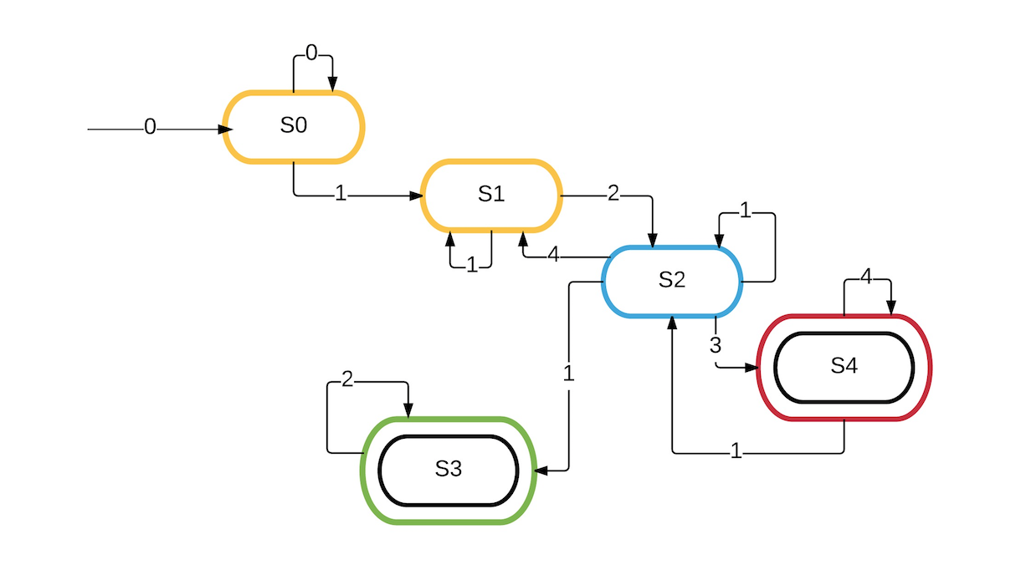
Less Basic Nondeterministic Finite State Machine

Slide 22
Nondeterministic Finite State Machines
Downsides
The lack of assurance of state locks on input
States can transition in less predictable ways
State Machines can interact with input each other

Slide 23
Applying State Machines: Choosing NDFSM
Flexibility is key when dealing with rapidly changing infrastructure
Multiple ways to get into the same problems in the ecosystem
We can implement “optimistic” state locking
More predictability in when transitions occur
We can control how states transition to each other

Slide 24
An Application of NDFSM

Slide 25
An Application of NDFSM: Data Services
Triggering installation of the service and monitor install
Can includes userdata, scripts, upstart, systemd, cron, etc.
Monitor Service health and availability
Check Service-controlled processes and resources on the Server
Transitions are triggered by inputs -> State “ticks”
Ticks queued regularly across each SM to check changes in input (or lack of input)

Slide 26
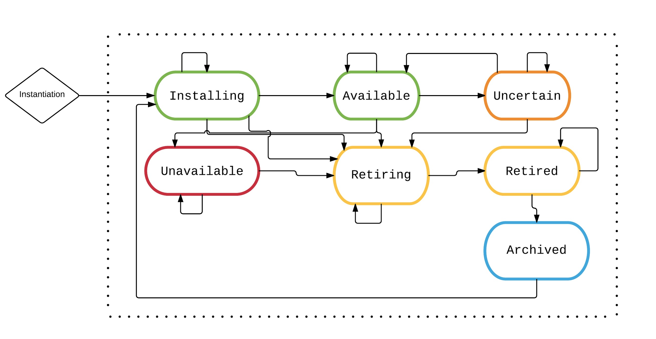
An Application of NDFSM: A Data Service

Slide 27
An Application of NDFSM: A Data Service
All data services are containerized
Assign each Service to a subsequent Server
The Server State machine represents system-level State of the underlying OS
The Server can trigger state changes up to the Service and vice-versa

Slide 28
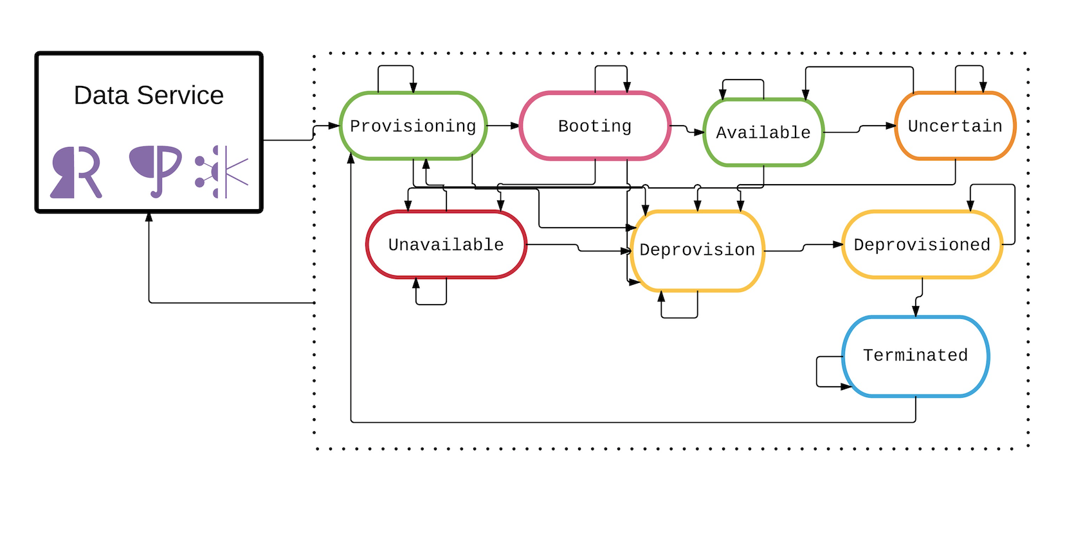
An Application of NDFSM: How the Server interacts

Slide 29
An Application of NDFSM: Servers
The Server State machine represents system-level state of the underlying VM
Constantly monitors health of the base VM
Runs remediations against the system resources
Disk space
RAM usage
etc.

Slide 30
An Application of NDFSM: Operational consistency
Running backup processes
High-Availability replication
Security Credential management
Service performance metric emissions
Many more individual service-type-specific operations

Slide 31
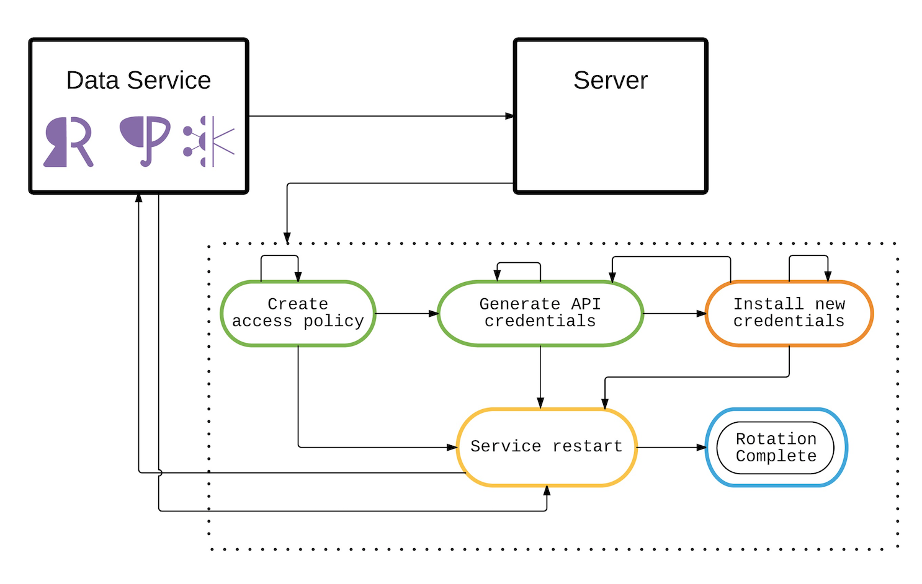
An Application of NDFSM: API credential rotation

Slide 32
An Application of NDFSM: Routine credential rotation
Average runtime of API credential rotation ~2 minutes
Recall Feb. 28th: ~1.55M services (1.5M + 50K + 1K)
Rotations happen every 4 hours (6 times a day)
2 minutes * 6(per day) * ~1.55M services
18612000 minutes = 310200 hours = 12925 days =
35.5 YEARS saved

Slide 33
An Application of NDFSM: Tools to make it possible
Postgres to persist the NDFSMs and their states
Redis for Sidekiq queues holding transition messages
Ruby and Sinatra to serve the orchestration logic
AWS EC2, S3 and EBS (which is also S3)

Slide 34
An Application of NDFSM: Tools to make it possible
Postgresql:
Maintains active snapshots
History of messages
(“Ticks”)
Metadata for each FSM
History of FSM relations
Redis/SK:
Constant queuing for
all FSMs
Partitioned queues for
FSM specific “ticks”
State locks for
contentious operations

Slide 35
An Application of NDFSM: More urgent Ops
Servers control maintaining storage disks on servers
Disks need resizing as part of normal customer usage
Maintenances occur that requiring underlying VMs be sunset
Hardware failures triggering failovers

Slide 36
Applying NDFSM to S3pocalypse: What went wrong
Backup failures to us-east-1 S3 caused servers to fill disks faster than expected
Some services experienced downtime from failed state changes
Inability to acquire new disks kept new services from being provisioned

Slide 37
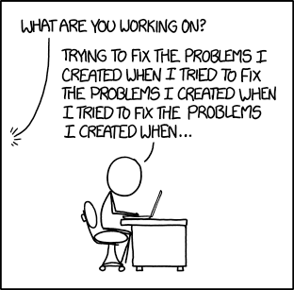
Tested in the wild: Needing manual fixes
Are you sure?
Photo: Fixing Problems,
By Randall Munroe
https://xkcd.com/1739/
is licensed under CC-BY-NC 2.5
Notes:
https://xkcd.com/1739/

Slide 38
Immutable Infrastructure: Stay your hands
Enforces knowledge of the application created at that time
Standardizes mechanisms for maintenance
Discourages just™ doing manual operations
Favor consistent configurations

Slide 39
Immutable Infrastructure: Stay your hands
Favor consistency
instance replacement instead of manual mitigation
Failover strategies for all infrastructure
Encourage seeing Infrastructure as Code
Tests: Unit, Integration and Performance

Slide 40
S3pocalypse resolutions: Missed edge cases
Some services and servers did not recover cleanly
Some gotchas occurred needing engineers live
Needed some scripted fixes
Dependency loops were identified in S3 usage

Slide 41
NDFSM to S3pocalypse: Recovering from the disaster
Most services recovered without any interaction from the operators
State machines similar to the Rotate Credentials example
Services with automated remediation healed once S3 was available
Confirmation that no data loss occurred
And we were able to go to sleep

Slide 42
Photo: Exploits of a Mom
By Randall Munroe
https://xkcd.com/327/
is licensed under CC-BY-NC 2.5

Slide 43
Immutable Infrastructure: Lessons learned
Need to keep “Break Glass” measures for such occasions
More automation, including emergency remedies
Increased testing of reliability cases

Slide 44
The story Continues

Slide 45
March 15, 2017 2:39 PM UTC
The system could be made to crash or run programs as an administrator.

Slide 46
March 15, 2017 2:39 PM UTC
USN-3234-1 (CVE-2016-10229, CVE-2017-5551) Linux Kernel Vulnerability
DoS and Admin escalation vulnerability
What images are running the vulnerability?

Slide 47
Immutable Infrastructure: Security vulnerabilities
CVE-2016-10229, CVE-2017-5551, CVE-2017-2636, CVE-2017-7308, CVE-2017-5551...
As fast as attackers can find and exploit them
How can we Find and
remove in our fleet?
Notes:
http://people.canonical.com/~ubuntu-security/cve/2017/CVE-2017-7308.html
http://people.canonical.com/~ubuntu-security/cve/2017/CVE-2017-5551.html
http://people.canonical.com/~ubuntu-security/cve/2017/CVE-2017-5986.html
http://people.canonical.com/~ubuntu-security/cve/2016/CVE-2016-8645.html

Slide 48
Immutable Infrastructure, as a NDFSM
Whaaat?!?!

Slide 49
Immutable Infrastructure, as a NDFSM
Fleet contains many versions of Containers
Servers have many iterations of AMIs
Features may not be blanketly enabled for certain versions
Our case here
Live patching kernel vulnerabilities: Large risk, small reward

Slide 50
Immutable Infrastructure, as a NDFSM
Container Images and Root Machine Images
Services installed
Security vulnerabilities that are patched
New features available
Bugs fixes rolled
Reliability test results

Slide 51
Great Success: Patching security holes
Service State machine retirements
Vulnerable infrastructure removed
Bad images state transitioned to decommissioned
No services interrupted

Slide 52
Key Takeaways
Make routine failover strategies
Treat infrastructure as full units
Abstractions have their limits
Automate yourself out of regular operations
Have emergency automation in place (scripts, jobs, etc.)

Slide 53
State Machine libraries in lots of languages
http://awesome-ruby.com/#awesome-ruby-state-machines
https://github.com/uhub/awesome-javascript
https://github.com/akullpp/awesome-java#distributed-applications
https://awesome-go.com/#distributed-systems
https://github.com/quozd/awesome-dotnet#state-machines
A few places to get started

Slide 54
Check us out
https://github.com/heroku
https://elements.heroku.com/addons/heroku-kafka
https://elements.heroku.com/addons/heroku-postgresql
https://elements.heroku.com/addons/heroku-redis
https://devcenter.heroku.com/start
Thank you

