Slide 1
Open Source Tools to Build ML into your Apps
QCon NY, June 2017

Slide 2
Notes:
OS languages company, Began in 1997 with ActivePerl for Windows, solving build issues on that platform
Founding member of PSF, ActivePython followed
ActiveTcl as well - small dedicated community, AS hosts the tcl.tk site
Komodo IDE and Free Komodo Edit
After more than a decade, new language distributions, ActiveGo, with ActiveRuby beta just launching tomorrow

Slide 4
Machine Learning
What do we mean when we talk about ML?
Notes:
Not differentiating between Deep Learning and ML, Deep Learning is a subset

Slide 5
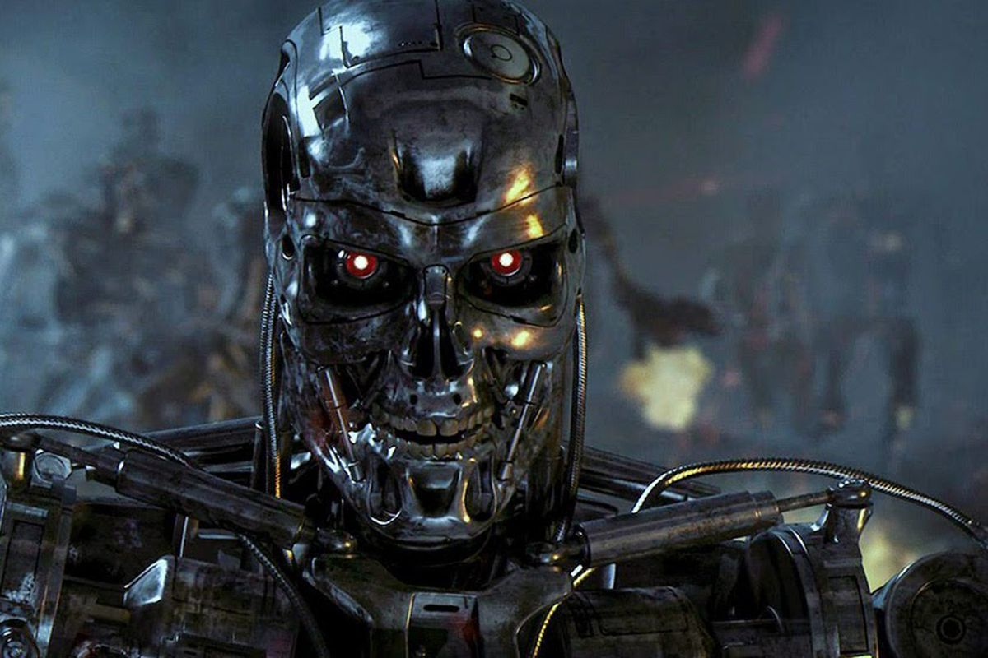
Notes:
We don’t mean this guy, people immediately think of SkyNet when talking about AI/ML, evil robot overlords, etc.

Slide 6
Machine Learning
Learning algorithms for training models:
Linear Regression
Logistic Regression
Support Vector Machines
Neural Networks
etc.
Notes:
ML is primarily a technique related to adaptive algorithms
Techniques have largely been around since the 50s/60s
Only recently has data and CPU power, GPUs made it really feasible for applications
Some of these algorithms are simple and widespread - Excel has a Linear Regression function built in

Slide 7
Machine Learning
Current use cases...too many to list!
Watson
Stanford Medical
WoeBot
Image Style Transfer
Google Apps
Sheets, Translate, etc.
Amazon Recommendations
Siri, Cortana
Virtual Assistants
...literally moving faster than you can keep up with.

Slide 8
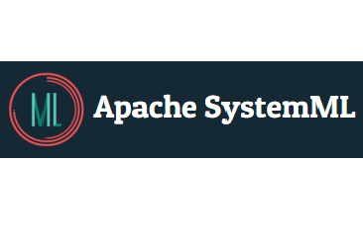
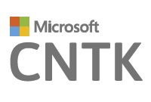
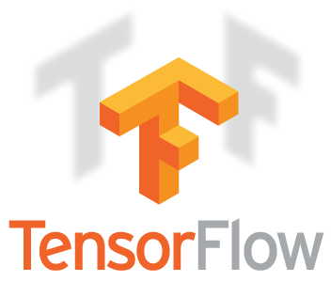
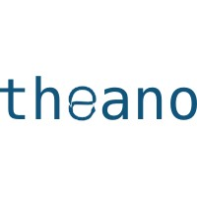
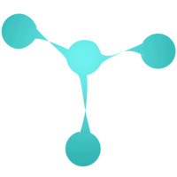
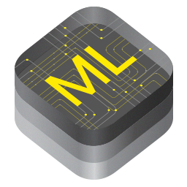
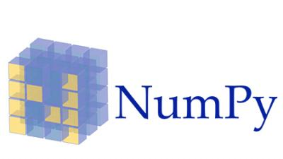
Machine Learning Ecosystem
Notes:
Explosion of projects and developments
In the past month, SystemML (Apache), CoreML (Apple), countless smaller projects
Lots of big players, well supported projects in here
Many of these large companies are effectively restructuring to put ML/AI as their core focus

Slide 9
Democratization of ML
Code
(OSS, GitHub, StackOverflow)
Publishing
(App Store, eCommerce)
Ops
(AWS, Docker, Kubernetes)
Intelligence
(ML, “Big Data”)
The Internet
(Communication, Information Processing, Data)
Notes:
Internet continued a trend of increasing democratization of technologies
Grants access to better communication, information processing, data for everyone
Code democratization - from a fringe activity to ubiquitous and accessible
Took ages, struggled in isolation learning to code, limited access to resources, and limited toolsets/libraries
How much duplication, etc.
Publish - selling direct to consumer, direct user feedback
Ops - virtual datacenters
Intelligence - now building specialized intelligence with human-like capabilities is being put into the hands of the masses
Made possible both by advances in computing power and the availability of tonnes of data - AND the availability of the tools is building on the previously mentioned revolutions - GitHub, AWS, eCommerce - these things make it possible to have an ecosystem of tools that can deliver on this

Slide 10
Democratizing Forces in ML
Tools: Keras, TensorFlow
Services: Google Brain/Cloud, Azure, Amazon Compute, TPU
APIs: TensorFlow Models, IBM Watson, Apple CoreML
Data: Open Data Initiatives
Notes:
Same democratization process underway in ML, see it in action with Tools - high quality, well supported tools that are available to everyone
See the availability of services that give access to incredible amounts of computing power (albeit for a price)
APIs, data, so models free to download - you don’t even have to understand anything about ML, you can just use a pre-trained object identification model or something, or, you don’t have to have access to massive library of data, universities like Stanford, and many open data initiatives

Slide 11
Democratization of ML
Not just standalone for data analysis
Moving to operationalize ML in Apps
Commodifying ML Models
Notes:
ML not just a sandbox application, not only for business intellligence, data analysis
Operationalization of models
Operationalize by integrating ML directly into apps, live code
ML in apps offers critical biz advantage,
ML Models being turned into deployable, operationalizable items of their own right

Slide 12
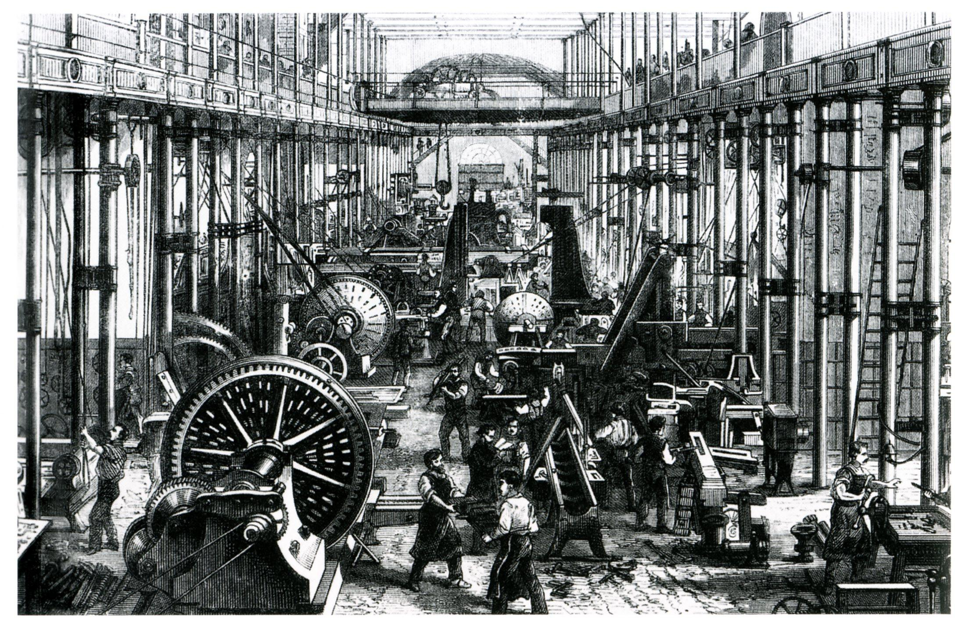
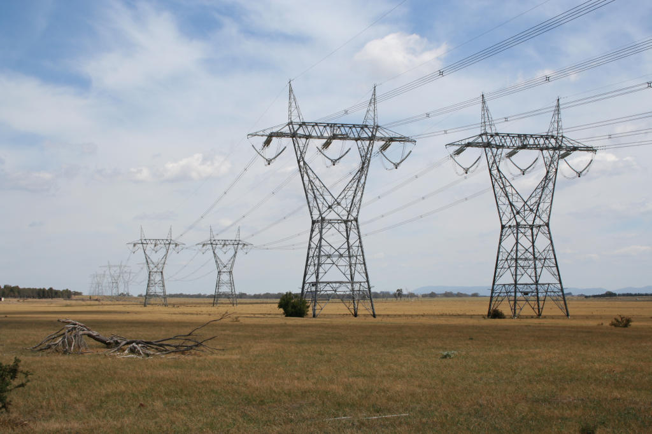
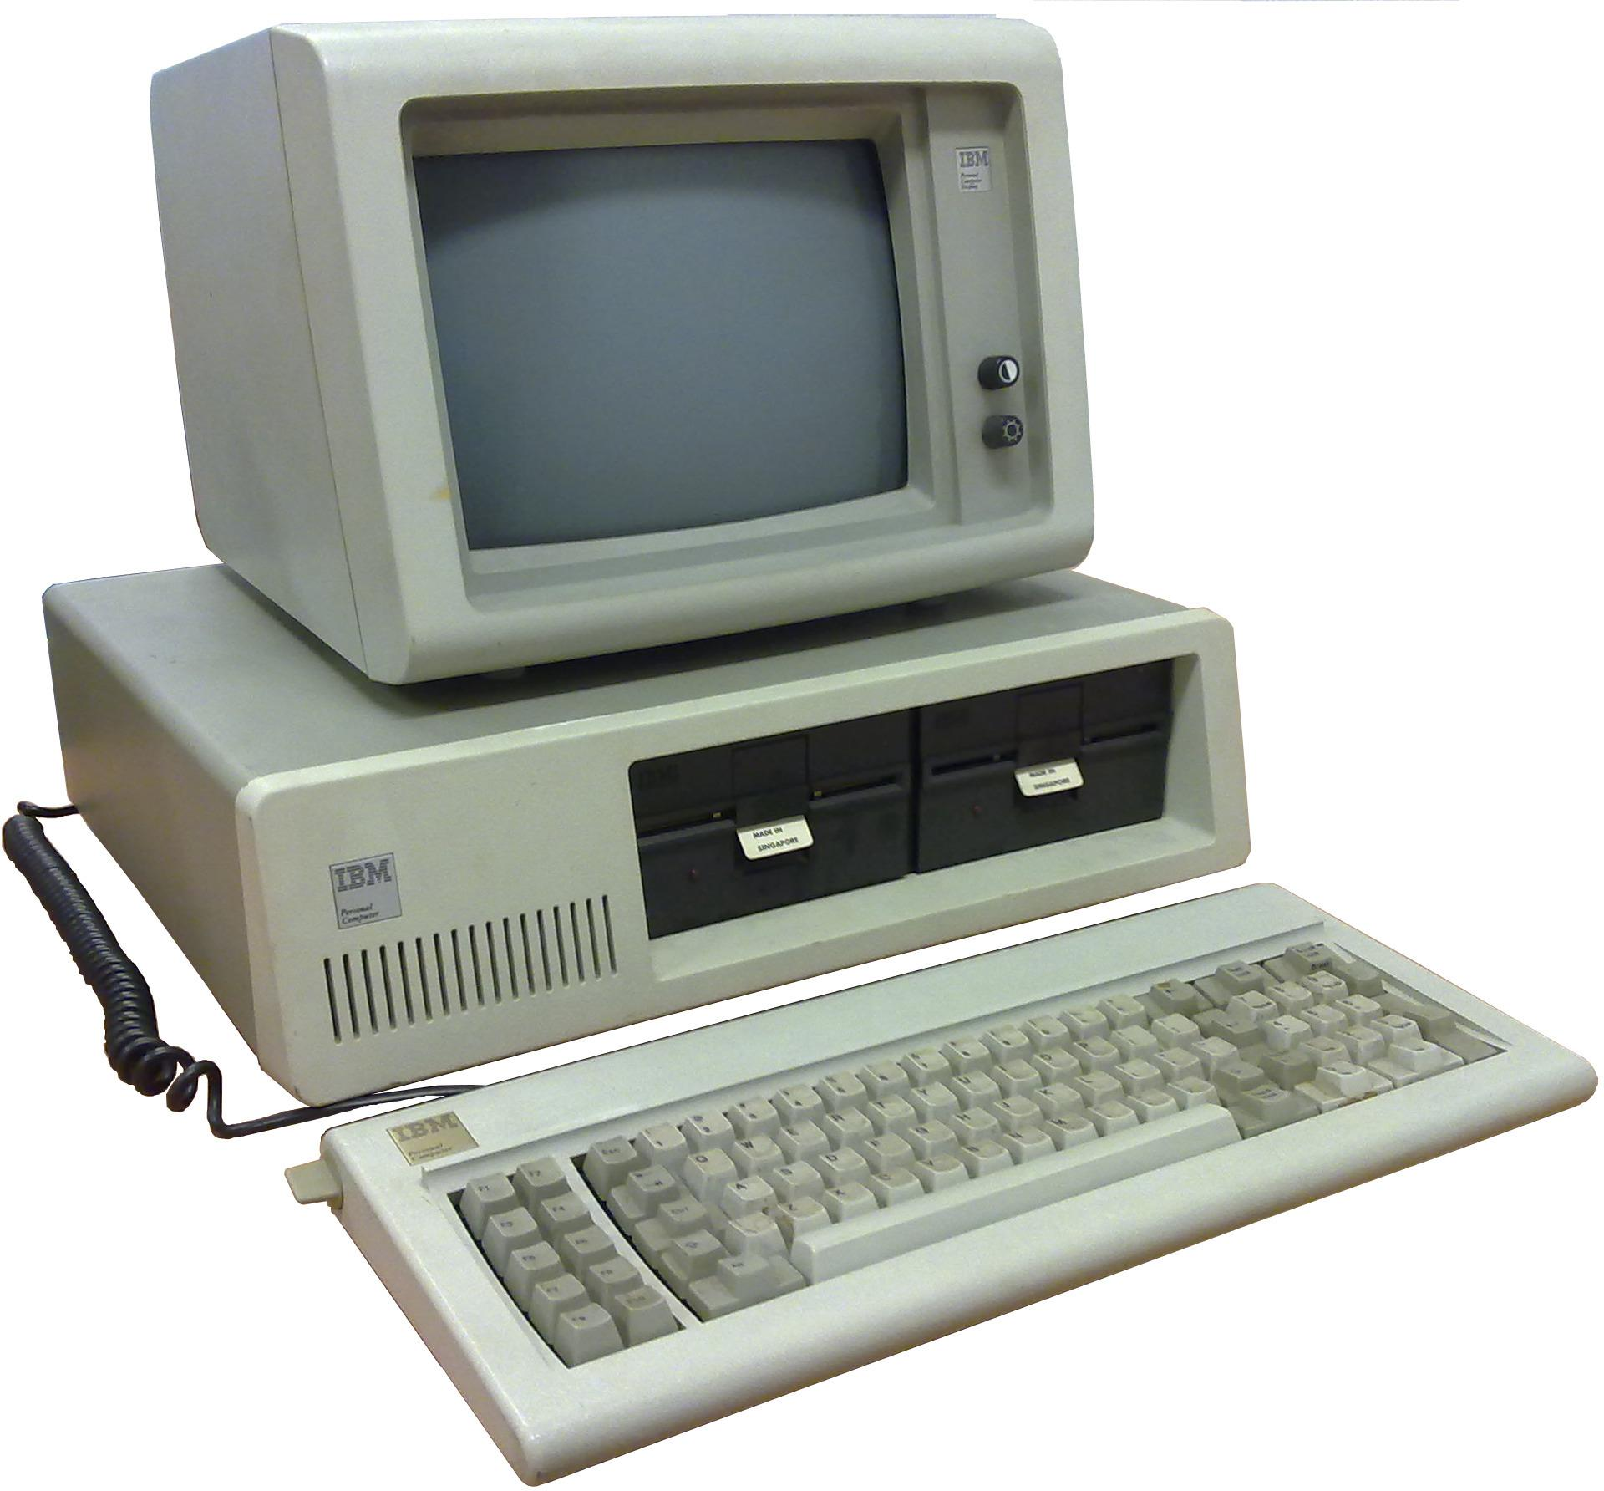
The next big Platform?
ML as not just a platform, but the next major revolution in society.
Notes:
“The next industrial revolution” (Sundar Pichai, Google’s CEO)
“AI is the new electricity” (Andrew Ng)
Process of Digitization->Data, this is effectively what the machine can ‘sense’ or ‘know’ - data, so as we digitize everything this expands what is knowable by machines
~1 second of thought is roughly right now what we reliably automate using ML - any task that takes roughly 1 second of thought by a human
Obviously you can chain these together to do more complex tasks

Slide 13
Languages for ML
Languages used for ML:
R
Python
Octave
Go
Lua
...many more!
Notes:
Some of these like R, Octave are statistical languages that have a lot of the tools for doing ML and sandbox applications
But not all are application languages, or have the right ecosystem in place to operationalize your models

Slide 14
App Languages for ML
Python as the clear leader, many APIs for other use cases
Go new to the space, also has good interfaces to TensorFlow
Lua w/ Torch
Notes:
Python has a clear lead with interfaces and robust tools for all ML packages and added benefit of ability to integrate with applications and a wide ecosystem of web packages, microservices, games, GUI, you name it
Go is new and is an excellent server and systems language with a growing library of tools, its advantage of course is compiled code and speed.
Going to see some C, Swift because of CoreML and the libraries written in C.

Slide 15
ML Workflows
Deploy in Language bound to ML runtime (eg. Tensorflow)
Train Model from Data in Python
Export Trained Model
Notes:
Using Python to Train models, and then import them to whatever language is common.
Use case for Go, or CoreML
Deployment vs. Sandbox

Slide 16
ML Workflows
Choose a pre-trained Model for use-case
Deploy in Language bound to ML Runtime (eg. Tensorflow or CoreML)
Notes:
Use a pre-existing, pre-trained model and just feed your data into it - ready to deploy.
Tensorflow is doing this - Google just released an object recognition model
CoreML doing this for common use cases (Natural Language, Image Recognition, etc.)
The only challenge is getting your data into the format that it expects - common for easy to “feed” models like image recognition where you just feed it raw images

Slide 17
ML Workflows
Deploy in Language bound to ML runtime (eg. Tensorflow)
Train Model from live ops data
Realtime Training/Deployment
Notes:
Doing realtime operationalization where your trained model is either reinforced by live data, or constantly retrained using live operational data
This is common with recommendation engines like Amazon, Netflix, etc. where your users habits are training a recommendation model
This is also the demo case we’ll walk through today in a very simple manner, where we will train an AI to play a game

Slide 18
Popular ML Libraries
SciKit-Learn
Built on NumPy, SciPy, matplotlib
Very actively maintained
Supports Classification, Regression, Clustering
Accessible
Python lib

Slide 19
ML Libraries
Theano
Popular in deep learning, not explicitly an ML package but optimized for eval mathematical expressions
Supports GPU
Python

Slide 20
ML Libraries
TensorFlow
Google’s library for ML
Expresses calculations as a computation graph
GPU/CPU Support
Many language bindings
Supports/provides pre-trained models

Slide 21
ML Libraries
Keras
High-level ML wrapper that supports Theano and TensorFlow backend
Python
Accessible, rapid development

Slide 22
ML Libraries
Torch
Lua
Accessible, high-level
Scientific computing, Neural Networks
GPU Support
C core, interface via LuaJIT

Slide 23
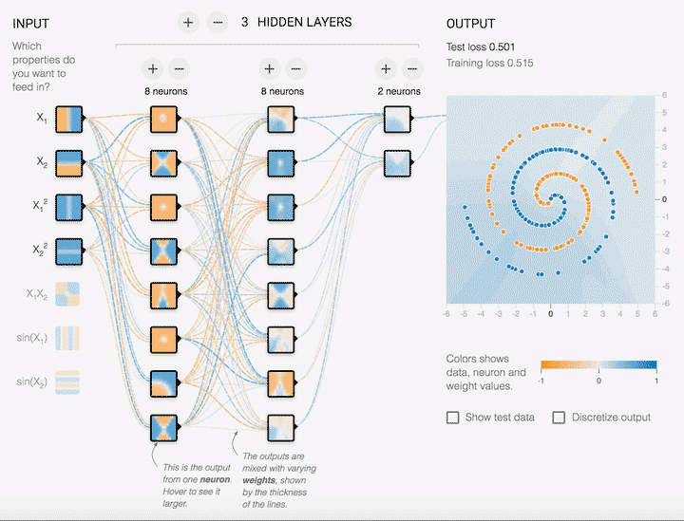
ML Visualization
Notes:
Tensorboard is built into TensorFlow and is relatively easy to enable since it uses effectively a live log parsing system to visualize your model

Slide 24
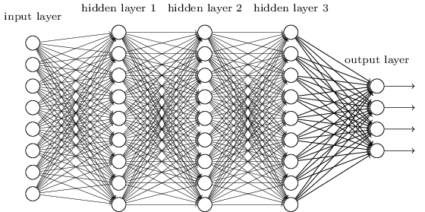
ML Visualization
Notes:
Matplotlib is a very extensively used plotting library for Python for visualizing any kind of data, graph, etc.

Slide 25
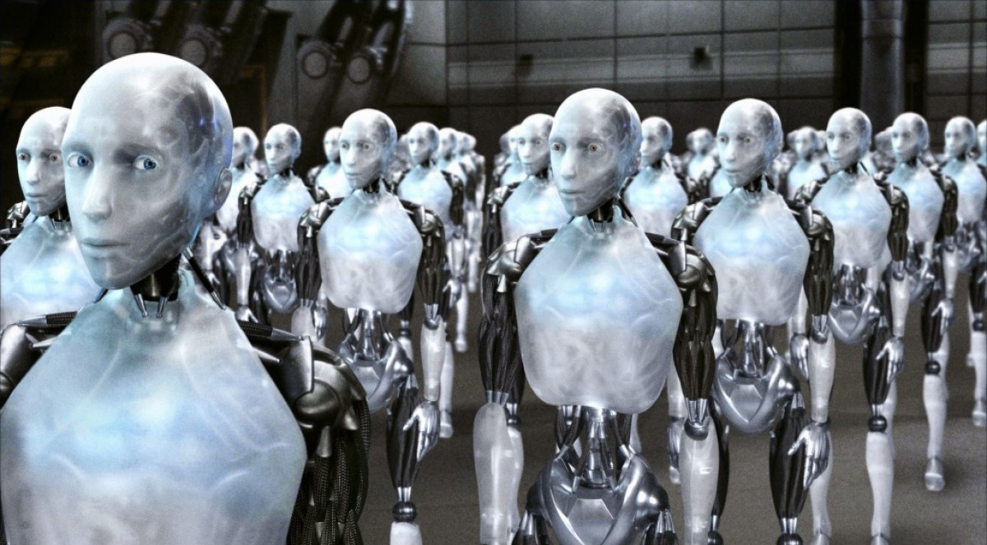
DIY Robot Army, sort of.
Notes:
So what if we DO want to build an army of robots who are trained to attack humans?
You have to start small, so let’s start today by building a game where we train an AI to shoot at a human with reasonable accuracy.

Slide 26
Integrating ML
Work with Python to integrate ML into a simple app
Using Keras for high level, accessible, ability to focus on problem
TensorFlow backend is fast + standard
Live training workflow

Slide 27
Integrating ML
Problem: train an AI to play against a human in simple shooter game
How do we model this?

Slide 28
Integrating ML
Data modelling important
ML is not magic, and you still need some expertise in how to ask the right questions

Slide 29
Integrating ML
Our data model:
Dx,dy,du,dv
Binary classifier
Shoot/Not shoot
Simple Neural Network

Slide 30
Dx = Difference in X
Dy = Difference in Y

Slide 31
Du = Difference in X velocity
Dv = Difference in Y vel

Slide 32
Hit = 1
Miss = 0
???

Slide 33
Keras Terminology
Some definitions:
Dense
Activation
Optimizer
Loss
Epochs

Slide 34
Keras Terminology
Dense
Densely connected layers, where every node is connected to every other node
Each node in each layer is connected to every other node in the next layer.

Slide 35
Keras Terminology
Sequential
A set of layers connected in series
Layers connected in a sequence.

Slide 36
Keras Terminology
Optimizer
Optimization algorithms for network
SGD (Gradient Descent)
Adam
etc.

Slide 37
Keras Terminology
Loss Function
Method of calculating errors
Mean squared error
Binary cross-entropy
etc.

Slide 38
Keras Terminology
Epoch
One pass over the full data set
More passes = more refined
Notes:
...generally speaking

Slide 39
Model Setup Code
# create model
self.keras = Sequential()
# Configure the Keras Model
self.keras.add(Dense(4, input_shape=(4,), activation='relu'))
self.keras.add(Dense(6, activation='relu'))
self.keras.add(Dense(4, activation='relu'))
self.keras.add(Dense(4, activation='relu'))
self.keras.add(Dense(1, activation='sigmoid'))
self.keras.compile(loss='binary_crossentropy', optimizer='adam', metrics=['accuracy'])
Notes:
Outline technique, reasoning for choosing layers, overfitting, underfitting, how to visualize and test this

Slide 40
Training the model
One line of code:
self.keras.fit(x,y,epochs=150,batch_size=10)

Slide 41
Sample Training Data
Sample data, raw:
Dx: 45 Dy: 200 Du: -6 Dv: -10
Normalized data:
Dx: 0.1 Dy: 0.25 Du: -0.04 Dv: -0.2
Notes:
...then each of these input vectors have an output vector associated that is just a 1 or a 0 that signifies a hit or a miss
If we could visualize this, 4 dimensional input vector, it would be very spiky because we only have 1s or 0s on the Y axis, but let’s imagine it just as X/Y
Say using the relative x-distance, it will fall off pretty quickly from zero, where they are perfectly lined up

Slide 42
Making it decide
“Thinking”
Again, one line of code:
self.brain.keras.predict(np.array([list((dx,dy,du,dv))]))>=0.5)

Slide 43
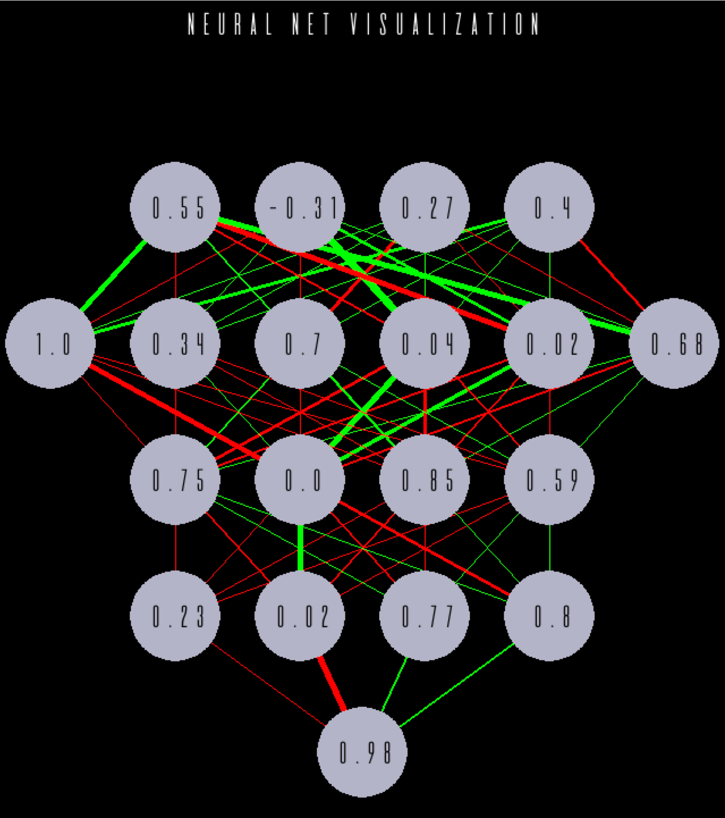
Visualizing the Network

Slide 44
Training the Model

Slide 45
Model in Action

Slide 46
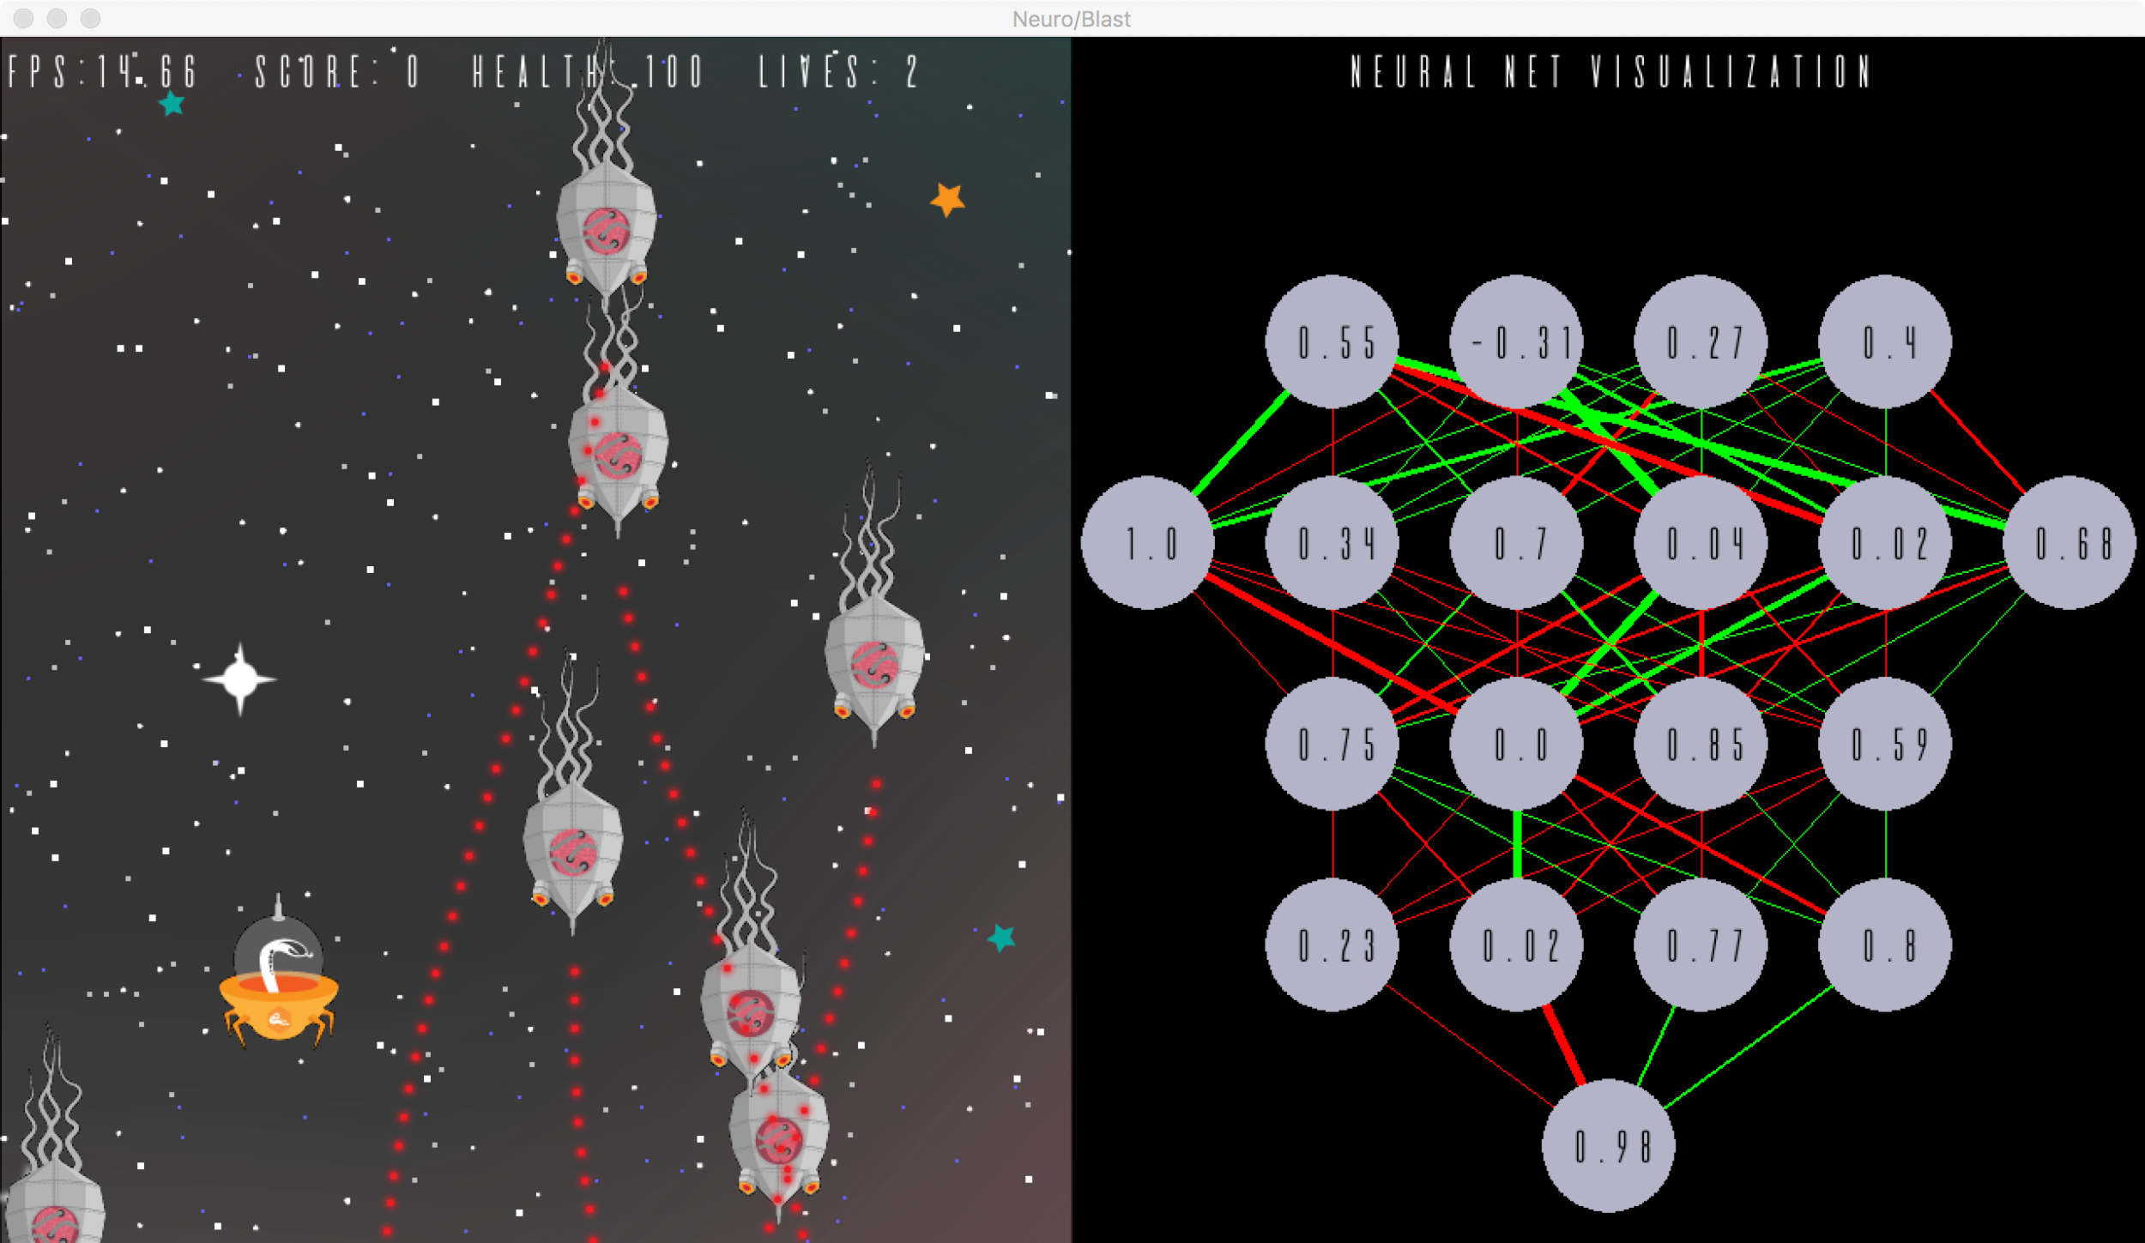
Model - Positive

Slide 47
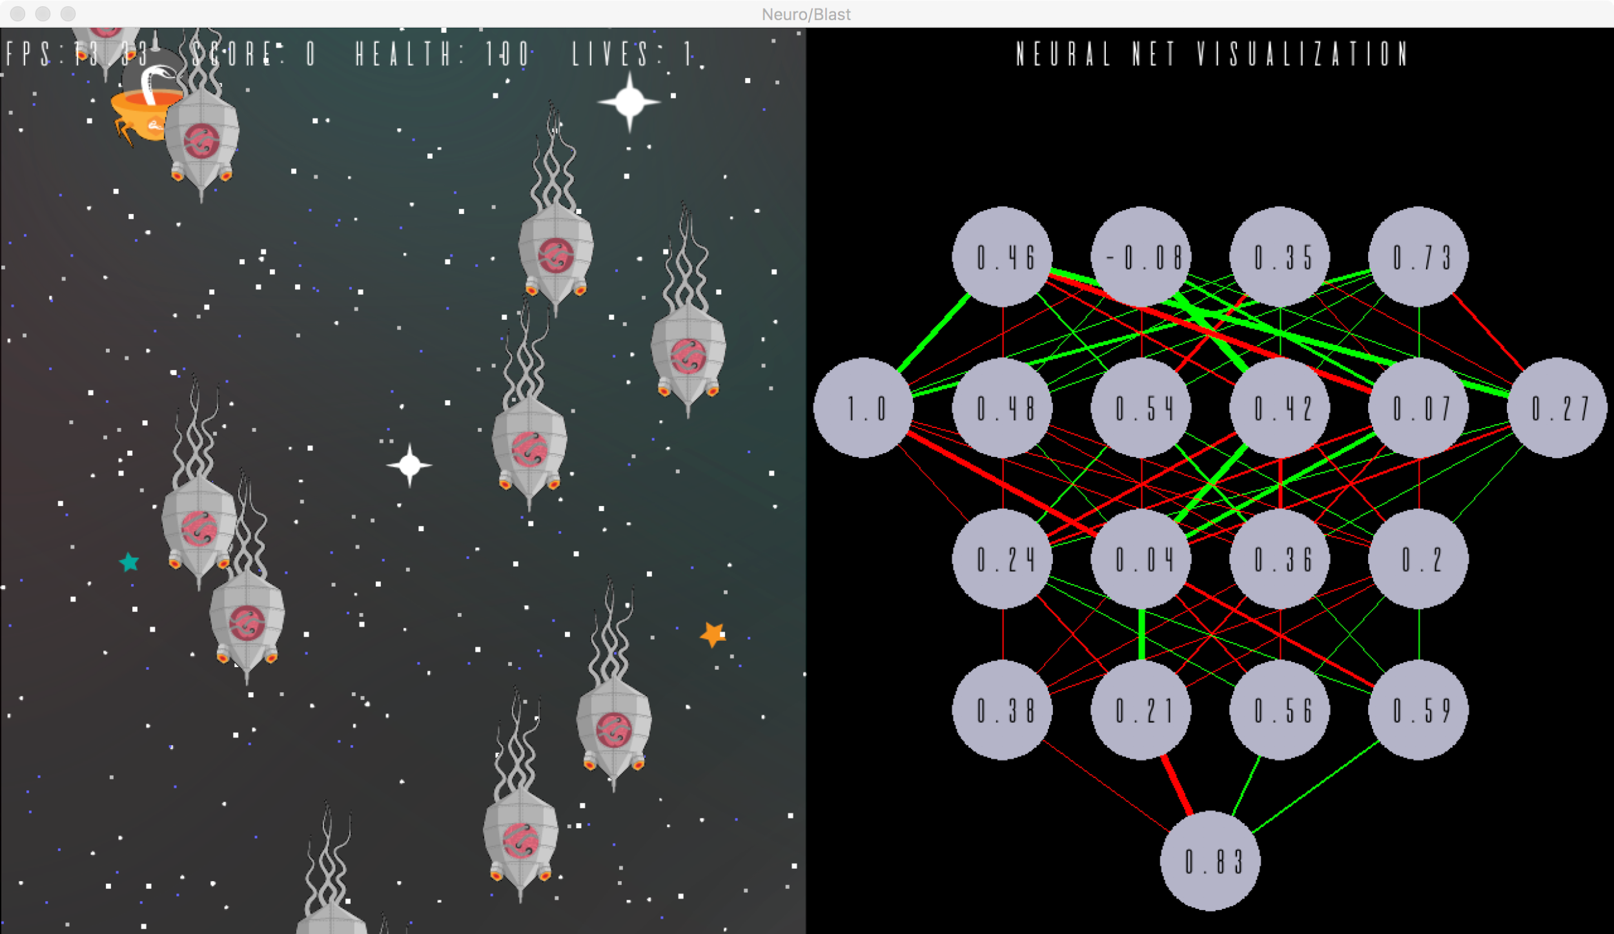
Model - Negative

Slide 48
Learning
Tools like Keras make it super easy to implement/integrate
The ML part is barely any code
Data manipulation is not much more
Extremely powerful results
Very performant, can run multiple instances in realtime
Notes:
Simple, fun example, not intended to be shippable, some obvious improvements to be made here, including giving a cost to firing, tracking the user (although that may end up being too hard as it will likely track you perfectly).

Slide 49
Moving Beyond
Easy to see applications in almost any field
Easy to see that mature, well maintained, open source, free tools provide a very smooth path to integration into your own applications

Slide 50
Moving Beyond
Doesn’t require major infrastructure or rewrites
Bindings for many languages, highly performant, already deployed tools

Slide 51
Moving Beyond
Ultimately all businesses will utilize ML to some degree
Pace of change is astronomical, new developments appearing literally daily
As a result, tools are advancing rapidly, and have very active development
Notes:
ML, leveraging data insights provides a disproportionate advantage at this stage

Slide 52
Summary
Large number of mature, stable, efficient libraries available
Easy to learn, integrate and deploy into existing applications
Active communities backed by large players (Google, Microsoft, Apple, Amazon, Apache)

Slide 53
Q&A
Thank you!
peteg@activestate.com
@rawktron

