Slide 1
More Reliable Delivery
Monte Carlo and Story Mapping

Slide 2
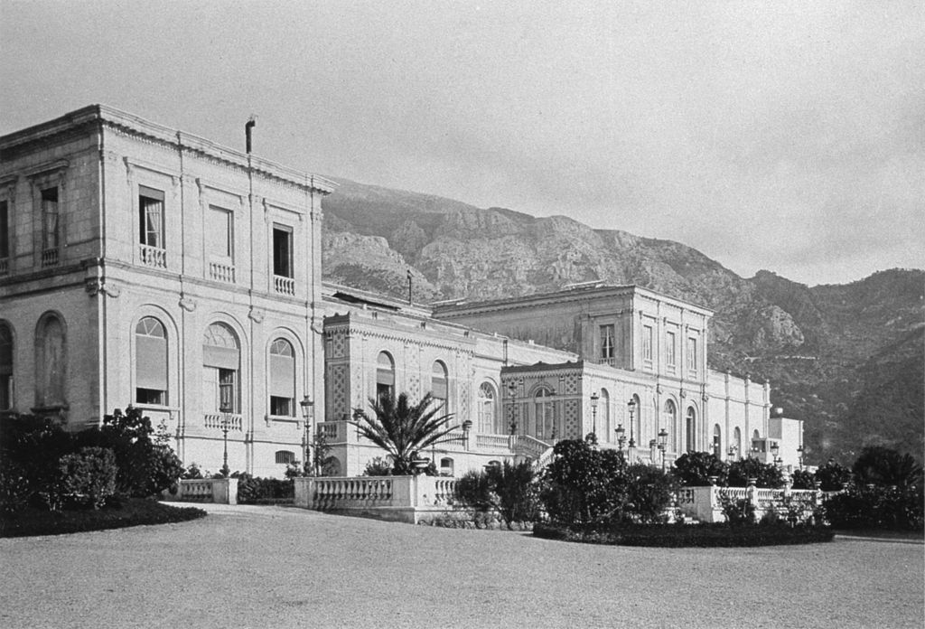
Joseph Jagger
Notes:
I like to start with a story. Everyone can probably guess what this building is – the casino at Monte Carlo. Joseph Jagger was a machinist and engineer in Yorkshire in the mid-1800s. Having worked with machines, he knew how imperfect they could be. At this point in history, we’re only [60] years removed from Eli Whitney mastering interchangeable parts in his musket assembly process. Prior to this, everything had be built by an artisan; every piece was more-or-less one of a kind.
Now, Jagger knows this, and has a hunch that the betting machines at casinos can’t possibly be as random as simple math would tell us: specifically, the roulette wheel. So, in 1873, he packs up and heads to Monte Carlo. He hires 6 assistants to watch each roulette wheel and write down every number that comes up throughout the day. At night, he analyzes the numbers to see if he can detect any patterns. 5 of the wheels don’t have any, but the final wheel has a handful of numbers that pop up more frequently than you would expect. So, he bets, and in the ensuing days racks up $300,000 in profit. Obviously, the casino would like to stop this, but it also wants it’s money back, so it subtlely rearranges the room. The 6th wheel that Jagger was betting no longer produces any winnings, but Jagger cleverly finds where it was placed and begins winning again. The desperate casino then starts moving the frets on the wheel every night, forcing Jagger into retirement, up about $5 million in today’s dollars.
Jagger beat the system, and the hypothesis that drove him to it is the same one that we’re going to explore today: given a sample, can we accurately use past performance to predict the future results of our system?

Slide 3
Planning Today
Expert-Based Estimation
Points
Buckets
Relative Sizing
Marathon meetings
Apathy
No predictability
Notes:
The reason And we want to talk about this because really, there is so much frustration in planning meetings today.
How many people here run some sort of agile/lean process?
How many of you are actually satisfied with how your planning goes?
Typically, we see:
Frustration, at the length and ambiguity
Apathy at the planning itself
Techniques: points/ t-shirt sizes, relative sizing,

Slide 4
Overview
Explore Monte Carlo simulations
How planning should be
Takeaway tool
Notes:
By the end of this, I hope you have enough of a background to understand why and explain this effectively to your organization, as well as enough material to think about implementing this.

Slide 5
Monte Carlo, Demystified

Slide 6
The Process
Define a domain of possible inputs
Generate inputs randomly from a probability distribution over the domain
Perform a deterministic computation on the inputs
Aggregate the results
Forecast
Notes:
In short: get data, make your sample larger, calculate your statistic, compare the results, then forecast

Slide 7
Two Rules
Every forecast includes a date range
Every forecast includes a probability of hitting that date range
Notes:
Douglas Hobbard’s How to Measure Anything
When we’re dealing with uncertain inputs, we need to represent the outcome as a distribution

Slide 8
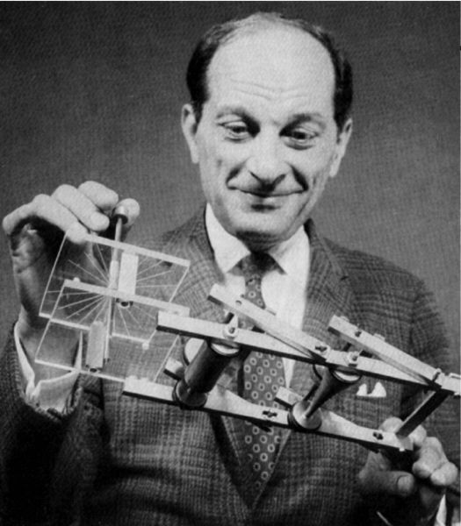
Origins
Stanislaw Ulam, 1949
Notes:
*Technique for projecting user stories based on past completion times
*Provides a range of probabilistic outcomes, rather than a deterministic date
Stanislaw Ulam, mathematician on the Manhattan project and at Los Alamos post-war, was sick in a hospital bed playing solitaire. He wondered, as mathematicians are wont to do, what the probability was of winning any game given a random shuffle. It ws later termed a Monte Carlo simulation, after his uncle who would say “he just had to go to Monte Carlo”
https://en.wikipedia.org/wiki/Stanislaw_Ulam#Monte_Carlo_method

Slide 9
Define
Cycle/Lead Time
Takt Time
Work In Progress
Velocity
Story Points
Notes:
Velocity is the number of backlog items or points per iteration
Which one you use hinges on how you work.
Both measure speed and throughput, but we’re moving to something that can be more predictable than velocity. These are sometimes referred to as “Flow Metrics”, but that’s a little misleading since you don’t need to be using a flow (Lean/Kanban) process to measure these things.
Your process should not suck! Make sure you track interrupts, know when stories start or complete, and don’t just discard work.

Slide 10
Define
Metric | Measurement
Lead Time | Time Work Done – Time Requested
Cycle Time | Time Work Done – Time Work Started
Takt Time | Time Between Delivered Work Items
Work in Progress | Count of Work Items in Progress
Notes:
The difference between lead time and cycle time can be trivial based on your definitions of lead/cycle times.
The important thing is to measure these! Define the boundaries and make sure your work follows the process. Nothing will make your process predictable and your delivery reliable if you don’t keep your ALM or your visual board updated, and if you aren’t moving work consistently through your workflow steps

Slide 11
Define
Days
Cycle Time = 2
Takt Time = 2
Cycle Time = 5
Takt Time = 3
Cycle Time = 8
Takt Time = 3
Notes:
Here we need to talk about some assumptions in your system.
For cycle time, we need to specify the entry and exit criteria. Entry can typically be just a certain status, while exit criteria should be when the story is fully-released in whatever the final environment is

Slide 12
Measurement
Sprint #1
Story | Cycle Time | Takt Time
Story #1 | 2 | 2
Story #2 | 5 | 3
Story #3 | 8 | 3
Average: | 5 | 2.66

Slide 13
Define
Program/Project/Feature
Sprint | Cycle Times | Takt Times
Sprint #1 | 2,5,8 | 2,3,3
Sprint #2 | 3,4,5 | 2,1,1.5
Sprint #3 | 5,8,8 | 3,0,9
Average: | 5 | 2.70
Notes:
Average is 5, but that will change

Slide 14
Cycle Times
4 | 5 | 4 | 5 | 2 | 5 | 2 | 4 | 3 | 2 | 2 | 8 | 4 | 8 | 5
8 | 5 | 5 | 8 | 8 | 2 | 8 | 8 | 8 | 5 | 5 | 8 | 5 | 4 | 5
3 | 5 | 3 | 8 | 8 | 2 | 5 | 5 | 5 | 5 | 5 | 8 | 2 | 8 | 8
8 | 8 | 3 | 4 | 5 | 5 | 3 | 8 | 5 | 5 | 4 | 3 | 8 | 4 | 8
5 | 5 | 5 | 8 | 5 | 8 | 5 | 5 | 2 | 5 | 4 | 2 | 5 | 2 | 5
8 | 2 | 4 | 2 | 8 | 3 | 8 | 5 | 2 | 3 | 4 | 5 | 8 | 5 | 8
8 | 8 | 5 | 8 | 5 | 5 | 3 | 5 | 8 | 8 | 8 | 8 | 2 | 2 | 8
4 | 4 | 3 | 5 | 5 | 8 | 5 | 2 | 3 | 8 | 5 | 5 | 3 | 5 | 8
8 | 5 | 8 | 8 | 8 | 5 | 8 | 5 | 3 | 3 | 2 | 8 | 8 | 4 | 5
5 | 8 | 5 | 8 | 3 | 8 | 5 | 5 | 5 | 3 | 8 | 4 | 8 | 3 | 2
8 | 5 | 8 | 5 | 4 | 8 | 8 | 8 | 2 | 5 | 5 | 8 | 8 | 5 | 8
4 | 3 | 8 | 8 | 3 | 8 | 5 | 5 | 5 | 3 | 2 | 3 | 8 | 8 | 5
4 | 3 | 8 | 8 | 3 | 8 | 8 | 5 | 4 | 2 | 8 | 5 | 5 | 8 | 4
8 | 5 | 5 | 5 | 4 | 5 | 5 | 4 | 3 | 8 | 8 | 5 | 3 | 2 | 5
5 | 2 | 8 | 8 | 8 | 8 | 5 | 4 | 5 | 4 | 8 | 5 | 5 | 2 | 5
5 | 3 | 5 | 5 | 8 | 5 | 5 | 5 | 5 | 4 | 4 | 8 | 5 | 5 | 5
5 | 8 | 8 | 5 | 5 | 3 | 5 | 5 | 8 | 2 | 4 | 5 | 5 | 4 | 5
2 | 8 | 5 | 5 | 8 | 8 | 5 | 8 | 8 | 5 | 8 | 5 | 5 | 5 | 2
5 | 3 | 2 | 5 | 5 | 4 | 5 | 5 | 5 | 5 | 3 | 5 | 4 | 5 | 5
8 | 5 | 5 | 5 | 8 | 5 | 8 | 8 | 2 | 5 | 8 | 5 | 5 | 5 | 4
8 | 4 | 2 | 2 | 5 | 3 | 5 | 8 | 5 | 8 | 5 | 5 | 4 | 5 | 5
5 | 5 | 8 | 8 | 4 | 8 | 8 | 3 | 8 | 8 | 4 | 8 | 4 | 3 | 4
4 | 3 | 8 | 8 | 8 | 5 | 8 | 4 | 8 | 8 | 5 | 8 | 8 | 5 | 8
4 | 8 | 3 | 5 | 5 | 5 | 4 | 5 | 5 | 5 | 8 | 8 | 8 | 5 | 5
5 | 8 | 5 | 8 | 5 | 8 | 8 | 8 | 5 | 4 | 3 | 8 | 3 | 3 | 8
4 | 5 | 8 | 2 | 8 | 2 | 3 | 4 | 5 | 8 | 8 | 4 | 8 | 8 | 8
8 | 3 | 8 | 5 | 8 | 3 | 8 | 2 | 3 | 3 | 3 | 5 | 8 | 8 | 5
8 | 8 | 5 | 5 | 5 | 4 | 8 | 2 | 2 | 3 | 3 | 4 | 8 | 4 | 3
5 | 5 | 5 | 4 | 3 | 8 | 5 | 8 | 3 | 2 | 8 | 8 | 3 | 3 | 8
4 | 8 | 3 | 8 | 3 | 5 | 5 | 8 | 2 | 3 | 8 | 4 | 5 | 5 | 8
Notes:
This is bootstrapping.

Slide 15
Two Rules
Every forecast includes a date range
Every forecast includes a probability of hitting that date range
Notes:
Douglas Hobbard’s How to Measure Anything
When we’re dealing with uncertain inputs, we need to represent the outcome as a distribution

Slide 16
Perform
Simulated Project | Avg. Cycle Time
1 | 3.78
2 | 6.67
3 | 4.88
4 | 5.44
5 | 5.33
6 | 4.66
7 | 6.11
8 | 4.33
9 | 6.44
10 | 5.77
Notes:
Remember our test statistic average before? It was 5 – look at the variability we get from the bootstrapping

Slide 17
Perform
Simulated Project | Projected Days to Completion
1 | 56.67
2 | 100
3 | 73.33
4 | 81.67
5 | 80
6 | 70
7 | 91.67
8 | 65
9 | 96.67
10 | 86.67
Notes:
Based on 15 stories. We do this 1000 times in order to build up a range of distributions for our project

Slide 18
Aggregate
Confidence Level | Days
50% | 82
85% | 92
95% | 96.67

Slide 19
Forecast

Slide 20
Forecast
No longer using the average
Every forecast should include two things: a range
of dates, and a probability that you will deliver on those dates
Notes:
Using the average of something is dangerous, because it doesn’t tell us anything about the underlying distribution of the data
Frex: The average salary in the room right now is probably $150k. If we added warren buffet, then the average would be greatly skewed, but none of us got richer

Slide 21
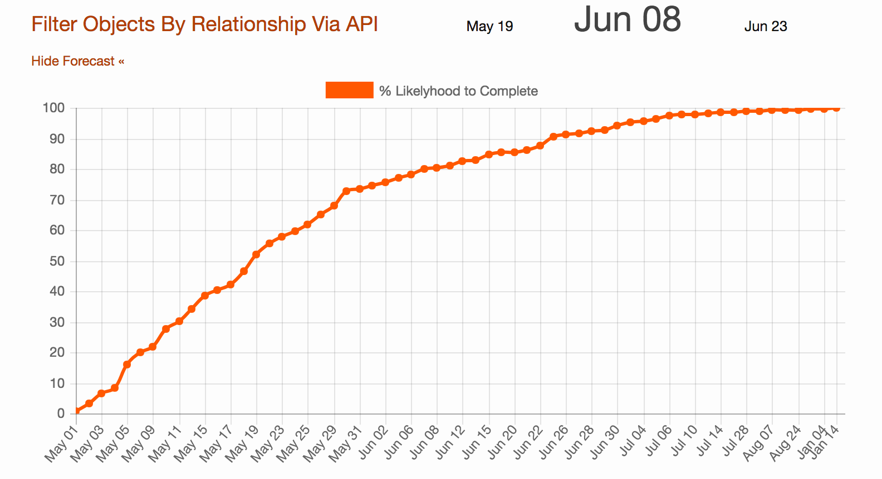
Risk Tolerance
Notes:
Per @mattstory
Dates on the bottom, cumulative percentage of how confident we are at completing this at the top. Generally use the dates that correspond to how comfortable you are with risk. This includes a stretch goal, a realistic goal, and a fairly bad case scenario at the end. As we discussed before, these are easily calculated once you have the percentages

Slide 22
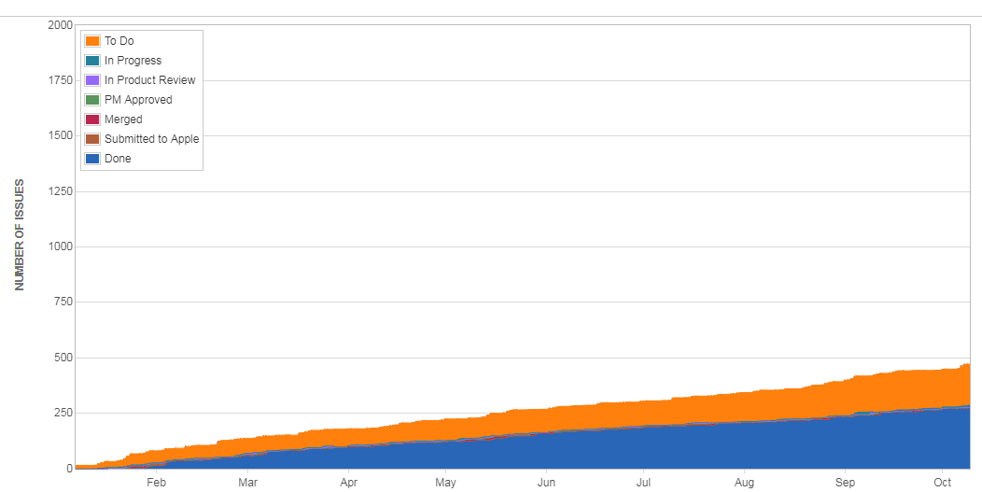
Notes:
You might ask, but we have these charts, like a release burnup or burndown or CFD (like here), why can’t we just project?
The first is that we’re not solving for that variability anymore by bootstrapping, we’re just taking the average of what happened (and not looking at what could’ve happened). We also only typically use one stat, like average, to look forward. We could add some variability, and say these are our trendlines, but that still just gives us a range for a certain date, not a range of dates.

Slide 23
A Note About Data
Mathematical modelling
Rule of 5
Garbage in, garbage out
Notes:
You don’t need a lot of data, but you need an actual process. Needless to say, if you don’t follow certain basic processes first, you really shouldn’t be worried about forecasting
Rule of 5 says that if you get 5 samples of any population, the real mean has a ~94% chance of being the min/max values
Things get steady after 30-50 data points in general in normal statistics, but you don’t need nearly that many

Slide 24
Recap
Measure cycle/takt time
Build a larger population to re-sample
Re-sample 1000 times to get 1000 average cycle/takt times
Multiply by project size
Chart cumulative probability
Notes:
We started with 9 samples, so we’re going to resample with replacement 9 values, but do that 1000 times. That’s going to give us the average cycle time we need to calculate the project length
Maybe complexity?

Slide 25
No Expert-based Estimations

Slide 26
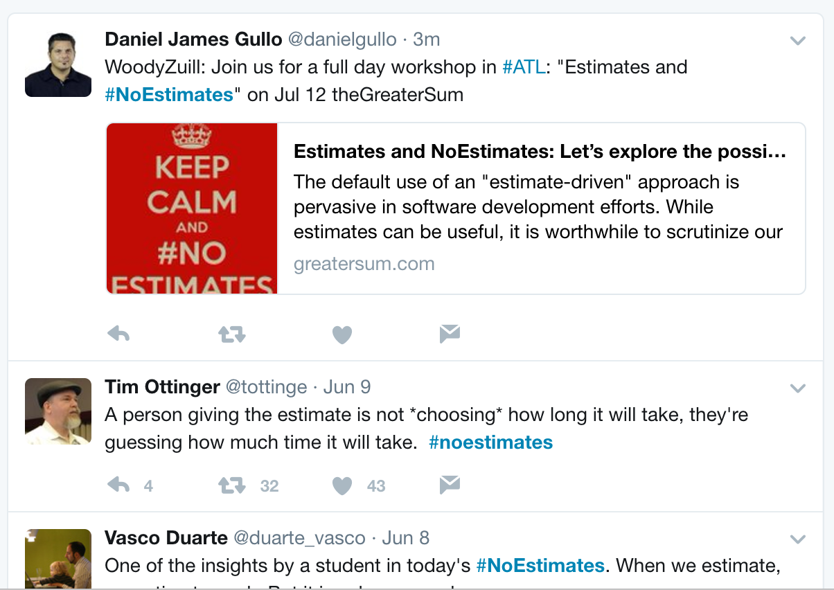
#NoEstimates
Notes:
No, or very little, correlation between estimate and cycle time, whether you’re using story points, or function points, or sizes. Measure for yourself, but there are several case studies proving this
Notice that there are no estimates in the process we just went through; it’s only dependent on the number of stories in the backlog. This means that the only thing we want to focus on is the actual number of user stories.
I can’t talk for other #noestimates people, but rather than no estimates in general, we can have no expert-based estimations

Slide 27
Planning with a Map
Notes:
Story mapping has been around for years, popularized by Jeff Patton but developed in multiple places.
It is the best way to make sure you have thought through all of the possible paths and alternatives in a system from a user’s perspective
Frame
Collect Steps
Organize
Fill in
Focus

Slide 28
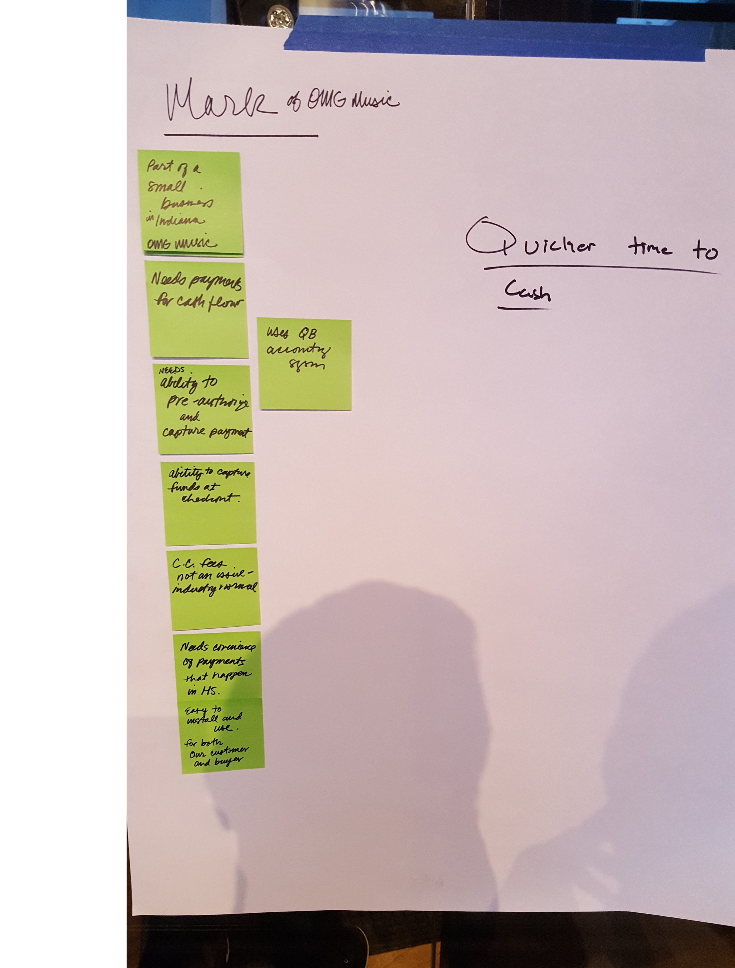
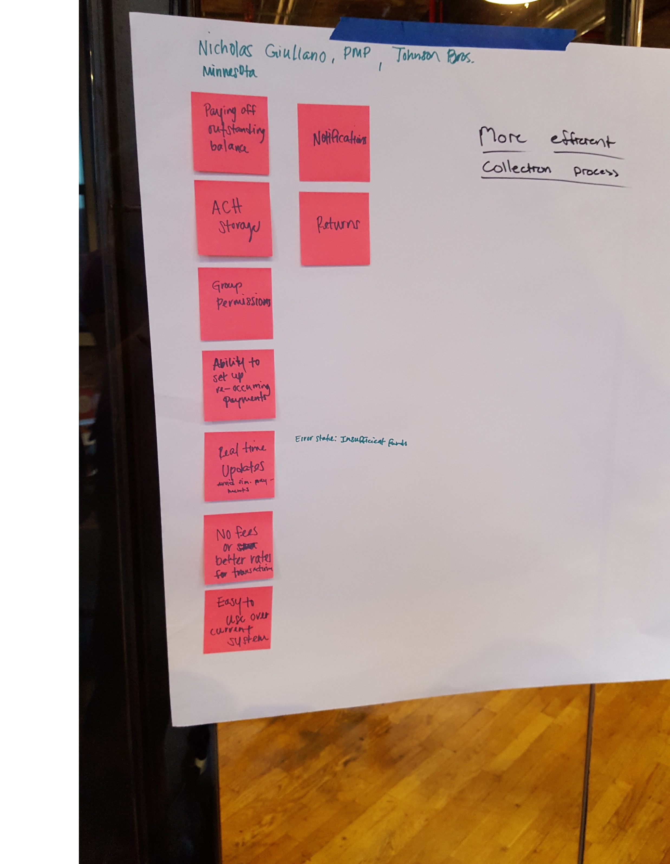
Start with a Problem
IMPACT | Win rate, retention
OUTCOME | Business value
OUTPUT | Features, stories
Notes:
2/3rds of the space on a story card is about who and why, and yet they are often the most overlooked.
“As a product owner, I need … because the client said so”
Really understand the who and the why. What problems are you trying to solve from the user’s perspective? How do they solve it without your software?
Not Solutions
Who has the problem? Why are we building it?

Slide 29
Map the Journey
Shop as
Guest
Search
Brand
View
Detail
Add to
Cart
View
Favs
Add Fav to Cart
Get Invite
Search
Product
View
Similar
Sign Up Online
Favorite
Email
Link
Notes:
Who has this problem? Individual or organization?

Slide 30
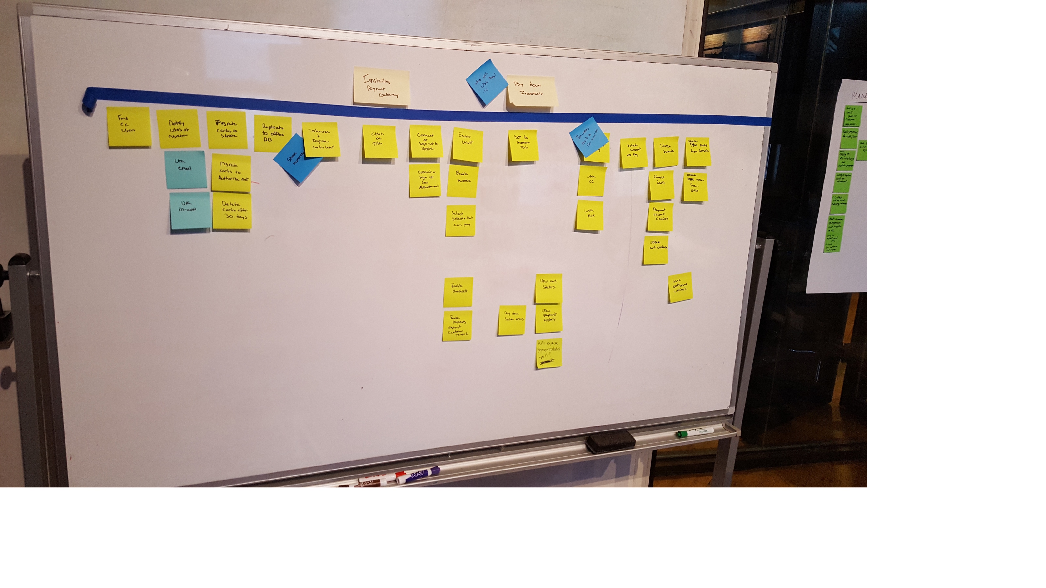
Explore
Notes:
Include everyone on your team, at least: testers, developers, analysts
Leverage your cross-functional experience
Include other functional areas: people selling or supporting the project

Slide 31
Plan to Learn
Notes:
You can run multi-variate experiments, but you will probably need someone with some graduate-level statistics experience to design and run the experiments. Single factor is much easier to change
Identify risks and assumptions that need to be validated
Design simple, single-factor experiments in order to learn
“What’s the smallest change we can make to learn what we need to learn?”
Maximize outcome while minimizing output

Slide 32
What’s the smallest change we can make to learn what we need to learn?

Slide 33
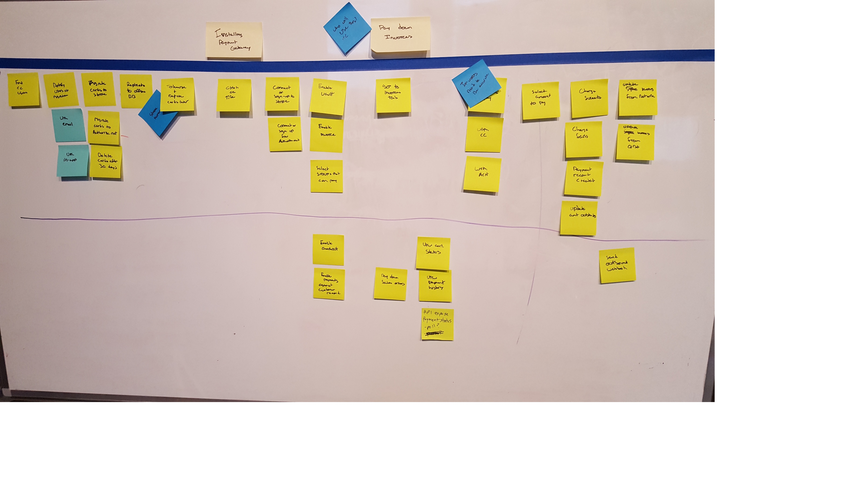
Plan to Release
Notes:
Insert picture of story map from Monday
Slice out releases accordingly
Good, Better, Best
Simplest Customer, Average Customer, Most Complex Customer
Each release should be self-contained
MVPs are not “the minimum amount we can release”
Should be “smallest amount we can build to achieve the desired outcome”

Slide 34
What’s the smallest amount we can build to achieve the desired outcome?

Slide 35
Plan to Develop
Validate assumptions as quickly as possible
Start on the riskiest stories first
Notes:
To fill up sprints, ask: which story could have the highest variability in cycle time? What do we still need to learn from our customers? Which assumptions do we need to validate? Work on these first, and only commit to what you think fits in the cadence

Slide 36
Forecast your Results
With Excel

Slide 37
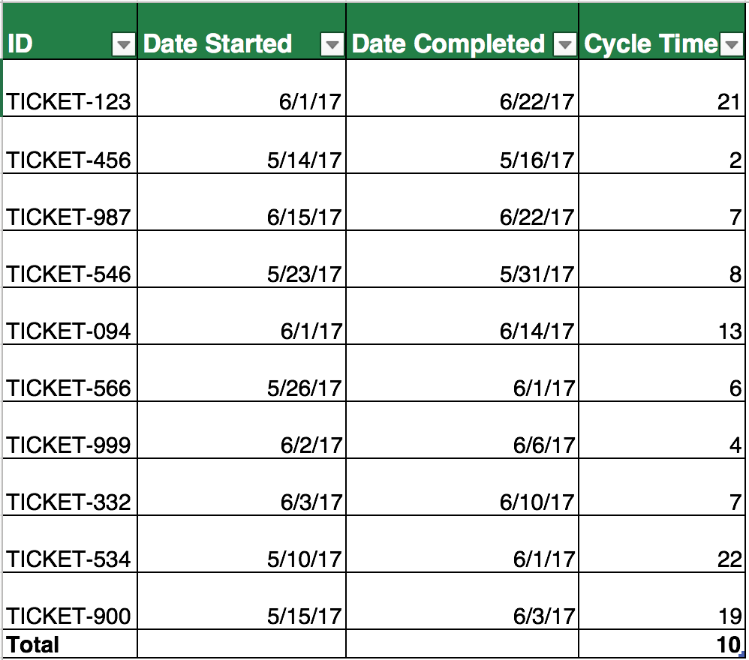

Slide 38
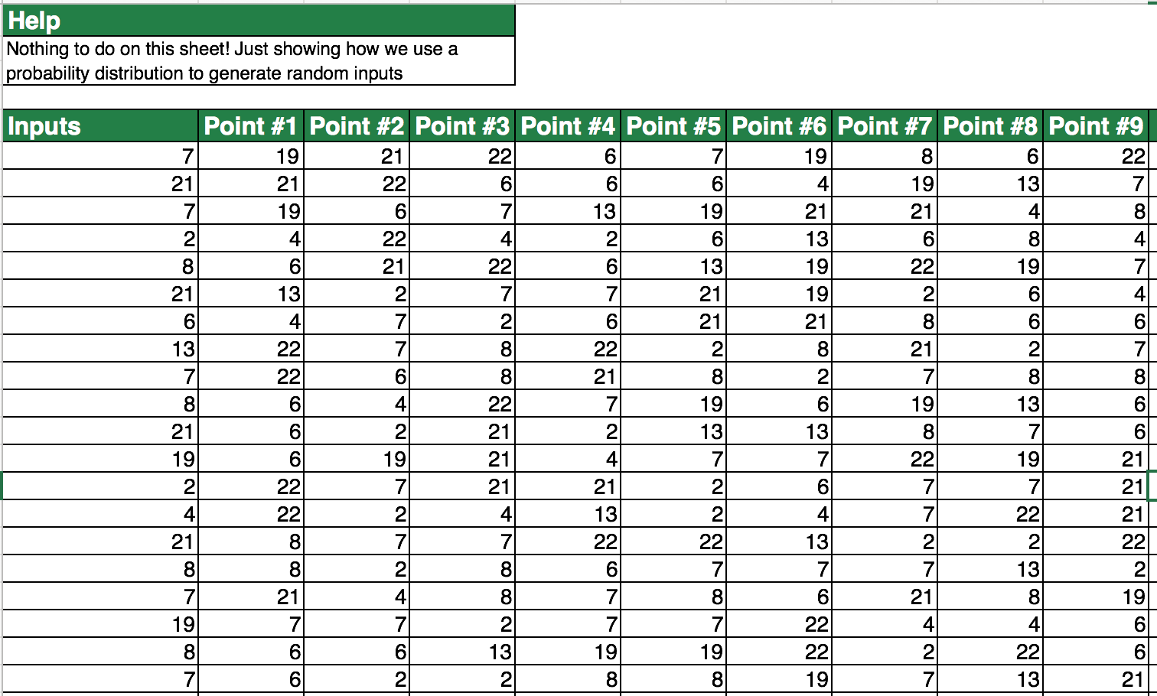
=INDEX(Inputs[Cycle Time], RANDBETWEEN(1,ROWS(Inputs)), 1)

Slide 39
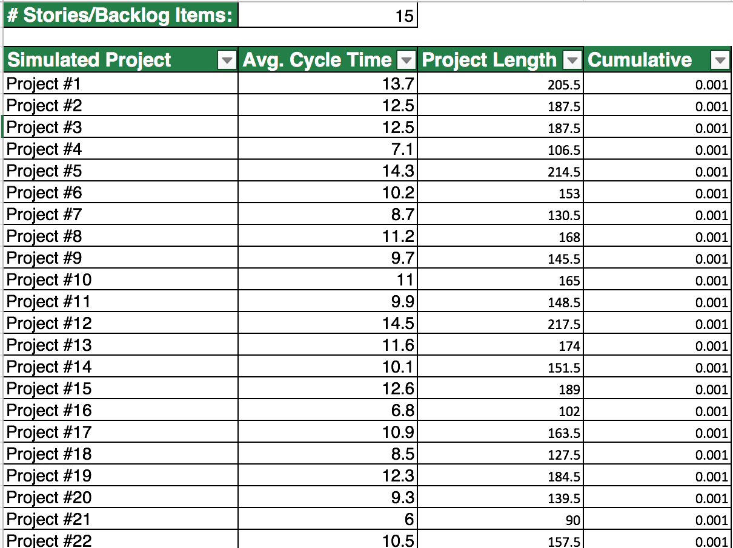

Slide 40
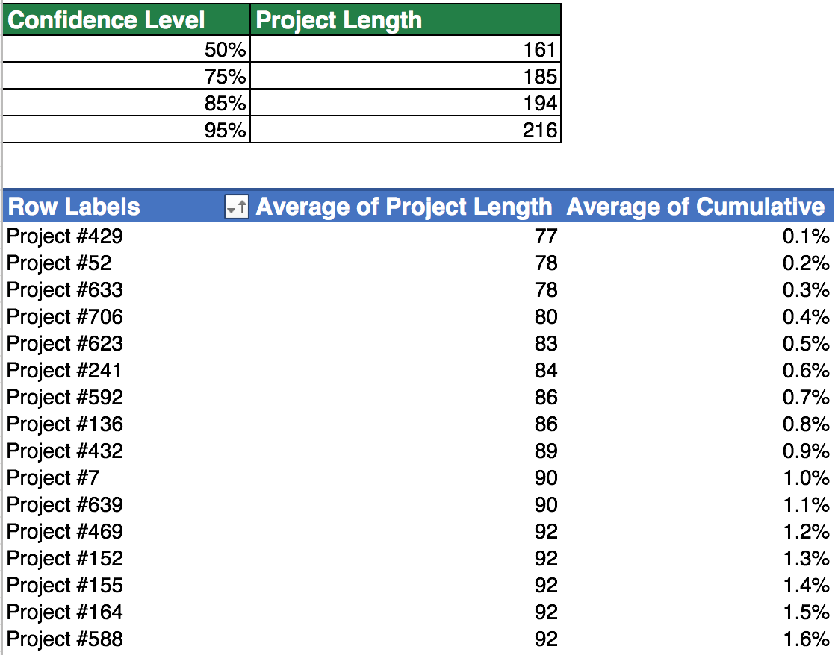
=PERCENTILE(Perform[Project Length], 0.5)

Slide 41
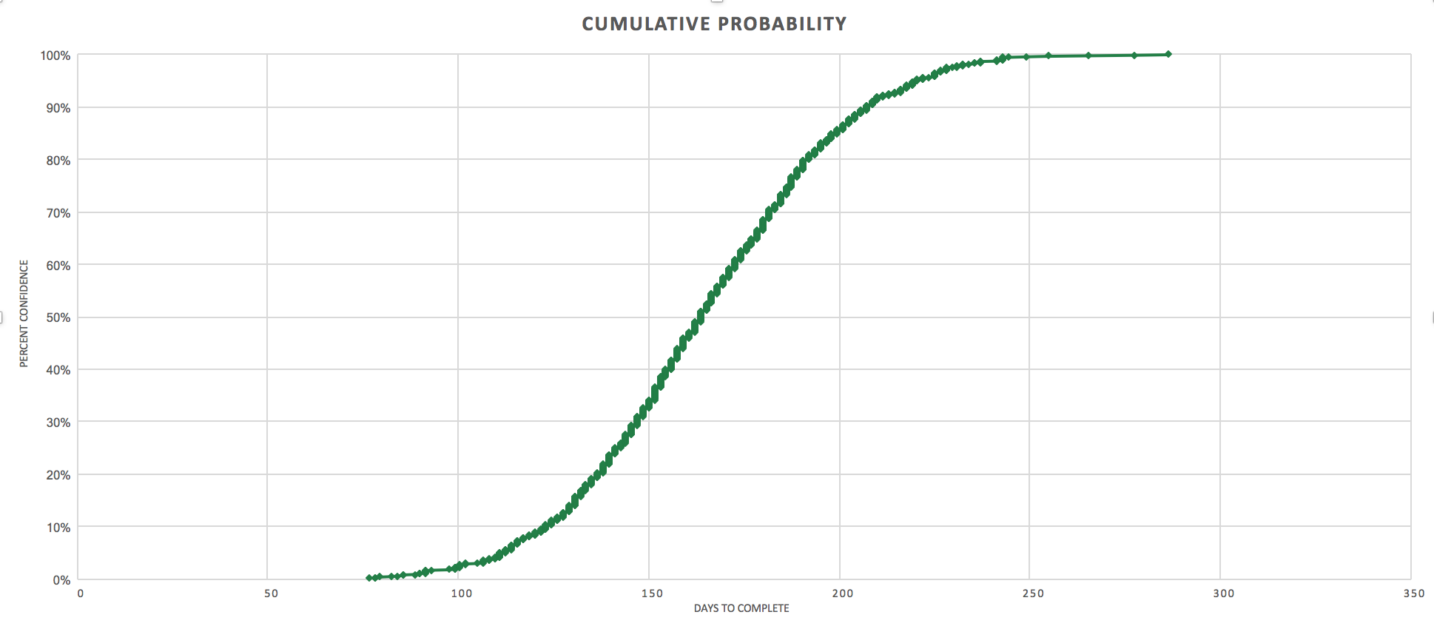
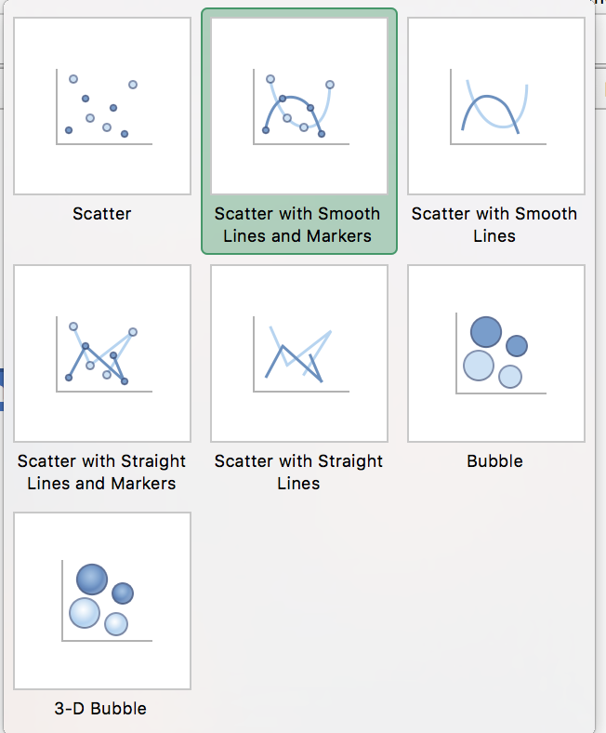

Slide 42
Using Ruby
Notes:
Count the stories, plug them in

Slide 43
References
http://scrumage.com/blog/2015/09/agile-project-forecasting-the-monte-carlo-method/
https://cms5109.github.io/posts/2017/06/26/more-reliable-delivery-monte-carlo-mapping/
Notes:
Count the stories, plug them in

