Slide 1
Reasoning About Complex Systems
Erich Ess

Slide 2
Myself
Engineer for 12 years, worked at big companies like Jet.com/Walmart, Verizon, and Northrop Grumman and several tiny start up companies.
The last 7 years I’ve been working in distributed systems and architectures.

Slide 3
Reasoning About Complex Systems
Problem
  Working with complex systems can be very messy.
What does it mean?
  Strategies for understanding behavior
Why?
  Efficiency
  Anecdotal experience: most engineers don’t use effective strategies.
  Make it easier to get back to bed when awakened at 3am.
Notes:
Goals:
How to get devs to build strategies for building hypotheses
Seniors – explain stuff you do unconciously
Jrs-Int – Guide for teaching them
This may sound very simple, but very few engineers ever talk about this

Slide 4
Quick Outline
Mental Modelling
  Building a simple simulation of a complex system
Experiments
  Creating experiments to validate hypotheses on a complex system’s behavior
Simple Examples
Notes:
Core tools for reasoning
Models – framework for making inferences and deductions
Experiments – validate hypotheses and collect data

Slide 5
Mental MOdels

Slide 6
Mental Models
Simplified representation of a complex system
Focus on how each component interacts with the whole system
How different inputs cause the system to act
How different stressors cause the system to act
Notes:
Stressors are: service outage, database problem, network outage, etc.
With a good mental model you should be able to make pretty good predictions for behavior
So how do you make a mental model?

Slide 7
Making a Model
The most important concepts that determine the behavior of your system
  Not super fine grained
The large scale business logic
  This component parses files and saves them to a database
Infrastructure
  Databases, Kafka, other teams’ systems
How does each component push and pull the other components?
Notes:
Think of it as a mechanical system where each part does something and interacts with other parts. What you want are rules describing what each part does and how it interacts with the other parts. This will let you reason about what will happen if you change the behavior of one of those parts.
In high throughput systems you don’t even need to worry about the biz logic, because every path will probably be executed during any given minute

Slide 8
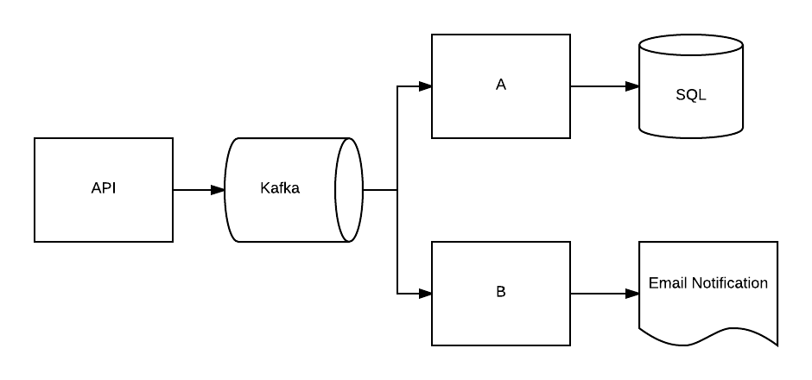
Simple Example
Notes:
You’ll note that this is basically an architecture diagram
It lets us see each major component and how it interacts with other components

Slide 9
Reasoning From The Mental Model
Think of this as a mechanical system
Each component performs some action
Components may connect to other components
When one component does an action, how does the system react?
Notes:
When you think of things as that mechanical system, this part becomes a case of changing out the behavior of one part and predicting how that will impact the other parts of the system.
Or you might think of it as a plumbing system with each connection being a pipe.
Reasoning boils down to: how does the system as a whole behave when one component does something specific

Slide 10
Simple Example
Notes:
We return to our first example model

Slide 11
What Happens When?
Notes:
What would happen if Kafka were having issues?
What if reads from it were running slowly?
Services A and B would be lagging behind the API writes to kafka
We would observe: SQL and Email Notifications are lagging behind

Slide 12
What We’d Expect
Notes:
Data would stop going into SQL and Emails would stop being sent.
Let’s reverse and think about deduction

Slide 13
Deduction Example: Observed
Data showing up in SQL with no lag
Email notifications are being sent with significant lag

Slide 14
Simplest Explanation?
Notes:
Given our understanding of the system, what’s the simplest way to have a lag in just the email notifications?
SQL writes are showing no lag, which means that A is working correctly, Kafka is working correctly, and so is the API.
That leaves B and the Email Service

Slide 15
Hypothesis
Notes:
We conclude B is probably the culprit as it’s pretty unlikely that the SMTP service is having issues.
SMTP could be having issues but it’s best to start with investigating B

Slide 16
Complex Example
Let’s take a look at a more complex system

Slide 17
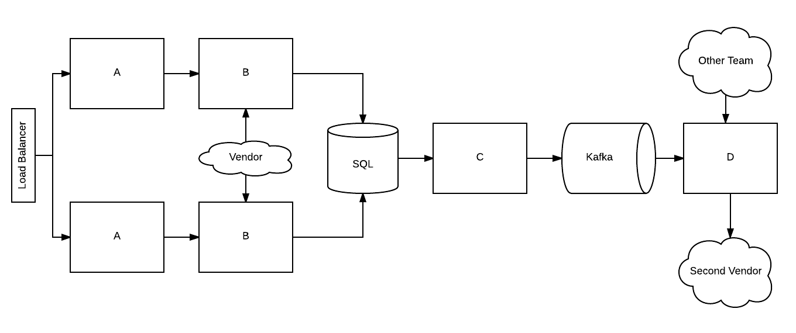
Complex Example
Notes:
What if you're getting problems only periodically when calling the api? Then it could mean that one of the system instances behind the LB is
having issues: when the LB sends you to the good system things work and when it sends you to the bad one they don't work. It also means
that there isn't anything wrong with internal components which are shared by both instances.

Slide 18
What If?
Notes:
What if we had issues with C?
Then they’d manifest with the system not sending data to the Second Vendor
However, everything before the SQL database would be working with no noticeable issues.

Slide 19
Deduction
What if you're getting problems only periodically when calling the Load Balancer?

Slide 20
Complex Example
Notes:
We know it’s not C or below
SQL and the Vendor would impact both groups
So…

Slide 21
Complex Example

Slide 22
Problem: All Calls Fail
What if we’re seeing issues with all calls to the Load Balancer?
What are the simplest configurations of our model which could cause an outage of both instances?

Slide 23
All Calls Fail
Notes:
It can’t be anything after the SQL database: you wouldn’t see those problems at service A
So what is in the system that could affect both sets of services?
The Load Balancer interacts with both instances
As does the First Vendor
And the SQL database
The other components are all separated from the APIs and the Load Balancer by SQL, so an outage there would not be visible on the API layer

Slide 24
All Calls Fail

Slide 25
Hypotheses
Using the mental model to build a hypothesis
The hypothesis is a testable explanation for why a system is behaving in a specific way
Notes:
What we are doing is building hypotheses that explain the behavior we are observing.

Slide 26
Experiments

Slide 27
Experiments
Validate a hypothesis
How the system is currently working
Help build a mental model for how the system ought to work
Notes:
When you do not yet have enough information to form a hypothesis.
Run through basic actions of your system using controlled test data.
Record how the system behaves.

Slide 28
Hypothesis Validation
Hypothesis
  How do I make the mental model give me the observed behavior?
Validate
  Create an experiment to verify the hypothesis
Update your hypothesis
  Use data from the experiment to update your hypothesis
Notes:
You start by using a mental model to make a hypothesis on a root cause.
Given my mental model of how the system works, what change in that model would create the symptoms I’m currently seeing?
How do a create an experiment to verify my claim? Often this will take the form of creating an experiment that will prove the change could NOT have happened.
Use your Test Data/Configuration to actually perform the experiment.

Slide 29
Deduction Example: Observe
Data showing up in SQL with no lag
Email notifications are being sent with significant lag

Slide 30
Simple Example

Slide 31
Validation Experiment
Use existing Observations
  Check service B’s metrics
Create an experiment
  Call the API with test data
  Monitor service B’s behavior

Slide 32
Complex Example
Notes:
But let’s say that the error only seems to come up with specific types of data

Slide 33
Validation Experiment
What are we trying to validate?
How do we validate?
Notes:
3 Hypotheses: LB, Vendor, SQL
How:
Observe Metrics
Tests: send a test call in and see where an error happens

Slide 34
Help to build a Mental Model
This is exploratory experimentation
Providing different inputs to see how the system behaves
Then using that to build a reasonable estimation of correct behavior

Slide 35
Tests and Test Data
A key component of an experiment is being able to test the hypothesis
In this case, a test is being done to see if the system misbehaves in the way your hypothesis predicts.
  The purpose of the test here is to validate or invalidate that hypothesis
To this end, you’ll also want test data
  You want a completely safe way to simulate anything which your customer will do with your system
  In effect, a set of real data about a fake customer
  This also allows you to control the state of the data you use for testing

Slide 36
Real World Examples

Slide 37
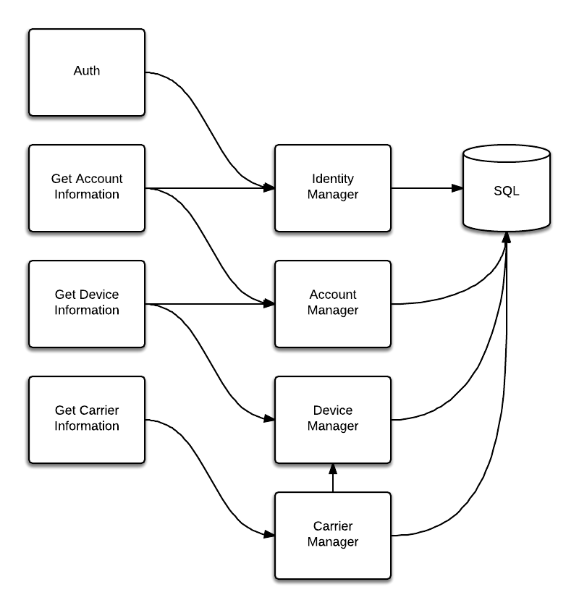
API As
Diagnostic
Tool

Slide 38
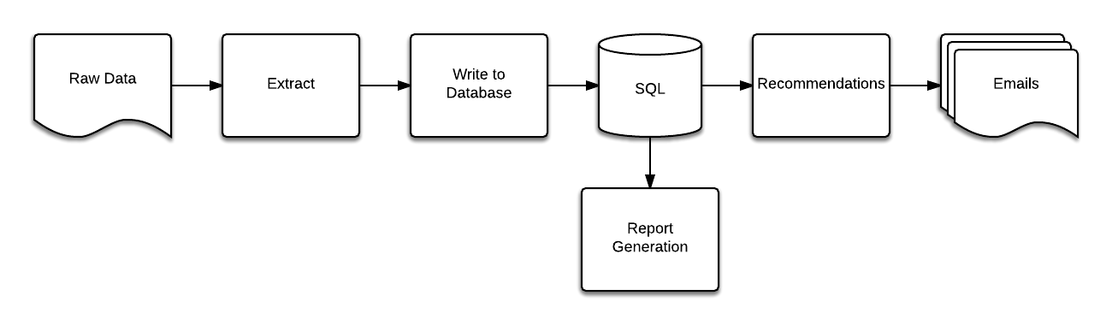
Personalized Emails
Notes:
An example of bad approach:
Reports look bad
So we assume it’s because our reporting system is broken

Slide 39
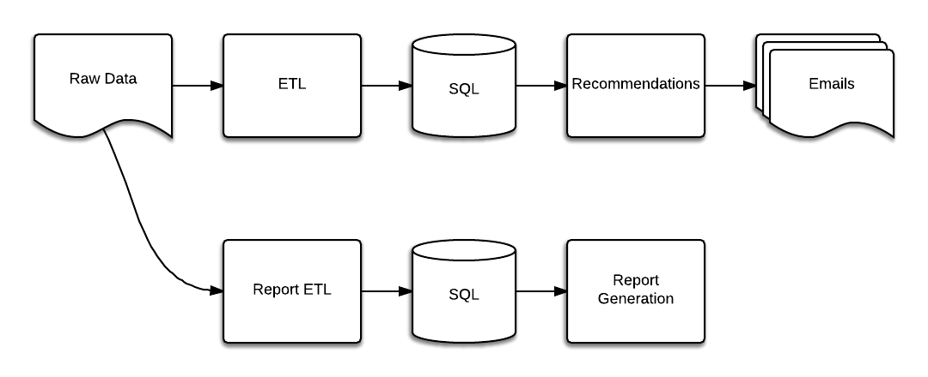
Personalized Emails
Notes:
We take the opportunity to try and get some rearchitecting done too
But we still get bad results
So we think it must be in our rec algorithms
Spend weeks working on improvements
Then finally realize the data in the DB was bad

Slide 40
Tools

Slide 41
Tools
Log Aggregation
  Splunk
  ElasticSearch
Distributed Tracing
  Zipkin
  Dapper
  A simple correlation or transaction id

Slide 42
Log Aggregation
A single source where all your logs are collected for searching, correlation, and analytics purposes.
Very common tool probably doesn’t sound like it’s worth calling out
Combined with distributed tracing it allows you to very quickly build a platform for gaining insight into how your system is working.
It’s also a critical tool for proving or disproving hypothesis and checking the outcome of experiments.

Slide 43
Distributed Tracing
The Problem
  When you have a system composed of a bunch of independent parts communicating with each other
  And your service sends a request to another service
  How can you tell exactly what happened to your request in that other service?
Solution
  Tag your messages with a unique correlation id which will link the telemetry from another service to the request your service sent!

Slide 44
Conclusion
Mental Models and Experiments weave together to help us understand a complex system’s behavior
A better understanding of the unconscious tools we all use to work with our systems
Some ideas which can be taught to junior and intermediate engineers

