Slide 1
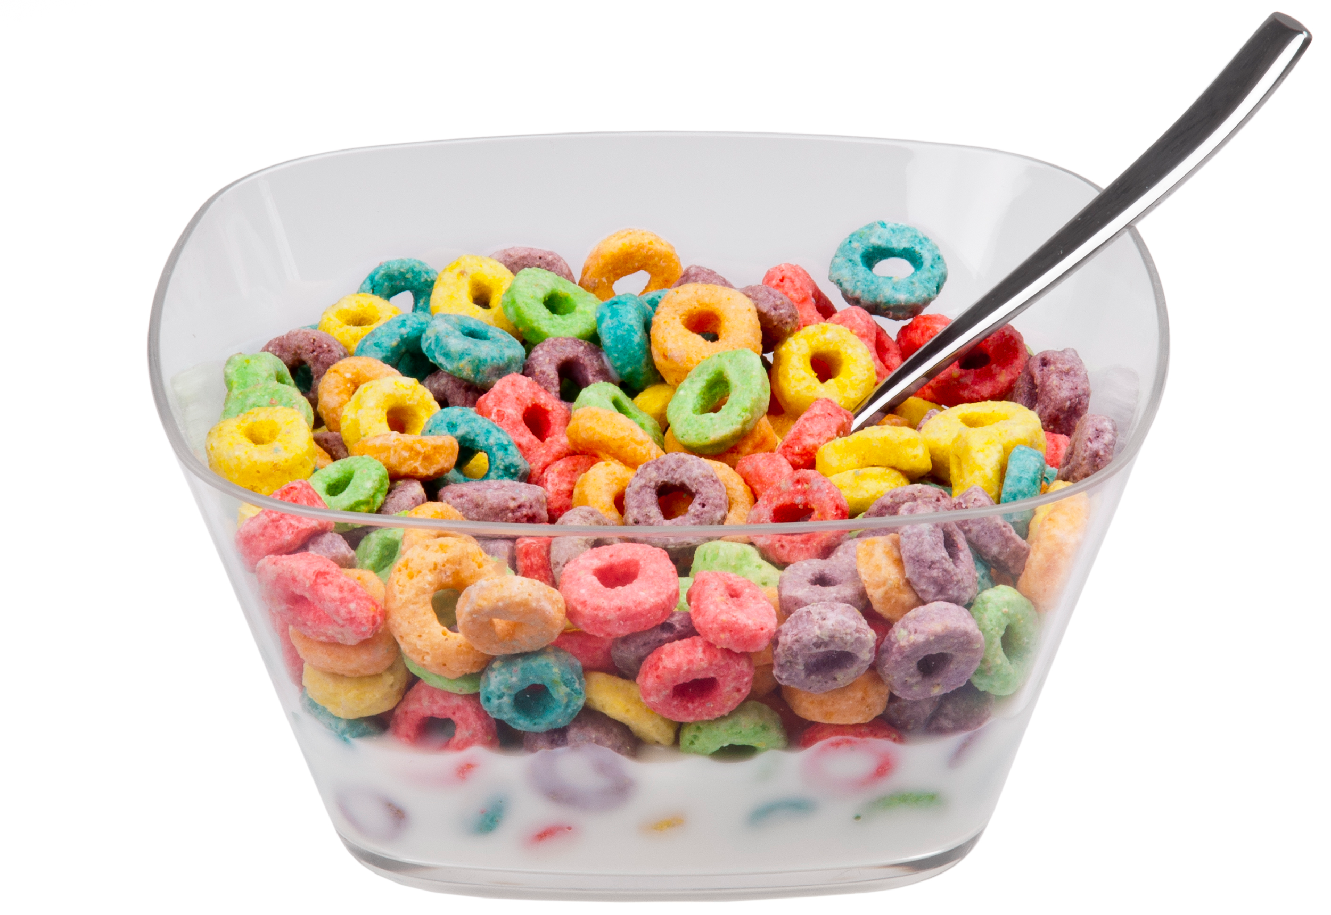
Development Metrics
You Should Use
(but Don’t)
@catswetel at #qconnyc

Slide 2
@catswetel at #qconnyc
Notes:
Why do we measure the development process (or really any process)? We measure to make decisions! What types of decisions? What kinds of questions are we asked to answer? How long will it take (when can we deliver everything)? What can we deliver by $DATE?

Slide 3
QUALITY | RESPONSIVENESS
PRODUCTIVITY | PREDICTABILITY
Notes:
Responsiveness -- lead time, time in process
Productivity -- Throughput
Predictability -- variability

Slide 4
QUALITY | RESPONSIVENESS
PRODUCTIVITY | PREDICTABILITY
What’s missing?
Notes:
Responsiveness -- lead time, time in process
Productivity -- Throughput
Predictability -- variability

Slide 5
“The RIGHTER we do the WRONG thing, the WRONGER we become.”
-- Dr Russell Ackoff
@catswetel at #qconnyc
cat.swetel@praxisflow.com

Slide 6
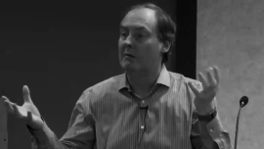
QUALITY | RESPONSIVENESS
PRODUCTIVITY | PREDICTABILITY

Slide 7
QUALITY | RESPONSIVENESS
PRODUCTIVITY | PREDICTABILITY

Slide 8
QUALITY | RESPONSIVENESS
PRODUCTIVITY | PREDICTABILITY
QUALITY
RESPONSIVENESS

Slide 9
@catswetel at #qconnyc
Notes:
Assumptions: you capture the start date and end date for each work item
For the purposes of this talk and understanding the metrics and visualizations of those metrics, start date is the date the work item crossed the line of comittment, when work actually began, and the end date is the date work was delivered to a customer. If you have questions about your specific context or about the dates you’re capturing, you can DM or email me.

Slide 10
Time in Process
Units of time per unit of work
@catswetel at #qconnyc
Notes:
What decisions can we make with this information? What kinds of questions can we answer?

Slide 11
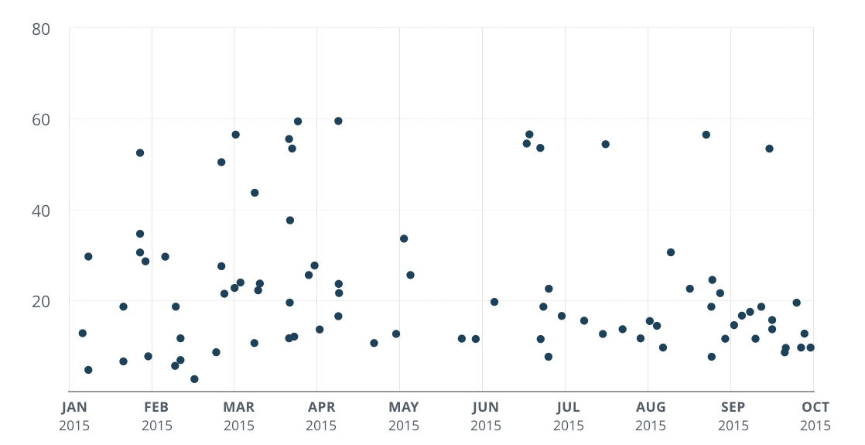
TIME IN PROCESS SCATTER PLOT
TIME IN PROCESS
DATE DELIVERED
Notes:
What’s the story here?
What types of questions could we answer based on this chart?

Slide 12
90%
TIME IN PROCESS
AVERAGE
DATE DELIVERED

Slide 13
QUALITY | RESPONSIVENESS
PRODUCTIVITY | PREDICTABILITY
Notes:
Responsiveness -- lead time, time in process
Productivity -- Throughput
Predictability -- variability

Slide 14
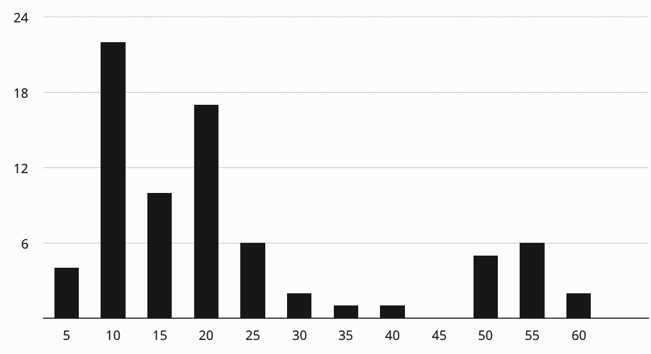
TIME IN PROCESS DISTRIBUTION
FREQUENCY
TIME IN PROCESS
@catswetel at #qconnyc
Notes:
Add up how many things there are, decide which confidence interval to use.
What if they ask a different question? What can I have in one month? How likely is it that this thing will be delivered by this date? If the date is 30 days out (one month because they are a global team operating in financial services), they can add up all the entries and see what % of the time they deliver in 30 days or less...about 80% of the time.

Slide 15
QUALITY | RESPONSIVENESS
PRODUCTIVITY | PREDICTABILITY
Notes:
Responsiveness -- lead time, time in process
Productivity -- Throughput
Predictability -- variability

Slide 16
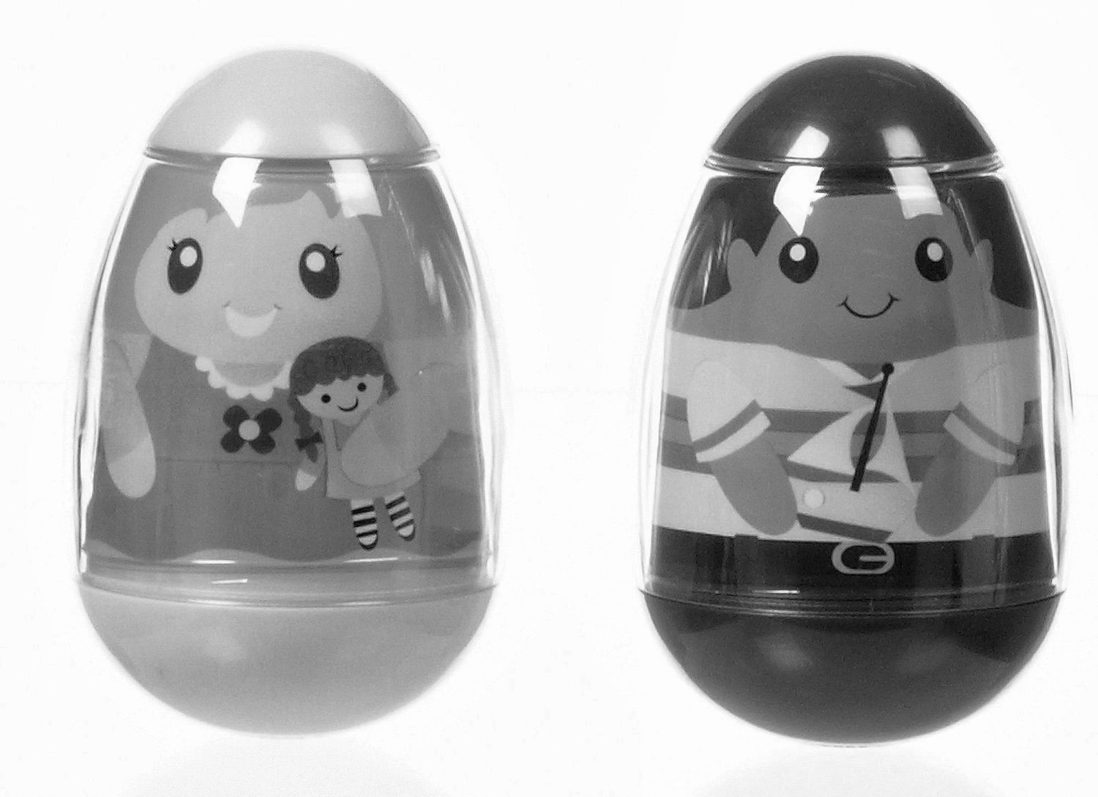
@catswetel at #qconnyc

Slide 17
WEIBULL DISTRIBUTION
@catswetel at #qconnyc

Slide 18
FREQUENCY
TIME IN PROCESS
@catswetel at #qconnyc

Slide 19
TIME IN PROCESS
DATE DELIVERED

Slide 20
TIME IN PROCESS
DATE DELIVERED

Slide 21
90%
TIME IN PROCESS
AVERAGE
DATE DELIVERED

Slide 22
MULTI MODAL
FREQUENCY
TIME IN PROCESS
@catswetel at #qconnyc

Slide 23
TIME IN PROCESS
DATE DELIVERED

Slide 24
QUALITY | RESPONSIVENESS
PRODUCTIVITY | PREDICTABILITY
Notes:
Responsiveness -- lead time, time in process
Productivity -- Throughput
Predictability -- variability

Slide 25
TIME IN PROCESS
DATE DELIVERED
Notes:
What else can we get from this representation of the data, those two data points (start and end date)?

Slide 26
THROUGHPUT
Units of work per unit of time
TIME IN PROCESS
DATE DELIVERED

Slide 27
TIME IN PROCESS
DATE DELIVERED

Slide 28
11
9
9
4
TIME IN PROCESS
10
6
6
13
4
DATE DELIVERED

Slide 29
QUALITY | RESPONSIVENESS
PRODUCTIVITY | PREDICTABILITY
Notes:
Responsiveness -- lead time, time in process
Productivity -- Throughput
Predictability -- variability

Slide 30
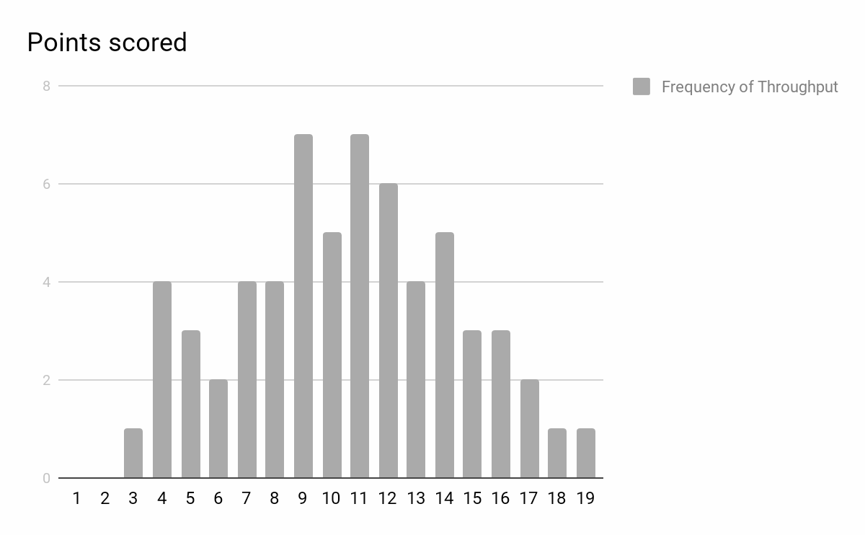
THROUGHPUT

Slide 31
50%
85%

Slide 32
QUALITY | RESPONSIVENESS
PRODUCTIVITY | PREDICTABILITY
Notes:
Responsiveness -- lead time, time in process
Productivity -- Throughput
Predictability -- variability

Slide 33
...per state
@catswetel at #qconnyc
Notes:
Example process: decompose, design. Develop, review, ready to deploy, deployed

Slide 34
@catswetel at #qconnyc

Slide 35
@catswetel at #qconnyc

Slide 36
Are we there yet?
@catswetel at #qconnyc
Notes:
Which state takes the longest? Which state is most variable? Which state affects a delivery dates the most?

Slide 37
Where should we focus improvement efforts?
@catswetel at #qconnyc
Notes:
Which state takes the longest? Which state is most variable? Which state affects a delivery dates the most?

Slide 38
@catswetel at #qconnyc
Notes:
Use one additional data point to look into our crystal ball and make predictions about what our metrics will do in the future

Slide 39
@catswetel at #qconnyc

Slide 40
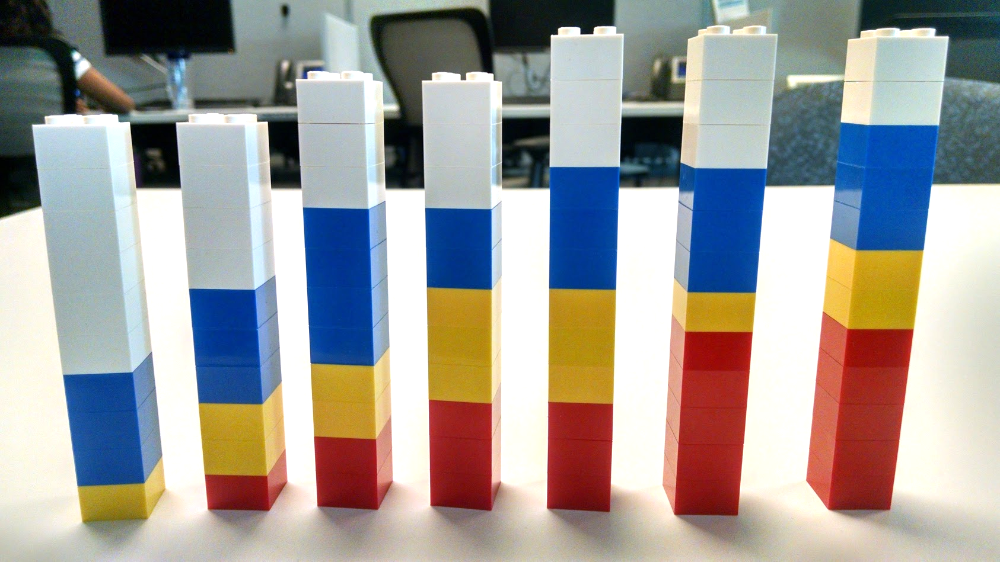
TO DO
DOING
REVIEW
DONE
@catswetel at #qconnyc
Notes:
New data poiint: counts of things per state

Slide 41
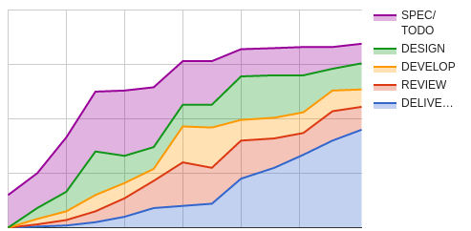
CUMULATIVE FLOW DIAGRAM
@catswetel at #qconnyc

Slide 42
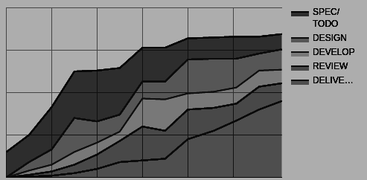
CUMULATIVE FLOW DIAGRAM
AVERAGE
ARRIVAL
RATE
@catswetel at #qconnyc

Slide 43
CUMULATIVE FLOW DIAGRAM
AVERAGE
DEPARTURE
RATE
@catswetel at #qconnyc

Slide 44
CUMULATIVE FLOW DIAGRAM
AVERAGE
WORK IN
PROCESS
@catswetel at #qconnyc

Slide 45
CUMULATIVE FLOW DIAGRAM
AVERAGE TIME IN PROCESS
@catswetel at #qconnyc

Slide 46
LITTLE’S LAW
@catswetel at #qconnyc

Slide 47
QUALITY | RESPONSIVENESS
PRODUCTIVITY | PREDICTABILITY
Notes:
Responsiveness -- lead time, time in process
Productivity -- Throughput
Predictability -- variability

Slide 48
#NOESTIMATES
@catswetel at #qconnyc

Slide 49
Pablo Picasso
“Computers are useless. They can only give you answers.”

Slide 50
Notes:
We measure to make decisions! What types of decisions? What kinds of questions are we asked to answer? How long will it take (when can we deliver everything)? What can we deliver by $DATE?

Slide 51
“STATISTICS are useless. They can only give you answers.”

Slide 52
@catswetel at #qconnyc
cat.swetel@praxisflow.com

