Slide 1
Grey Matter
The Intelligent Service Mesh

Slide 2
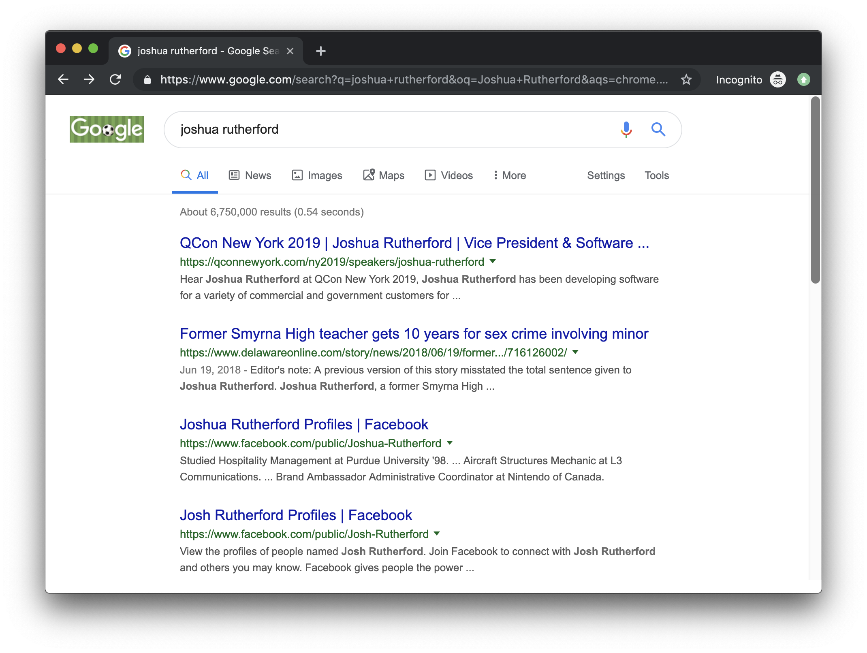
Introduction
Joshua Rutherford
Vice President, Product Engineering

Slide 3
Origin(al) Story
*event shown may not be a biathlon
*individual shown may not be Chris Holmes

Slide 4
Origin Story
*control plane may not resemble underwear

Slide 5
Grey Matter and Envoy
Envoy Filters
Server Name Indication, Redis, MongoDB, MySQL, Thrift, ZooKeeper
CORS, CSFR, Fault Injection, Health Checking, Rate Limiting, JWT Authentication, External Authorization
Grey Matter Filters
mTLS Impersonation, Observables, List Authorization, OpenID Connect

Slide 6
Guiding Principles
Business Intelligence
Hybrid and Multi-cloud
Content Security and Compliance

Slide 7
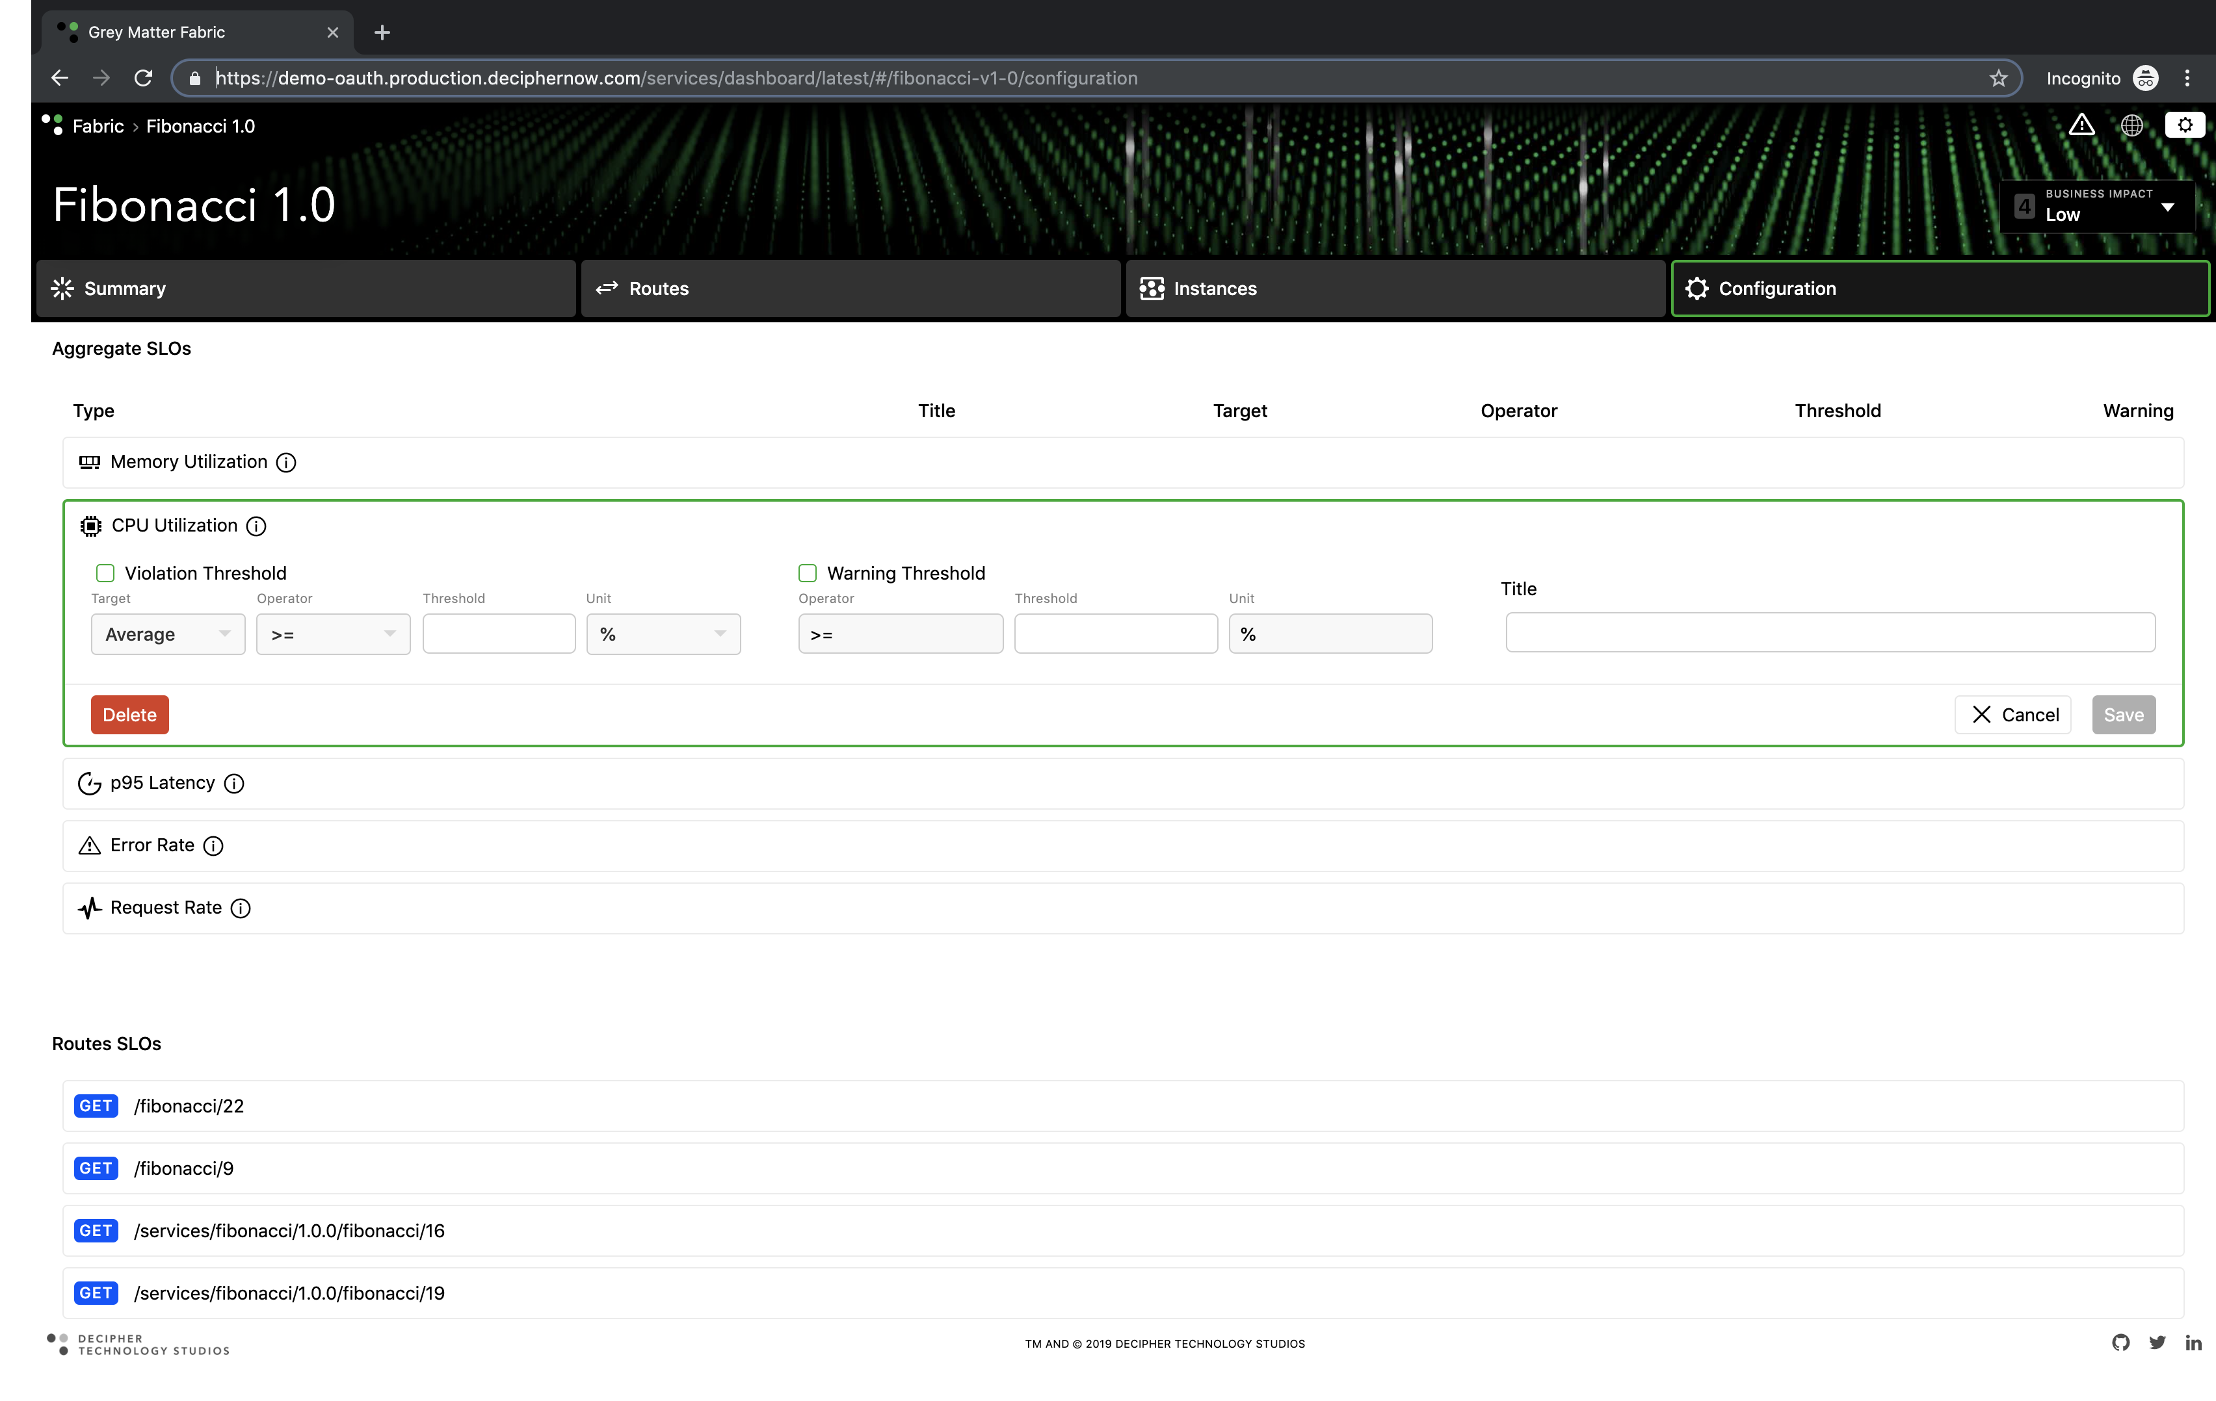
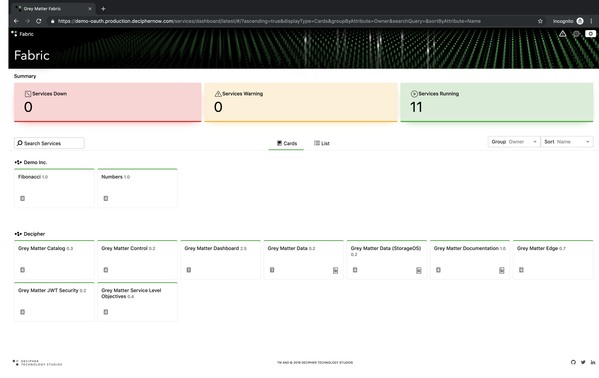
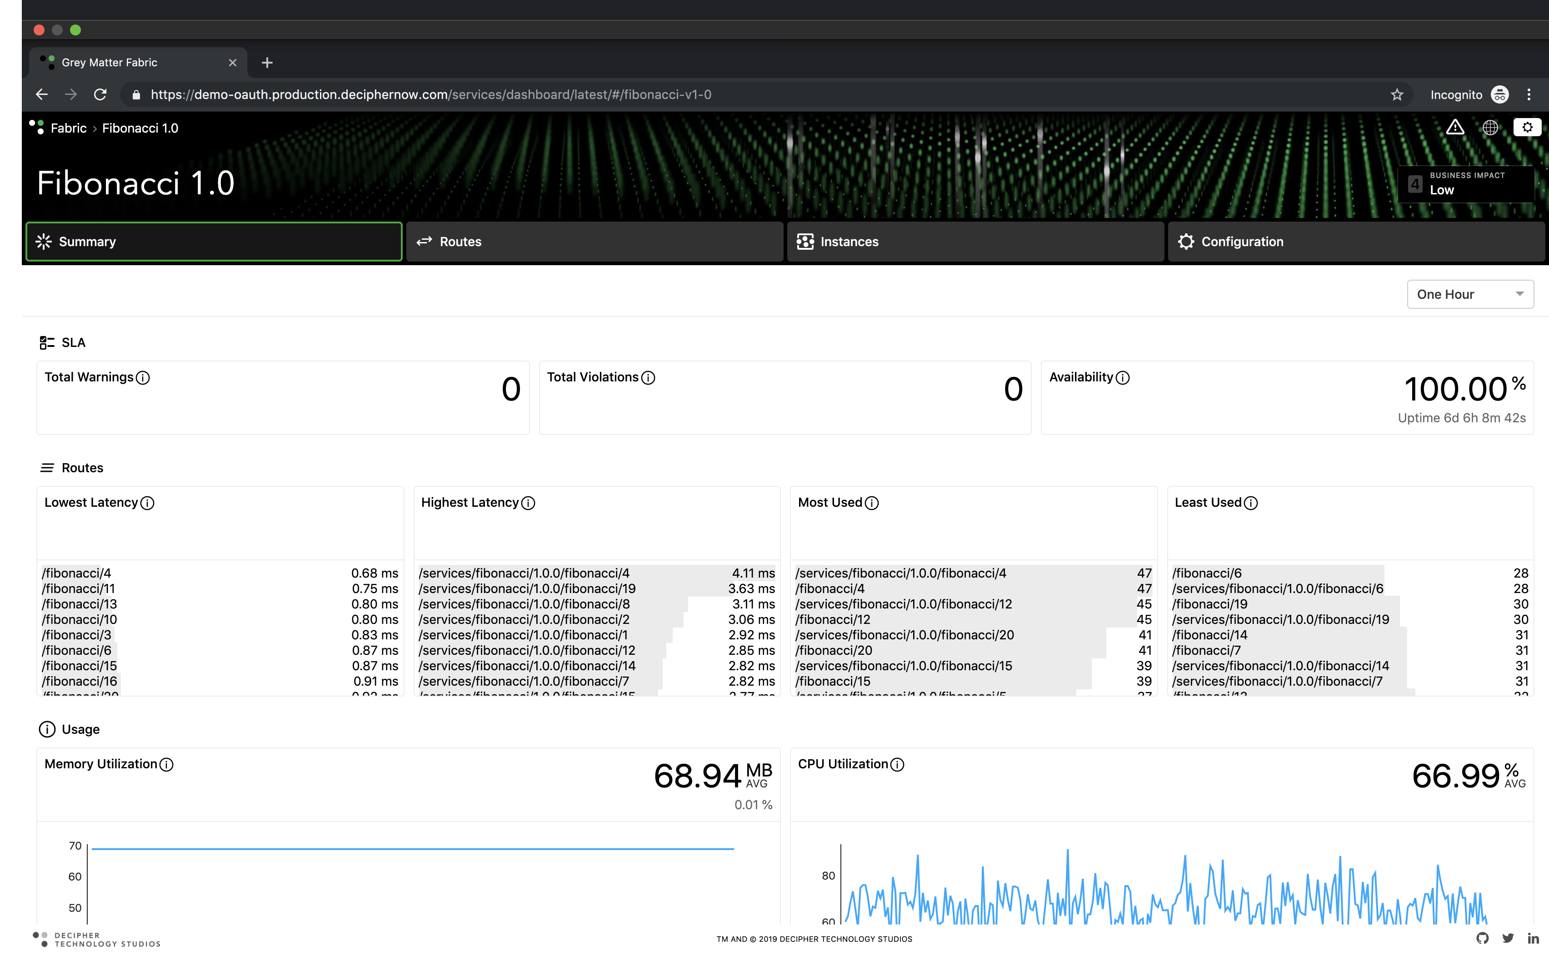
Business Intelligence

Slide 8
Hybrid and Multi-cloud
{
}
$$∉$$
{
}
$$∉$$

Slide 9
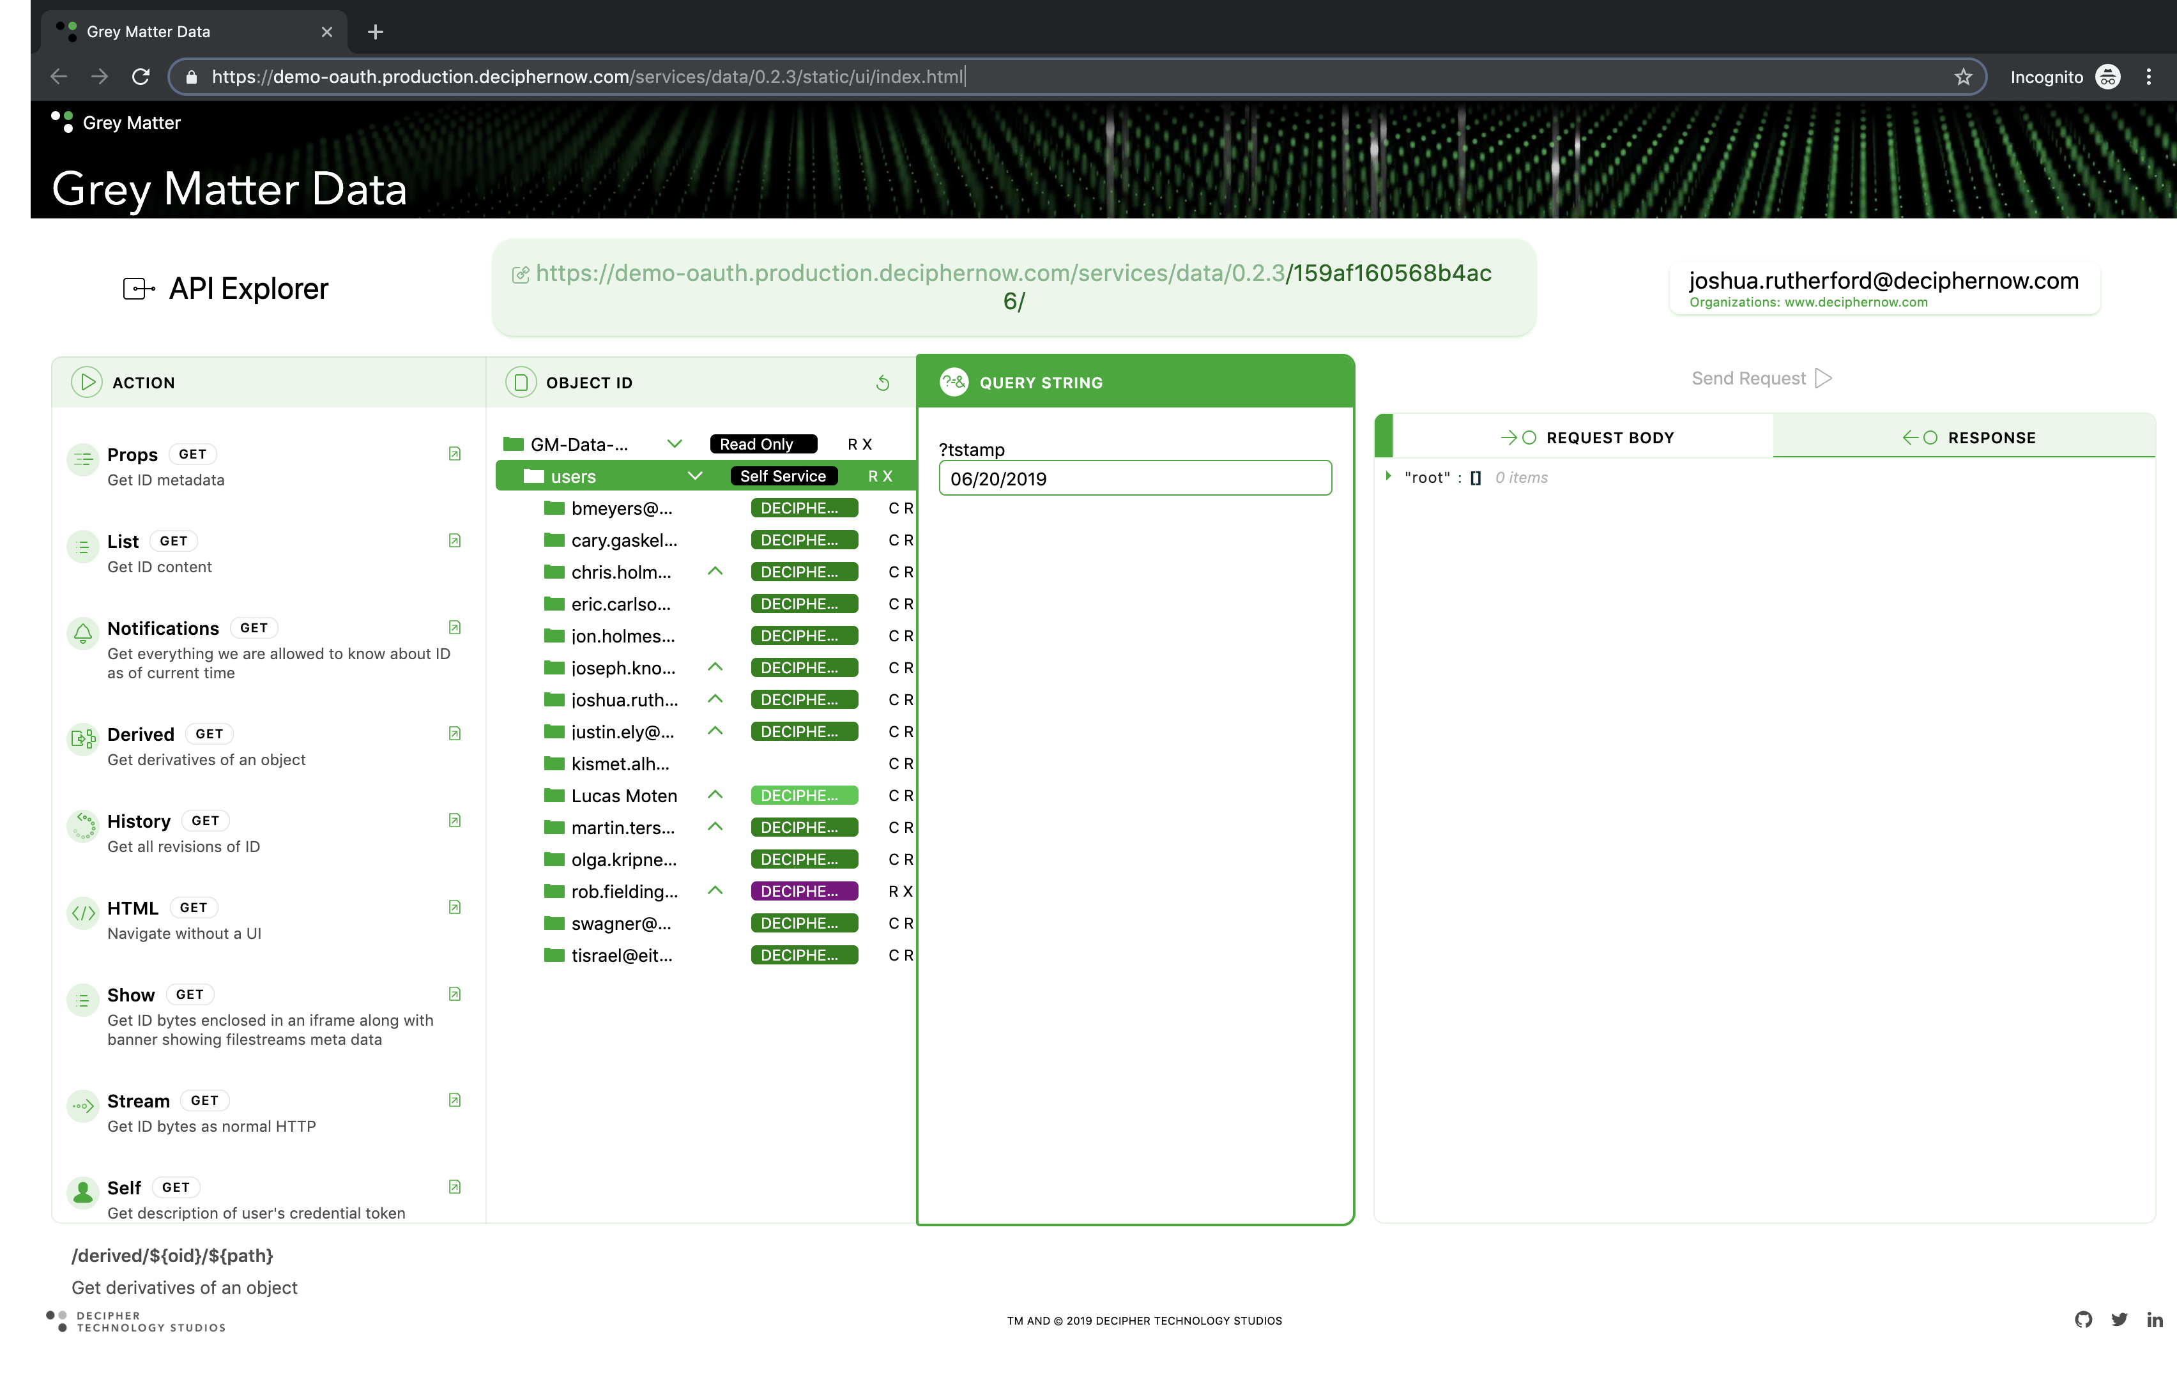
Content Security and Compliance
Immutable Ledger
Platform Agnostic
Dynamic Policy Engine

Slide 10
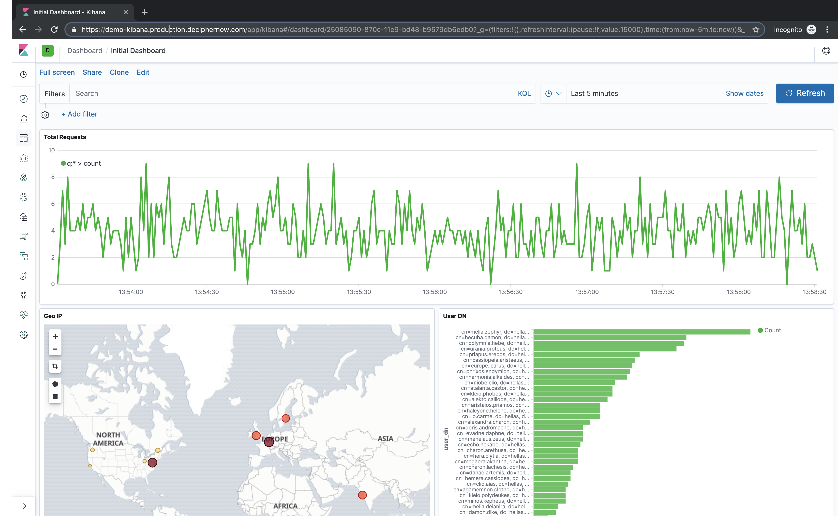
Content Security and Compliance
Zero Trust Networking
Role Based Access
Fleet Wide Auditing

Slide 11
Questions

