Slide 1
Data, GDPR & Privacy:
Doing it Right Without Losing it All
Amie Durr, VP Product
June 2018

Slide 2
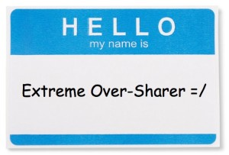
VP Product, SparkPost
Handle 25% Of The World’s Legitimate Email
Performance, Deliverability, Data Focused

Slide 3

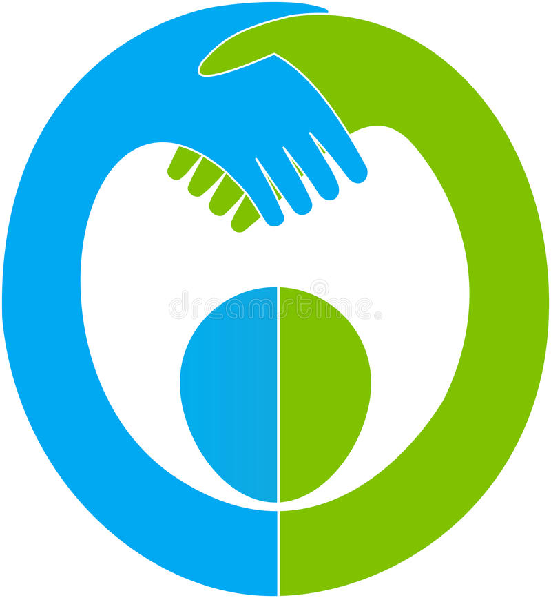



AGENDA
Consumer Trust
Key Issues
Privacy Regulations
Do It Right
Notes:
Towards the middle of last year, our team embarked on two major initiatives – working through how we could leverage the data we had about our customers, who they sent to, and what the recipients did with what was sent to help optimize engagement, improve conversions, and drive brand stickiness…. And GDPR compliance.

Slide 4
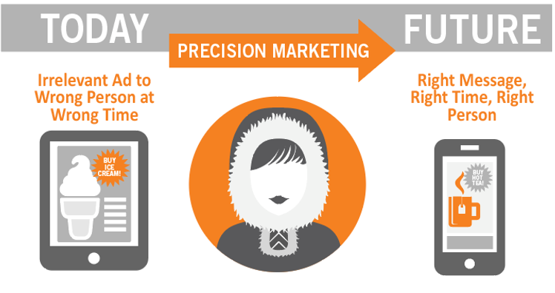
Consumer Experience

Slide 5
More Than 2/3 of Consumers Don’t Trust Brands With Their Personal Information
Notes:
The 2017 State of Consumer Privacy and Trust survey from Gigya finds that:
- 69% don’t trust brands to handle their personal information appropriately
68% don’t believe that changes in regulations will really make a difference
http://info.gigya.com/rs/672-YBF-078/images/201704-Gigya-DS-Privacy_Survey_Report-web.pdf

Slide 6

Employee Confidence is Low
63%
Not Confident Their Company is Compliant
90%
Don’t Believe Consent Data Is Accurate
The Stakes Are High
31%
Don’t’ Feel Personally Responsible
Notes:
Kingston Digital, Inc., https://gdpr.report/news/2018/06/07/survey-reveals-only-a-third-of-employees-are-very-confident-their-company-is-gdpr-compliant/ by during the week following the May 25 cutoff date when the rules came into force

Slide 7




27 Million
Do We Deserve Consumer’s Trust?
37 Million
92 Million
150 Million
Notes:
What data is stored and in what ways and for how long really matters. Both for the everyday trust given to us by our customers to use it for what we say we will, but also for when things go really bad and the data we’re keeping is accessed by people or systems who shouldn’t be
why should consumers trust brands with their personal information?
In just 2018 alone, nearly 400-500 million consumers have had their data illegally accessed – and those are just the breaches we know about. Many times, including in the examples here, notifiaction of a breach occurs months after the breach started, and often we learn that more and more people were affected as time goes on.
These breaches have real impacts to the organizations that suffer them, not to mention to the individuals whose data was accessed.
Facebook los 2.8 million users under the age of 25 last year. And when the Cambridge Analytica scandal broke, they lost 80billion in market share
Under Armour, based out of my hometown of Baltimore, and the parent company (who owns myfitnesspal) saw their stock drop about 5% as soon as news broke of the intrusion.

Slide 8

Data & Privacy Rights Regulations On The Rise
1
4
2
3
1
CASL
2
CAN-SPAM
3
Privacy Shield
4
GDPR
Notes:
CASL Hipaa, GDPR, Privacy shield, etc. CAN-SPAM

Slide 9

But Wait! Demand Is On The Rise
In 2018, Demand For Data Scientists is 50-60% Higher Than Supply
Data Scientists Roles Have Grown 650% Since 2012
Notes:
Given the trust concerns and the data leaks and theft, it may seem surprising but data gathering, data analysis, and data as a product are becoming strategic differentiators
This makes sense this goes hand in hand technological trends like cloud computing, big data and the IOT. By recognizing this the EU GDPR is basically catching up with reality
https://www.forbes.com/sites/louiscolumbus/2017/12/11/linkedins-fastest-growing-jobs-today-are-in-data-science-machine-learning/#55e9170d51bd

Slide 10
Build Trust
Notes:
Customer Trust is Broken and there are three things that need to be done to fix it

Slide 11
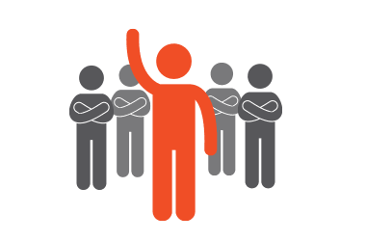
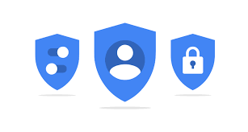
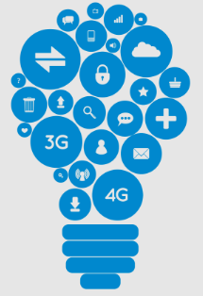
Key Issues In Building Trust
Accountability
Privacy by design
Innovation

Slide 12
Accountability
Audit Your Data Inventory And Make Necessary Adjustments
GET
CLEAN
STAY
SHOW
Notes:
Greater Accountability Understanding where all your data is and what it’s currently used for - and making the changes that need to be made
Integrity and confidentiality
How: “get clean,” “stay clean,” and “show clean.”
What? Understand the value of data as a strategic asset for the business

Slide 13
Accountability
Audit Your Data Inventory And Make Necessary Adjustments
GET
Ensure Processes In Place to Evaluate All New Data Streams And Potential Changes To Data Policy
CLEAN
STAY
SHOW
Notes:
Greater Accountability Understanding where all your data is and what it’s currently used for - and making the changes that need to be made
Integrity and confidentiality
How: “get clean,” “stay clean,” and “show clean.”
What? Understand the value of data as a strategic asset for the business

Slide 14
Accountability
Audit Your Data Inventory And Make Necessary Adjustments
GET
Ensure Processes In Place to Evaluate All New Data Streams And Potential Changes To Data Policy
CLEAN
STAY
Make It Easy To See What Data You Have And Easier To Opt-Out Or Be Deleted
SHOW
Notes:
Greater Accountability Understanding where all your data is and what it’s currently used for - and making the changes that need to be made
Integrity and confidentiality
How: “get clean,” “stay clean,” and “show clean.”
What? Understand the value of data as a strategic asset for the business

Slide 15
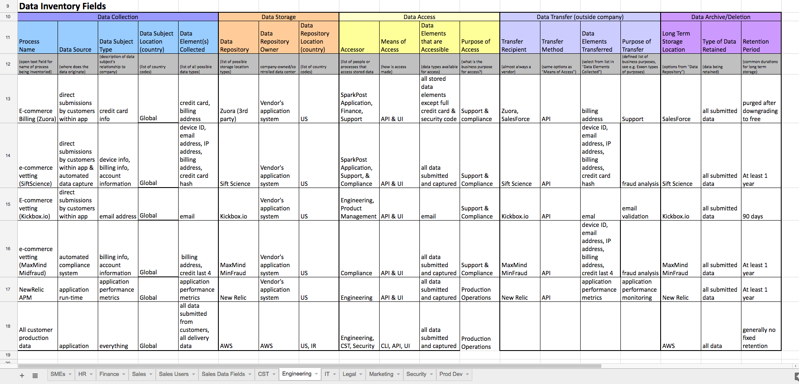
Accountability - In Practice
Notes:
Audited our data. What we stored, where, and why, and who was using it for what.
It took a long time
and we found some less than awesome things.

Slide 16

Accountability - In Practice
Notes:
Audited our data. What we stored, where, and why, and who was using it for what.
It took a long time. We found some less than awesome things.
Dropped our log storage from infinity to 30 days.
And at the same time Implemented a data lake but dropped non-relevant data and hashed other things we needed
And we’re still finding data that we didn’t think about or some process that’s running that no one thought to include. For instance just last week, I learned that we have 6 months of unhashed recipient data sitting in Timber for some data backporting …

Slide 17
Accountability - In Practice
How We Became Accountable:
  Dropped S3 Log Storage To 30 Days
  Hashed “rcpt_to” And Dropped Meta Data
  Removed Unused Tracking Tags & Cookies
  Educated Our Customers
Notes:
Audited our data. What we stored, where, and why, and who was using it for what.
It took a long time. We found some less than awesome things.
Dropped our log storage from infinity to 30 days.
And at the same time Implemented a data lake but dropped non-relevant data and hashed other things we needed

Slide 18
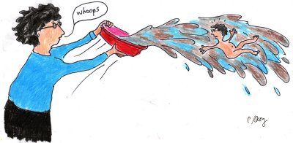
Accountability - In Practice
How We Became Accountable: We Kept Stuff Too!
  Suppression Lists
  Support Inquiries
  Compliance Data
  Anonymized Data In Our Data Lake
Notes:
Audited our data. What we stored, where, and why, and who was using it for what.
It took a long time. We found some less than awesome things.
Dropped our log storage from infinity to 30 days.
And at the same time Implemented a data lake but dropped non-relevant data and hashed other things we needed

Slide 19

Accountability – Doing It Right
What It Means
Lawful, Fairness, And Transparency Purpose Limitation Data Minimization Accuracy Storage limitation
How To Do It
Shared Responsibility Continuous Focus – Not A One Time Set Of Activities
Notes:
Accountability isn’t a one time thing you have to think about - we’re constantly reviewing and refining our data privacy policy and analyzing what data we need to keep or may want to keep. I’m currently in the beginning stages of a major new initaitive that is all around data
Accountability is a shared responsibility. If you’re not hearing from you product teams, or R&d teams how their changes impact data and customers rights, then you need to stand up and ask. – we had a hackathon last week and there were some really innovative hacks that leveraged data. I was proud and impressed how many people asked what impact the hack would have to GDPR compliance if put into the real world, and equally as proud hearing the teams talk about how they protected the data.
Clean Up after yourself – if you’re beta’ing something, or need a process for a certain activity or whatever, make sure to create a traceable task for yourself to go back and remove that if it’s unnecessary. (like all of our marketing javascript tags).

Slide 20
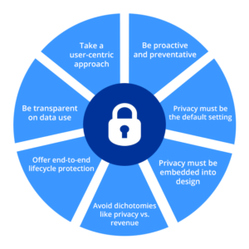
Privacy by design
7 Principle Elements Noted By GDPR
Be User Centric
Remember What It Took To Be Compliant – Stay Clean!
Notes:
Add value, but do no harm
Once you have an accountability strategy in place and have corrected things that may not be compliant (or generally just aren’t good practices), it’s time to look forward and to ensure that the new development you do takes into account all of the
Seven Principles of Privacy By Design
1. Proactive not Reactive; Preventative not Remedial
This approach anticipates and prevents privacy breaches before they happen. Because privacy has been integrated into the product, security is a priority from the beginning of the design process. Privacy by design protects organizations from privacy issues that could hurt the company’s reputation.
2. Privacy as the Default
This ensures that personal data are automatically protected in any system or business practice. Individuals don’t have to protect their own privacy because the system was created to be secure. If people want to take steps to secure their own data they can, but by making privacy the default, they don’t have to.
3. Privacy Embedded into Design
By embedding privacy into the design, rather than trying to add it on later, the system will run better. Ann Cavoukian, Ph.D, author of Privacy by Design: The 7 Foundational Principles says privacy should be “integral to the system, without diminishing functionality.” Making user-experiences worse for the sake of privacy is not an option. Privacy must be integrated in a holistic and creative way.
4. Full Functionality — Postive-Sum, not Zero-Sum
Trade-offs shouldn’t be made to accommodate either privacy or functionality. It’s easy to fall victim to false dichotomies, like privacy vs. security, among others. But if the system requires compromises, its likely not as effective or user-friendly as it should be.
5. End-to-End Security — Lifecycle Protection
Privacy by Design considers security from start to finish. This means that information is secure and protected when it enters the system, is retained safely, and then properly destroyed.
6. Visibility and Transparency
By allowing users and other involved parties to see how information moves through your system, the system improves. Accountability, openness and compliance are required for an effective and secure system. Being clear about your system, and the level of security it provides, creates trust and holds your organization accountable.
7. Respect for User Privacy
You should make user privacy your number one concern. If you are dealing with customer’s private information, the stakes of letting it fall into the wrong hands are extremely high. More generally, your system should be optimized for your users and all of their needs.

Slide 21
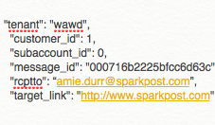
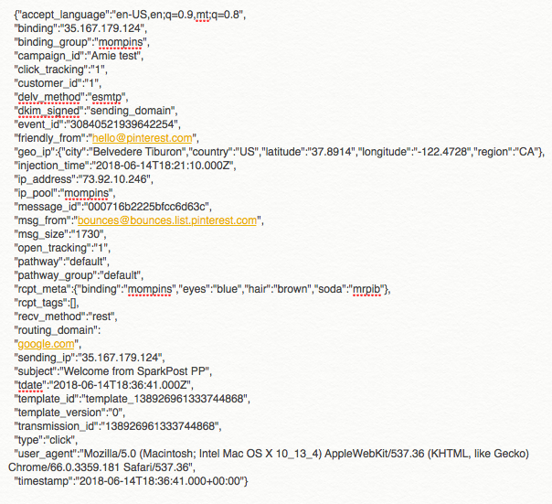
Privacy by design – In Practice:
Engagement Message Events
Encoded In Our Links
Stored In Our Redis or S3 For 1 Year
Notes:
Our Challenge: Provide Critical Functionality While Respecting Consent And Data Minimization
Industry Best Practice To Resolve Links Wrapped For Tracking Up To 1 Year After Message Sent
Attribution Data For Who Took What Action On An Email Is Processed – And There’s A Lot Of It

Slide 22
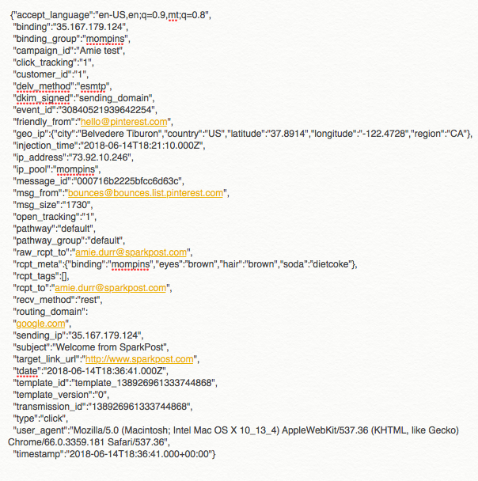
Privacy by design – In Practice
Engagement Message Events
Strict PII
rcpt_to
Possible PII
rcpt_meta
geo_ip
Enriched Message Event
Notes:
Talk about the whole engagement tracking, right to be forgotten, but links and open tracking still work up to a year
Stopped storing non-anonymized PII
Encoded PII in link with
Enrich data on look up
SparkPost EU

Slide 23
Privacy by design – Doing It Right
Privacy By Design Is a Brand Benefit!
Understand What Is/Is Not PII, And What May Feel Like PII To the Individual
Stop Storing Non-Anonymized PII, Wherever Possible
Encode PII, Encrypt, or Hash PII You Need To Keep
Aggregate Data Wherever Possible
Amend R&D, User Story, Or Other Artifact Documents To Include Callout For Data Management
Make The DPO Your Best Friend
Build The Ability To Self-Serve Delete Requests First!
Better Yet, Have Data Roll-Off Within 30 Days!
Notes:
Rolling out some encryption, pseudonymization, or blocking and data-deletion technology, for example, is necessary and good. T

Slide 24
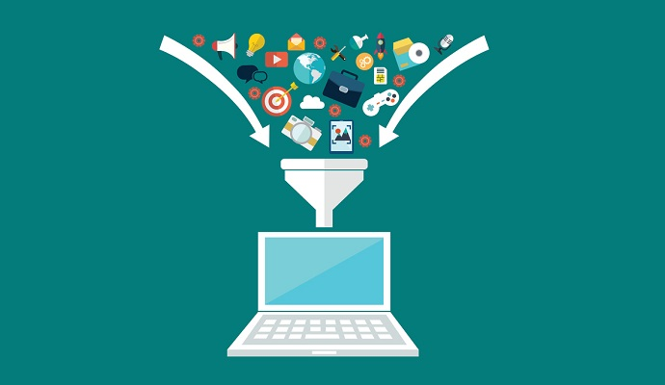
Innovation
Data Is The Fuel That Powers Much Of Our Technological Progress
Notes:
Data is one of the most valuable assets of any organization – it’s increasingly becoming the oxygen of modern business
There feels like a persistent tug between creative freedom and rules that are seen to inhibit innovation.
Figuring out how to innovate with consumers best interest in mind

Slide 25
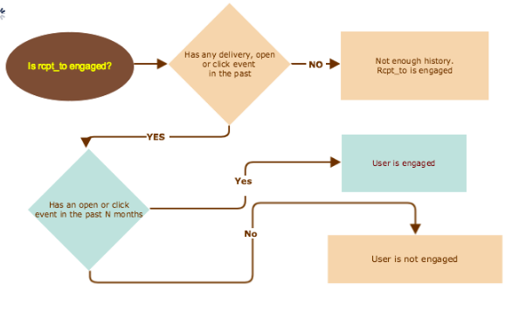
Innovation – In Practice:
Smart Send
Notes:
Redshift (with anonymized rcpt_to) for backfill; an Omni ETL module that listens for delivery, click, and open events and loads those into DynamoDB.
Redshift (with anonymized rcpt_to) for backfill; an Omni ETL module that listens for delivery, click, and open events and loads those into DynamoDB.
The endpoint will use the raw NodeJS http2 native module rather than express to minimize overhead. We will do no validation and will bypass authentication. We expect Momentum to send correctly formatted requests and will error ungracefully if the request is not made properly. Dropping validation constraints helps us reduce latency. The docs are here.

Slide 26
Innovation – In Practice:
Smart Send
Ran Tests On 10 Days Worth Of Data (What We Initially Stored) To See If There Was Any Value
Lined Up Customer Interest For Sharing and Using Service
False-Started Backfilling Data That Wasn’t Hashed….so...
Re-implemented Data Backfill From The Data Lake With Hashed rcpt_to
Deployed To Beta And Continuing To Develop New Enhancements!

Slide 27

Innovation – Doing it Right
Experiment With Shorter Windows Of Data To Determine Value
Communicate Early and Often With Your DPO
Maintain Accountability
Ensure You’re Implementing Privacy By Design
Don’t Be Afraid!

Slide 28
What’s Next

Slide 29

Regulations vs. Innovation
Team
Regulations
Team
Innovation
Notes:
Picture with rules on one side, and creativity/innocation on the other and an annoyed person in between (maybe daydreaming looking at the innovation)

Slide 30

Regulations AND Innovation: What’s Next
Learn
Ask Questions
Keep Innovating
Become a Champion
Team
Regulations
Team
Innovation

Slide 31
Build A System of Trust
Notes:
-GDPR and many of the other regulations around data and privacy protections are about empowering individuals and placing them at the center of data protection
In order to change that 2/3 of consumers who don’t trust brands with their data, you’ll need to focus on being Accountable. Accountability means including data protection and privacy in your design, and ultimately being transparent with your users about how you’re using their data.
And you do that by asking keeping data part of all the questions your ask, the technology and implementation methodolies that you use, and not being afraid to keep innovating.
If you do this right, You’ll be able to keep innovating and building a system of trust with your consumers.
Thank you very much
https://theodi.org/article/odi-survey-reveals-british-consumer-attitudes-to-sharing-personal-data

Slide 32
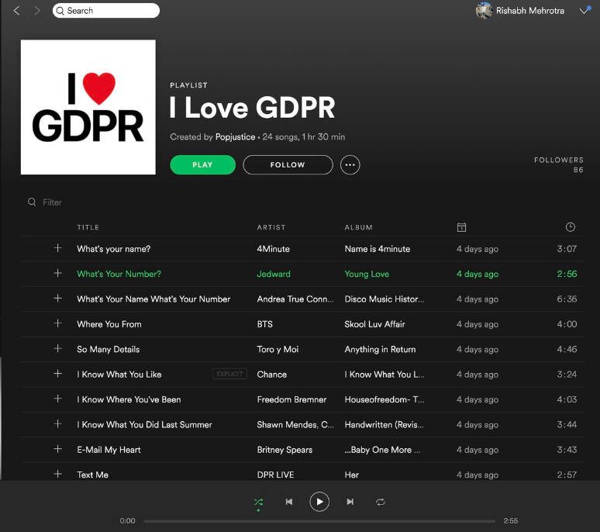
https://open.spotify.com/user/popjustice/playlist/5Pe51v0sHLybSEkX0m0JRf#_=_
Notes:
https://open.spotify.com/user/popjustice/playlist/5Pe51v0sHLybSEkX0m0JRf#_=_

Slide 33
Additional Slides

