Slide 1


Engineer Innovation Through Rapid Prototyping
Ramon Harrington, Principal Software Engineer

Slide 2
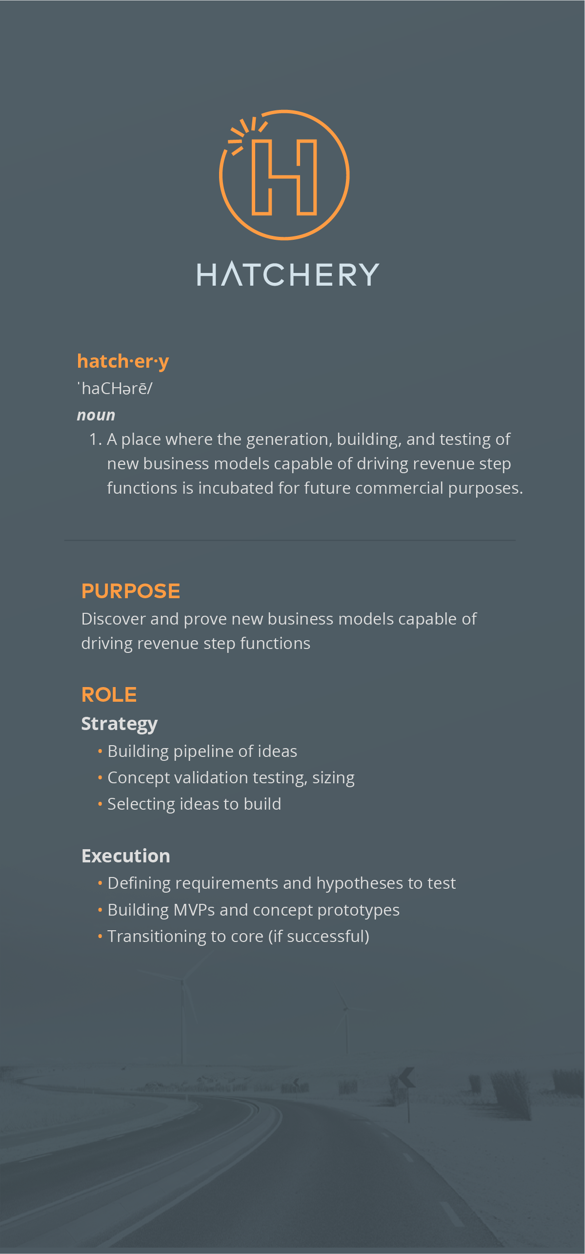

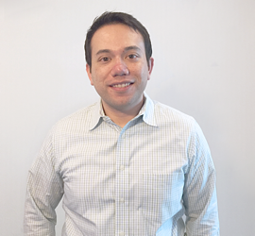



Vistaprint’s Innovation Lab
Formed 2 years ago
Small team
  1 Product Owner
  3 Engineers
  2 Designers
  1 Analyst
Identify opportunities
In-market testing
Funnel projects to Core
http://hatchery.vistaprint.com

Slide 3
Our Products

Slide 4
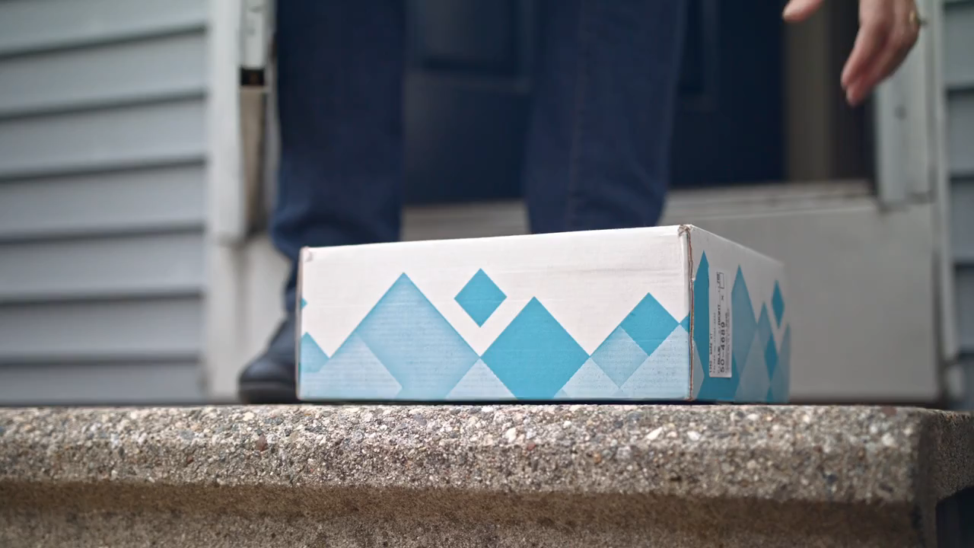

Slide 5



Individual like your business

Slide 6
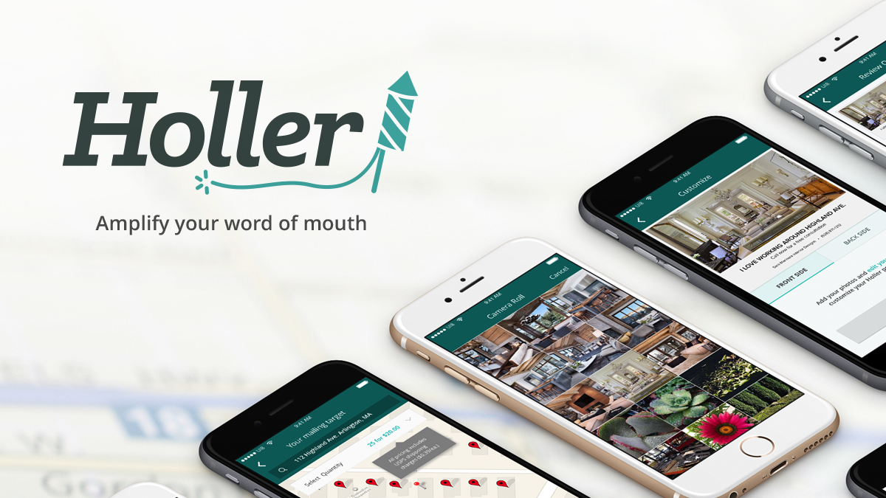

Slide 7
Our Process

Slide 8

Our Process
Ideate
Prototype
Concept Test
Build
Launch
Generate or find ideas we will pursue
Understand and visualize product
Collect feedback from potential customers
Create an interactive user experience
Get product into market and learn
1-4 hours
2-3 days
2-3 days
4-6 weeks

Slide 9



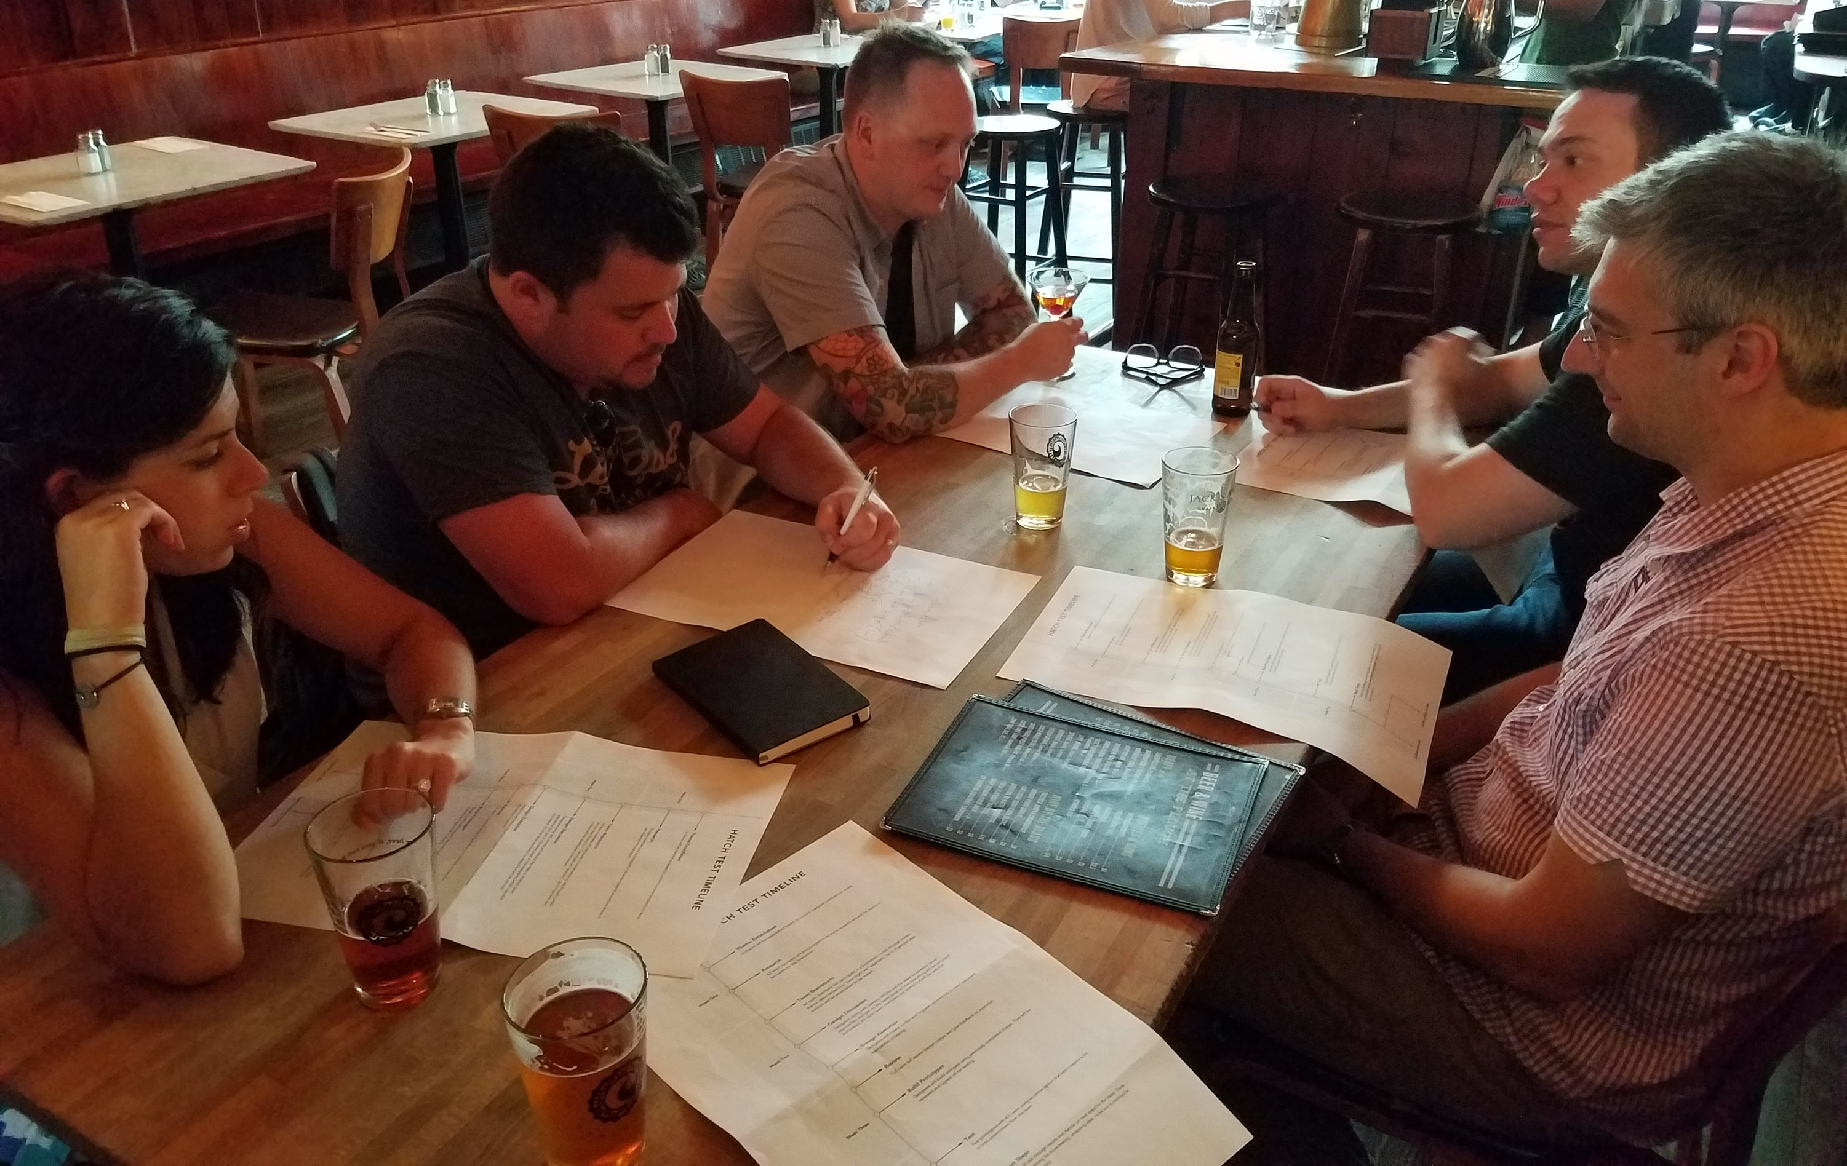

Our Process
Ideate
Prototype
Concept Test
Build
Launch
Team brainstorming
Coworkers
Analogous experiences

Slide 10
Our Process
Ideate
Prototype
Concept Test
Build
Launch

Slide 11
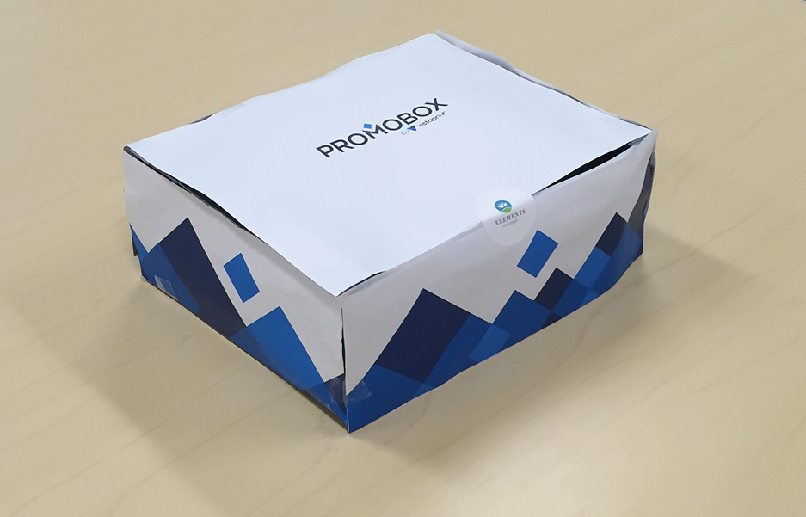
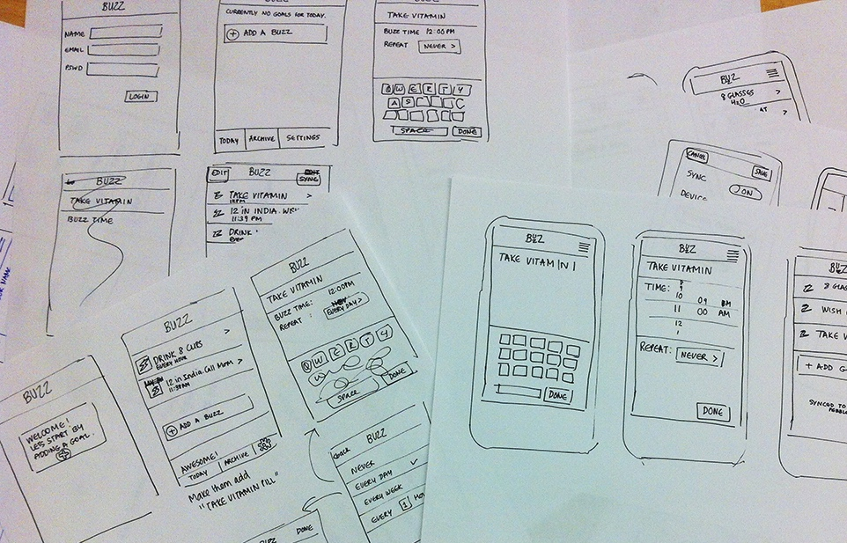
Our Process
Ideate
Prototype
Concept Test
Build
Launch
Paper prototypes
Sketches

Slide 12
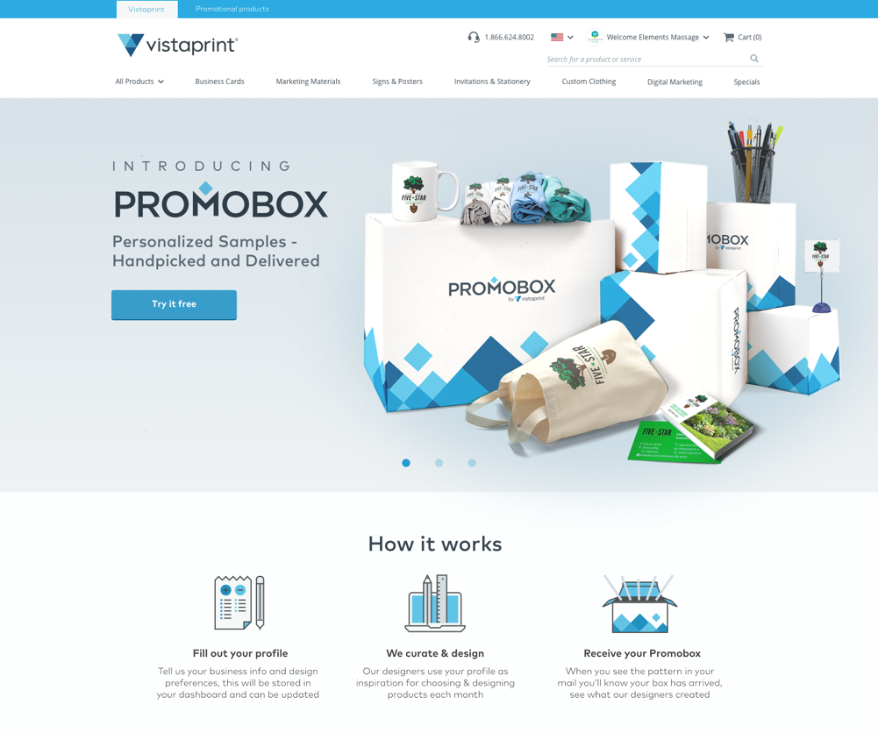
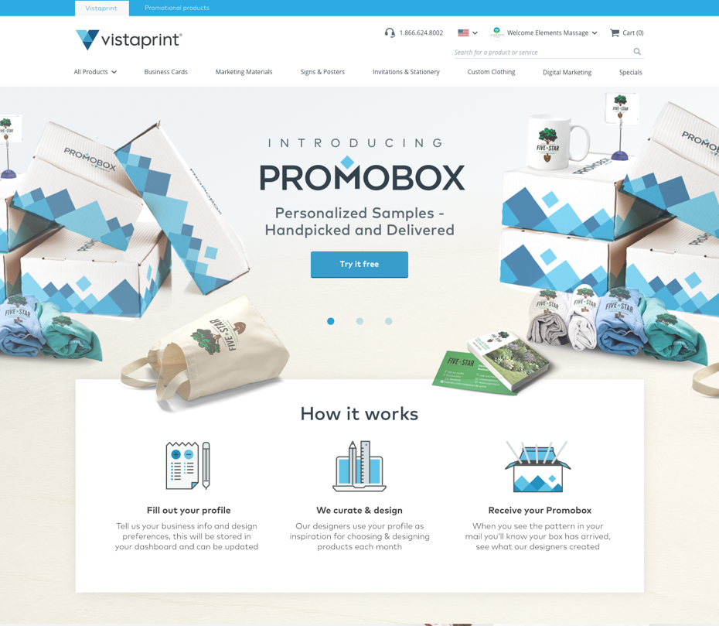
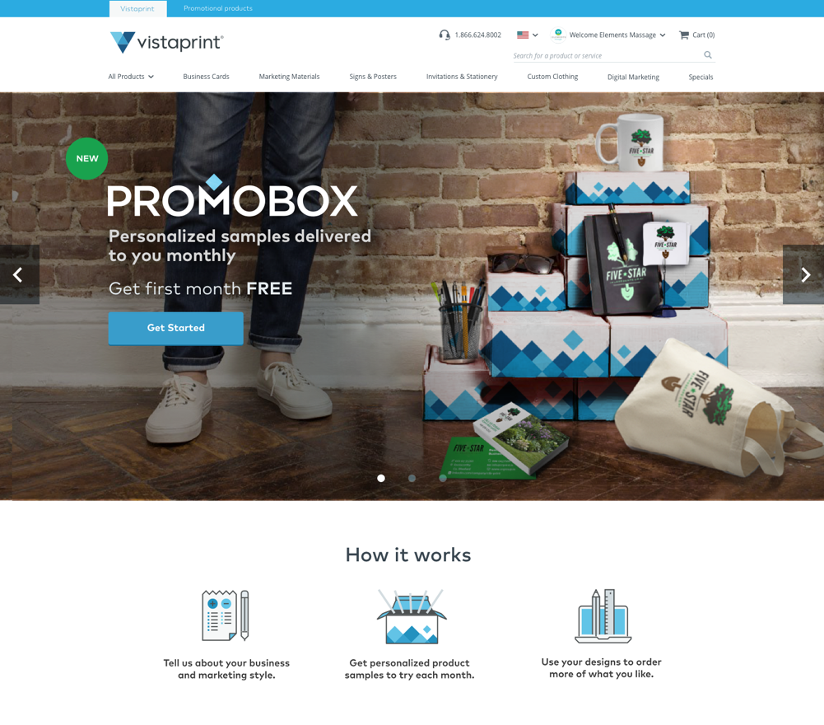
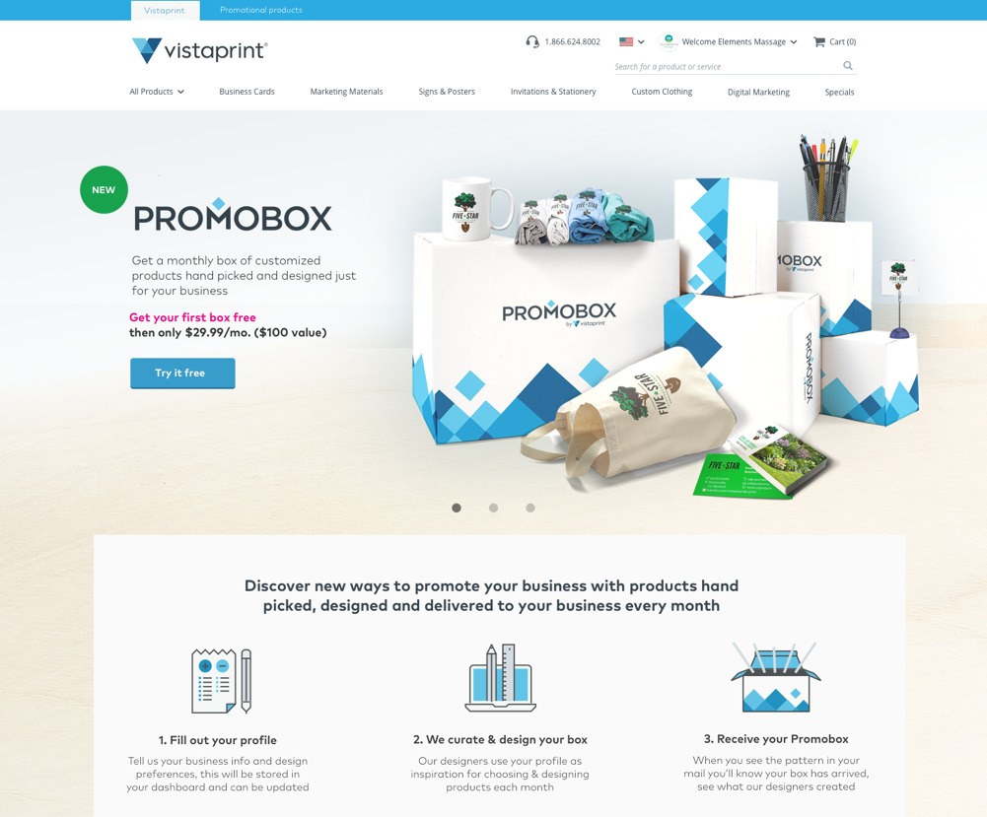
Our Process
Ideate
Prototype
Concept Test
Build
Launch
High-fidelity visual prototypes to experiment with features

Slide 13
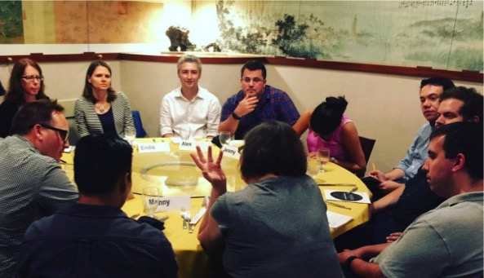
Our Process
Ideate
Prototype
Concept Test
Build
Launch
Customer feedback sessions

Slide 14
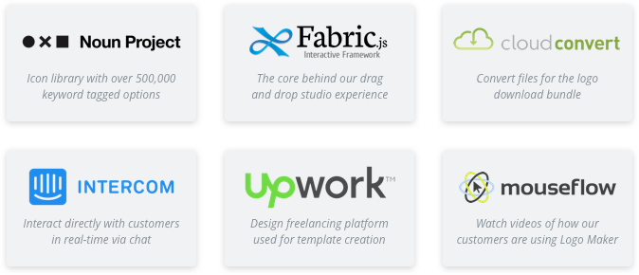
Ideate
Prototype
Concept Test
Build
Launch
Our Process
Ideate
Prototype
Concept Test
Build
Launch
Leverage third-party tools and services

Slide 15
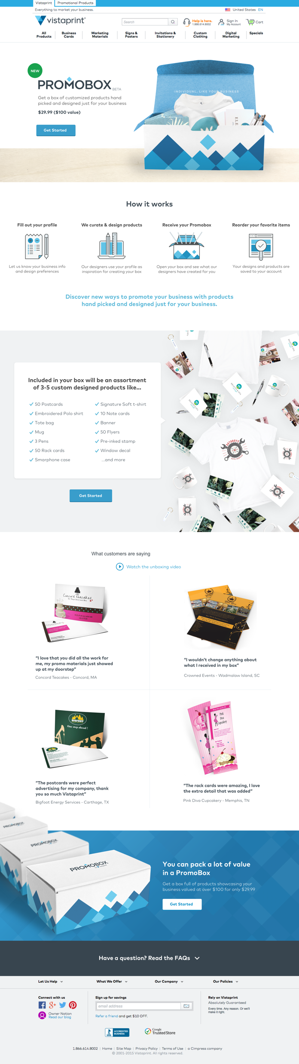
Our Process
Ideate
Prototype
Concept Test
Build
Launch
Release the product
Learn from users

Slide 16
Lessons Learned

Slide 17
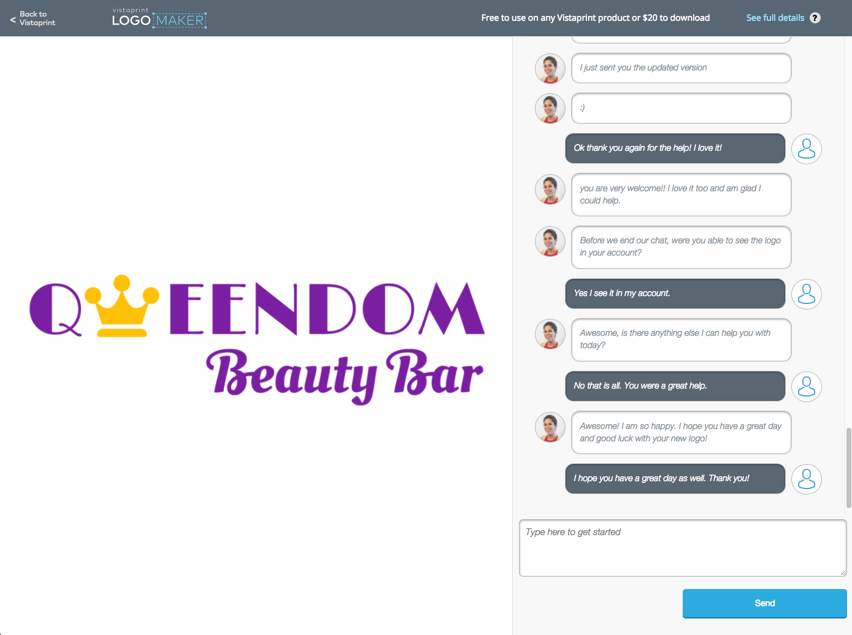
Lessons Learned
Simultaneous chats
Don’t worry about scale
You won’t have an overwhelming number of users right away – that doesn’t happen

Slide 18
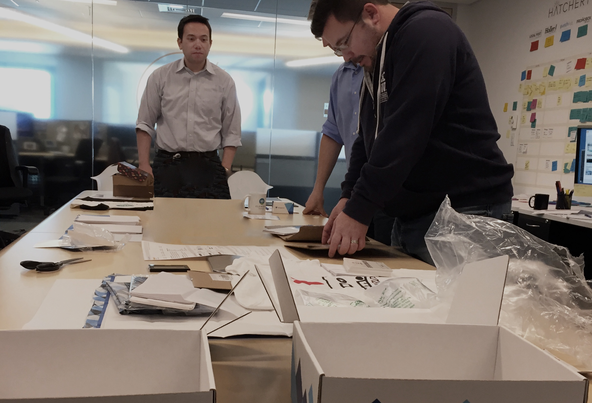
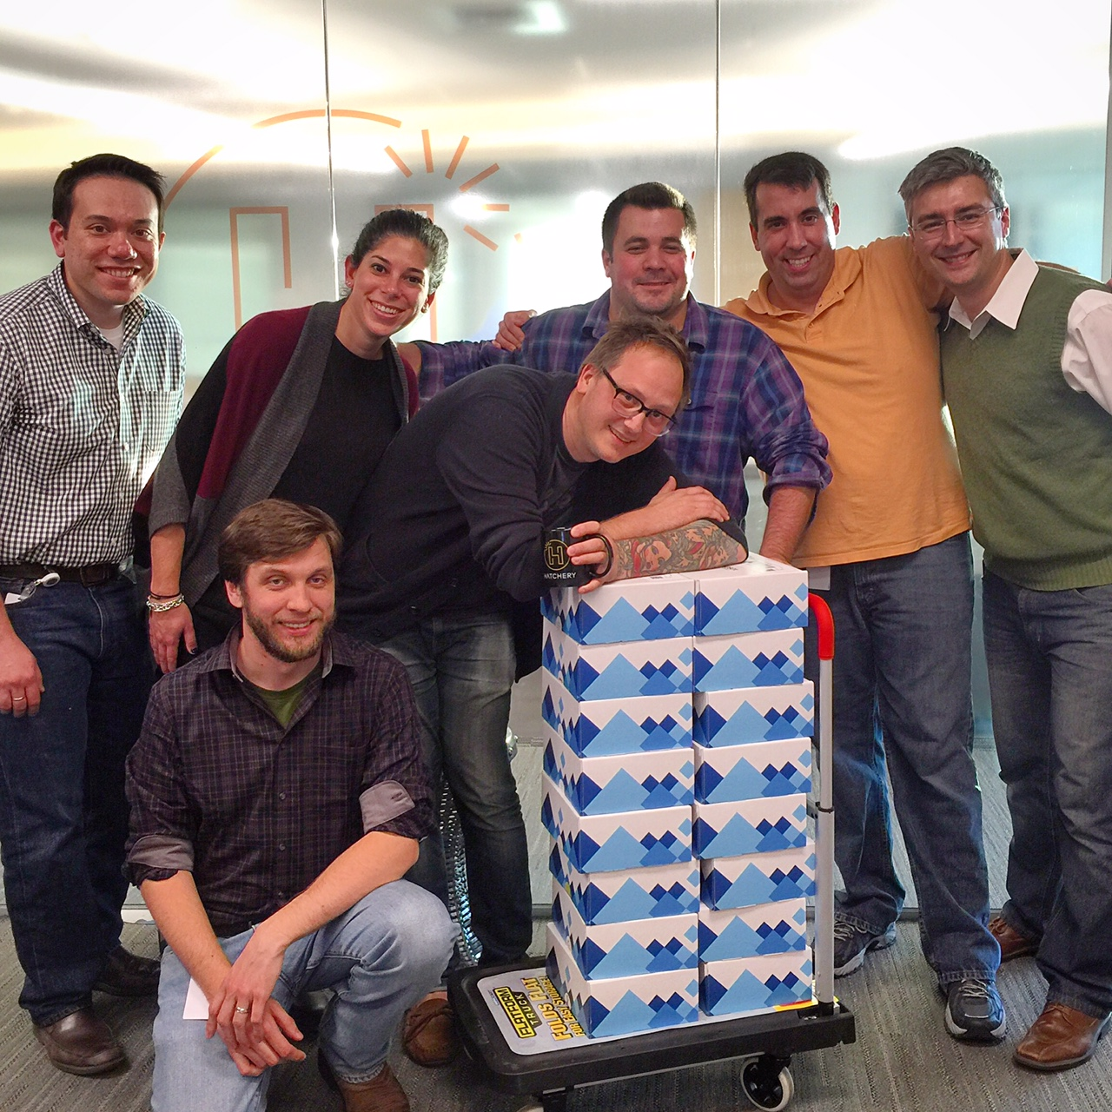
Lessons Learned
Only automate what you understand well
Promobox Fulfillment
You need to know what the process is before you can design a scalable version of it

Slide 19
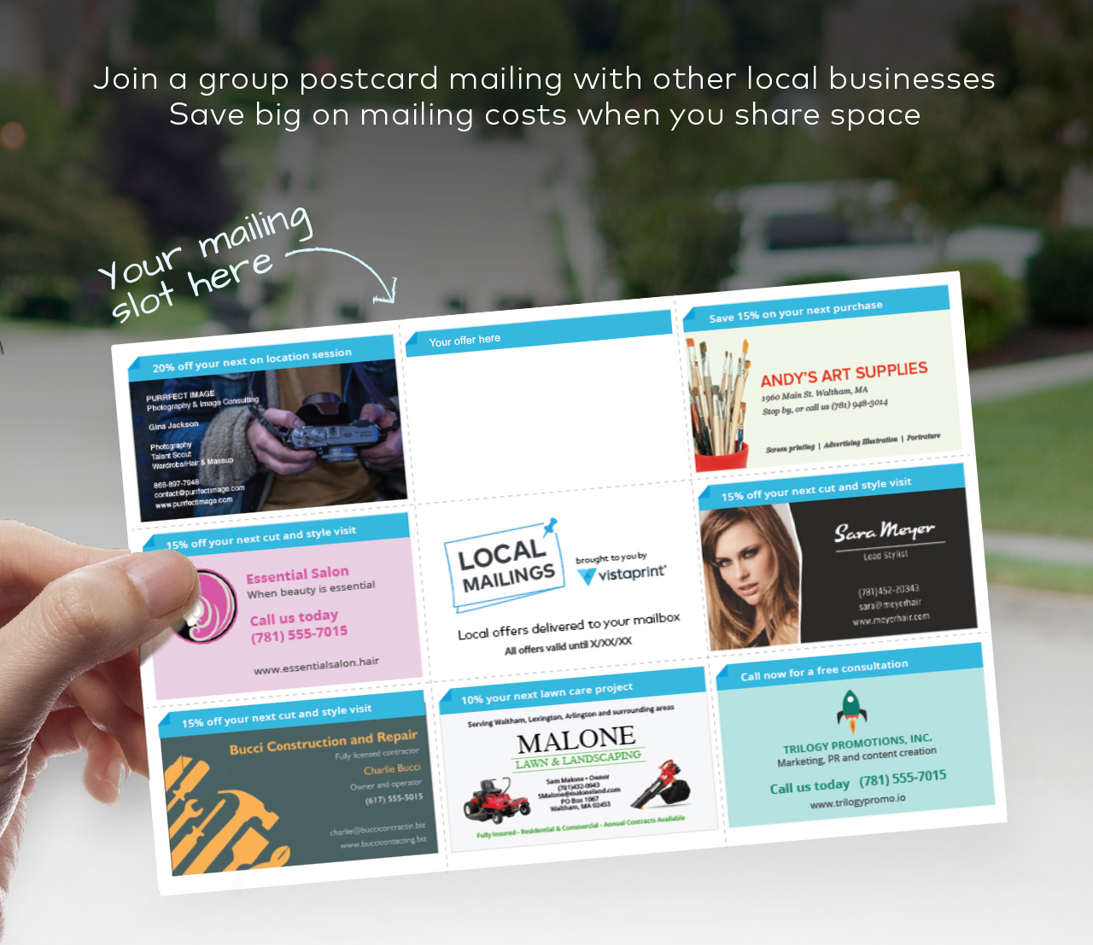
Lessons Learned
Manhattan vs Montauk
Can it work in the best-case scenario?
If it can’t catch on in the best conditions, then it can’t anywhere

Slide 20
Lessons Learned
Internet Explorer vs Chrome
Focus on the serving the most users with the least effort
Avoid spending a lot of time trying to serve a small subset of your users

Slide 21
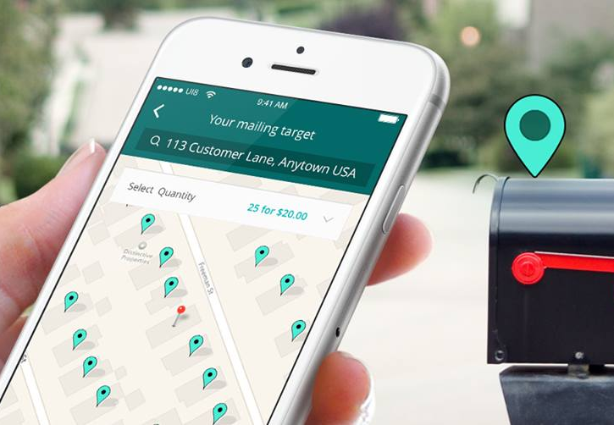
Lessons Learned
Feature Set vs Payment Processing
Build toward your learning agenda
Make sure you’re spending time learning what you don’t know

Slide 22
Lessons Learned
Sometimes the software that you don’t write, is more important than the software that you do.

Slide 23
Questions?

