Slide 1
Refactoring Organizations
A Netflix Study
Josh Evans – (Former Netflix) Engineering Leader at Large
June 26, 2017

Slide 2
2009
Streaming

Slide 3
Devices
…

Slide 4
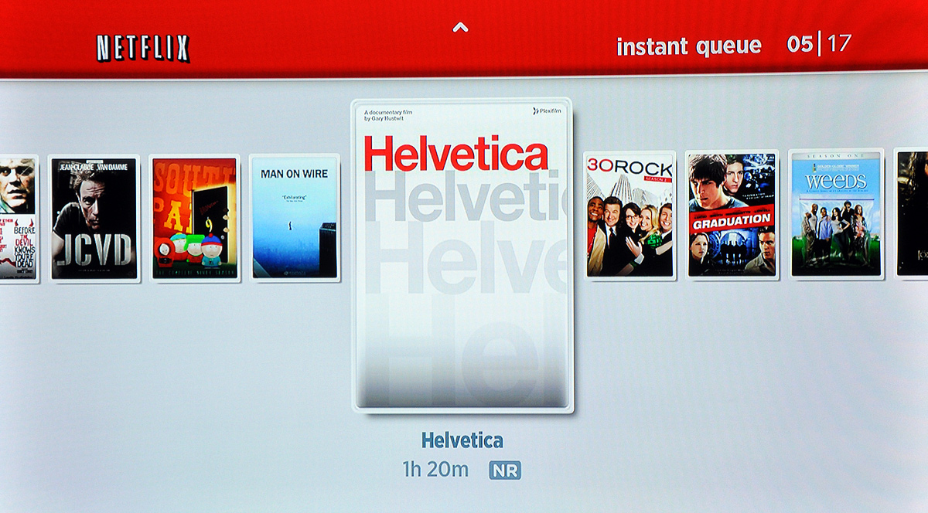
Queue Reader UX

Slide 5
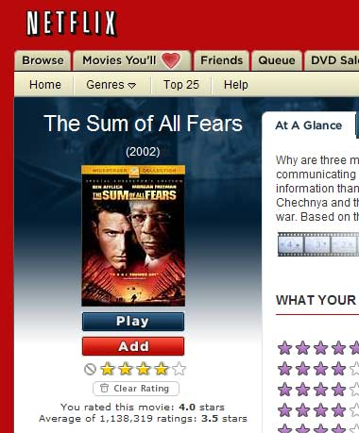
DVD Foundation

Slide 6
Electronic Delivery
Customer Device
Netflix Data Center
Netflix App
UI
HTTP/S
Security
Activation
Playback
Load Balancer
NCCP
DVD Legacy
Platform (NRDP)
XML/RPC
Ticket-based security
Custom responses
DVD Legacy
DB

Slide 7
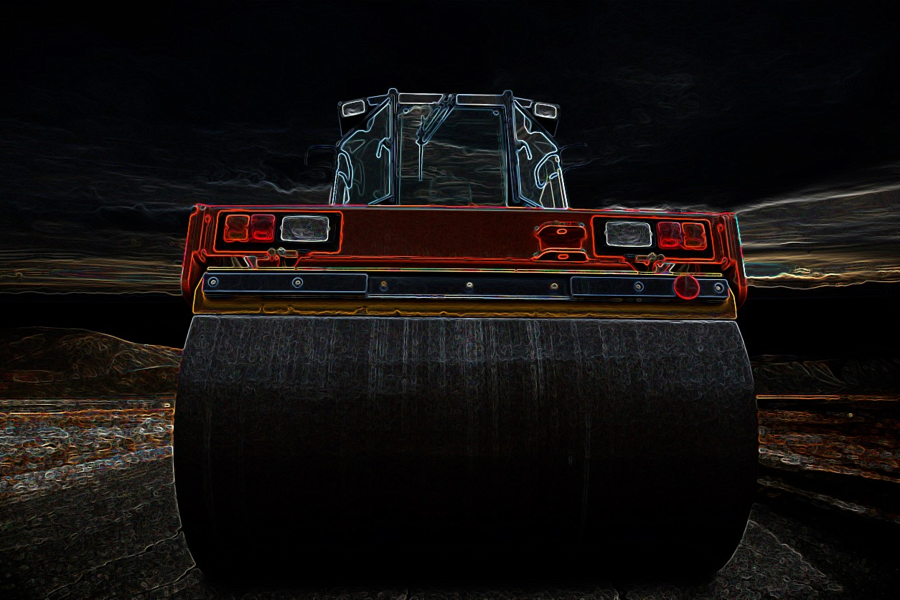

Slide 8
Netflix API

Slide 9
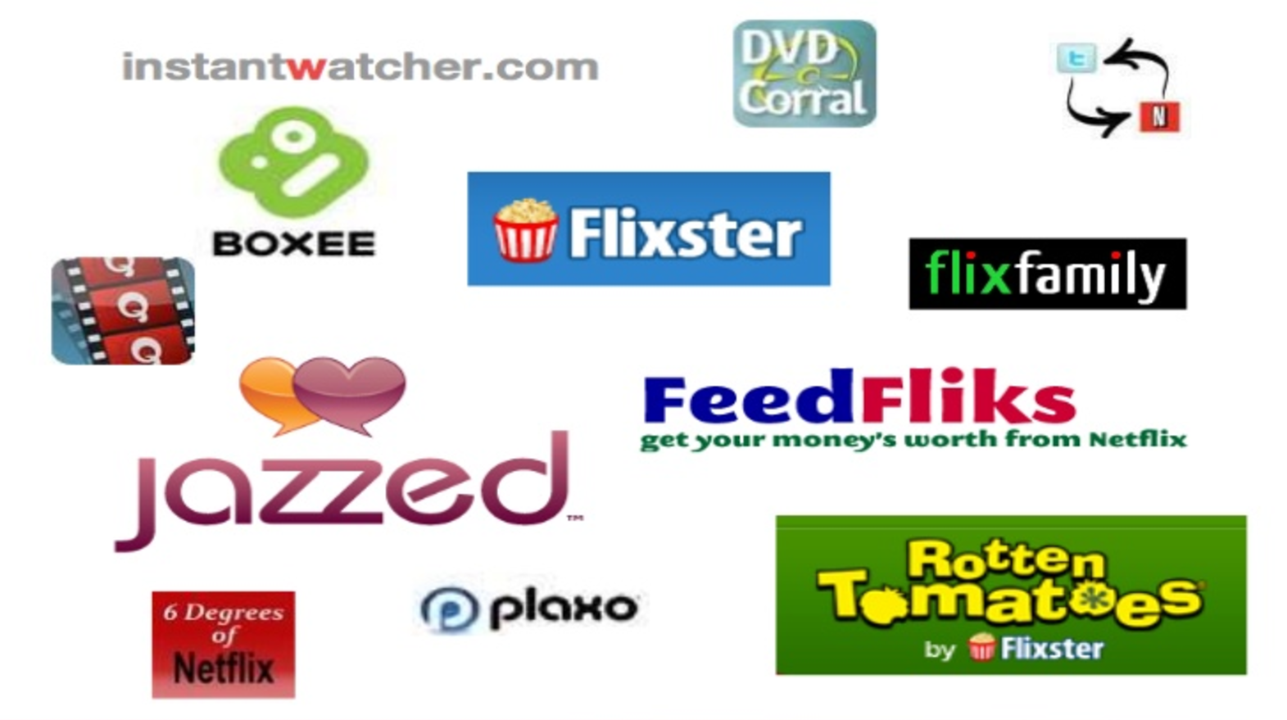
Let 1000 flowers bloom!

Slide 10
Netflix API
Netflix Data Center
HTTP/S
Application
Load Balancer
API
REST API
JSON schema
HTTP response codes
Oauth
Content Metadata

Slide 11
Proposal
Netflix Data Center
Content Metadata
Customer Device
Netflix App
content discovery
LB
API
UI
Security
Activation
Playback
playback, security, platform
LB
NCCP
Platform (NRDP)
ED

Slide 12
Assessment
Pros
Cons
Separation of concerns
Bandwidth
Increased innovation
API reliability
Heterogeneous architecture
Lack of domain knowledge

Slide 13
Neil Hunt, CPO

Slide 14
What was the reaction?

Slide 15
Concern
Anger

Slide 16
Tribalism

Slide 17
Conway’s Law
Notes:
Melvin Conway

Slide 18
If you have four teams working on a compiler you will end up with a four pass compiler

Slide 19
Today’s Premise
Conway’s Law describes dysfunction
We must embrace architecture before organization
Technical analogs drive better organizational solutions

Slide 20
Selfless Leadership
Company
Team
You
In that order!

Slide 21
Today’s Program
Introductions
Framework
Scaling Teams
IQ v EQ
Conway’s Revenge

Slide 22
Today’s Program
Introductions
Framework
Scaling Teams
IQ v EQ
Conway’s Revenge

Slide 23
Josh Evans – Engineering Leader at Large
@
1999 – 2009
Ecommerce (DVD → Streaming)
2009 – 2013
Streaming Infrastructure
2013 - 2016
Operations Engineering
2017
Time off, exploring options
@ops_engineering

Slide 24
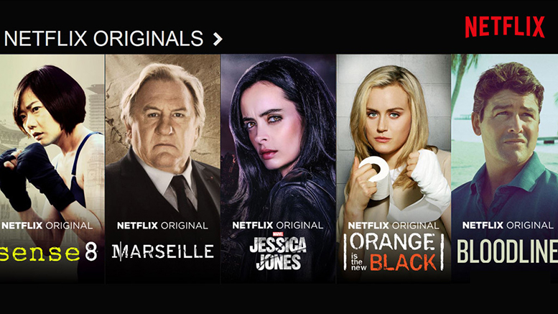
Global leader in subscription internet TV
Growing slate of original content
100 million members
190 countries, 10s of languages
1000s of device types
Microservices on AWS
Unique company culture

Slide 25
Today’s Program
Introductions
Framework
Scaling Teams
IQ v EQ
Conway’s Revenge

Slide 26
Why do we refactor?

Slide 27
We refactor to improve or sustain
Functionality
Engineering velocity
Functional and operational quality
As we scale!

Slide 28
Functional Scalability
The ability to enhance a system by adding new functionality at minimal effort
Load Scalability
The ease with which a system or component can be modified, added, or removed, to accommodate changing load

Slide 29
Organizational Scalability
The ability for an organization to easily add people and domain responsibilities in response to increased work and complexity
The ease with which an organization or team can adapt to shifts in business strategy

Slide 30
When do we refactor?
Common tasks are difficult
Strategic efforts are impractical or impossible

Slide 31
How do we refactor?

Slide 32
Technical Patterns
Object-oriented design
Micro-service architecture
Systems engineering

Slide 33
Example: Organizational Polymorphism

Slide 34
Netflix Culture
With the right people
Instead of a culture process adherence
We have a culture of creativity and self discipline, freedom and responsibility

Slide 35
You build it You run it

Slide 36
Today’s Program
Introductions
Framework
Scaling Teams
IQ v EQ
Conway’s Revenge

Slide 37
2009
Streaming

Slide 38
Devices in Production
…

Slide 39
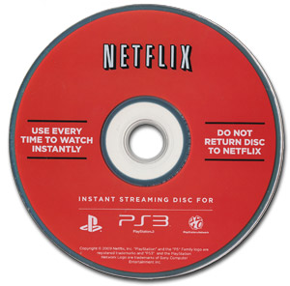
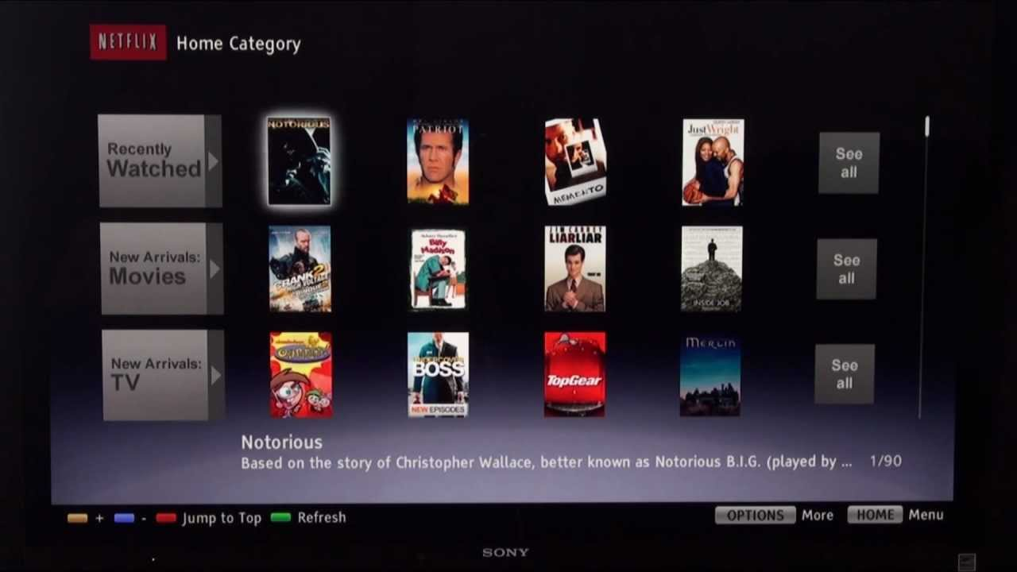
Key Platforms in Progress

Slide 40
Anthony Park

Slide 41
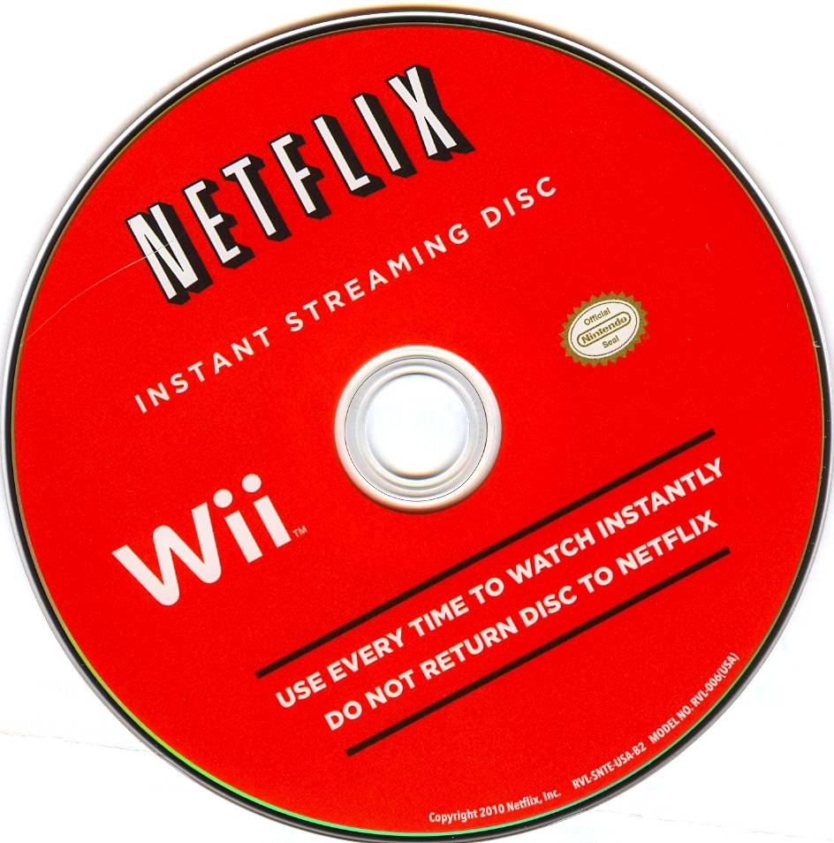
Surprise!
John Funge

Slide 42
Big Picture
Device Ubiquity
Product Innovation
Internationalization
Cloud Migration
Service Reliability

Slide 43
How many engineers?
6

Slide 45
What would you do?

Slide 46
Prioritize & Queue
Task Queue
…
Thread Pool
…
…
Completed Tasks
…

Slide 47
Prioritize & Queue
Prioritize
Queue
Service availability
Game consoles
Downloadable apps
CE expansion
Mobile
…
Audio & subtitles
International support
New codecs
…

Slide 48
Scale Up
Work profile
Roles & throughput
Team structure

Slide 49
Monolithic Team
Manager
Engineer
Engineer
Engineer
Engineer
Engineer
Test/Ops
One leader
Undifferentiated roles
Ad hoc responsibilities

Slide 50
Monolithic Decomposition
Distinct modules & services
Workload partitioning
Dependency awareness
Loose coupling

Slide 51
Streaming Infrastructure
Server
NRDP Features
Protocols Security
Bootstrap
Key Platforms
Device integration
Device launch
Device & partner-oriented load balancing

Slide 52
On Call Overload

Slide 53
Vicious Cycle
Philip was great at
Development
Test infrastructure
Project management
Troubleshooting
Philip Fisher-Ogden

Slide 54
You build it You run it

Slide 55
Risks
Burnout
Slow progress on key initiatives
Philip Fisher-Ogden

Slide 56
Thread Starvation
Shared
exclusive
resource
Tasks
…
…
High priority/frequency
Other - blocked
Notes:
A thread is unable to gain regular access to shared resources and is unable to make progress

Slide 57
Context Switching
OS
Interrupt or system call
Process 1
Process 2
Executing
.
Save state - pcb₁
Idle
.
Get state – pcb₂
Idle
Interrupt or system call
Executing
Save state – pcb₂
.
.
Get state – pcb₁
Idle
Executing

Slide 58
Thread Pool Isolation
Partition pools & locks
Distribute problematic workloads
…
…
…
…
…
…
…
…

Slide 59
Organizational Solution
Deepen troubleshooting skills
Distribute escalations
Engineer operations

Slide 60
Consolidating Operations Engineering
Key Platforms
Device integration
Device launch
Server
NRDP
Protocols Security
Bootstrap
Insight/Tools
Delivery Dashboards
Performance
Operational tools

Slide 61
Cloud Migration

Slide 62
Cloud v. Product
Rapid iteration v. systematic, long-cycle execution

Slide 63
Heterogeneous Workloads
Member Traffic
Batch Processes
. . .
. . .
S
S
S
. . .
S
DB
DB
DB
. . .
DB

Slide 64
Interference
Member Path
Batch
Member Path
Batch
Member Path
Batch
. . .
. . .
S
S
S
. . .
S
DB
DB
DB
. . .
DB

Slide 65
Interference
Member Path
Batch
Member Path
Batch
Member Path
Batch
. . .
. . .
S
S
S
. . .
S
DB
DB
DB
. . .
DB

Slide 66
Interference
Member Path
Batch
Member Path
Batch
Member Path
Batch
. . .
. . .
S
S
S
. . .
S
DB
DB
DB
. . .
DB

Slide 67
Interference
Member Path
Batch
Member Path
Batch
Member Path
Batch
X
. . .
. . .
S
S
S
. . .
S
DB
DB
DB
. . .
DB

Slide 68
Partitioning
Member Path
Batch
Member Path
Batch
Member Path
Batch
. . .
. . .
S
S
S
. . .
S
Online
Offline
DB
DB
DB
. . .
DB

Slide 69
Silverlight Migration

Slide 70
Partitioning & Domain Portability
Streaming Infrastructure
Platform Engineering
Engineer as a Library
Ranjit
Ranjit

Slide 71
Partitioning & Domain Portability
Streaming Infrastructure
Platform Engineering
Engineer as a Library

Slide 72
Streaming Infrastructure
Systems
Cloud migration
Key Platforms
Device integration
Device launch
Server
NRDP
Protocols Security
Bootstrap
Insight/Tools
Delivery Dashboards
Performance
Ops tools

Slide 73
Staffing

Slide 74
6 → 24

Slide 75
Bottleneck

Slide 76
Cloning & Parallel Processing
Systems
Cloud migration
Viewing history
Viewing sessions
Key Platforms
Device integration
Device launch
Server
NRDP
Protocols Security
Bootstrap
Insight/Tools
Delivery Dashboards
Performance
Ops tools

Slide 77
By 2012
cloud migration
Canada, Latin America, UK
massive device expansion
major product improvements
Netflix CDN

Slide 78
Today’s Program
Introductions
Framework
Scaling Teams
IQ v EQ
Conway’s Revenge

Slide 79
Bimodal Thinking
IQ
EQ
Task-oriented
Logical
Literal
Detached
Autocratic
Feeling-oriented
Emotional
Social
Empathetic
Democratic

Slide 80
Overcoming Tribalism
IQ
EQ
Design
Evaluation
Implementation
Inception
Socialization

Slide 81
Flawed Inception

Slide 82
Today’s Program
Introductions
Framework
Scaling Teams
IQ v EQ
Conway’s Revenge

Slide 83
2012
Streaming

Slide 84
This…
Netflix Data Center
Content Metadata
Customer Device
Netflix App
content discovery
LB
API
UI
Security
Activation
Playback
playback, security, platform
LB
NCCP
Platform (NRDP)
ED

Slide 85
…has become this
Zuul
ELB
API
NCCP

Slide 86
…and this
ELB

Slide 87
Growing complexity
Duplication of effort
Engineering tax
Notes:
Leading to
Slower innovation
Longer service outages
Inefficiency

Slide 88
Raising the Stakes
Playback start in 500ms
More UI/Playback scenarios
Faster rate of innovation
Better service reliability

Slide 89
When do we refactor?
Common tasks are difficult
Strategic efforts are impractical or impossible

Slide 90
Conway’s Revenge!
If you have four teams working on a compiler you will end up with a four pass compiler
We had two teams and a two-service edge architecture

Slide 91
A Better Foundation
Mature API team
Robust API platform
Strong operational focus
Trust & respect
Daniel Jacobson

Slide 92
Moment of Truth
Josh: what’s the right architectural solution?
Peter: do you care about the organizational implications?

Slide 93
Selfless Leadership

Slide 94
Moment of Truth
Josh: what’s the right architectural solution?
Peter: do you care about the organizational implications?
Josh: no – we’ll figure that out later

Slide 96
Before
Zuul
ELB
API
NCCP

Slide 97
After
Integrated architecture
Distributed functionality
Shared services
Common practices

Slide 98
Edge Services
Edge Services
Zuul
API Server
Insight/Tools
Playback Services
Features
Security
Platform
Data Systems
Shared services
Organized around microservices, functionality, shared services

Slide 99
Takeaways
Put architecture first
Leverage technical analogs
Know when to use IQ v EQ
Be selfless

Slide 100
Where to find me
www.linkedin.com/in/jevansnflx

Slide 101
Refactoring Organizations
?

