Slide 1
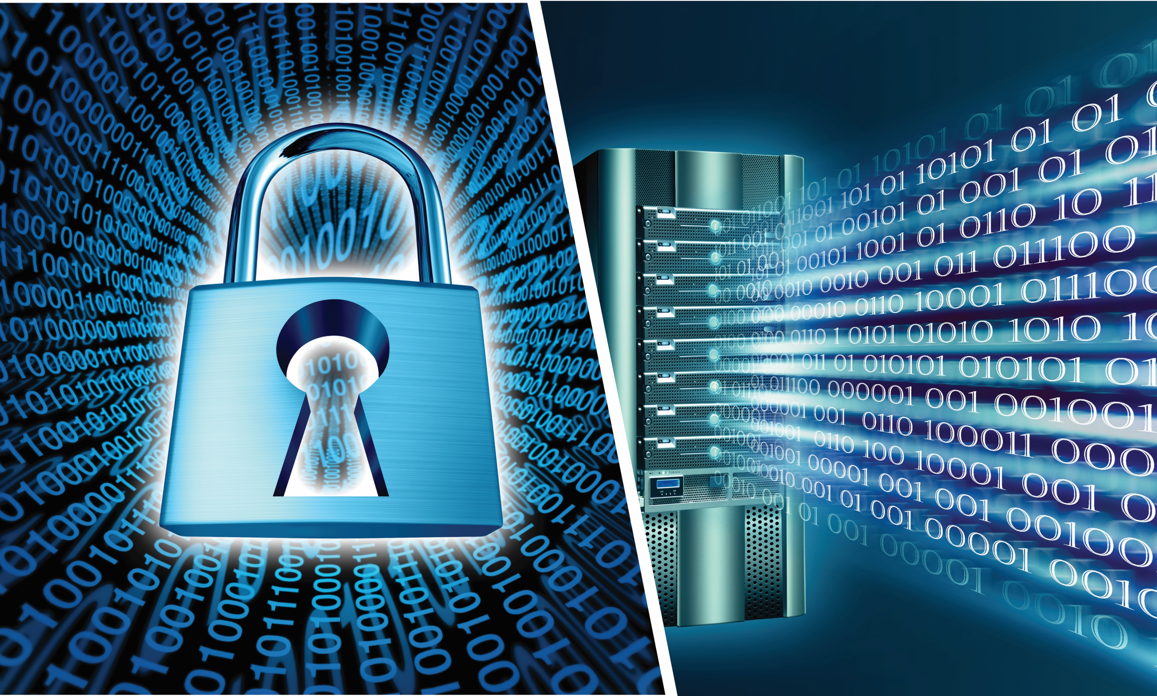

SECURITY DREAMS AND NIGHTMARES
Alex Holden
CISO - Hold Security, LLC
www.holdsecurity.com

Slide 2

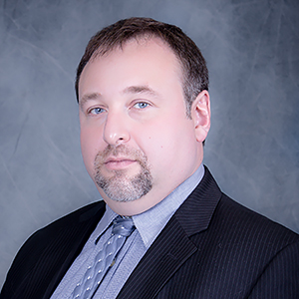
Who Am I?
IT Professional
Security Researcher
Hacker Hunter

Slide 3
Threat Intelligence
Staying ahead of hackers
6,600,000,000 stolen credentials recovered
4,000,000,000 botnet logs collected
100,000,000 financial records recovered
5,000,000 site compromises identified

Slide 4

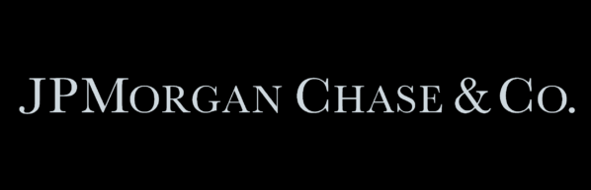










My Resume

Slide 5
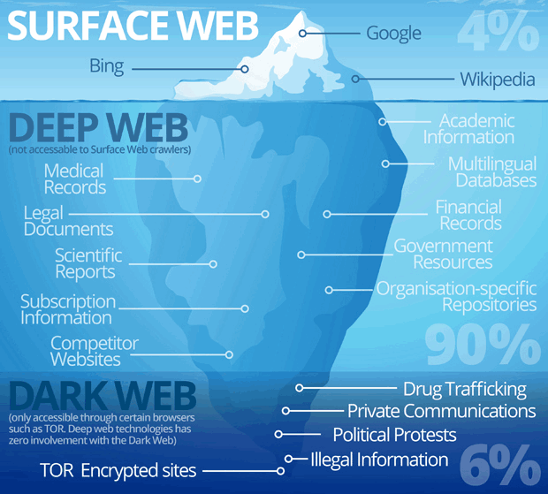
Terminology
Internet - Intended to be Public
Deep Web - Intended to be Private
Dark Web - Intended to be Hidden

Slide 6
Dark Web Components
Spam
Cash Out
Drugs
ID Theft
Ransomware
Injects
Cyber Warfare
Shop & Drop
Weapons
Verification
Denial of Service
Industrial Espionage
Defacement
Botnet
Hijacking
Impersonations
Viruses
0days
Social scams
(dating)
Hacktivism
Phishing
Crypting
Hacking

Slide 7
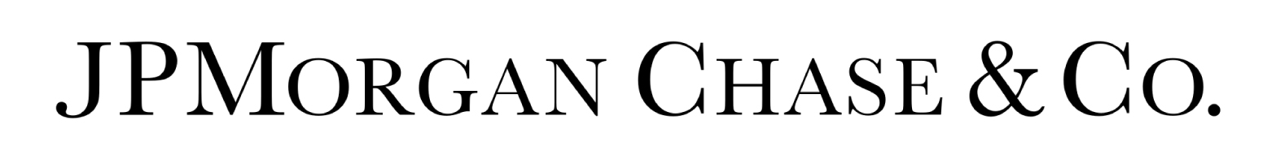

When You Do Security Right, Does Anyone Notice?
JP Morgan Breach 2014
  Breach full impact never disclosed
  $250,000,000 budget allocated toward security
  No major incidents since
United Airlines
  Changed authentication system to combat mass abuse
  Bug bounty program
  One of least preferred brands by hackers

Slide 8

Practical Example
Medical Company X
Embraced Cloud
Embraced DevOps Culture
Serious Approach to Incidents
Hackathons and Blame-Free Bug Bounties
Security Liaisons Throughout the Business

Slide 9
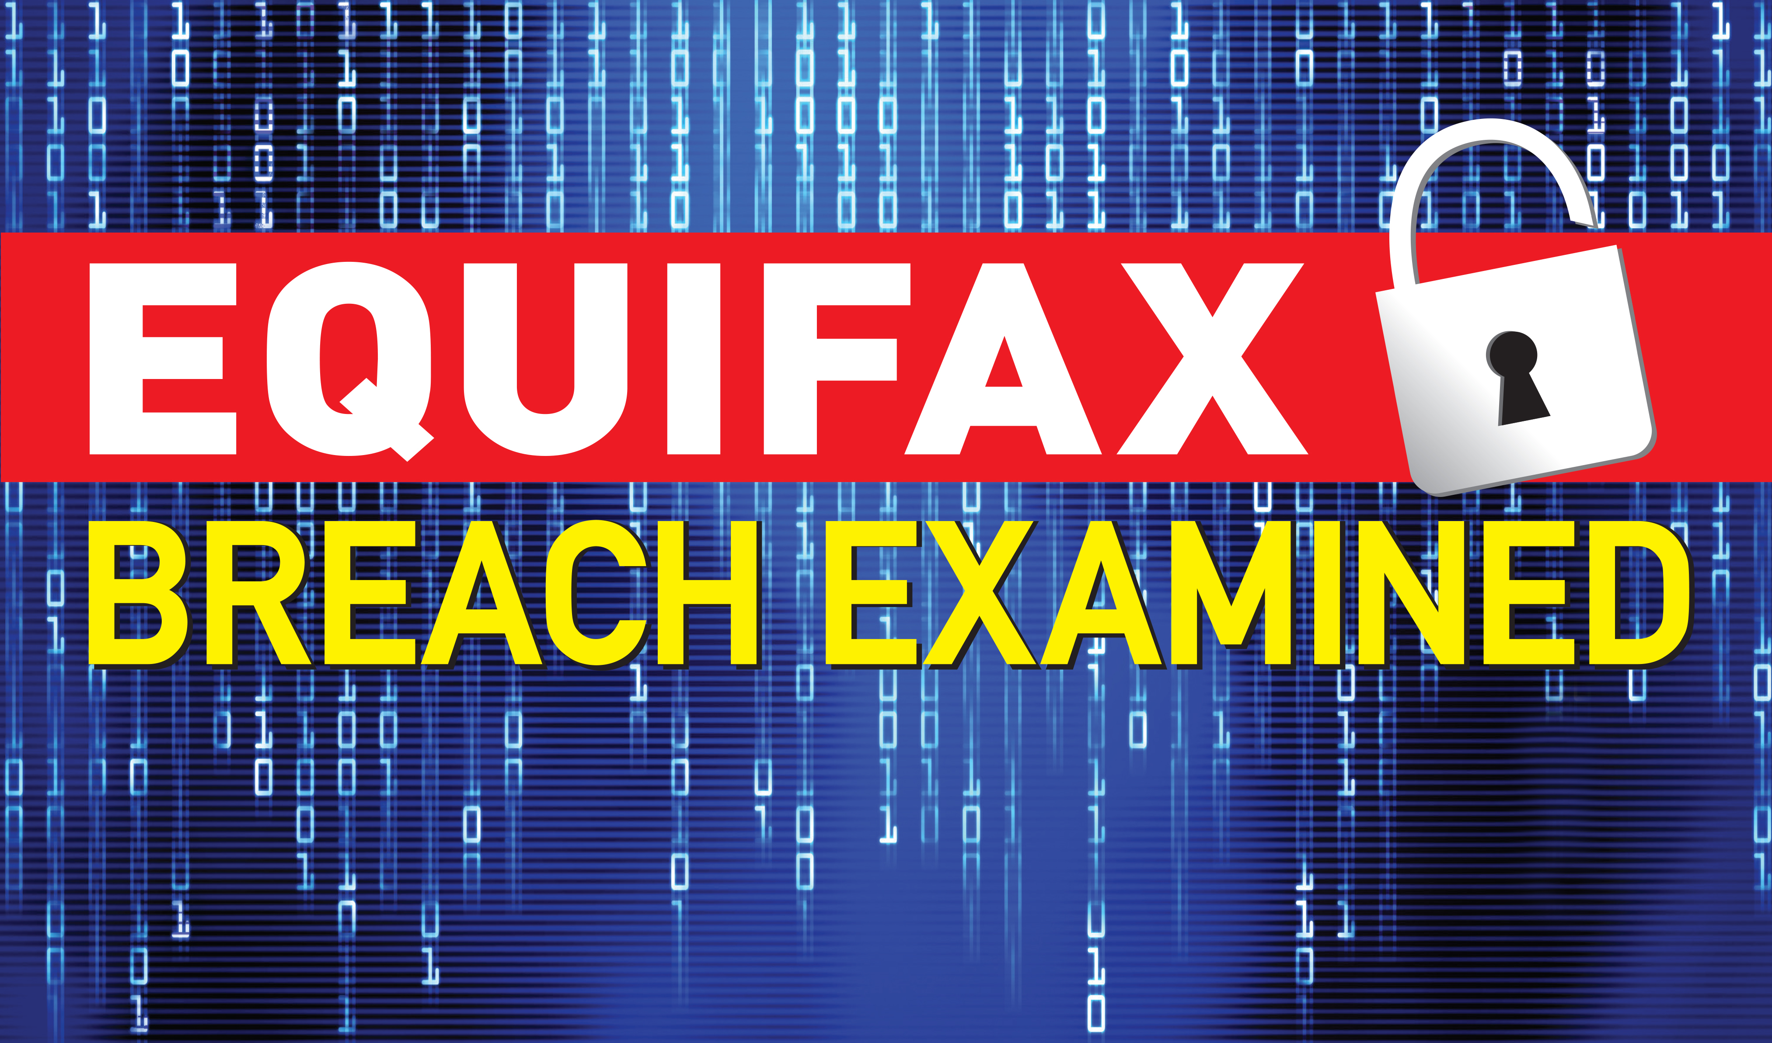

Slide 10
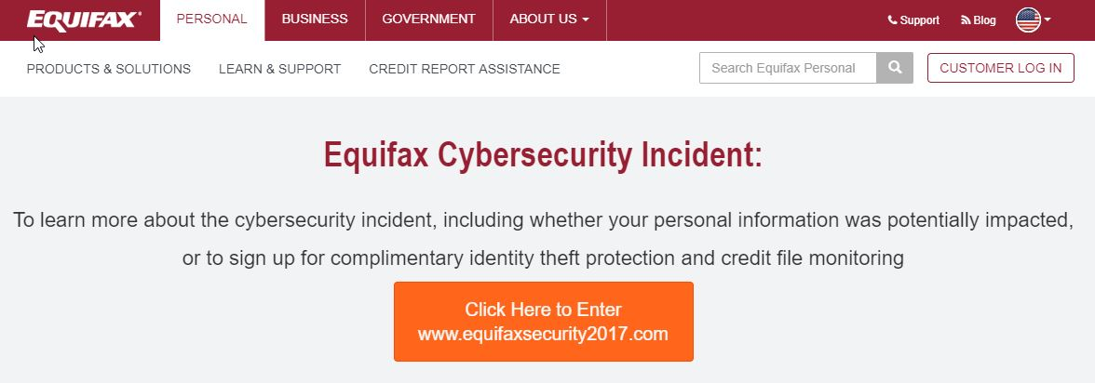
What Happened?
July 29, 2017 – Discovery
Struts2 exploit
6 week delay
PANIC!

Slide 11
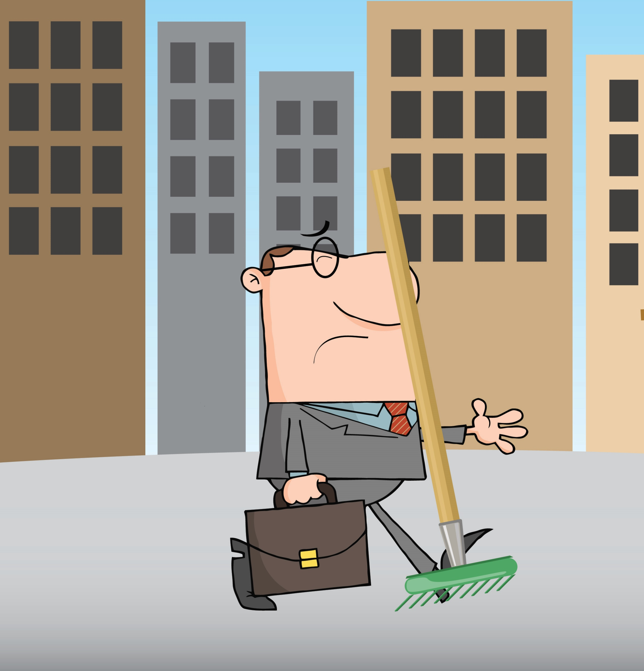
What Went Wrong?
Single point of failure – struts 2?
No one watched on the inside?
Stealing tons of data goes unnoticed?

Slide 12
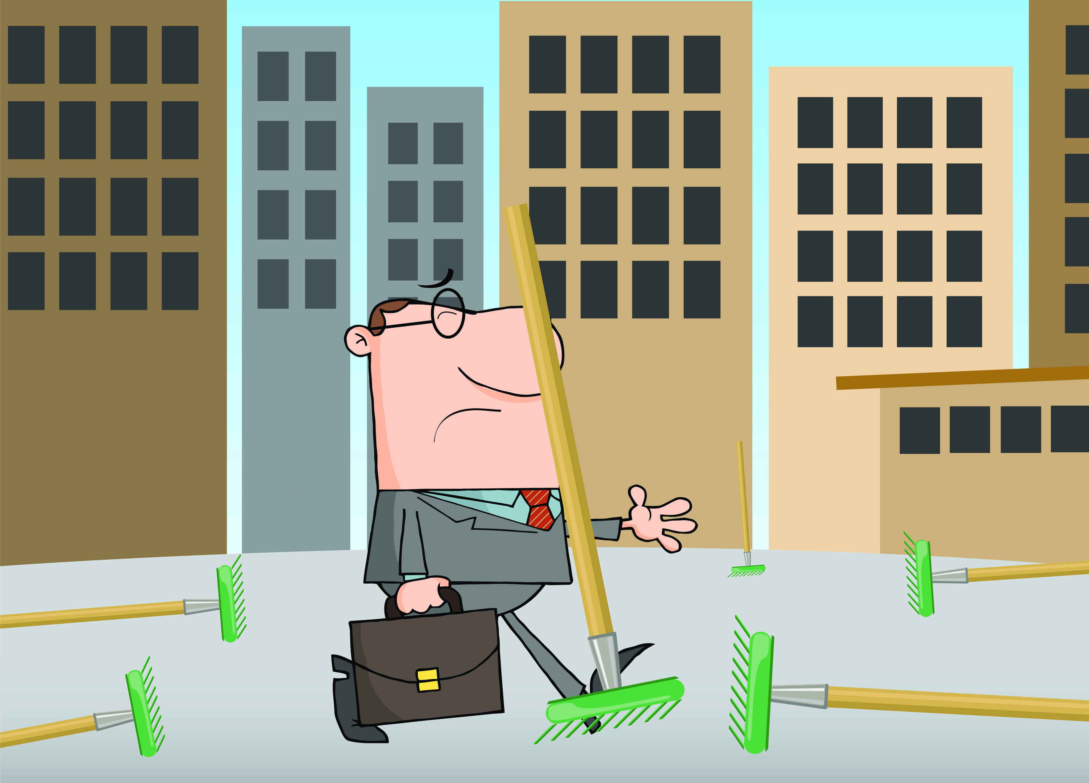
What Else is Wrong?
No consent data aggregation
Protection offered insufficient and self-serving
No recourse
Long term damage

Slide 13
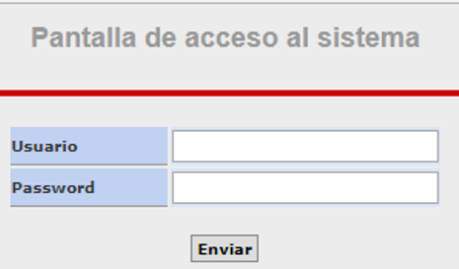
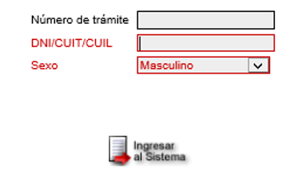
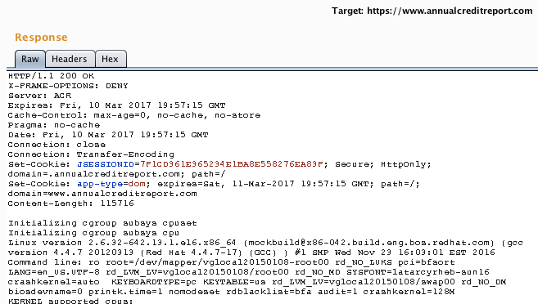
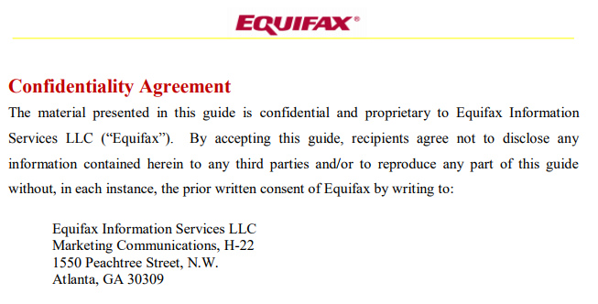
How Secure is Equifax?
admin
admin

Slide 14
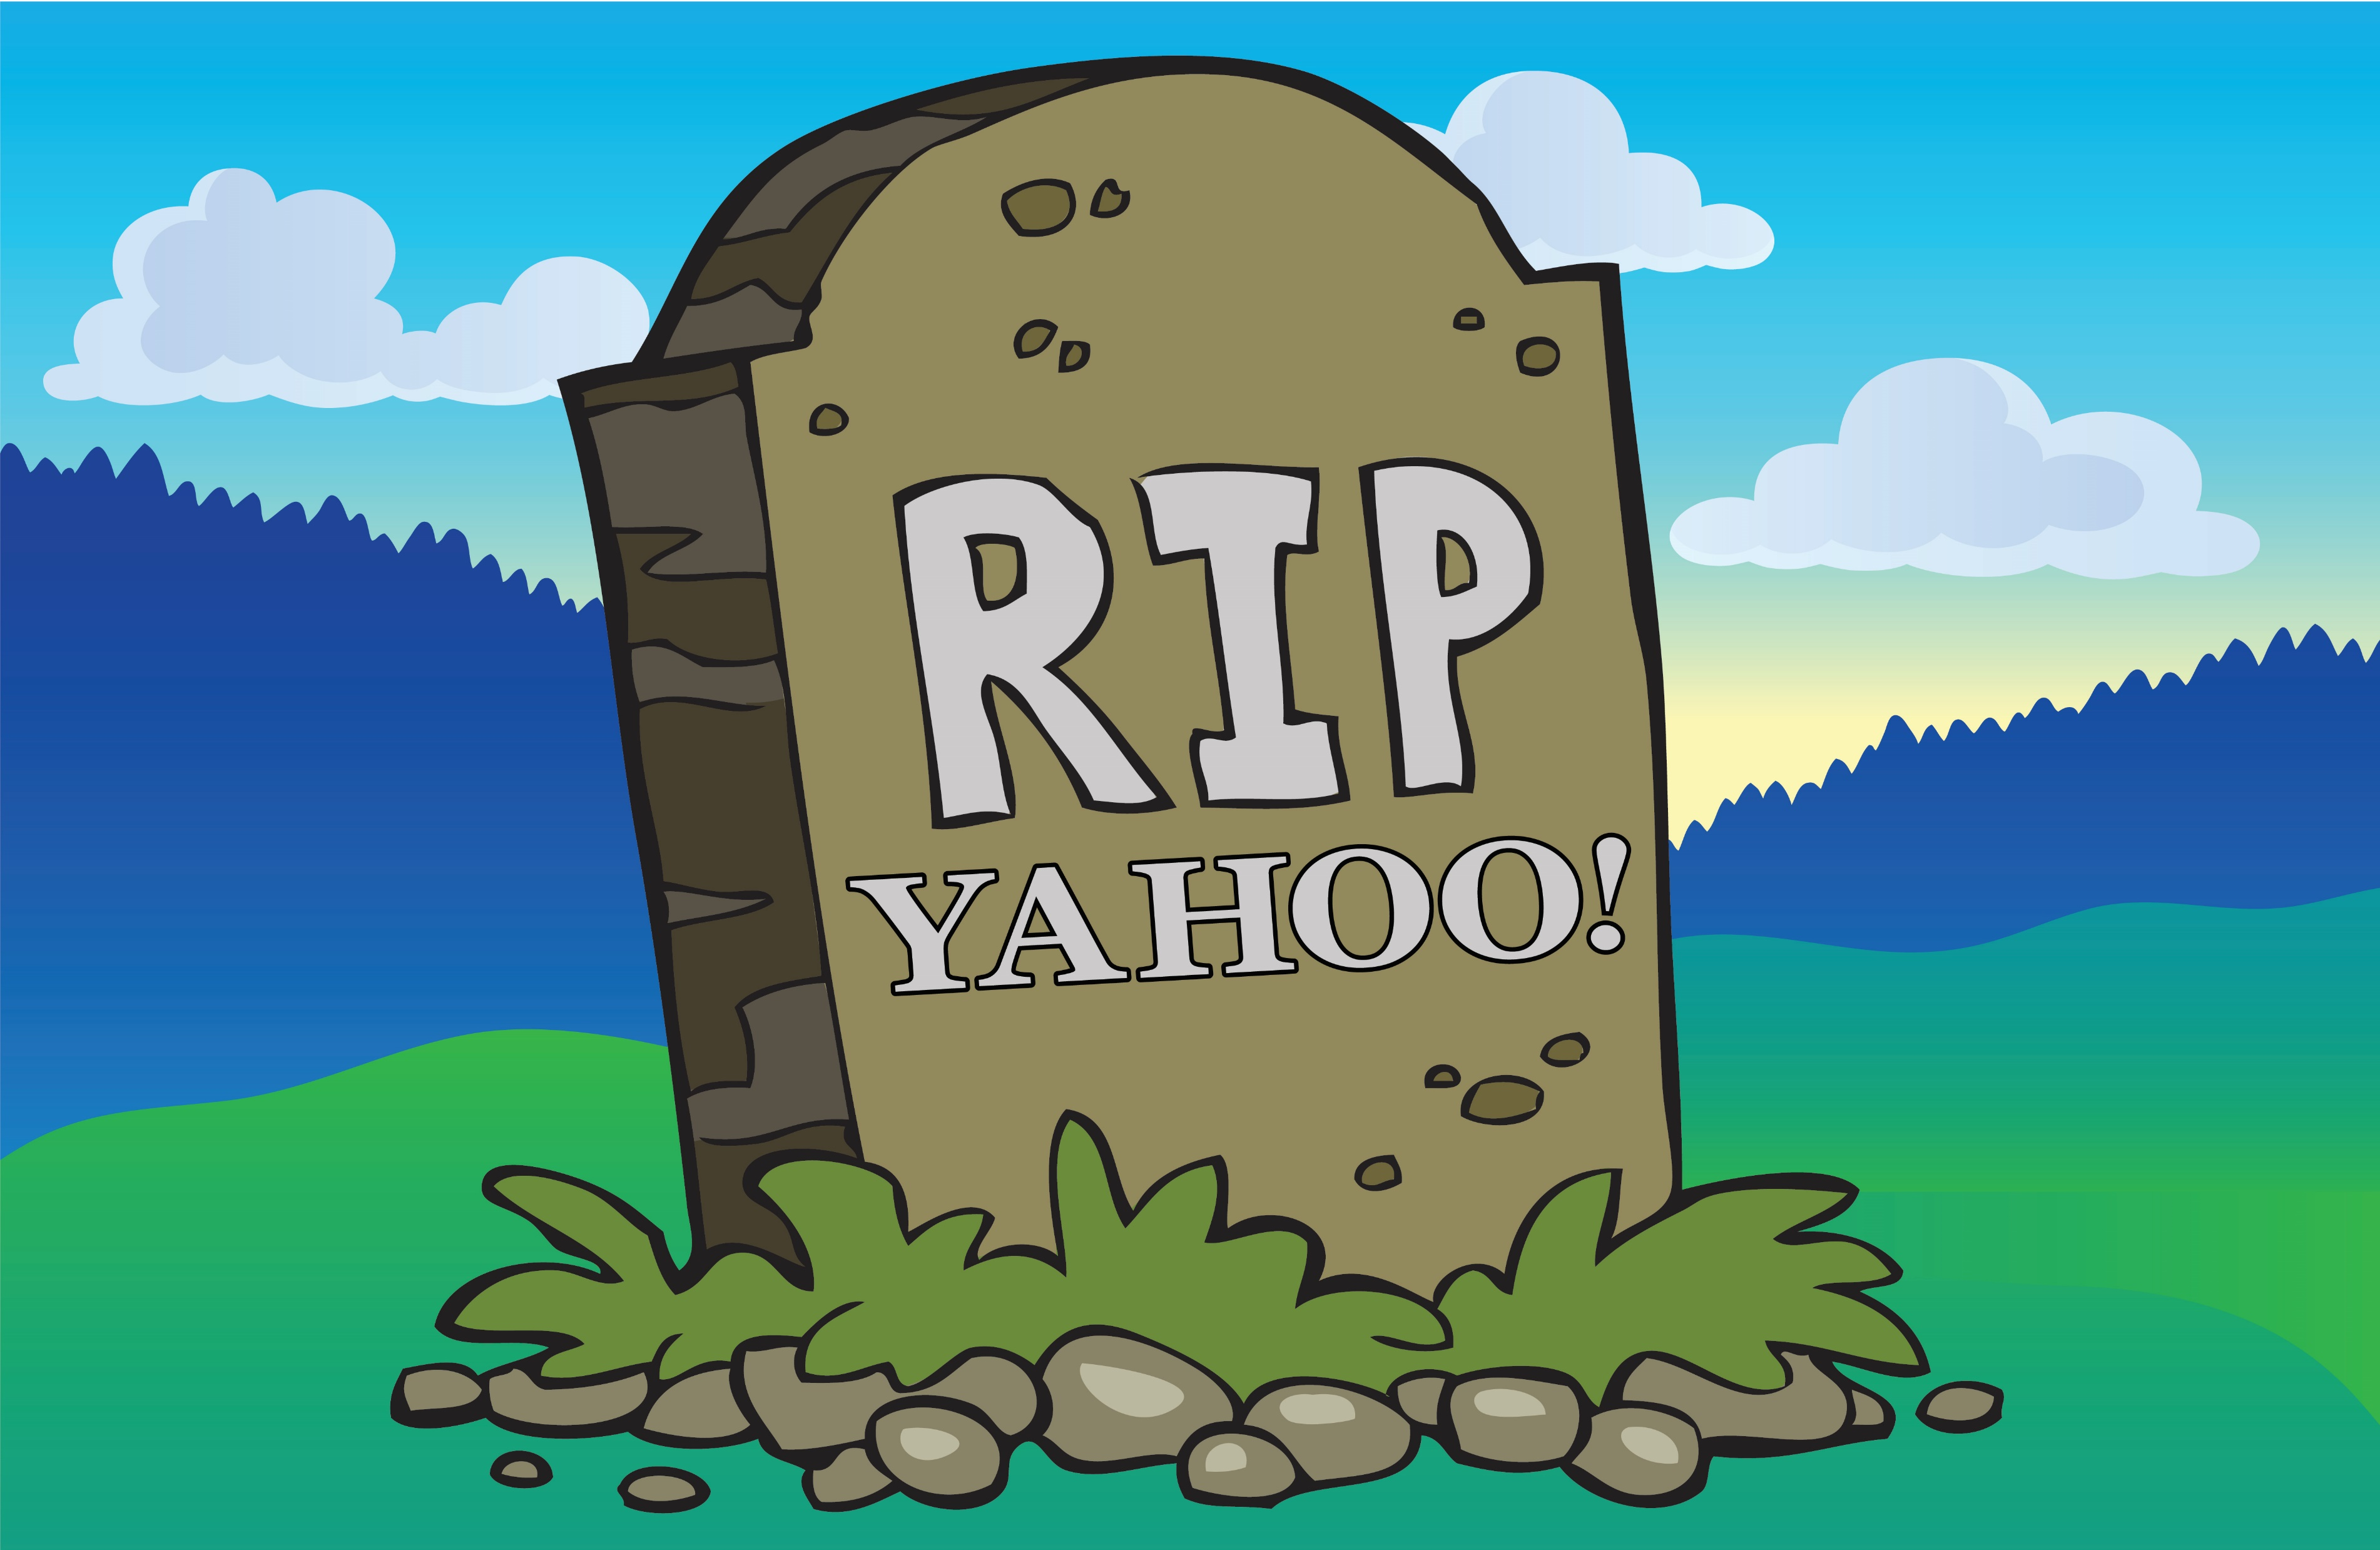

Slide 15
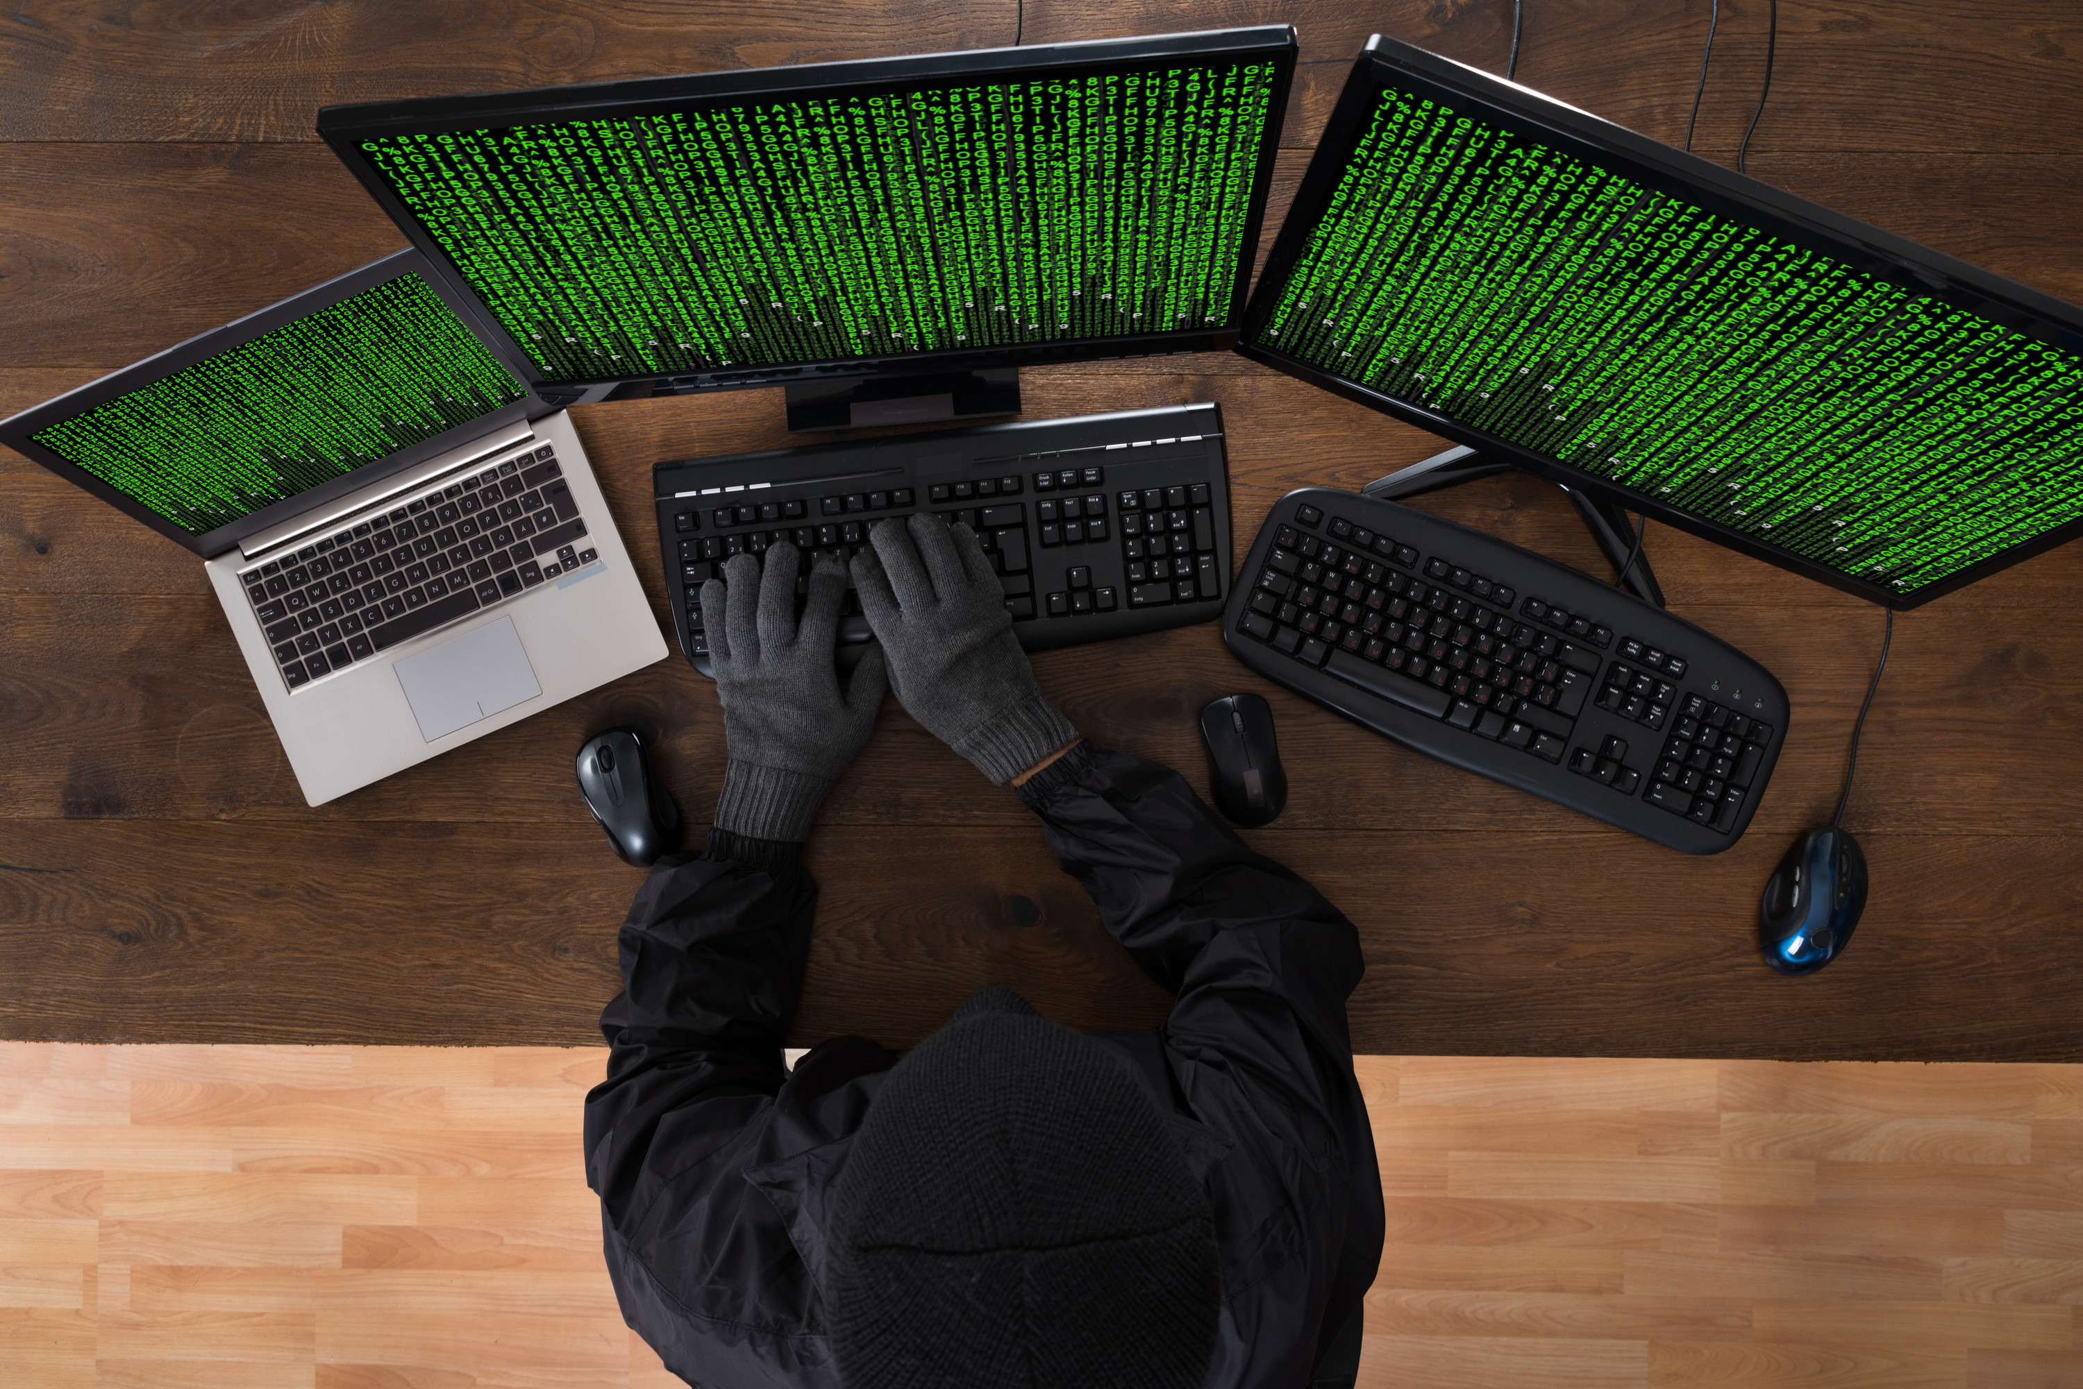
Yahoo! Breached – What Happened?
2013 Breach
  Timing
  3 billion accounts breached
    Secondary services
  Actors
  Data
  Victims

Slide 16

Yahoo! Breached – What Happened?
2014 Breach Recap
  State-sponsored actors
  500 million records stolen
  Who has the data?
  Victims

Slide 17
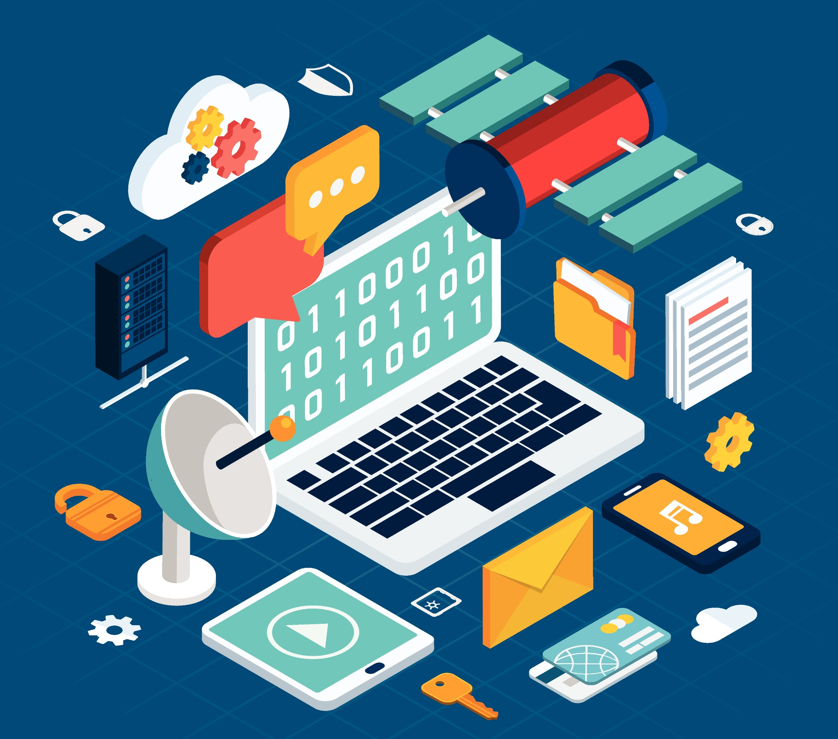
Late Disclosures
Breach disclosures in 2016 and what to expect in 2017?
Stale data can still be useful
Threat landscape change

Slide 18
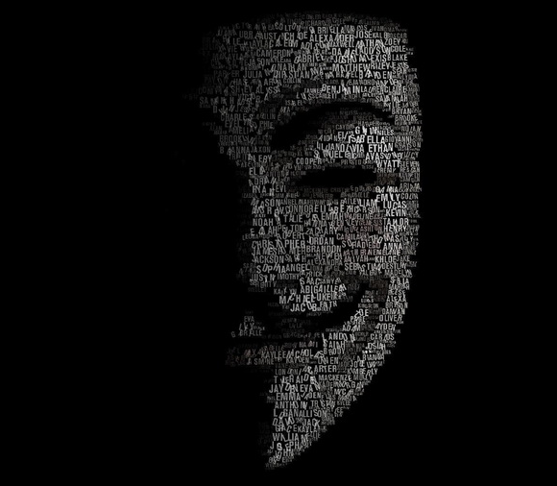
Who Did This?
Hackers profile
Their intentions
Their next steps

Slide 19
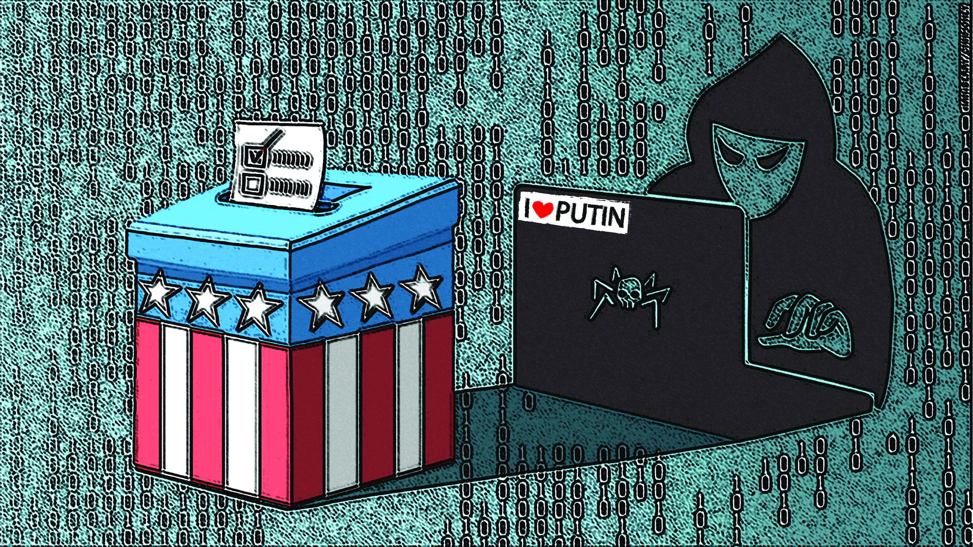
What Did Russians Really Hack?

Slide 20

What Do We Know About the Russian Hackers?
Culture forced into hacking
Collaborative learning structure
Monetizing at any cost
Perceived enemies

Slide 21
Hackers View of Us
War of stereotypes
“I’m fighting a holy war against the West… They drive their Rolls Royces and go home to their million-dollar houses, while people here are struggling. I will never harm my fellow Slavs; but America, Europe, and Australia deserve it.”
- aqua (jabberzeus)

Slide 22
Russian State Sponsored Hacking
Covert Techniques
Targets
Information Exchange
Intelligence Use

Slide 23
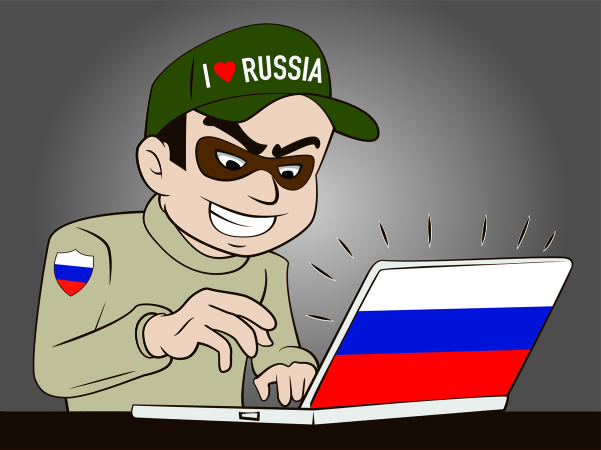
Russian Activists
Motivation
Past Targets
Stake in US Elections
Group Goals

Slide 24
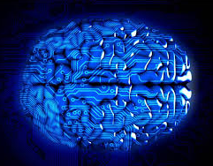
Security Human Intelligence + AI
Early stages of AI awareness
Fear of making mistakes
Not fully leveraged existing tools
AI advances in prediction and response
Learning curves

Slide 25

What Do We Do?
We will make mistakes!
Learning from your mistakes as an art form
Embrace Risk Management
*DLC – path of constant improvement

Slide 26

THANK YOU!
Please contact us at:
aholden@HoldSecurity.com or www.holdsecurity.com

