Slide 1
Privacy Ethics – A Big Data Problem

Slide 2
RAGHU GOLLAMUDI
Co-founder/VP Engineering - Integris Software
Founder/CEO - Revuly
CTO - Shippable
Principal Dev Lead – Microsoft
Notes:
The challenge of how to address management of data associated with
Regulations, Contracts, Policies and Consent
in an operational environment with little documentation, where data is centralized, there's high churn in personnel and overall there's a lack of institutional knowledge AND
where Data is everywhere - At Rest, In Motion, In the Cloud - Big Data ( High Volume, Variety and Velocity)

Slide 3
Trivia
What happened on the 25th May 2018?
PROPRIETARY AND CONFIDENTIAL.
Notes:
GDPR was enforced on that day

Slide 4
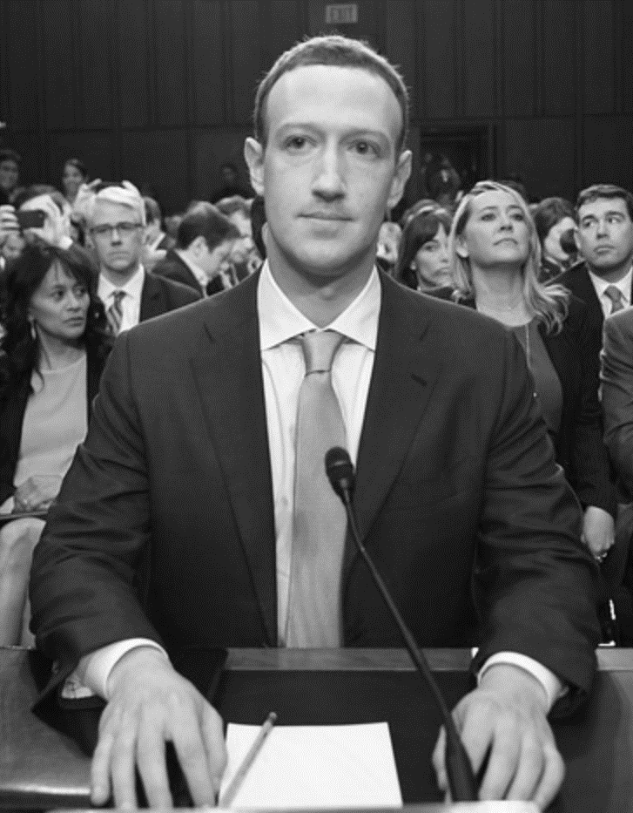
GENERAL DATA PROTECTION REGULATION (“GDPR”)
May 25th, 2018
People are more aware
Unethical processing
Governments around the world are catching up
Notes:
PEOPLE ARE MORE AWARE of how much data exists about them, how that data can be used and are concerned about their privacy and freedom (amazon and google employees are now reaching out to their management to stop selling their image recognition software to law enforcement agencies because in the current climate it is worrisome for an organization to have such a powerful tool)
STORING DATA IS CHEAP: Google capturing location info even though the phone was turned off. NBC report
PUBLIC SENTIMENT IS CHANGING – GDPR is just the first ripple in a new wave of global regulations affecting organizations everywhere , and it’s coming to the United States
Cheap data: People are sharing more and more online because storage is cheap and companies are now able to take advantage of that and use the data for their benefits
Companies are now using images uploaded by users to improve their image recognition algorithms. Companies need data and they are using this as a way to get free data. Also, companies are using this data for targeted advertisement.
Social networking site fiasco which lead to sharing of consumer data which lead to precise targeting during election causing impact on election results.
GDPR General data protection regulation, follow good data practices. Singapore, Argentina, India and Croatia are some of the countries passing new privacy laws
FCC fines VERIZON for Super cookie , tracking mobile device what website they visited so that they could help companies target their advertisements

Slide 5
Problem: A Big Data Problem?
DATA IS EXPLODING
PROPRIETARY AND CONFIDENTIAL.
Notes:
Social media, youtube, netflix etc

Slide 6
Problem: A Big Data Problem?
DATA IS EXPLODING
Data is being acquired/purchased at a rapid pace
IOT data is ending up into massive data lakes
Application logs
Biased Algorithms
PROPRIETARY AND CONFIDENTIAL.
Notes:
and companies are now sitting on hoards of data not knowing what is in it.
Example of the travel and expense company acquiring trip information which had hotel receipts which contained creditcard, hotel food items etc
2) and each device is capturing different data points and linking two datasets is making the data more identifiable
Fitness tracking app gives away location of secret US army bases
3) are now continuously streamed to third-party log processing systems with different access control compared to Production systems
Ecommerce company web logs had user searches which contained their user names and adult search info…giving away their gender, sexual orientation and other behavioral stats
Twitter passwords
4) Biased Algorithms: Target pregnancy prediction (unscented lotion, mineral supplements, and cotton balls)

Slide 7
Trivia
Privacy Vs Security?
PROPRIETARY AND CONFIDENTIAL.
Notes:
Privacy and security are two sides of the same coin

Slide 8
PRIVACY VS SECURITY
PRIVACY IS…
A fundamental right of the individual
Focused on use of data based on business purpose and consent
Open to interpretation based on context and risk
Under-invested market
SECURITY IS…
A framework to protect information
Focused on confidentiality and accessibility
Clearly defined with explicit controls to monitor for and prevent unauthorized access
Matured market

Slide 9
Confusion : Privacy Vs Security
Security: Have controls in place to limit access to information and protect against unauthorized use and acquisition
Privacy: Information is collected, processed, protected and destroyed legally and fairly
PROPRIETARY AND CONFIDENTIAL.
Notes:
Privacy and security are two sides of the same coin

Slide 10
Solution: Culture
Customer/Employees first
Performance reviews
PROPRIETARY AND CONFIDENTIAL.
Notes:
Uber: God View
Reformed technologist
Consent and data processing accordingly was a alien to me
FB and equifax notified me that my info was beached
Performance reviews: Accountability and ownership, people are creative
1) Speed of delivery
2) Quality
3) feature adoption
4) revenue impact
5) Manager: How effective and efficient my team was

Slide 11
Solution: Security
Encrypt Encrypt Encrypt!: Transit, Rest, Backups
Robust Authentication mechanism
Anonymization and/or Pseudonymization
Store credentials in Vault storage
Audit Logs
PROPRIETARY AND CONFIDENTIAL.
Notes:
Encrypt:
Transit: SSL
Rest and backups: Disk Excryption
App encryption, FPE (format preserved encryption)
Authentication:
SSO
MFA
Cred rotation policies

Slide 12
Solution: Design
Data Integrity
Authorization
Obscurity by design
Conservative approach to privacy settings by default
Visibility and Transparency
https://iab.org/wp-content/IAB-uploads/2011/03/fred_carter.pdf
PROPRIETARY AND CONFIDENTIAL.
Notes:
Dr. Ann Cavoukian
Visibility and Transparency: How data is being collected, processed, used, technology etc

Slide 13
Solution: Process
PIA: Privacy impact assessment
Privacy related tasks part of scrum/sprint
Data minimization
Self service user management portal
Honor user consent when processing user data
Retention
Ref: https://www.usaid.gov/sites/default/files/documents/1868/RI_Fellowships_PIA_Summary_May_12_2014.pdf
PROPRIETARY AND CONFIDENTIAL.
Notes:
Data minimization: Collect only what you need
Retention: This is by attribute. Store info that is required and deleted or redact the rest
Consent: While sharing and processing info

Slide 14
Solution: Automation
Continuous compliance
Discovery: Rest and In-Motion
Rules
Issue management
PROPRIETARY AND CONFIDENTIAL.
Notes:
Target data breach… PCI compliant until the data breach.

Slide 15
Solution: Automation - Discovery
Continuous compliance
Labeling
Tagging
Classifying
Confidence scores
Challenges
Data sources
Data formats
Performance
PROPRIETARY AND CONFIDENTIAL.
Notes:
Lookups, regexs, NER and NLPs for blob
Reduce false positives

Slide 16
Solution: Automation - Discovery
Continuous compliance
Sources
High/Low compute
SAAS
Cloud/Hybrid
Formats
Structured/Tabular: Lookups, Regex, Enhancers
Unstructured: NLP, NER and Enhancers
Semi-structured: JSON, XML
Performance
Advanced tokenization
Tries
Feedback loop
PROPRIETARY AND CONFIDENTIAL.
Notes:
Lookups, regexs, NER and NLPs for blob
Reduce false positives

Slide 17
Solution: Automation - Rules
Continuous compliance
Regulations
Consent
Contracts
PROPRIETARY AND CONFIDENTIAL.
Notes:
Too many regulations and policies to adhere to
Configurable
Contracts: How data will be used

Slide 18
Solution: Automation – Issue Management
Continuous compliance
Rule Violations
Issue resolution
SAR (Subject Access Requests)
PROPRIETARY AND CONFIDENTIAL.
Notes:
JIRA, Service now integration etc…

Slide 19
Benefits
Low Risk Exposure
Brand Recognition/Loyalty
PROPRIETARY AND CONFIDENTIAL.
Notes:
Low Risk Exposure in case of data breaches because good data handling procedures
Brand Recognition/Loyalty because the company and its employees value integrity

Slide 20
Thank You
PROPRIETARY AND CONFIDENTIAL.

