Slide 1
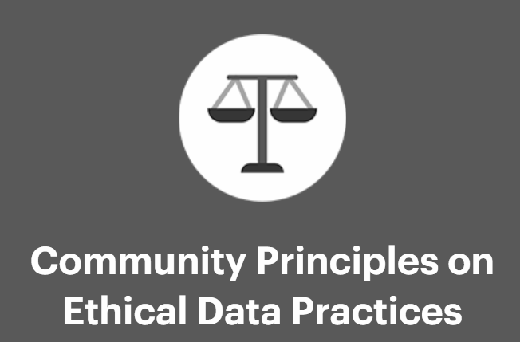
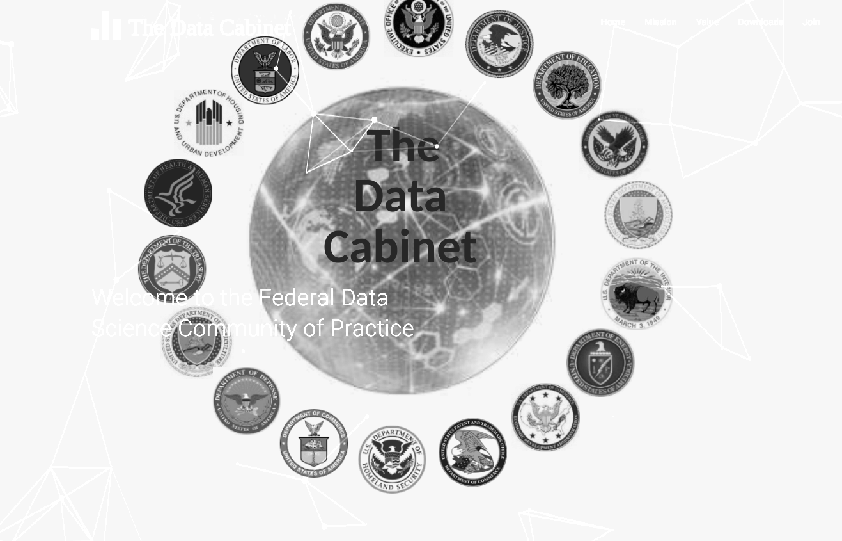
“Spurring The Ethical Imagination for Responsible Use of Data”
Natalie Evans Harris Co-Founder and COO, BrightHive
Co-Ideator, Community-driven Principles for Ethical Data Practices (CPEDS)
Former Senior Policy Advisor to US Chief Technology Officer, Obama Administration
@QuietStormnat
natalie@brighthive.io

Slide 2
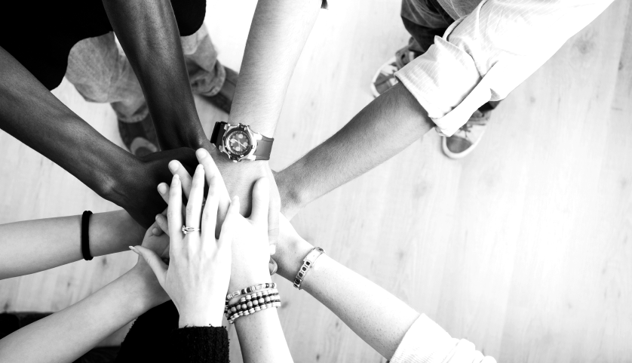
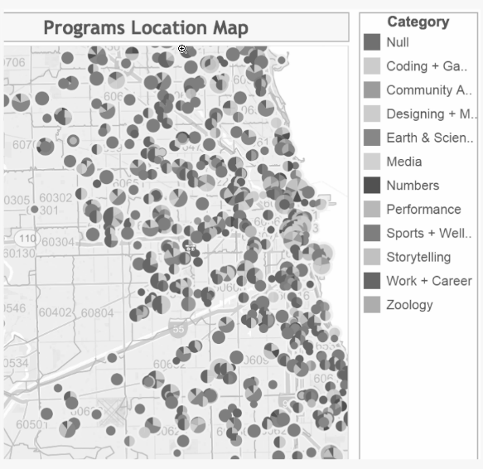
How are summer job opportunities distributed in my city?
Describe.
Notes:
Purpose

Slide 3
Which students are at risk of dropping out early?
Predict.
Notes:
Purpose

Slide 4
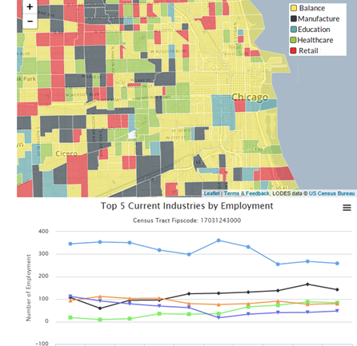
What occupations are changing most rapidly in my area?
Detect.
Notes:
Purpose

Slide 5
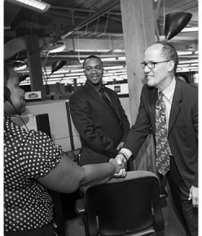
How are my training programs affecting future wages and employment?
Evaluate.
Notes:
Purpose

Slide 6
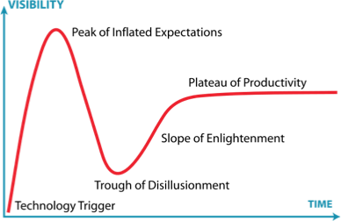
“Data Science can do the impossible!”
Notes:
Purpose

Slide 7
Individuals Are The Power:
We are a people in a quandary about the present. We are a people in search of our future. We are a people in search of a national community.
We are a people trying not only to solve the problems of the present, unemployment, inflation, but we are attempting on a larger scale to fulfill the promise of America.
We are attempting to fulfill our national purpose, to create and sustain a society in which all of us are equal.”
Barbara Charlie Jordan, Former House of Representative, Texas
1976 Democratic National Convention Keynote Address
Notes:
Purpose

Slide 8
Challenges to using Data for Social Good

Slide 9
Data

Slide 10
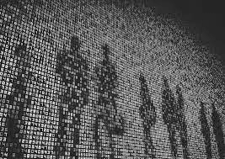
Growing tension between individual rights and company profits
Trust?
Notes:
Purpose

Slide 11
What We’ve Learned
Ultimately: Ethics is driven by culture, measured by compliance, and determined by society
Building Trust requires:
Empowering People to speak on data use,
establishing Processes to clarify practices,
and leveraging Technology to hold us accountable
Notes:
Purpose

Slide 12
Remember the individual IS THE MOST POWERFUL
“There is no executive order; there is no law that can require the American people to form a national community. This we must do as individuals, and if we do it as individuals, there is no President of the United States who can veto that decision…
we must define the "common good" and begin again to shape a common future.”
Barbara Charlie Jordan, Former House of Representative, Texas
1976 Democratic National Convention Keynote Address
Notes:
Purpose

Slide 13
Community-driven Principles for Ethical Data Sharing (CPEDS)
Increases responsiveness to the needs and concerns of data scientists
Better captures the diverse spectrum of interests across the data science community
May facilitate adoption of the code of ethics
By Data Scientists, For Data Scientists:
Notes:
Purpose

Slide 15
As a community, what’s important is…
Informed and purposeful consent
Guarantee the security of data, subjects, and algorithms
Protect anonymous data subjects
Transparency as the default
Foster diversity
Acknowledge and mitigate unfair bias
Clearly established provenance
Respect relevant tensions
Communicate responsibly and accessibly
Exercise Our Ethical Imagination!!
www.datapractices.org

Slide 16
As a community, what’s important is…
Collecting and Storage of Data
Informed and purposeful consent
Guarantee the security of data, subjects, and algorithms
Protect anonymous data subjects
Foster diversity
Exercise Our Ethical Imagination!!
www.datapractices.org

Slide 17
As a community, what’s important is…
Analysis of Data
Transparency as the default
Foster diversity
Acknowledge and mitigate unfair bias
Exercise Our Ethical Imagination!!
www.datapractices.org

Slide 18
As a community, what’s important is…
Use of Data
Foster diversity Clearly established provenance
Respect relevant tensions
Communicate responsibly and accessibly
Exercise Our Ethical Imagination!!
www.datapractices.org

Slide 19
Defining Your Ethical Principles
What are three words to describe the relationship between people and data?
What are the key activities of the data lifecycle that affect this relationship?
What are key questions you can ask yourself during those activities to check yourself?
Go to www.menti.com Enter code 14 33 64
Notes:
Purpose

Slide 20
Strengthen community with Data For Democracy to continue working on Principles, supporting data scientists, and holding each other accountable
Building partnerships to drive development of standards, tools, frameworks, etc to support the community in navigating the data life-cycle responsibly
Develop ethical framework by leveraging principles and examining personal relationship between data and the citizen.

Slide 21
While Data Science can’t do the impossible, if we get this right, we can make the impossible more doable.

