Slide 1
5 Secrets
Improve Team Communication
So That
You Can Scale Your Tech Team Without Failing
Debbie Madden
CEO & Founder
debbie@stride.nyc
@debbiemadden200

Slide 2
“We back a good team and a team is the most important criteria for investment.” ~ said every VC everywhere

Slide 3
The Problem
2

Slide 4
The Problem
X
4
12

Slide 5
Communication is hard and it gets infinitely more complex as your team gets bigger.
The Problem

Slide 6
“The single most untapped competitive advantage is teamwork.”
~ Patrick Lencioni

Slide 7
5 Secrets To Improve Team Communication
Recognize chaos
Change it up
Communicate the why
Prioritize team productivity
Protect team health

Slide 8
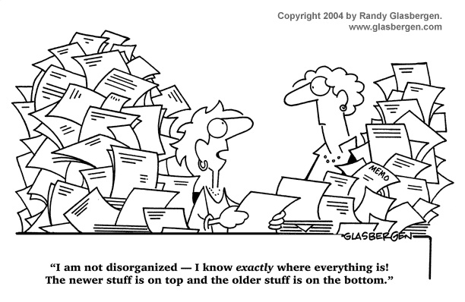
Secret 1: Recognize chaos

Slide 9
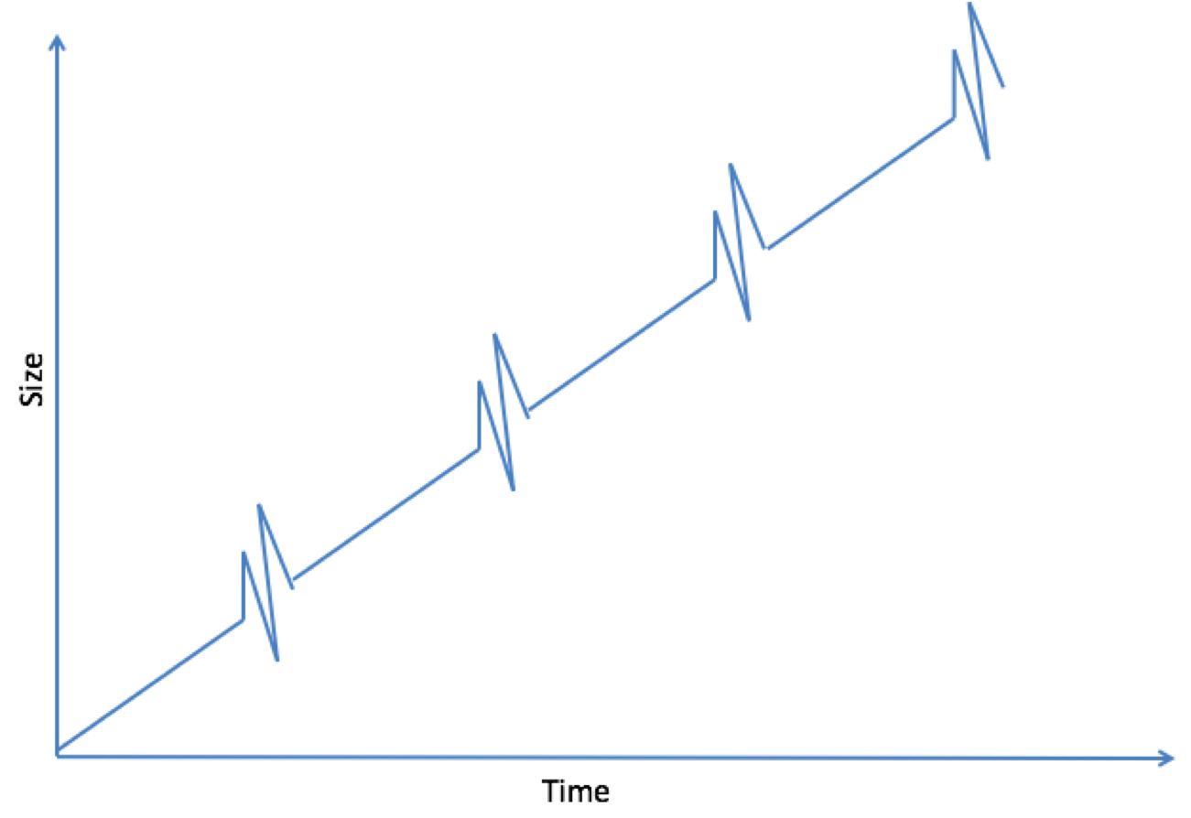
Alliances
Collaboration
Greiner Curve
Coordination
Growth Crisis
Red Tape Crisis
Delegation
Calm
Control Crisis
Direction
Autonomy Crisis
Creativity
Chaos
Leadership Crisis

Slide 10
How to Tell
 | Chaos | Calm
Things | Hard | Easy
People | Unhappy | Happy
Procedures | Get in the way | Help
Management | Misaligned | Aligned

Slide 11
Some of the smartest tech leaders I know have missed the signs their teams are in chaos.

Slide 12
Ask your peers.

Slide 13
5 Secrets To Improve Team Communication
Recognize chaos
Change it up
Communicate the why
Prioritize team productivity
Protect team health

Slide 14
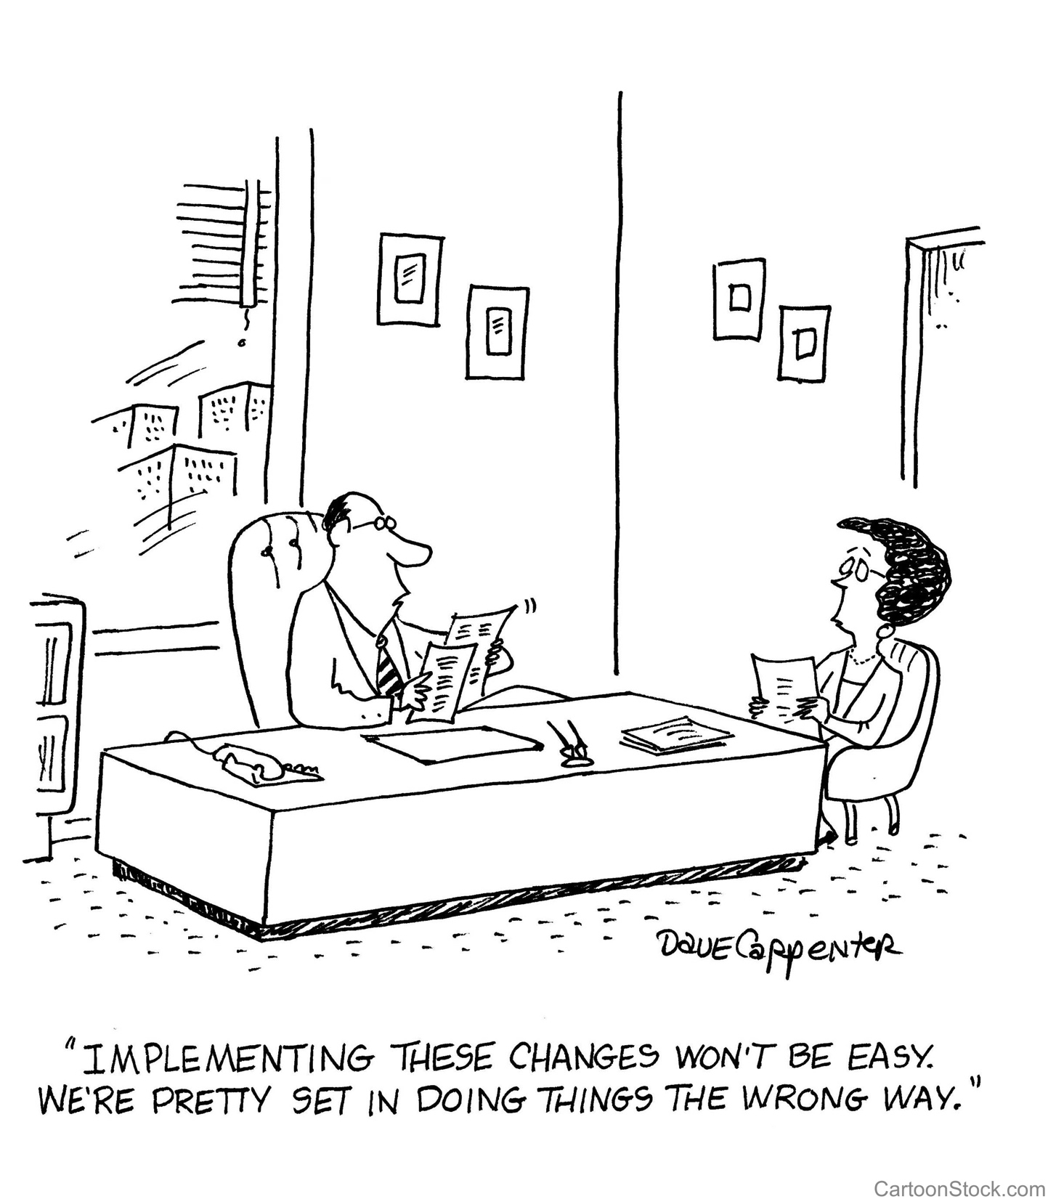
Secret 2: CHANGE IT UP

Slide 15
Change 4 Things
Meeting rhythms
Roles
Humans
And, get a coach

Slide 16
Meeting Rhythms
Kill/Combine/Keep Retrospectives on Meetings
Every 6 months
Length, cadence, attendees, agenda
Fist of fives

Slide 17
Roles/Humans
Wipe the slate clean
Identify roles needed
Plug in current team members in the seat most ideal for them now
See what gaps you have left
Should any humans be put in a different role? Be fired? Promoted?
Notes:
Draw this out on a whiteboard
Do this every time you double in size

Slide 18
Roles/Humans
B
A
Values
C
BC
Skill
Notes:
Draw this out on a whiteboard
Do this every time you double in size

Slide 19
Coach
Business
Executive/Individual

Slide 20
5 Secrets To Improve Team Communication
Recognize chaos
Change it up
Communicate the why
Prioritize team productivity
Protect team health

Slide 21
Secret 3: COMMUNICATE THE WHY

Slide 22
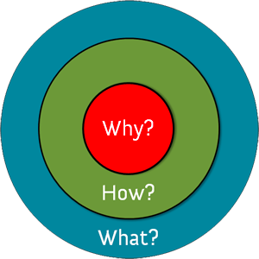

Slide 23
Apple’s Why:
We believe in
challenging the status quo.
Apple’s How:
Make stuff that’s beautifully designed and user friendly.
Apple’s What:
We Make Great
Computers

Slide 24
5 Secrets To Improve Team Communication
Recognize chaos
Change it up
Communicate the why
Prioritize team productivity
Protect team health

Slide 25
Secret 4: Prioritize Team Productivity

Slide 26
The Best Teams:
Speak in same proportion
Can sacrifice an item they want for something the team needs
~ New York Times: “What Google Learned from it’s Quest to Build the Perfect Team”

Slide 27
Working agreements
Continuously earn your seat at the table
Disagree and commit
silence = disagreement
Create a measurable definition of success

Slide 28
5 Secrets To Improve Team Communication
Recognize chaos
Change it up
Communicate the why
Prioritize team productivity
Protect team health

Slide 29
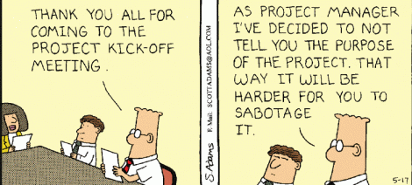
Secret 5: Protect Team Health

Slide 30
Team Health
Results
Accountability
Commitment
Healthy Conflict
Trust

Slide 31
2 Types of Trust
Capability
Desire

Slide 32
Healthy Conflict
No conflict
WW3

Slide 33
Friendster vs Facebook
Case Study:
Trust &Healthy Conflict
Season 5
Episodes 2 and 3

Slide 34
5 Secrets to Improved Team Communication
Recognize chaos
Change it up
Communicate the why
Prioritize team productivity
Protect team health

Slide 35
Fist of Fives

Slide 36
Questions?
Debbie Madden
CEO & Founder
debbie@stride.nyc
@debbiemadden200
www.stride.nyc

