Slide 1
Unifying Banks & Blockchains
@ Coinbase
Notes:
All right, let’s get started. My name is Jim Posen, and I’ll be talking to you today about how payments work at Coinbase. How many of you know what Coinbase does? For those who don't, Coinbase provides services to exchange your local currency for blockchain-based digital currencies. So if you want to buy or sell Bitcoin, we want Coinbase to be the place you go to do that. Today I’m going to focus just on our infrastructure for moving various currencies on and off the platform and between accounts. But to understand this architecture and how we arrived at it, it is important we understand how Coinbase got to where it is today.
30s

Slide 2
History of Coinbase
Bitcoin
Europe
Bitcoin Microservice
2012
2013
2014
2015
2016
2017
US Buy & Sell
Exchange (GDAX)
Ethereum
Notes:
In May of 2012, coinbase.com launched as a hosted Bitcoin wallet. It was just a website where you could store, send in, and send out Bitcoin. Sort of like a bank, but for Bitcoin.
Then in November that year, Coinbase added the ability to buy and sell Bitcoin using funds in your actual bank account. This has been the core of our business ever since.
But in 2012 we only supported US bank accounts. It wasn't until September 2014 that we expanded internationally and added European bank accounts as a payment option as well.
In January 2015, Coinbase launched it's second major product, the Coinbase Exchange, which we have since renamed to GDAX. Whereas on coinbase.com, you can buy and sell Bitcoin directly to or from Coinbase the company, GDAX is a marketplace matching buyers and sellers. It is geared toward professional traders and large institutions, but more complicated to use for regular customers. But while GDAX is a wholly separate product, it shares the same underlying payments infrastructure that Coinbase uses for moving funds on and off the platform.
At this time, all of Coinbase, except the exchange, was in one monolithic Rails application and it had started to become a major pain point. The Bitcoin related code, which was obviously the oldest, was really starting to degrade in 2015, so we
decided to move it into a microservice. In February 2016, we launched Wallace, a new microservice to handle our integration with the Bitcoin blockchain. This was one of our first production microservices, and the first one to handle an entire payment integration.
The last milestone worth noting here came in May 2016, when we added support for a second digital currency, Ethereum. Ever since Bitcoin first came out in 2009, other digital currencies using similar blockchain technology started to emerge, and Ethereum is a particularly popular one.
So over the course of the past 5 years, we have expanded the number of digital currencies one can trade, the number of countries and payment options we support, the number of trading platforms to include GDAX, and the number of codebases that our payments code is split across. Which brings us to day, when we now have…
2m30s

Slide 3
2 Trading Platforms

Slide 4
3 Digital Currencies

Slide 5
6 Fiat Currencies
USD
EUR
GBP
SGD
CAD
AUD
Notes:
Fiat currencies just means government-issued.

Slide 6
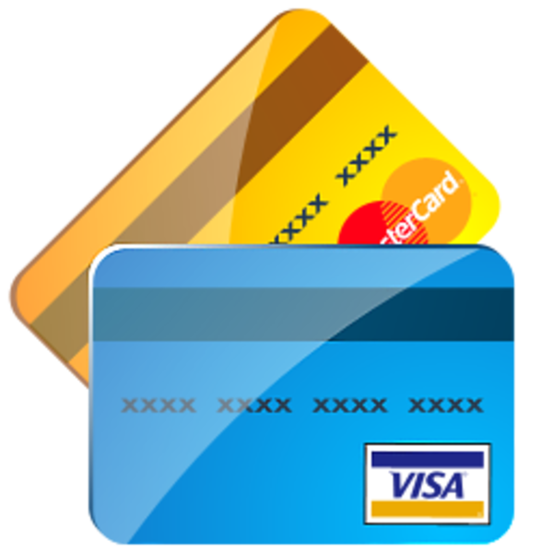
7 Traditional Payment Integrations
US Domestic Wires
3-D Secure Cards

Slide 7
32 Countries

Slide 8
4 Microservices
Knox (Private keys)
Macbeth (Ethereum)
Wallace (Bitcoin)
Iron Bank (US Banking)
Notes:
And on the technical side, 4 payments-related microservices and
TODO: Copyright issues?

Slide 9
1 Monolithic Rails App

Slide 10
What is Bitcoin?
Bitcoin is both:
a scarce digital resource
a protocol for transferring the resource over the Internet
Notes:
I know many of you may not be too familiar with idea of digital currencies, so let's get this out of the way early. What is Bitcoin?
Bitcoin really refers to two things.
First, there is Bitcoin the asset. This is a purely digital resource with a limited supply. Some people use it like a currency to buy things, some people look at it as a financial asset like gold, but in either case the main point is that it is scarce.
Bitcoin is also the name of the Internet protocol used to transfer Bitcoin the asset between people. You can think of it like email: email is both a digital message as in "I sent you an email" or a protocol as in "I'm running an email server."
Now, maybe you're thinking "all money is digital now, no one uses cash, so what makes this Bitcoin thing so special?"
45s

Slide 11
US Banking System | Bitcoin
Bank accounts | Cryptographic addresses
ACH/Wire | Peer-to-peer protocol
Interbank settlement | Public transaction ledger
Issued by US government | Fixed issuance
3 business days | ~30 minutes
Chargebacks | Irreversible payments
Notes:
With regular dollars, which I may start calling fiat money, you store them in a bank account. When you want to spend that money, someone charges your bank account and moves the funds to their bank account. To move money from your bank account directly, you need to give someone your bank account and routing numbers.
With Bitcoin, the money is stored in cryptographically generated addresses and in order to spend it you need to provide a cryptographic signature. When you want to spend the Bitcoin, you just broadcast a transaction to the peer-to-peer network using the Bitcoin wallet software and other people will see it. So with Bitcoin, you don’t need someone else, a bank, to store the money or send transactions for you.
Since Bitcoin is a peer-to-peer protocol with no central authority, Bitcoin is created by a process called mining and the protocol specifies the rate at which new Bitcoin is issued. Unlike the US dollar, where the Federal Reserve has various ways of influencing the money supply. In the US, the central bank is required to settle transactions between banks and there is no visibility into these interbank transactions. Bitcoin instead has a completely public transaction ledger so everyone can see every transaction that has ever occurred.
There are two ways to move money between US banks: wire payments and the ACH network. I'm going to focus on ACH today. It takes 3 business days to confirm that an ACH payment completed successfully, and even after that it is possible that the payment will be reversed in cases of identity theft or other types of fraud. Bitcoin transactions, on the other hand, generally confirm in about 30 minutes, aren’t dependent on banking hours, and cannot be reversed once they are confirmed.
The point here isn't to say one system is better than another, but to highlight that these systems are very different on a fundamental level.
6m

Slide 12
Overview
How ACH & Bitcoin work
Unified payments architecture
How our ACH & Bitcoin services work
Notes:
Over the next 40 or so minutes, I’m going to present to you the payments architecture we are developing to for integrating with various blockchains and traditional payment rails using the same service-level abstraction. But first we need to understand how blockchain and banking integrations work on a technical level. So we are going to dive into the mechanics of the ACH network and the Bitcoin blockchain to provide this foundation. Then I’ll describe the architecture and abstraction layer at a high level, and finally reify those concepts using our ACH and Bitcoin microservices as examples. Understanding how Coinbase integrates with the ACH network and Bitcoin blockchain should illustrate what this abstract architecture looks like in production. Sound good to everyone? I sure hope so.
So let’s start with how ACH works.

Slide 13
Automated Clearing House (ACH)
Originating Depository Financial Institution
ACH Operator
(Federal Reserve)
Receiving Depository Financial Institution
Originator
Receiver
Notes:
ACH, for Automated Clearing House, is a system in the US for moving money between bank accounts. When you use direct deposit to receive your paycheck or pay your credit card bill with your bank account, you are using the ACH network.
There are lots of scary banking terms and obscure details about ACH, but at its core it is very simple. Let's say you want to deposit dollars from your bank account into your Coinbase account. Coinbase then initiates, or originates, a debit on your bank account. It does this by sending the required transaction information, like the amount and your bank account and routing numbers, to its bank. This bank is known as the ODFI, the Originating Depository Financial Institution. Your bank, in this scenario, is the RDFI, the Receiving Depository Financial Institution.
The way the originator sends the transactions to the bank is using an ACH batch file. The originator batches up all ACH payments on a daily basis and generates a file listing them in an archaic fixed-width text format. The originator then uploads the file to the bank via FTP.

Slide 14
Automated Clearing House (ACH)
Originating Depository Financial Institution
ACH Operator
(Federal Reserve)
Receiving Depository Financial Institution
Originator
Receiver
Notes:
The ODFI, Coinbase's bank, then forwards the transaction information to a central ACH operator, the main one of which is the Federal Reserve.

Slide 15
Automated Clearing House (ACH)
Originating Depository Financial Institution
ACH Operator
(Federal Reserve)
Receiving Depository Financial Institution
Originator
Receiver
Notes:
Overnight, the Fed makes the record of the debit available to the RDFI.

Slide 16
Automated Clearing House (ACH)
Originating Depository Financial Institution
ACH Operator
(Federal Reserve)
Receiving Depository Financial Institution
Originator
Receiver
Notes:
When the RDFI, your bank, opens the next morning, it sees the request to debit your account and reduces your balance.

Slide 17
Automated Clearing House (ACH)
Originating Depository Financial Institution
ACH Operator
(Federal Reserve)
Receiving Depository Financial Institution
Originator
Receiver
Notes:
OK, so that seems pretty reasonable. Now the transaction is complete, right? Nope. What happens if there's no money in your bank account? Or the account is closed?

Slide 18
ACH Returns
Payments are returned if insufficient funds, account closed, unauthorized debit, etc.
RDFI has 24 hours to return for insufficient funds
Receiver has 60 days to issue a chargeback
“No news is good news”
Notes:
Let's say the RDFI gets a debit on an account with insufficient funds. Since it can't debit the receiver's balance, it has to return the payment. It does this by creating an ACH return file, again in a fixed-width text format, and sends that to the ACH operator, which forwards it back down the chain to the ODFI, then the originator. And the originator can now process it.
The return file specifies which payments from a particular batch are being returned and a code for each one. The return code indicates why the payment was returned. R01, for example, means insufficient funds, R02 means the receiver's bank account is closed, and so on. As per ACH rules, the RDFI has up to 24 hours to return a payment for one of the reasons I just listed. So if it takes one day to deliver the batch file to the RDFI, one day to submit the return file, and one day to deliver the return file to the ODFI, it can take three days to see that a transaction didn’t succeed. And all of this happens in the time domain of banking days, so if Coinbase originated the payment on Wednesday, it wouldn't see the returned payment until the following Monday.
But wait, we’re still not done. Even after this 24 hour window, the payment may be returned for a host of different reasons. For example, the R10 return code means there was an unauthorized debit on the account and the receiver wants to charge it back. R10s can be issued within 60 days of a charge hitting a person's bank account. While this is an important consumer protection, in practice it means you can't be sure if an ACH payment completed until at least 60 days after you initiate it.
Note also that there's no explicit feedback in the system that a payment actually completed successfully. The originator just has to wait for any returns and the longer it waits, the more confident it can be that the change in its bank account balance is permanent. It’s sort of a “no news is good news” system. I’ll mention too that these time limits, 24 hours and 60 days, are how the network is supposed to work, but we of course see payments get returned after they are supposed to.

Slide 19
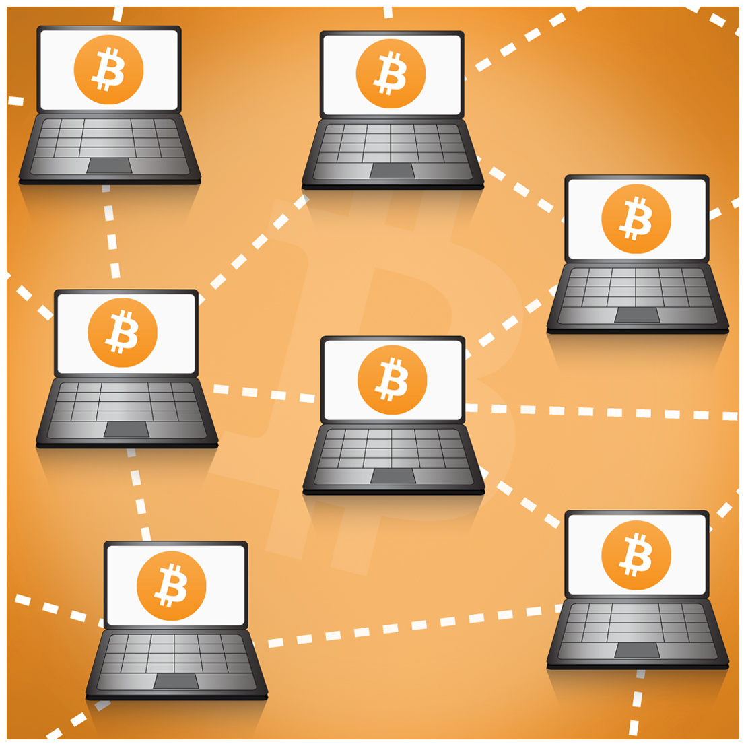
How Bitcoin Works
Notes:
OK, now onto Bitcoin. As we said before, Bitcoin does not have central authorities. There are no banks or ACH operators with special status in the system; all the nodes are equal. Anyone can originate a payment, and everyone on the network sees the same thing. Bitcoin uses a gossip protocol where each node on the network connects to a handful of other nodes and they relay messages to each other, including notifications of new transactions and such. It’s designed such that even if you are connected to a malicious Bitcoin node, it can’t trick you into accepting a transaction that’s not valid. To understand why, we need to quickly review some basic crypto.
45s
Source: Source: http://epsombusec.blogspot.com/2016/03/bitcoin.html

Slide 20
Cryptography Review
Digital signature schemes:
Gen() => (Public key, Private key)
Sign(Private key, Data) => Signature
Verify(Public key, Data, Signature) => {True, False}
Collision-resistant one-way functions
Hash(Data) => Fixed length binary string
Notes:
There are two main cryptographic primitives that we need.
The first is digital signatures, the same type used in TLS certificate chains. So say you have a public-private key pair, you can take the private key and some message and produce a signature. The really cool thing about this signature though, is that anyone, without knowing your secret key, can verify that the signature for this message was created by the owner of the public key. Said another way, the signatures are impossible to forge for a particular public key unless created using the associated private key.
The second thing we need is a hash function. I assume most people know what hash functions do, but for the sake of completeness, they are functions that deterministically produce a small, unique, random-looking identifier for any data. So if there's a file I'm supposed to send you that you already know the hash of, it is impossible for me to send you another file and fool you into thinking that it is the one you’re expecting.
OK, now that that's out of the way, we can talk about Bitcoin.
1m

Slide 21
Bits of Coin
Notes:
In the banking world, we are used to digital money just being account balances that go up and down. You receive money, your balance goes up, you send money, the balance goes down. But Bitcoin actually works more like coins.
Bitcoin comes in discrete units called UTXOs. Each UTXO has an amount and a Bitcoin address, which is derived from a public key. The UTXO can only be spent if the owner of the Bitcoin address provides a digital signature using the private key linked to the address. Unlike coins, though, UTXOs don’t get transferred or reassigned. Instead, when you want to send Bitcoin you create brand new UTXOs assigned to the recipient’s Bitcoin address and at the same time destroy and equal amount of your own UTXOs. The way you create and destroy these UTXOs is with a transaction.
45s

Slide 22
Transactions
0.5 BTC
Alice
2.0 BTC
Alice
4.0 BTC
Alice
Notes:
Let's say Alice owns these three UTXOs, one for half a Bitcoin, one for 2, and one for 4. Meaning each one is associated with a Bitcoin address that Alice, and only Alice, owns the private key to. So Alice has a total of 6.5 Bitcoin and wants to send 5 to Bob. What Alice is going to do is create one new UTXO belonging to Bob for 5 BTC, and in exchange destroy her 2 and 4 Bitcoin UTXOS. The remaining 1 BTC will go into another new UTXO back to Alice, which we call the change.

Slide 23
Transactions
Inputs Outputs
0.5 BTC
Alice
5.0 BTC
Bob
2.0 BTC
Alice
1.0 BTC
Alice
4.0 BTC
Alice
Notes:
The way this works is that Alice creates a new transaction with the two old UTXOs as inputs and the new UTXOs as outputs. The inputs are like pointers to the old ones and the new ones actually live in the transaction. Once this transaction is processed everyone can see that the old UTXOs have been spent and are no longer valid and the newly created ones are.
This transaction is not valid yet though. So far anyone could generate the data containing this transaction information.
30s

Slide 24
Transactions
Inputs Outputs
0.5 BTC
Alice
✔
5.0 BTC
Bob
2.0 BTC
Alice
✔
1.0 BTC
Alice
4.0 BTC
Alice
Notes:
The last thing we need is for Alice to provide a digital signature on each input saying in effect "I, the owner of this input, authorize it to be spent as a part of this particular transaction." Now anyone can check this signature against the Bitcoin address of the inputs and see that the transaction is valid.

Slide 25
Transactions
Inputs Outputs
0.5 BTC
Alice
✔
5.0 BTC
Bob
2.0 BTC
Alice
✔
1.0 BTC
Alice
4.0 BTC
Alice
UTXO means “Unspent Transaction Output”
Notes:
I'll point out now that UTXO actually stands for "Unspent Transaction Output".
So we have a way of moving funds through transactions, but what if Alice tries to send the same funds to Carol? How can we be sure that Alice is not going to reuse those same inputs in a different transaction?
1m45s

Slide 26
Public Ledger
0.5 BTC
Alice
2.0 BTC
Alice
4.0 BTC
Alice
Transaction #286
Notes:
We are going to impose an absolute ordering of all transactions. New transactions can only be added to the end of this append-only ledger if they are valid. Using the ledger, we can determine the set of all valid UTXOs after each transaction happens. So let’s say there’s a transaction, number 286 in the ledger, with three outputs all belonging to Alice. Since transaction 286 created this new outputs, immediately after the transaction they are still unspent.
Next we will append the transaction Alice just created to Bob in the previous example.

Slide 27
Public Ledger
0.5 BTC
Alice
2.0 BTC
Alice
4.0 BTC
Alice
Transaction #286
Transaction #287
5.0 BTC
Bob
1.0 BTC
Alice
Notes:
After this transaction we can see that two of the outputs from the previous transaction are marked as spent. So there are now still three unspent outputs totalling 6.5 Bitcoin, but now one of them belongs to Bob.
And if Bob creates a new transaction to Carol and that gets appended to the ledger...

Slide 28
Public Ledger
0.5 BTC
Alice
2.0 BTC
Alice
4.0 BTC
Alice
Transaction #286
Transaction #287
Transaction #288
5.0 BTC
Bob
1.0 BTC
Alice
3.0 BTC
Carol
2.0 BTC
Bob
Notes:
we wind up with four unspent outputs, again preserving the total value of 6.5 BTC. At each step, we can ensure that a transaction never spends an output that has already been spent. We call the set of unspent outputs the UTXO set and we can look at each transaction as a transformation of the UTXO set. And what we see is that the UTXO set is fully determined by the ordering of transactions.
But what if part of the network sees one ledger, and another part of the network sees a different ledger. How can be be sure there's only one global ledger? That is Bitcoin's big breakthrough.
1m30s

Slide 29
Blocks & Chains
Transaction #286
Transaction #287
Transaction #288
Block 277
Block 276
Notes:
The first thing we do is batch transactions into a block. Each block contains an ordered list of transactions and a pointer to the previous block, forming a linked list, or chain, of blocks. This pointer is stored in each block as the hash of the previous block. And since hashes are collision resistant, this makes it impossible to tamper with or modify the contents of the previous blocks in a chain.
Except that it’s actually not strictly one chain.

Slide 30
Blocks & Chains
Block 277
Block 277?
Block 276
Notes:
Since multiple blocks can have a pointer to the same preceding block, it forms more of a tree structure. But we really need the network to choose just one of these chains as the block chain. The creator of Bitcoin came up with a very clever way of ensuring that the whole network reaches consensus on which chain is the official chain.
What he did was make it provably difficult to generate a new block using the randomness properties of hash functions. Essentially each node that wants to create a new block has to spent a lot of computing cycles brute forcing a bunch of different blocks until one of them has a valid hash. In exchange for this computing power, the node that creates a new block gets a reward of newly minted Bitcoin. That’s why the process of generating new blocks is called mining.
Since it is hard to generate new blocks, then the whole network produces them at a very slow rate, one every ten minutes. Each node simply chooses the longest block chain it sees, and since blocks come out slower than it takes to propagate them across the Internet, it is harder for the network to get confused.

Slide 31
Blocks & Chains
Block 278
Longest chain = Main chain
Block 277a
Block 277b
Block 276
Notes:
While it is possible for nodes on the network to disagree on the longest chain temporarily, the next block that comes out will most likely resolve the dispute. So here if some nodes thought block 277a was the longest chain, and some thought 277b was, as soon so they all see block 278, that’s the clear winner. In practice it is standard to wait for a transaction to be buried under three blocks to be sure that it is permanently in the ledger.
This technology for creating a public ledger, called a proof-of-work blockchain, is very secure and very general. Since Bitcoin came out in 2009, there has been an explosion in the number of different blockchains, including the other two that Coinbase added support for, Ethereum and Litecoin.
2m30s
18:45

Slide 32
Overview
How ACH & Bitcoin work
Unified payments architecture
How our ACH & Bitcoin services work
Notes:
Whew, OK, you guys still with me? Cool, now onto the fun part.
Now that we understand all that, we can talk about how we process ACH and Bitcoin payments at Coinbase and how it fits into our larger payments architecture. As we do this though, it's important to keep in mind the evolution of Coinbase as a company because, as is often true, the architecture has had to adapt to changing requirements.
19m

Slide 33
History of Coinbase
Bitcoin
Europe
Bitcoin Microservice
2012
2013
2014
2015
2016
2017
US Buy & Sell
Exchange (GDAX)
Ethereum
Notes:
Again, we started with just one digital currency, Bitcoin. Then we had Bitcoin and ACH. Then Bitcoin and multiple payment options. Then Bitcoin and multiple payment options on multiple platforms. And now we have multiple digital currencies as well. So we need an architecture that scales along each of these four dimensions.

Slide 34
A Not-So-Scalable Architecture
Notes:
There's a natural separation in our platform between digital currencies and fiat currencies: digital currencies are the product and fiat currencies are how you pay for them. A design with this sort of separation is especially easy to justify when there is just one product, Bitcoin. In fact, from the earliest days, this separation was baked into the code. The best illustration of this I can give is that there were completely separate models for moving Bitcoin onto and off of the platform and moving fiat money.
For a long time, all payments code, in fact pretty much all the code, was in the monolithic Rails application that we affectionately call the Monorail. So loosely, we had three payments concepts that all lived inside the Monorail: transactions for sending and receiving Bitcoin, fiat payments, and in the middle what I'm going to call "core transaction processing." As we started scaling from one to two to three payment methods, each integration was written slightly differently in a subtle and annoying way. And as we kept adding more code to the Rails app, the common problems with monoliths began to become more painful: slower build and deploy times, poorly-defined interfaces, inability to switch databases, you know what I’m talking about. Then later when moving to decouple Coinbase from GDAX and considering support for multiple digital currencies, we realized the existing architecture was untenable. So we started thinking about what a microservice architecture for payments would look like.
1m30s

Slide 35
Core Transaction Processing
 | Debit | Credit
Deposit | External account | Coinbase account
Withdrawal | Coinbase account | External account
Buy | Bank account | Coinbase crypto account
Sell | Coinbase crypto account | Bank account
Send | Coinbase account | Coinbase account
Notes:
There are multiple types of transactions you can do on Coinbase. The five main ones are depositing funds into your Coinbase account, withdrawing funds from your Coinbase account, buying digital currency, selling digital currency, and sending digital currency to another account.
In the simplest case, you can look at these all as debiting money from one place and crediting an equal amount to another place. That is, by the way, the core idea behind double-entry accounting. So for example, buys debit an external bank account account, convert the amount to digital currency, and credit it to your Coinbase account. The business logic for these transactions gets more complicated when considering the timing of the credits and debits and handling refunds and chargebacks and the like, but I’ll leave that stuff for another talk.
***
But when you look at all transactions as just orchestrating debits and credits such that they all balance out, you realize that from the point of view of the core transaction processing logic, it doesn't matter if a credit or debit is for Bitcoin or fiat currency as long as we know the amount, currency, and status of the payment. So instead of an architecture where we differentiate between the digital currencies and the fiat currencies, treating one as the product and one as the payment method, we can just split the system into transaction logic and payment logic.
***

Slide 36
Transaction Processing Service
Why is a payment made?
Coordinates calls to payment services
Ensures credits and debits balance out
Buys, sells, deposits, withdrawals, sends
Notes:
Our transaction processing service has the job of completing buys, sells, deposits, withdrawals, and sends. It does this by initiating payments and delegating the work of performing them to another service. So while the transaction logic knows when and why payments are created, it does not know how they are completed.

Slide 37
Payment Services
How is a payment made?
Can send and charge/receive money
Encapsulates integration logic
Implemented for both banks and blockchains
Notes:
That is the job of our payment microservices. These services lack the context of the higher-level transaction that spawned the payments, but knows how to complete credits and debits for system they integrate with. The important thing is that despite different services integrating with different systems, they all implement a common service interface, which I will describe in a second. In fact the primary goal of these services is to hide away all details of the integration from the transaction service, including whether the service communicates with a bank or a blockchain, while still fulfilling this contract.

Slide 38
A Scalable Architecture
Notes:
So our architecture can have this central transaction processing service and a bunch of microservices that each handle one payment integration. And now all services are symmetrical because they expose the same interface. To add a new payment integration in this architecture, we would just need to write to implement a new microservice and could avoid making changes to the rest of the system.

Slide 39
A Scalable Architecture
Notes:
Supporting multiple trading platforms fits quite nicely into this model, too. Consider that Coinbase accounts and GDAX accounts are payment methods that you can credit and debit just like any other. All we need is make the the Coinbase and GDAX accounting systems, which are different, implement this universal service interface.
This model is very simple but very powerful. The idea of treating blockchains and traditional payment methods equally as just different ways of moving money may seem obvious now, but until we had to integrate with multiple of each, it was not clear this was the best approach. If there is a single instance of something, it is often tempting to treat it as a one-off. Not only is this model conceptually cleaner, but it helps us split up work more effectively among members of the team by service, so that one service maintainer doesn’t need to know the details of another payment service.
So far this has been pretty abstract, and I’m sure you are all wondering what this magical service interface looks like that enables such an architecture.
2m30s

Slide 40
Universal Interface: Payment Structure
{
"id": "21ee4091-ad9a-45b7-be49-6562ef19ea0e",
"currency": "BTC",
"amount": "-2.500000000",
"fee": "0.000000000",
"payment_method":
"15pef9Cq8yd5a4b38DjKyKcT7R48VS4How",
"account_id":
"6ac6b0e1-8a2d-47d9-9f1e-bb3361b4f93e",
"status": "completed"
}
Notes:
The first thing we need is a serializable data model that the two services can synchronize on. We call this the payment.
A payment has:
A unique identifier, often a UUID but it doesn't have to be.
A currency.
An amount. We indicate credits with positive amounts and debits with negative amounts.
The fee that Coinbase pays to perform the payment, which is not necessarily the fee a customer pays to Coinbase. So with ACH for example, this is the fee Coinbase pays to the bank to complete the transaction.
The payment method information. This is different for each service, and represents an identifier for an external account. For ACH, this is the account and routing number, and for Bitcoin it is the Bitcoin address that received funds or that we are sending to. It could also be an internal ID that allows the payment service to look up the information from its local database.
We also may need an internal identifier. Whereas the payment method references an external account, the account ID references a Coinbase user.
And we need to know the payment status. There are five payment statuses: created, started, completed, cancelled, and reversed. A payment starts in created, moves to started when it has been sent to the external system, like the bank, and is pending, then can be completed or cancelled. Some payments can be reversed from the completed state, and some are irreversible.
These are the fields that must be defined for all payments, but of course some integrations are going to include some additional information. We’ll see some examples in a few minutes.
Cleverly defining a "payment" in each service is how we are able to unify banks and blockchains. Sometimes this is simple and sometimes it is not. With Bitcoin for example, we cannot map transactions one-to-one with payments because a transaction can have multiple outputs that send funds to different Coinbase accounts. There's also of course the question of when a payment should be considered completed. This is up to each payment service to decide.
2m30s

Slide 41
Universal Interface: Microservice Protocol
HTTP
Payment
Service
SQS
SQS
Notes:
Now that we understand the content of the data transmitted between the payment services and the transaction processor, we can discuss what the actual communication looks like. Each service exposes a REST interface for synchronous communication and can send and receive messages asynchronously to or from the transaction processor via message queue. We use Amazon SQS as our message queues, and have one queue to send messages in each direction. All messages over both the REST and SQS interfaces are serialized with JSON and authenticated with HMAC.

Slide 42
Universal Interface: Microservice Protocol
HTTP
Payment
Service
SQS
SQS
GET /payments/:id
Notes:
First you can always synchronously query a payment by ID. This is straightforward. It just returns the payment information as JSON.

Slide 43
Universal Interface: Microservice Protocol
HTTP
Payment
Service
SQS
SQS
create_payment(id, amount, currency, …)
Notes:
Next, the transaction processor needs to be able to create new credits and debits. It does this by sending asynchronous create_payment messages. Note here that payment ID is sent by the transaction processor, not generated by the payment service. This is very important for a few reasons. First, makes it possible to link asynchronous response messages to the original requests, something that is taken for granted with synchronous communication. Second, Amazon SQS makes an at-least-once delivery guarantee, which is standard for distributed message queues. If a message is delivered twice, we can use the unique payment ID to ensure that we don’t create a duplicate payment.

Slide 44
Universal Interface: Microservice Protocol
HTTP
Payment
Service
SQS
SQS
payment_update(id)
Notes:
In response to the create_payment message, the payment service sends back a payment_update message. The payment at this point has a created status. As the payment goes through it's lifecycle from started to completed or cancelled to possibly reversed, the payment service pushes a payment_update message at each status change.
Notice here that the payment_update messages only include the ID of the payment instead of the full payment data, requiring the transaction processor to follow up with a synchronous lookup. The reason for this is to ensure that messages received out of order, which is possible with a distributed message queue like SQS, are handled correctly, because the message receiver always fetches the up-to-date payment state. If the payment service is down when the request is made, no problem, we'll just requeue the payment_update message for later. Some of you may be quick to point out that we can avoid this additional round trip by using message sequence numbers or something like that. We could, but I’d argue it’s more complex to implement. This is an example of a case where we prioritize simplicity and consistency over performance and availability.
Another principle we follow is to use asynchronous communication wherever possible. This makes the system handle downtime in the payment services gracefully. When the payment service comes back online, it can just process all messages waiting in the queue. The asynchronicity also eliminates any timing assumptions made about the payment integration. Our ACH service for example, may not batch and originate a payment for many hours. As long as the payment completes eventually, that is all we care about.
There are some other messages that certain services implement as well, but these are the most important.
12m

Slide 45
Overview
How ACH & Bitcoin work
Unified payments architecture
How our ACH & Bitcoin services work
Notes:
What I want to do now is dive into the details of our production ACH and Bitcoin payment microservices, called Iron Bank and Wallace, and show concretely how they implement this service interface. How payments are defined, when messages are sent, when payments transition states, and so on.
But before we do that, I want to make sure I haven’t misled you into thinking that we currently have a beautiful, modular, loosely coupled backed. Our move to this architecture is still a work in progress. As things currently stand, the transaction processing logic is implemented inside the monolithic Rails app. The transaction logic interacts with the payment integrations through adapter objects since not all of the payment integrations have been migrated to microservices yet. Also, even the services I am about to describe deviate slightly from the message formats I showed earlier above as they were developed before this interface was formalized. But they fulfill this contract conceptually, are are, I think, sufficient to show that this abstraction and communication protocol work for both banks and blockchains. So with that said, let's get into it.
30m30s

Slide 46
Iron Bank
HTTP
ODFI
SQS
SFTP
SQS
Notes:
As I just mentioned, our ACH payment service is called the Iron Bank, and it implements the ACH-related logic we saw early on in the presentation. For anyone wondering, that symbol in the middle is the symbol for the Iron Bank of Braavos in Game of Thrones.
These are the main components of the Iron Bank architecture. On the left, we have the transaction processing code living in the Monorail, and in the middle, we have the Iron Bank microservice. And on the right, the Iron Bank service communicates with the SFTP server run by our bank, the ODFI.

Slide 47
Iron Bank
HTTP
ODFI
SQS
create_payment
SFTP
SQS
Notes:
Essentially, throughout the day as customers make requests to deposit or withdraw from their bank account, the Monorail sends the requests to Iron Bank as create_payment messages. The Iron Bank service just collects these payments in its database. The payment method in these messages an account number/routing number pair. Since this is very sensitive personally identifiable information that we are obligated to keep secure, we encrypt these messages end to end from the Monorail to Iron Bank, and the account information in stored encrypted in Postgres.

Slide 48
Iron Bank
HTTP
ODFI
payment_update
SQS
SFTP
SQS
Notes:
After saving the record of a new payment, Iron Bank immediately sends back a payment_update message.

Slide 49
Iron Bank
GET /payments/:id
HTTP
ODFI
SQS
SFTP
SQS
Notes:
The Monorail then receives the message and queries the current state of the payment, which now has a created status. This serves as an acknowledgement to the Rails app that Iron Bank received the payment. Until this ack is received, the Monorail will periodically resend the create_payment message.

Slide 50
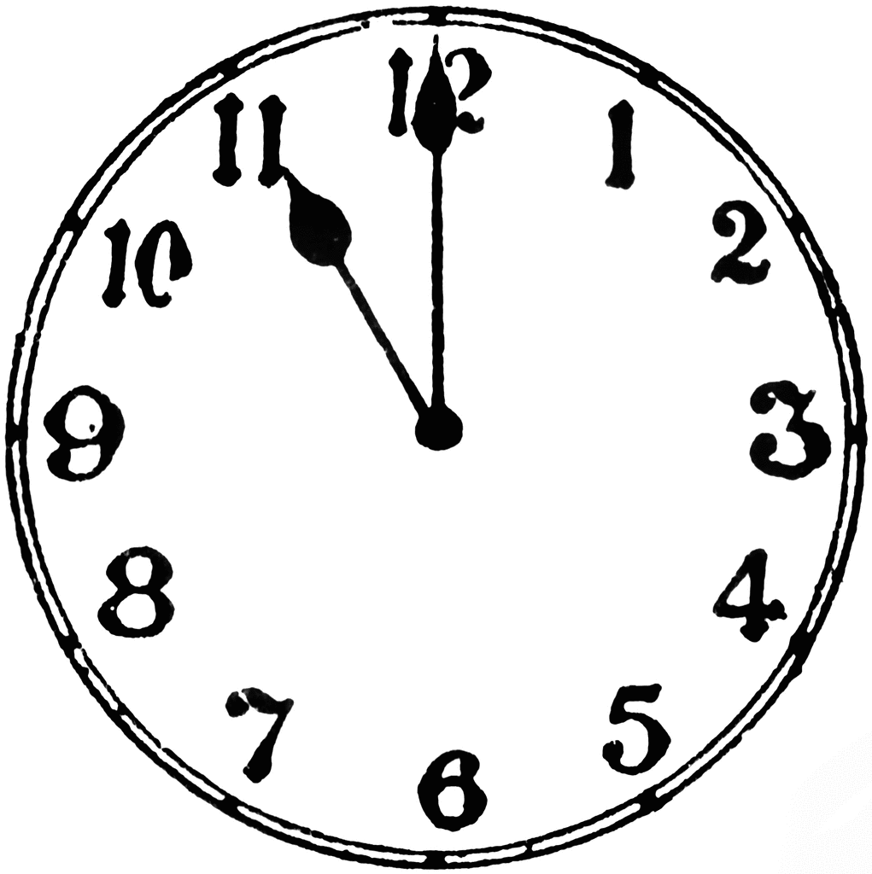
Iron Bank
HTTP
ODFI
SQS
SFTP
SQS
Batch
Notes:
Sometime before the our bank closes for the day, Iron Bank assigns each payment to a batch, generates an ACH batch file enumerating them, and uploads it to an FTP server managed by the bank. The bank then forwards that information to the Federal Reserve.

Slide 51
Iron Bank
HTTP
ODFI
SQS
SFTP
SQS
ACK
Notes:
After it does, the ODFI drops a new file on the FTP server acknowledging which payments were sent to the Fed. Some of the payments in our batch may be withheld by the bank for one reason or another, and we can tell which by parsing the ACK file. Iron Bank polls the FTP server looking for this ACK file, and when it gets it, it marks each payment in the file as completed. We still don’t know at this point that these payments won't be returned, but we can be sure that the RDFI will receive them.

Slide 52
Iron Bank
GET /payments/:id
HTTP
ODFI
payment_update
SQS
SFTP
SQS
Notes:
Iron Bank then pushes payment_update messages for each completed payment in the batch, and the Monorail again responds by querying the updated status of each payment. And that’s pretty much the end of the story for successful credits and debits.

Slide 53
Iron Bank
HTTP
ODFI
SQS
SFTP
SQS
Return
Notes:
However, at some point later, the bank may drop a return file for the batch on the FTP server. When Iron Bank sees it, it parses the files and marks all returned payments with a reversed status.

Slide 54
Iron Bank
GET /payments/:id
HTTP
ODFI
payment_update
SQS
SFTP
SQS
Notes:
Iron Bank then again pushes payment_update messages for each reversed payment, and the transaction processing logic can handle the reversal appropriately.
And now we’re done. Since there’s no way for a customer to push money to Coinbase via ACH, this the process is exactly the same for both debits and credits.

Slide 55
Iron Bank Details
Multiple banks
Quantity and volume limits per bank
Web scrapers as alternative to FTP
Notes:
The Iron Bank implementation is not quite that straightforward though, of course. I want to quickly mention some of the more interesting implementation details encapsulated in the Iron Bank service.
First, there’s not just one bank that we use to originate payments. We have accounts with multiple banks, both for redundancy and so we can process more transactions. See, each bank has limits on the volume we can transact per day, and they also might have restrictions on which customers we can originate payments for. Some banks may not process transactions for business accounts for example. When generating batches, Iron Bank needs to understand the limits imposed by our banks and only enter payments the bank will accept. It also needs other details about the banks like the operating hours for each one so we can finalize and upload the batches before the banks close.
Also, I said that we use SFTP to transmit files to and from the bank. Well, actually, not all of our banks run FTP servers. With some of them we can only upload and download these files through a web portal, so Iron Bank uses a headless browser to automatically transfer files with these banks. It’s not pretty, but at least the dependency on phantomjs is contained to one small service.

Slide 56
Wallace
HTTP
SQS
SQS
Notes:
Now let’s compare the Iron Bank to the payment service for Bitcoin payments, Wallace the Wallet. We call Wallace a “wallet” because in the Bitcoin space, a wallet is the type of software you use to send and receive Bitcoin payments. You can download a variety of open source Bitcoin wallets on your phone or desktop, but Wallace is our custom wallet that processes incoming and outbound transactions for all Coinbase customers. TODO: Why is Wallace custom?
Here we have the main components of the Wallace architecture, with Wallace represented by Sir William Wallace as portrayed in Braveheart. The left half looks very similar to the IronBank diagram, right? The only new thing is the service marked with a key. That is our highly secure Knox microservice that stores private keys and signs transactions. The right half of the diagram is different though. Instead of communicating with an SFTP server run by a bank, Wallace has open connections to our Bitcoin edge nodes. These are just running regular, off-the-shelf open source Bitcoin software and they connect to the P2P network and validate all transactions and blocks. We call them edge nodes because they sit on the edge of the infrastructure, separating our internal Bitcoin service from the big, bad open Internet. Whereas we can’t just blindly trust any node in the P2P network, we fully trust the edge nodes because we run them.
Wallace knows the full set of all addresses controlled by Coinbase, the addresses that Coinbase generated and has the private key to. Each such address is linked to a Coinbase account so when funds go into it, we know which account to credit. Though Wallace knows every address and which account it is linked to, the it doesn’t store the private keys. The keys are stored either in Knox, the service with the key, or offline in what we call “cold storage.” I’ll get back to this in a bit.
In order to process Bitcoin payments, Wallace, like every other Bitcoin wallet, needs to stay in sync with the blockchain and track the set of UTXOs belonging to all addresses it controls. It does this in the way we talked about in the beginning.

Slide 57
Wallace: Incoming payments
HTTP
SQS
SQS
Block N
Notes:
Every time there’s a new block on the network, the edge nodes hear about it from their peers and tell Wallace. Wallace always considers the longest connected chain it hears about to be the official ledger. Every time a new block gets added to the chain, Wallace scans all of the transactions and inspects each one to see if it has any outputs going to an address Coinbase controls.

Slide 58
Wallace: Incoming payments
HTTP
SQS
SQS
Block N
Notes:
Say one of the new transactions does have an output going to a Coinbase address. Wallace then creates a new debit for each output and stores the payment to the database. Since a transaction can have multiple outputs going to different Coinbase addresses, a single Bitcoin transaction can result in multiple payments in Wallace. And we make them debits because the balance of the Bitcoin wallet that generated this transaction to Coinbase went down. These new outputs also get recorded by Wallace in the UTXO set, so we can spend them in the future when processing outbound payments.
This is already very different from Iron Bank. With ACH, you move funds onto the site by asking Coinbase to charge your bank account, but with Bitcoin, the customer just sends Bitcoin to an address associated with their account. So this is the first type payment we have seen so far that was not created in response to a create_payment message. We call these push payments. All blockchains work this way and so do some fiat payment methods like European bank accounts. Since the payment ID didn’t get sent in with a create_payment message, Wallace just generates one at random.

Slide 59
Wallace: Incoming payments
GET /payments/:id
HTTP
payment_update
SQS
SQS
Notes:
But just like we saw with IronBank, immediately after creating the payment, Wallace sends a payment_update message to the Monorail informing it of the new debit. The Monorail, having never seen this payment ID before, queries Wallace for it and upon seeing the new incoming payment, the transaction processing code creates a new transaction. The payment data includes the address that received funds as the payment method and the transaction hash in the extra data. Wallace, since it knows which Coinbase account the output’s address is linked to, also includes this account ID in the payment structure so that the Monorail knows which account to credit as part of the new transaction. This payment still has a started status though because it is hasn’t been confirmed yet.

Slide 60
Wallace: Incoming Payments
GET /payments/:id
HTTP
payment_update
SQS
SQS
Block N+2
Notes:
So Wallace keeps listening for new blocks and syncing the chain. After two more blocks come along on top of the one with the transaction, Wallace marks the debit complete and notifies the Monorail. Since the transaction in buried under three blocks, we can be confident the payment is permanently in the ledger and won’t be reversed.
So that’s how incoming payments work. Let’s look at outbound payments.

Slide 61
Wallace: Outbound payments
HTTP
SQS
SQS
Notes:
This process is fairly similar to ACH except that we generate Bitcoin transactions instead of ACH batch files, broadcast them to the network immediately instead of waiting for the close of the banking day, and complete the credit when we see the transaction in the blockchain instead of when the bank acknowledges that it was sent to the Federal Reserve.

Slide 62
Wallace: Outbound payments
HTTP
SQS
create_payment
SQS
Notes:
First the Monorail sends the create_payment message, and Wallace records the new credit in it’s database.

Slide 63
Wallace: Outbound payments
HTTP
SQS
SQS
Notes:
It then needs to generate a new Bitcoin transaction fulfilling this request. So it selects some appropriate unspent outputs from the UTXO set, generates the unsigned transaction, and then asks Knox to provide the signatures.

Slide 64
Wallace: Outbound Payments
GET /payments/:id
HTTP
payment_update
SQS
SQS
Notes:
Now Wallace takes the signed transaction and does two things. First it broadcasts the transaction to the edge nodes, which relay it to the P2P network. At the same time, Wallace sends a payment_update message for the credit. The Monorail sees that the payment now has a started status.

Slide 65
Wallace: Incoming payments
HTTP
SQS
SQS
Block N
Notes:
And from here, it’s just the same as with the debit payment. First then transaction makes it into one block. Then another block comes along.

Slide 66
Wallace: Incoming Payments
GET /payments/:id
HTTP
payment_update
SQS
SQS
Block N+2
Notes:
And when that third block comes along, Wallace marks the payment complete and notifies the Monorail of the updated payment status.

Slide 67
Wallace Details
Transaction generation/UTXO selection
Maintains separate pool of online & offline funds
Notes:
Now let’s talk about some of the interesting things Wallace is doing behind the scenes.
One the things I glossed over is how Wallace generates a transaction for an outbound payment. So if Wallace gets a request to send 1 BTC to a particular address, how does it actually generate the transaction to be broadcast? The first step is to select from all of the unspent outputs belonging to Coinbase addresses which should be the inputs to the transaction. We don’t have a great story here and basically just do the most naive thing possible: select the outputs with amounts closest to the amount we want to send. We aren’t able to use the same algorithm as regular Bitcoin wallet software because the UTXO set Wallace maintains is orders of magnitude larger that what regular wallets are designed for. This is currently an area of research for us.
There’s one more bit of very important logic Wallace implements that I touched on briefly earlier. It’s the idea of storing some of the private keys online and some offline. While we have taken many super-paranoid measures to secure the Knox microservice that stores our online private keys, no data accessible by a live server, especially one connected to the Internet, can be 100% secure. So to limit our losses in the event of a possible security breach, we keep 99% of the funds in keys that are stored offline. It is Wallace’s job to monitor the balance of funds between these online keys and offline keys. If the total online balance gets too high, Wallace generates Bitcoin transactions moving funds to the offline keys. Conversely, if the online balance gets too low and we cannot process customer withdrawals, Wallace alerts people who then kick off a manual process to move funds online.
And Wallace can do all of this without the rest of the system being aware of this split. If online funds are too low to process a credit payment, the payment just stays in a pending state for a longer time. Because of the asynchronous communication with the Monorail, no additional messages are required; the transaction processing code simply sees this as a delay in completing the payment.
So hopefully these examples illustrate how we define a “payment” for these two services and what the lifecycles of these payments look like.

Slide 68
Recap
How blockchain integrations differ from banking integrations
Evolution of Coinbase payments towards a unified architecture
Polymorphic service interface using an abstraction of payments
Notes:
So we went through a huge amount of very technical information today and I would be impressed if in a few weeks you are able to remember all the specifics. But I do want you to come away with a few main ideas.
First, some of the fundamental differences between bank transfers and blockchain transfers. The idea of a payment network based on cryptographic security that uses a completely public transaction ledger and has no central authorities is a big break from how banking has worked traditionally. I personally believe this technology has a lot of potential and hopefully you guys understand it a little better now.
The second is the evolution of the product and how it impacts the architecture. I wasn’t able to spend a lot of time on what the old architecture looked like, but I find this idea very interesting. When we decided to make GDAX a first-class client of our payments services or add support for multiple digital currencies, it broke some deeply ingrained assumptions about the app. Very often we might look at some code and think “who the hell decided to do it this way? Didn’t they realize they would have to add X or Y?” Well, no. It may have actually been a good design at the time, but as you continue to shoehorn in new, unexpected features, you need to periodically go back and assess “do our basic abstractions still make sense or is there something that would work better now”?
The third is this idea of having polymorphic microservices that all expose the same interface. This is really the key idea in our new payments architecture and lets us get the benefits of a microservice infrastructure while lowering the cost of integrating each new service. It’s not always easy to do but if you’re able to come up with abstraction that makes a whole set of your services appear the same to the rest of the system, it can really help in scaling. And I don’t mean scaling from a throughput perspective, but scaling from a manpower and feature set perspective.

Slide 69
Ongoing & Future Work
Rearchitecture of existing integrations around new abstraction
Migration of internal accounting to a microservice
Dedicated microservice for core transaction processing
We would love your help :-)
Notes:
We’re still in the middle of this migration, but have already been seeing significant benefits. The fact that we were able to integrate with the Ethereum and Litecoin networks in the time frame that we did was thanks in large part to the payment abstractions we implemented for Wallace. The Ethereum protocol is rather different from Bitcoin, requiring us to write a completely separate payment service called Macbeth, but because of the polymorphic service design, we are able to use the same transaction processing code in the Monorail to interact with all three blockchain services.
As I mentioned, two of the upcoming projects we are looking at are moving our accounting code into its own payment service and extracting the core transaction processing logic into a dedicated service.
These are sure to be large projects, so if any of this sounds interesting to you, Coinbase is always looking for strong engineers.

Slide 70
Thanks for listening!
mailto:jimpo@coinbase.com

